Slide 1



Natural Distributed Algorithms
- Lecture 2 -
Rumor Spreading in the
Noisy PUSH Model
Emanuele Natale
CNRS - UCA
CdL in Informatica
Università degli Studi di Roma “Tor Vergata”

Slide 2

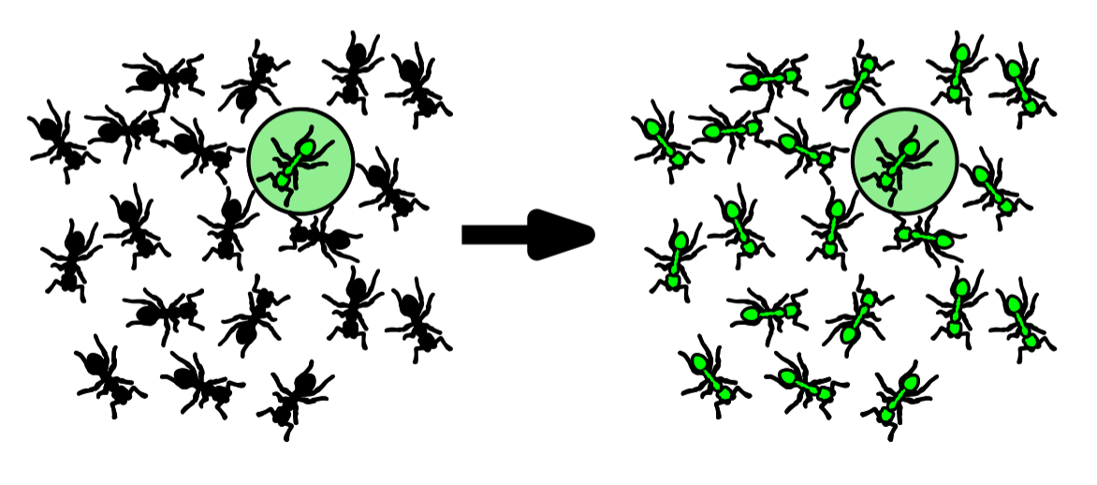
Rumor Spreading Problem
One source node in a special state
Goal configuration: all agents in the special state

Slide 3
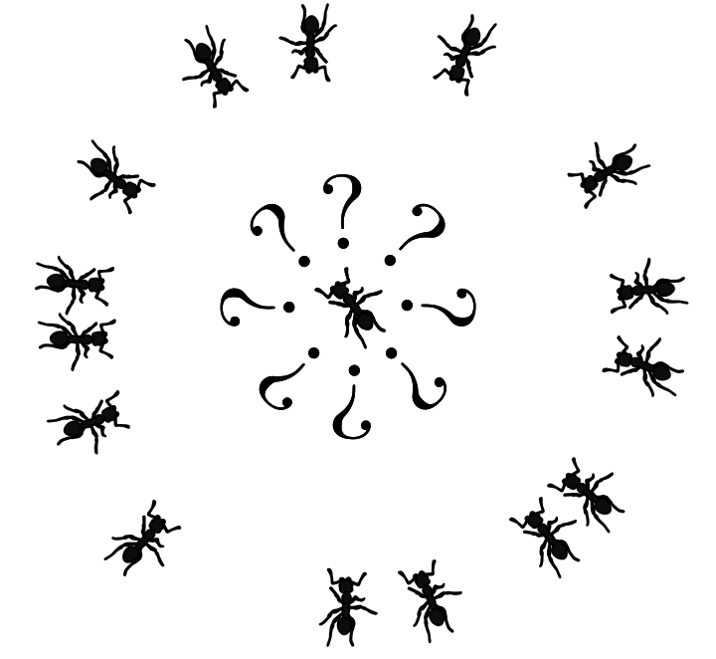
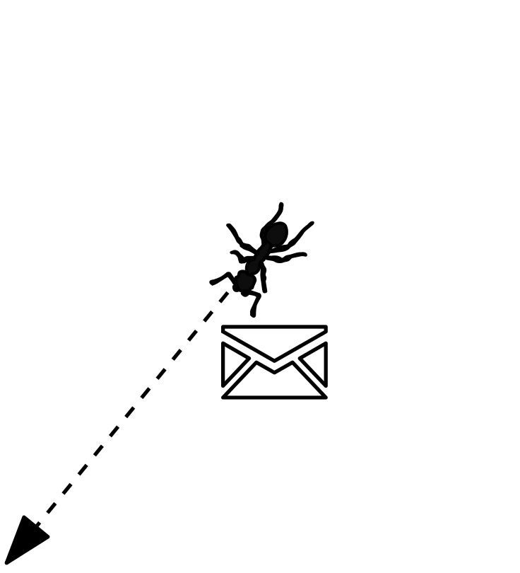
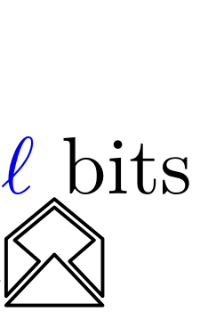
Stochastic Interactions: PUSH Model
Desired features
Stochastic
Parsimonious (Anonymous)
Active (uni-directional)
(Uniform) PUSH model [Demers ’88]
(single binary message)
Discrete parallel time
At each round each agent can send one bit message
Each message is received by one agent chosen independently and uniformly at random

Slide 4

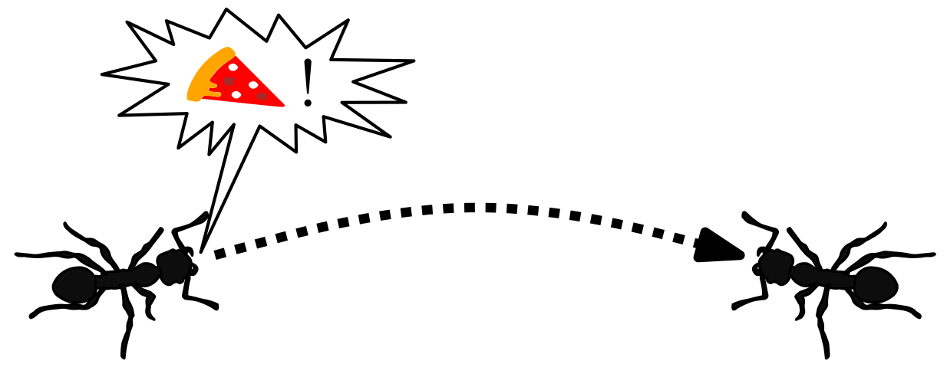



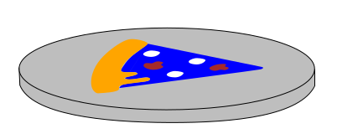
Noisy Communication
Before being received,
each bit is flipped with probability

Slide 5
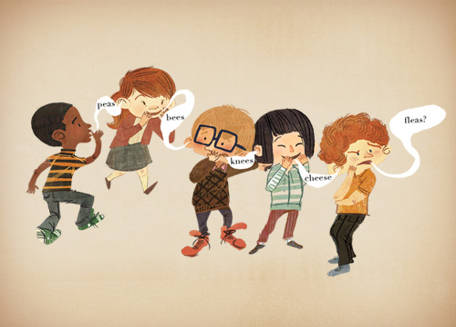
Rumor Spreading in the Noisy PUSH Model:
“Chinese-Whispers” Does Not Work
If each agent sends the rumor as soon as it receives it…

Slide 6
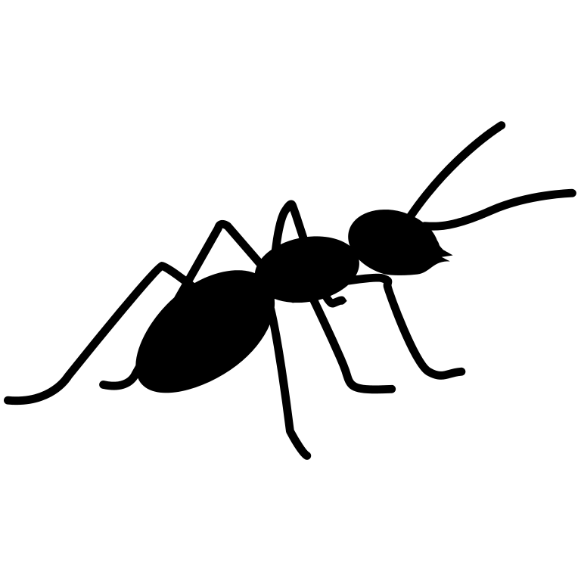
Breathe-Before-Speaking Algorithm
Feinerman, Ofer, Bernhard Haeupler, and Amos Korman. 2017. “Breathe before Speaking: Efficient Information Dissemination despite Noisy, Limited and Anonymous Communication.” Distributed Computing 30 (5): 339–55. https://doi.org/10.1007/s00446-015-0249-4.
Idea. Reduce number of “message hops” from the source.
Algorithm “Breathe-Before-Speaking”
(informal description)
Stage 1:
For phases:
At each round of each phase:
- each informed agent
sends its opinion
- each uninformed agent
only listens to incoming
messages
At the end of the phase each
uninformed that has received a message
becomes informed with the opinion that it
has received
Stage 2: …...
Source
Example with phases
of 3 steps

Slide 7
Breathe-Before-Speaking Algorithm:
Core Idea of Stage 1
How large should k be?

Slide 8
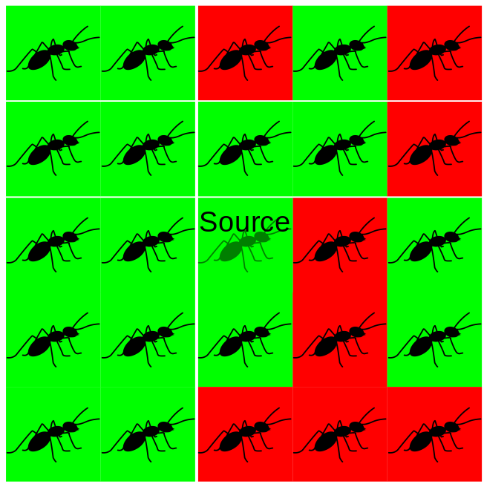
From Stage 1 to Stage 2:
How Many Rounds in a Phase?
Algorithm “Breathe-Before-Speaking” (informal description)
Stage 1: …… (all agents got an opinion)
Stage 2: For phases, at each round each agent sends its opinion and counts the opinions of received messages. At the end of the phase each agent takes the most frequent opinion.

Slide 9
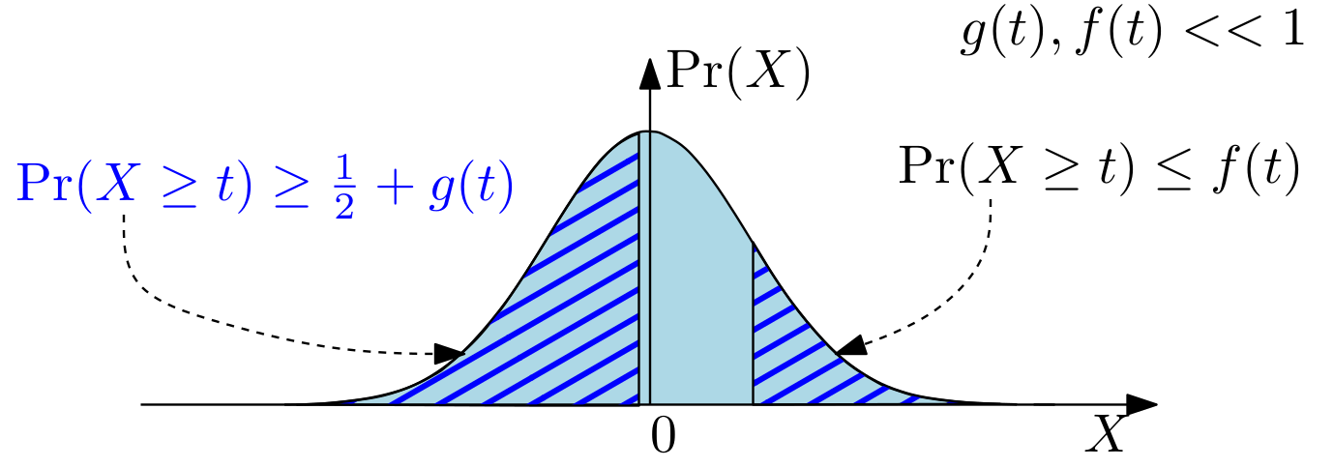
Mathematical Challenge: Small Deviations Theory
There is a well-established large deviations theory concerned with showing that the probability that a r.v. exceeds a certain bound is very small
Warning: In Multi-Agent Systems (MAS), ensuring that a node doesn’t make an error can be computationally expensive (e.g. needs many messages).
Since in MAS we have many agents, if we can easily solve the majority consensus problem, it is enough that the majority is right.

Slide 10
Majority Amplification of Small Deviations
Idea of Stage 2. Use majority rule to amplify bias (reduce noise).
optimal rule
(Recall: bias decreases exponentially if we forward directly!)
effective bias
How much does bias increases if we wait that we receive k messages and then send the majority? (Breathe before speaking!)
Attention! If we wait k rounds we can only say that the majority of nodes will receive at least k/2 messages (Why? Chernoff bound...)

Slide 11
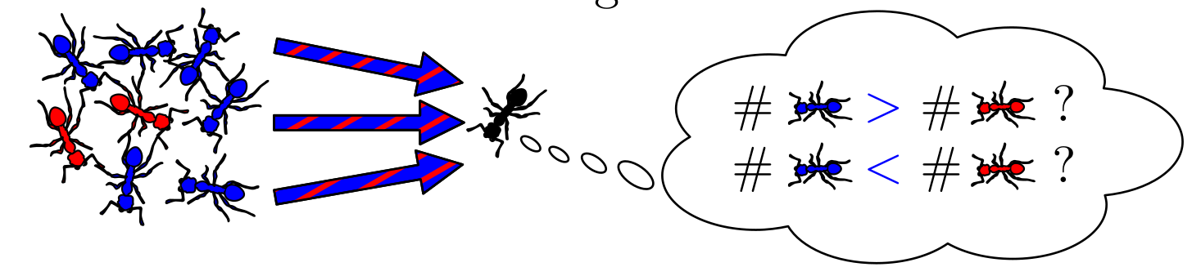
Majority Amplification Lemma (1/2)
Stage 2: For phases, at each round each agent sends its opinion and counts the opinions of received messages.
At the end of the phase each agent takes the most frequent opinion.

Slide 12
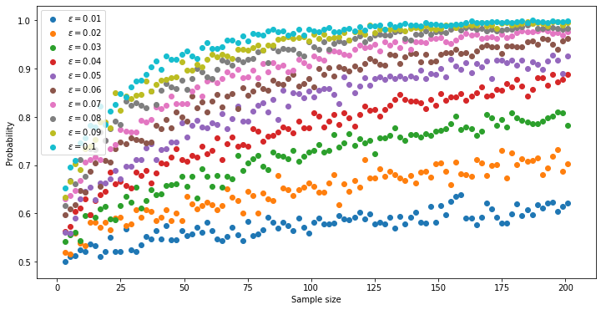
Application of Majority Amplification Lemma (2/2)

Slide 13
Breathe-Before-Speaking Algorithm: Summary
Stage 1:
For phases:
At each of the rounds of each phase:
- each informed agent sends its opinion
- each uninformed agent only listens to incoming messages
At the end of the phase each uninformed that has received a message becomes informed with the opinion that it has received
Stage 2:
For phases:
At each of the rounds of each phase:
- each agent sends its opinion
- each agent counts the opinions of received messages.
At the end of the phase each agent takes the most frequent opinion.
( except first and last phase)
( except first and last phase)

Slide 14
(Half of the) Proof of Majority Amplification
x is computed
such that this
is true

Slide 15
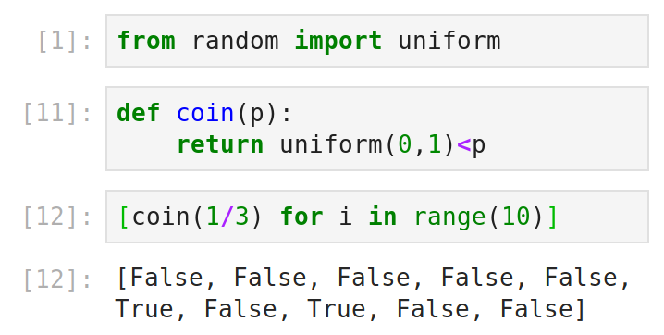
The Case: Intuition
Observation:
We can simulate a coin
with probability p using
a uniform random variable
We can
simulate
Given that
the uniform
variable is
more than .5,
is it
here?
Yes→1
No→ 0
Is the uniform
variable less
than .5?
Yes→1
No→ continue
as follows:
Step 1
Step 2

Slide 16

...Project Idea
As for the case ,
there are two proofs, both accessible but with lots of calculations:
Feinerman, Ofer, Bernhard Haeupler, and Amos Korman. 2017. “Breathe before Speaking: Efficient Information Dissemination despite Noisy, Limited and Anonymous Communication.” Distributed Computing 30 (5): 339–55. https://doi.org/10.1007/s00446-015-0249-4.
Fraigniaud, Pierre, and Emanuele Natale. 2019. “Noisy Rumor Spreading and Plurality Consensus.” Distributed Computing 32 (4): 257–76. https://doi.org/10.1007/s00446-018-0335-5.
Project: (First, understand and then) write a detailed exposition of either one of the proofs.

Slide 17
More Project Ideas
Write the analysis in expectation of Phase 1 of the
Breathe-Before-Speaking algorithm.
The reasoning is similar to what we have done for the “Chinese-whispers protocol” in order to solve the non-noisy rumor spreading problem. You can also check the analysis w.h.p. (much, much harder than in expectation!), in
- Feinerman, Ofer, Bernhard Haeupler, and Amos Korman. 2017. “Breathe before Speaking: Efficient Information Dissemination despite Noisy, Limited and Anonymous Communication.” Distributed Computing 30 (5): 339–55. https://doi.org/10.1007/s00446-015-0249-4.
- Fraigniaud, Pierre, and Emanuele Natale. 2019. “Noisy Rumor Spreading and Plurality Consensus.” Distributed Computing 32 (4): 257–76. https://doi.org/10.1007/s00446-018-0335-5.
Simulate the Breathe-Before-Speaking algorithm on Erdős-Rényi graphs (random graphs where each edge is added with probability p), varying p, the noise parameter ϵ and the duration of the time-windows.
Simulations should be performed using open-source software with some effort to make them efficient (e.g. coded in Python using Numpy), and the source code should be made publicly available (e.g. on Gitlab) and GPL licensed.

Slide 18
Likelihood Ratio Test (Neyman-Pearson Lemma)
Back to
Majority
Amplification

Slide 19
Chebyshev’s Inequality
Recall Markov’s inequality: Given positive random variable
Recall Markov’s inequality: Given positive random variable
To prove Chebyshev’s inequality, given a r.v. , set
...and apply Markov’s inequality
Back to
Proof of
Lemma

Slide 20
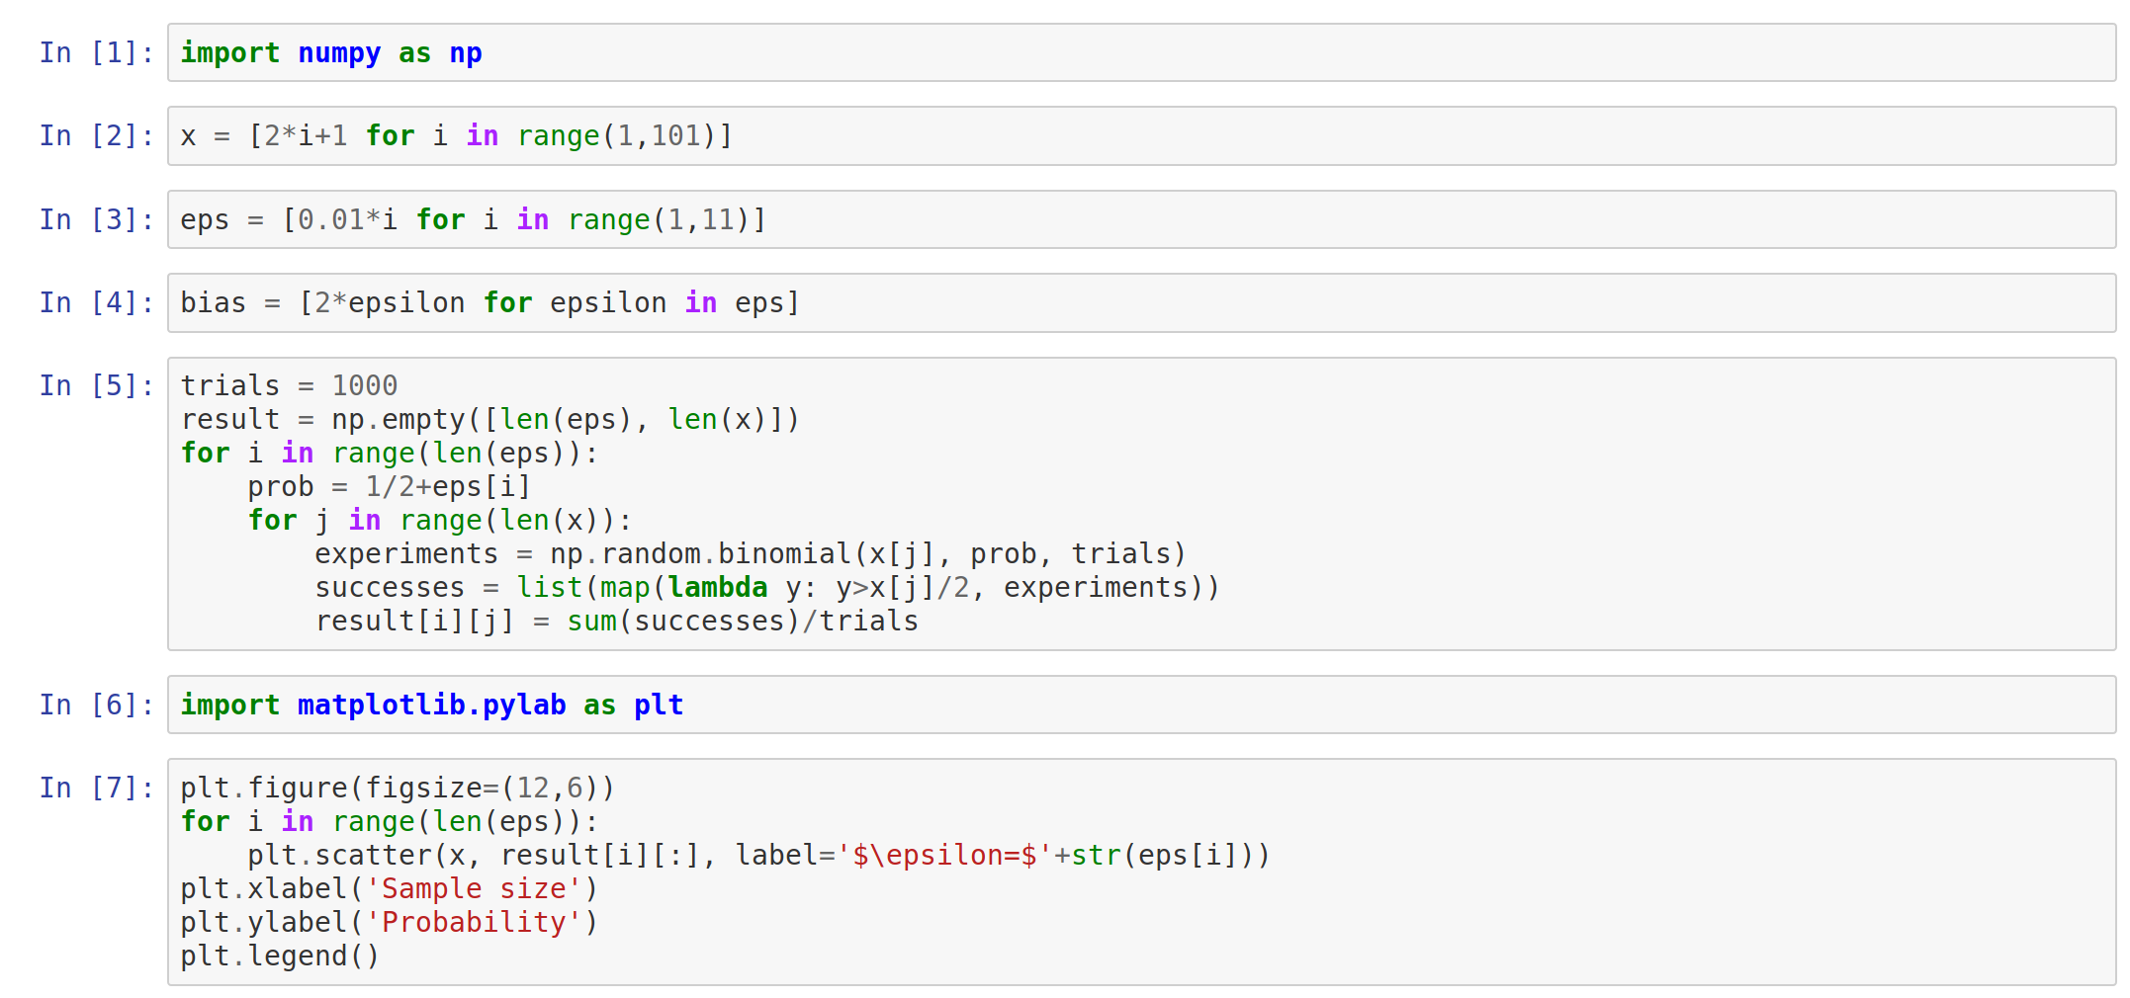
Experiments on Majority Amplification
Jupyter-lab notebook (included in the Anaconda Python distribution)
Back to
the Lemma
Application

Slide 21
Computing t
Back to
the Proof
Intuition

Slide 22
Requirement for Concentration via CB

