Slide 1



Natural Distributed Algorithms
- Lecture 3 -
Rumor Spreading in the
Noisy PULL Model
Emanuele Natale
CNRS - UCA
CdL in Informatica
Università degli Studi di Roma “Tor Vergata”

Slide 2

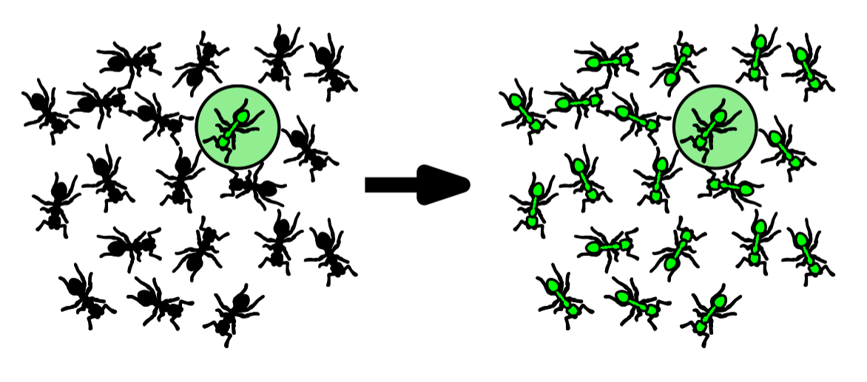
Rumor Spreading Problem
One source node in a special state
Goal configuration: all agents in the special state

Slide 3
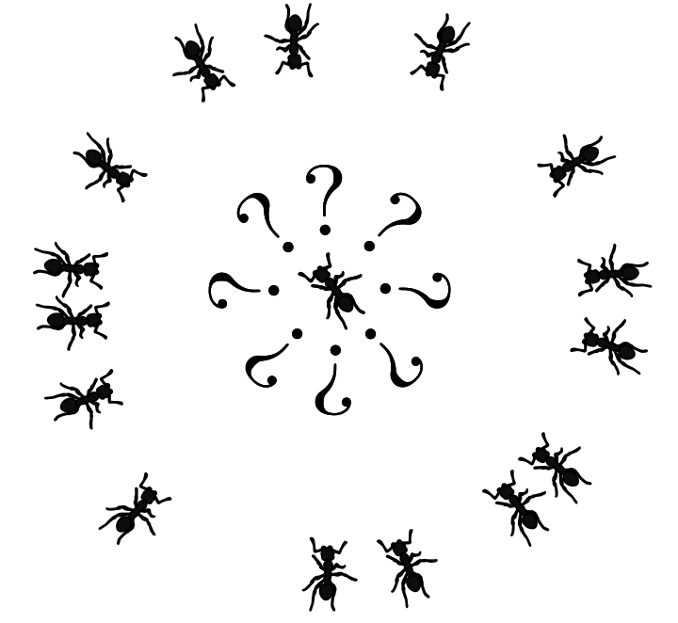
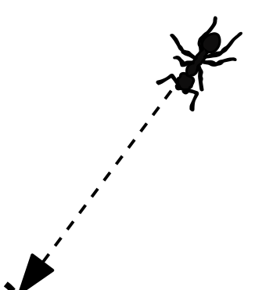



Stochastic Interactions: PULL Model
Desired features
Stochastic
Parsimonious (Anonymous)
Passive (uni-directional)
(Uniform) PULL model [Demers ’88]
(single binary message)
Discrete parallel time
At each round each agent shows one bit message
The agent can observe the message shown by one agent chosen independently and uniformly at random

Slide 4

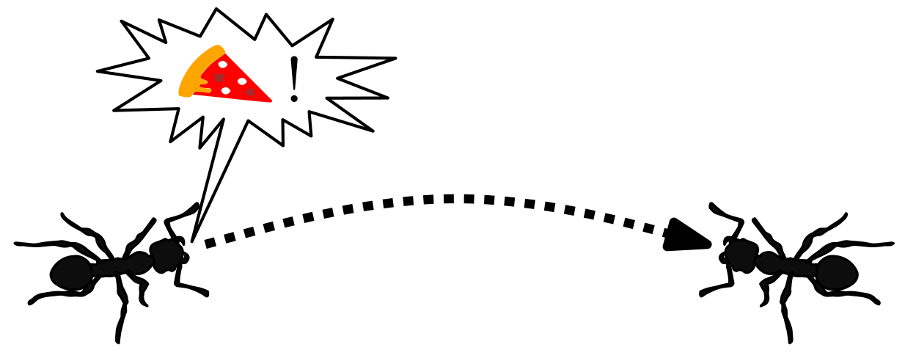



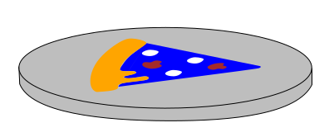
Noisy Communication
Before being received,
each bit is flipped with probability

Slide 5



Rumor Spreading in the Noisy PULL Model:
The Source is Lost in Too Much Noise
In the PUSH model we could estimate the distance that a message travelled from the source, thanks to the fact that in the B.B.S. algorithm agents can avoid communicating
In the PULL model we can only ask one bit to a random node:
What is the probability to receive the right opinion message from the source?
How many messages do we need then?
Source

Slide 6
Broadcast-PULL: A Simpler Model
In the PULL Model each agent gets a message from another randomly-chosen agent
In the PULL Model each agent gets a message from another randomly-chosen agent
In the PULL Model each agent gets a message from another randomly-chosen agent
Different agents get different information… Difficult to analyze!
Pòlya’s principle:
“If you can't solve a problem, then there is
an easier problem you can solve: find it.”
Broadcast-PULL Model:
Each agent sees all messages…
and everything all other (non-source) agents see!

Slide 7

Distinguishing the Opinion of the Source
Assume w.l.o.g. that at each round the agents pull a message one-by-one (sequential version).
Recall: every agent sees everything that each non-source agents sees, even “random” choices (shared randomness)
The only difference between the two cases is the opinion of the source
Source
Source
Given identical message histories, the two systems behave identically
Case 0
Case 1

Slide 8
Lower Bound on Number of Messages via Relative Entropy: Preliminaries

Slide 9
Lower Bound on the Number of Messages
Proof

Slide 10
Application of the Lower Bound 1/2
Source
Source
Case 0
Case 1

Slide 11
Application of the Lower Bound 2/2

Slide 12

Project Idea:
Propose algorithms to solve Rumor Spreading in the Noisy PULL Model on Erdős-Rényi graphs with parameter p and simulate them varying p and the noise parameter ϵ.
Clementi, Andrea, Luciano Gualà, Emanuele Natale, Francesco Pasquale, Giacomo Scornavacca, and Luca Trevisan. 2018. “Consensus Needs Broadcast in Noiseless Models but Can Be Exponentially Easier in the Presence of Noise.” Report. CNRS. https://hal.inria.fr/hal-01958994/document
Boczkowski, Lucas, Ofer Feinerman, Amos Korman, and Emanuele Natale. 2018. “Limits for Rumor Spreading in Stochastic Populations.” In 9th Innovations in Theoretical Computer Science Conference (ITCS 2018), edited by Anna R. Karlin, 94:49:1–49:21. Leibniz International Proceedings in Informatics (LIPIcs). Dagstuhl, Germany: Schloss Dagstuhl–Leibniz-Zentrum fuer Informatik. https://doi.org/10.4230/LIPIcs.ITCS.2018.49
Consider only the binary-message case.
Simulations should be performed using open-source software with some effort to make them efficient (e.g. coded in Python using Numpy), and the source code should be made publicly available (e.g. on Gitlab) and GPL licensed.

Slide 13
Proof of the Lower Bound on the Number of Messages
Back to
Entropy
Bound

Slide 14
Information Processing Inequality for Relative Entropy
Proof
Back to
Relative
Entropy

Slide 15
Sketch of Proof of the
Information Processing Inequality
Back to
Relative
Entropy

Slide 16
Chain Rule for Relative Entropy
Back to
Relative
Entropy

Slide 17
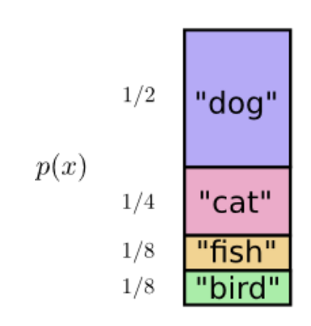
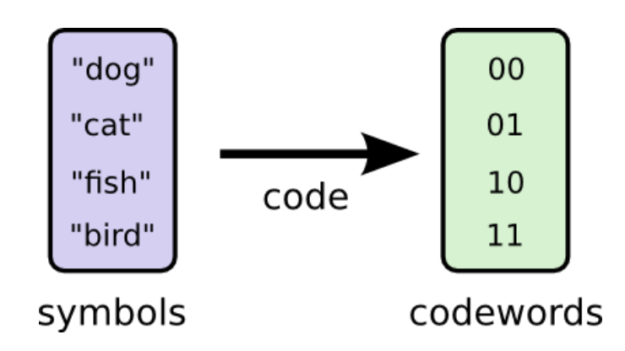
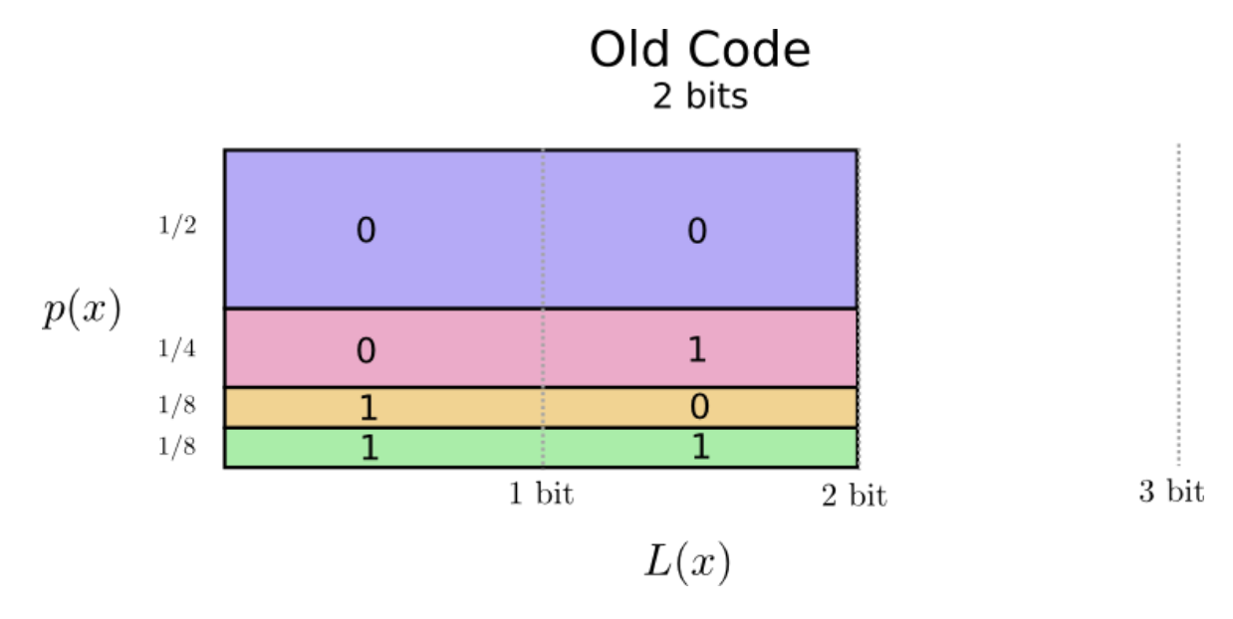
Visual Information Theory - Crash Course
Based on the Colah’s essay Visual Information Theory
(all following images are from there)
Back to
Relative
Entropy

Slide 18
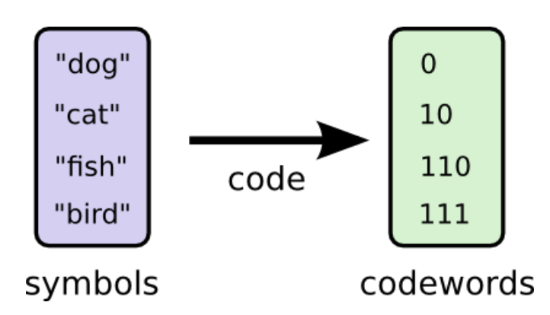
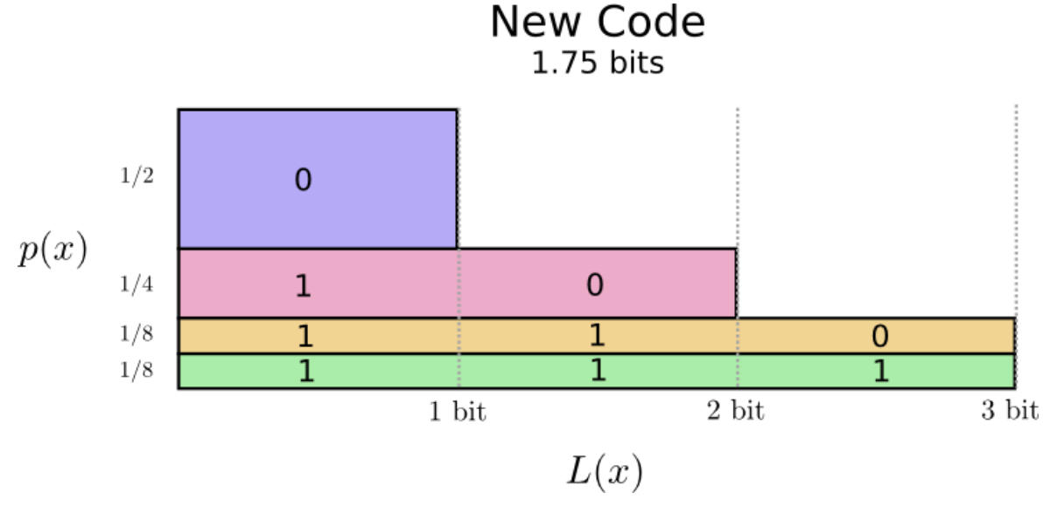
Minimizing Average Length

Slide 19
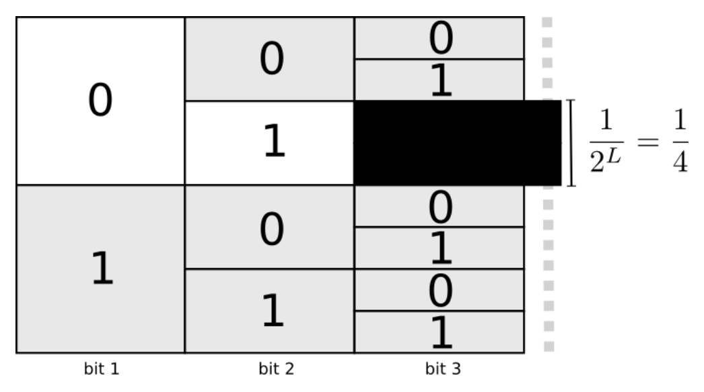
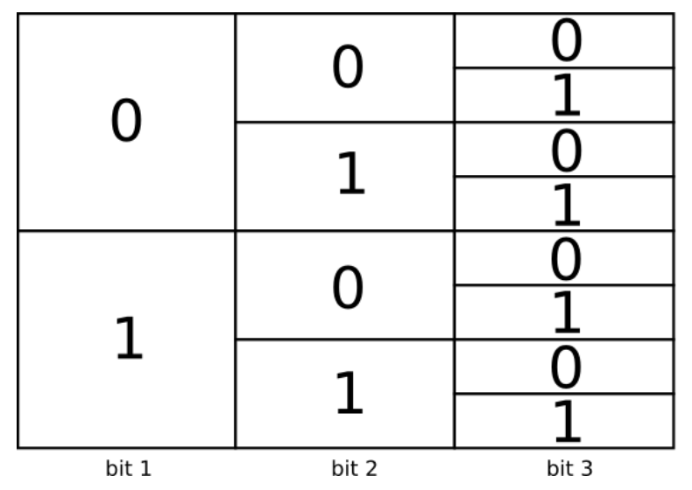
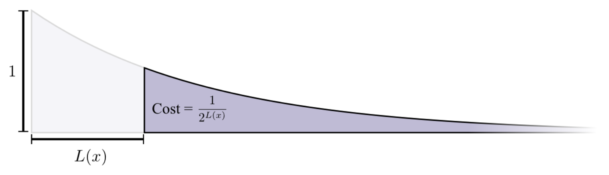
Prefix-free Codes

Slide 20
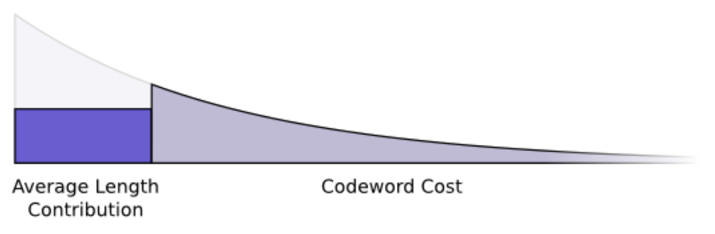
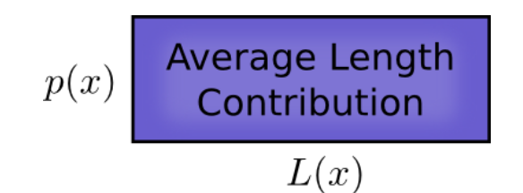
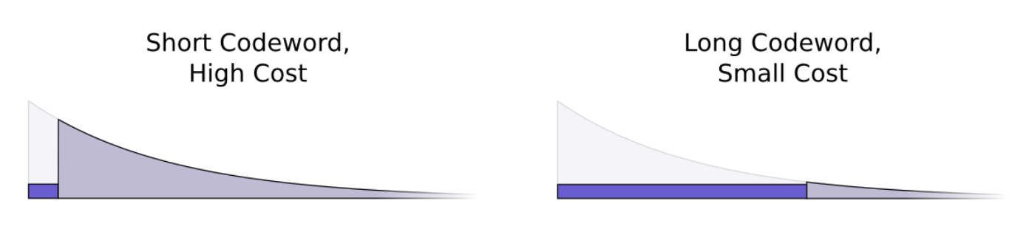
Average Length vs Cost

Slide 21
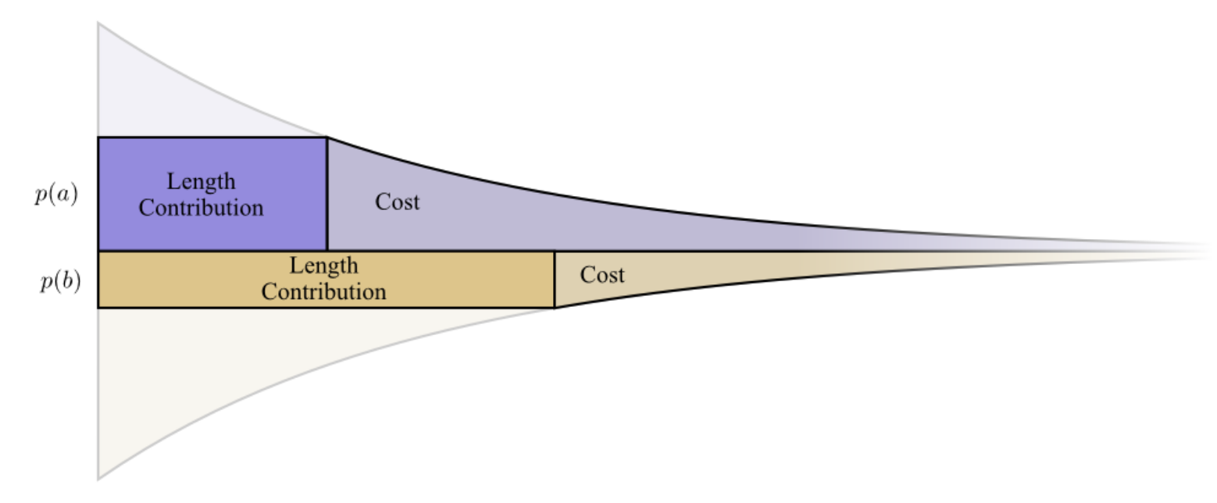
Information Content gives Optimal Length

Slide 22

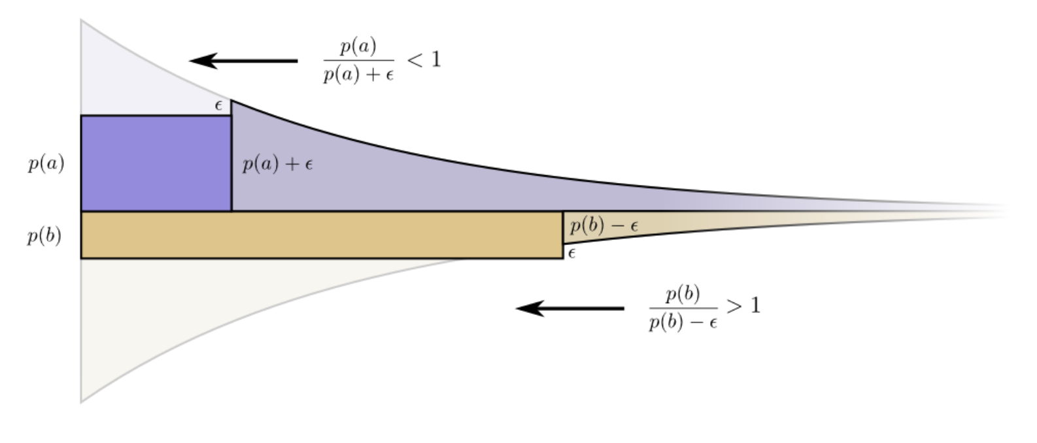
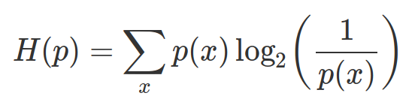
Proving Optimality

Slide 23
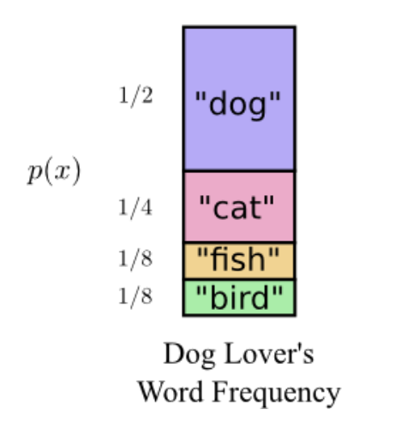
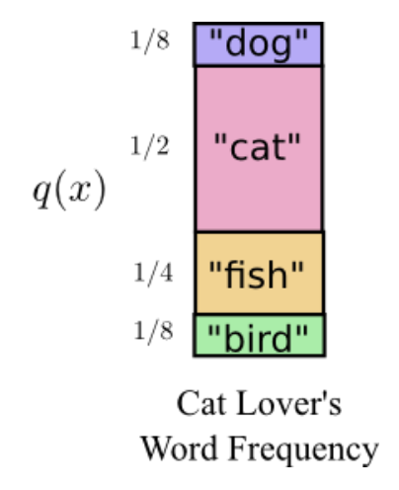
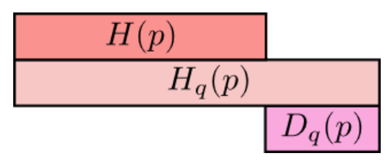
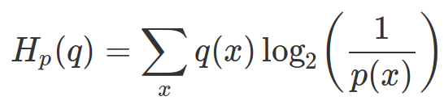
Cross and Relative Entropy

