Slide 1

Green Pace
Security Policy Presentation
Developer: Nathaniel Madore

Slide 2

OVERVIEW: DEFENSE IN DEPTH
This detailed model gives an overview of methods of defense for maintaining a secure coding environment that is up to standard with best practices.

Slide 3
THREATS MATRIX
This chart prioritizes standards and threats by establishing a level of vulnerability for occurrences.
Likely These threats are most likely to occur. | Priority Standard that has high relevancy
Low priority Standard that has low relevancy | Unlikely These threats are not likely to occur

Slide 4
10 PRINCIPLES
Validate Input Data
Heed Compiler Warnings
Architect and Design for Security Principles
Keep it Simple
Default Deny
Adhere to the Principle of Least Privilege.
Sanitize Data Sent to Other Systems
Practice Defense in Depth
Use Effective Quality Assurance Techniques
Adopt a Secure Coding Standard

Slide 5
CODING STANDARDS
Do not cast to an out-of-range enumeration
Use valid references, pointers, and iterators to reference elements of a container
Do not attempt to create a std::string from a null pointer
Do not store an already owned pointer value in an unrelated smart pointer
Properly deallocate dynamically allocated resources
Use a static assertion to test the value of a constant expression
Handle all exceptions thrown before main() begins execution
Do not alternate input and output from a file stream without an intervening positioning call
Do not invoke virtual functions from constructors or destructors
Value returning functions must return a value from all exit paths

Slide 6
ENCRYPTION POLICIES
Encryption at rest – When data is stored on a system disk and is not in use. This data should be encrypted. This prevents unauthorized access while the file is not being used. An attacker must gain the encryption keys otherwise it is unlikely they will be able to access the data.
Encryption in Flight – This means to encrypt data while it is being transmitted. For example, only allowing remote access through a VPN. Another standard for encrypting data in flight is SSL/TLS. This means that an attacker cannot intercept plaintext transmissions when data is moving across the network.
Encryption in Use – Data that can be accessed unencrypted in its volatile state can be used to compromise security. Ensuring that the RAM is encrypted will make sure that these types of attacks are far less likely to be successful.

Slide 7
TRIPLE-A POLICIES
Authentication – This means to confirm that the user is who they say they are and therefore can access the system. A user will usually login with a username and password. Although there can also be authentication processes that employ 2-factor authorization.
Authorization – This is the level of access a user has once authenticated with the security credentials to access the system. Users should only have access to what they need in order to complete work. Users can be assigned different levels of access. Some may only be able to read files while others may be able to modify or delete.
Accounting – The processes in which a system is monitored determines how accounting is done within an organization. This is purposed to keep track of which users access which databases and so forth.

Slide 8
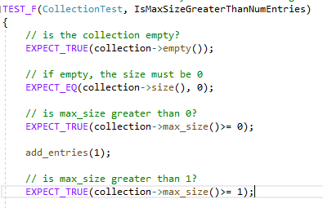
Unit Testing
One example of unit testing is by Google Test
Functions. The Google Test functions EXPECT_TRUE
and EXPECT_EQ are used to verify that the
actual contents of the vector are the same as
the expected contents.

Slide 9
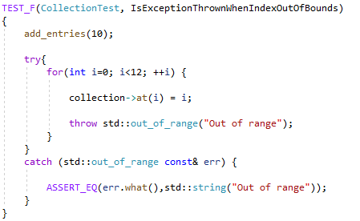
Unit Testing
Another example is by verifying a known error has
Occurred from a thrown exception. The error
message thrown describes the error so that the
user is aware of the nature of the bug identified.
The assertion tests that the exception is thrown,
and the error message is displayed as expected.

Slide 10

AUTOMATION SUMMARY

Slide 11
TOOLS
DevSecOps is a complete approach to enforcing policy with secure coding practices. This is meant to make sure that secure code is built efficiently.
The Google Test unit tests are grouped together to form a collections of tests that can be automated and run daily. There are a many other tools which can be used to identify compilation errors, warnings, and/or style suggestions. CPPCheck is one such tool which can be used for static analysis, and all resulting notes made by CPPCheck are addressed prior to releasing the code. No tool is perfect which is why using more than one static analysis tool is advised.

Slide 12
RISKS AND BENEFITS
Solving security issues is not an afterthought. Waiting to fix cybersecurity until later in the development cycle is costly and inefficient. No matter what type of attacker or what their motive is waiting until after an incident occurs is not ideal. Testing early and often is more efficient while being less costly.

Slide 13
RECOMMENDATIONS
Ensuring the development team is testing early and often is the best way to minimize the risk of a successful attack on the application. Keeping simplicity in mind while also testing as early and often as possible will reduce the risks of security flaws remaining unnoticed by the development team.

Slide 14
CONCLUSIONS
This security policy is considered a living document. Management should review and update at least annually, or when new threats are identified. The coding standards incorporated into this presentation are a mere start to protection against exploitable vulnerabilities. Additional standards shall be added to address and incorporate compliance with all ten principles. It is also recommended that Green Pace hire a white hat cyber security firm to test all applications for vulnerabilities. The cost of protection is insignificant in comparison to the risk of exploitation.

Slide 15
REFERENCES
Seacord, R. C. (2006). Secure coding in C and C++. Addison-Wesley Professional.

