Slide 1
COMM 4940: How do AI Systems Work? What Does It Mean to Fail?
J. Nathan Matias, January 2026

Slide 2
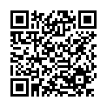
Reading for Today
1.2 Tech and Methods: How Do AI Systems Work? What Does It Mean to Fail?
In this class, we will discuss the code and mathematics behind adaptive algorithms, as well as what it means for an AI system to fail.
Paresh Dave (2023) The 5 Instagram Features That US States Say Ruin Teens’ Mental Health. WIRED
Narayanan, A. (2023). Understanding social media recommendation algorithms . Knight First Amendement Institute.
Graduate student reading:
Angel, M. P., & boyd, d. (2024, March). Techno-legal solutionism: Regulating children's online safety in the United States. In Proceedings of the 2024 Symposium on Computer Science and Law (pp. 86-97).

Slide 3
Harms and possible causes
Accused features
Core concepts
Recommendation algorithms (keep teens scrolling)
Likes (social comparison)
Notifications (distracting)
Photo filters (body image)
Stories (must view before vanish)
Addiction
Social comparison
Body image
Paresh Dave (2023) The 5 Instagram Features That US States Say Ruin Teens’ Mental Health. WIRED

Slide 4
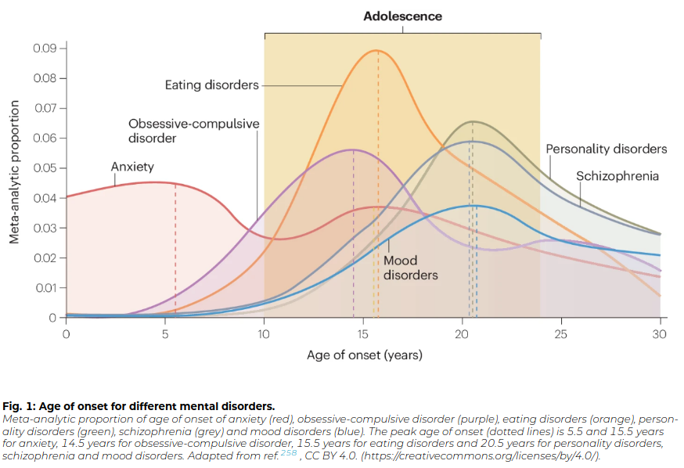
How do scientists think about it?
Orben, A., Meier, A., Dalgleish, T., & Blakemore, S. J. (2024). Mechanisms linking social media use to adolescent mental health vulnerability. Nature Reviews Psychology, 3(6), 407-423.

Slide 5
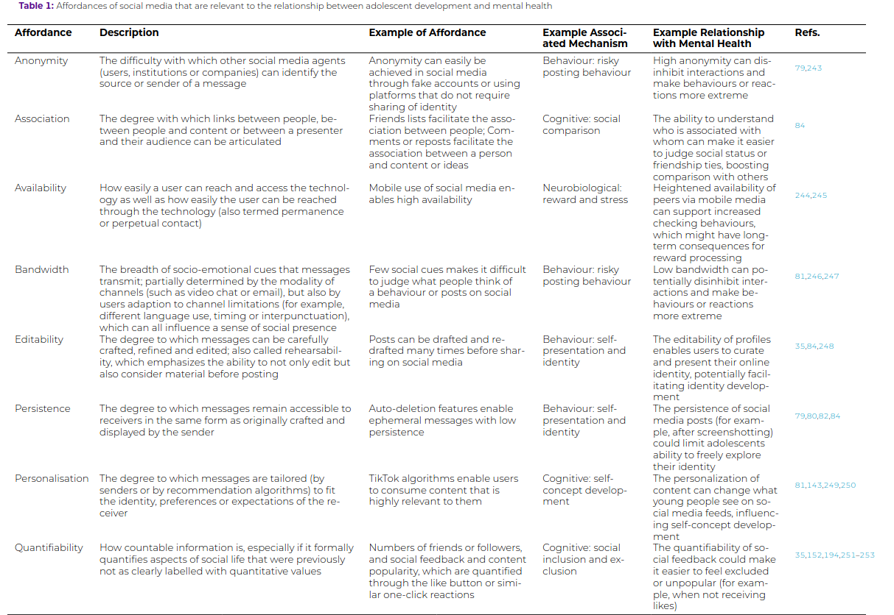
How do scientists think about it?
Orben, A., Meier, A., Dalgleish, T., & Blakemore, S. J. (2024). Mechanisms linking social media use to adolescent mental health vulnerability. Nature Reviews Psychology, 3(6), 407-423.

Slide 6
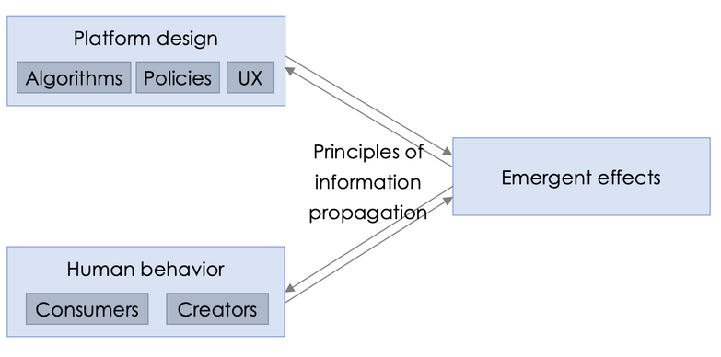
Understanding Social Media Recommendation Algorithms
Narayanan, A. (2023). Understanding social media recommendation algorithms . Knight First Amendement Institute.

Slide 7
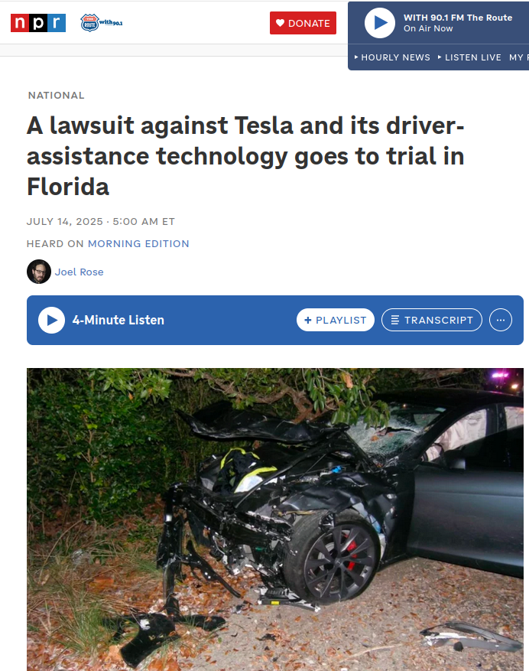
Tesla Lawsuit
George McGee was behind the wheel of his Tesla Model S in April 2019 when the car sped through a T intersection near Key Largo, Fla., crashing into a parked SUV at more than 50 miles per hour.
"I was driving, I dropped my phone, and looked down," McGee told police at the scene. "I ran the stop sign and hit the guy's car."
Before the crash, McGee had engaged the system that Tesla calls Autopilot, which can steer, brake and accelerate the car on its own.
But that didn't stop the Tesla from slamming into the parked Chevrolet Tahoe. The impact of the crash killed 22-year-old Naibel Benavides Leon, who had been standing next to the parked SUV with Dillon Angulo. Angulo was severely injured, while Benavides' body was found about 75 feet away.

Slide 8
Break-outs:
The Court Case
Group one: the family – argue that Tesla was responsible
Group two: Tesla – argue it was driver error
Group three: a Jury – what would you want to know to decide?
(5 mins) make a plan (you can google)
Use what you know about algorithms to make a case

Slide 9
Arc of the semester
Final projects
Introductory sessions
Midterm (before Spring Break) incident analysis
Final project (in teams)
An in-depth case study and/or forensic analysis of some failure of an adaptive algorithm
A proposal for a "black box" or data schema of what to record to inform future analysis of incidents
An independent project involving a graduate student team member

Slide 10
Weekly activities
Once projects begin
Read two articles per class
Post a comment by 9pm the night before, and reply to another student’s comment
Post at least one news article to Canvas and comment on another student’s post, each week
Submit progress reports on the team project

Slide 11
Reading for Tuesday
2.1 Feedback Loops: Simple Models to Explain Complex Behaviors
In this class, we will discuss why it can be so hard to understand the role, if any, that an AI system has had in a clear harm.
Clegg, N. (2021, March 31). You and the Algorithm: It Takes Two to Tango. Medium.
Kimmerer, R. (2013) "Windigo Footprints" from Braiding Sweetgrass. Milkweed Editions
Graduate student reading:
Matias, J.N. (2023) Humans and algorithms work together — so study them together. Nature.

Slide 12
Pre-requisites: quantitative methods
Required abilities
CSV files in R or Python
Basic data cleaning
Summarizing continuous, binary, categorical, and time-series, variables
Transforming dataset dimensionality (aggregating etc)
Null hypothesis testing (t-tests, correlations etc)
Multiple regression, including goodness-of-fit evaluation
Interpreting coefficients & p-values
This course requires students to have taken introductory statistics and be able to conduct multiple regression. This could include ILRST2110, AEM 2100, CRP 1200, ENGRD 2700, HADM 2010, MATH 1710, PUBPOL 2100, PUBPOL 2101, PSYCH 2500, SOC 3010, STSCI 2100, STSCI 2150, BTRY 3020, STSCI 2110, STSCI 3200. If you have any questions about this requirement, please contact the instructor.

Slide 13
Upcoming Statistics Assignment
Assigned on Thurs 1/22
Due on Thurs 1/29

