Slide 1
COMM 4940: Investigating Artificial Intelligence Failures
J. Nathan Matias, January 2026

Slide 2
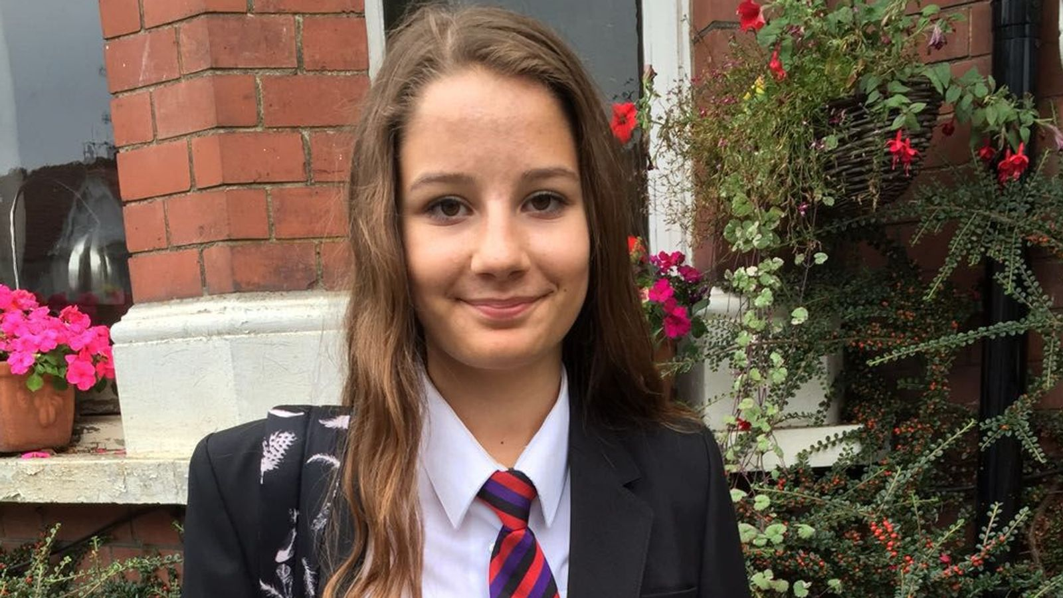
The story of Molly Russell
A senior executive at Meta apologized on Monday for allowing a British teenager to view graphic Instagram posts related to self-harm and suicide before she took her own life.
Meta’s head of health and wellbeing, Elizabeth Lagone, told an inquest looking into the circumstances surrounding the death of Molly Russell at the North London Coroner’s court that the teenager had “viewed some content that violated our policies and we regret that.”
Sophie Mellor (2022) After a 14-year-old Instagram user's suicide, Meta apologizes for (some of) the self-harm and suicide content she saw. Yahoo! News.
Molly Russell (source: Molly Rose Foundation)
Notes:
In November 2017, Molly Russell, a 14-year old British girl died of self-harm after viewing content on Meta’s Instagram and Pinterest relating to anxietdepression, and self-harm. In the last six months of her life, Russell saver 16,300 images on her Instagram account, over two thousand of which were linked to depression and suicide.
It took almost five years for a London coroner to conclude that social media may have played a role in Russell’s death – and that happened because over the course of several years, her father Ian Russell campaigned to get access to data about his own daughter’s digital interactions in the months before she died. Meta initially resisted these attempts, citing privacy concerns, and when they relented and provided the data after years of work, the picture about her final months became clearer.

Slide 3
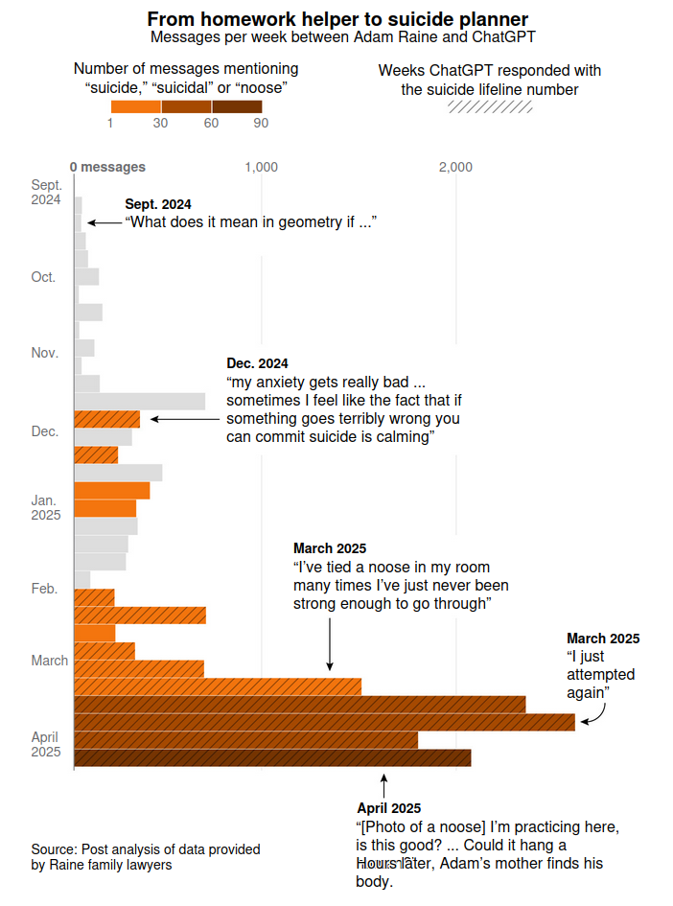
The story of Adam Raine
The Raines’ lawsuit alleges that OpenAI caused Adam’s death by distributing ChatGPT to minors despite knowing it could encourage psychological dependency and suicidal ideation. His parents were the first of five families to file wrongful-death lawsuits against OpenAI in recent months, alleging that the world’s most popular chatbot had encouraged their loved ones to kill themselves.
Schaul, K., Tiku, N (2025) 74 Suicide warnings and 243 mentions of hanging: What ChatGPT said to a suicidal teen. The Washington Post
Notes:
This fall, a similar story played out over the life and death of Adam Raine, a high school sophomore, who died by suicide in April 2025. After his death, Adam’s family went through his phone to try to understand what had led him to this point and came across his ChatGPT logs. According to Raine’s lawyers, ChatGPT advised him on methods to end his life and even offered to write the first draft of his suicide note.

Slide 4
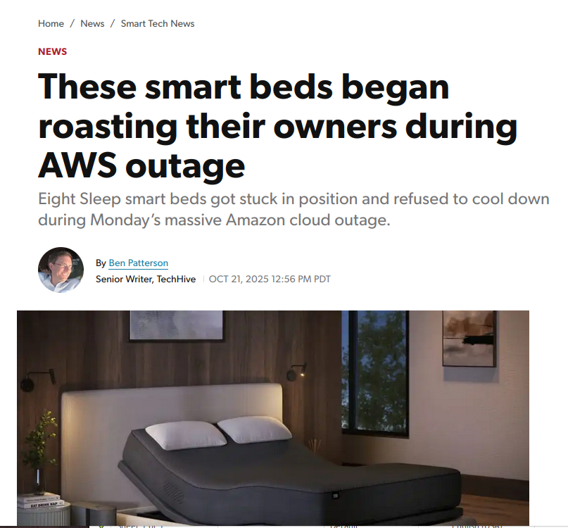
Investigating Artificial Intelligence Failures
- Car autopilot crashes
- Generative AI failures
- Deaths Involving Social Media
- Algorithmic Discrimination
- Flawed inferences (plagiarism detection for example)
- Physical infrastructure failure
Notes:
Molly and Adam’s stories are fundamentally stories about the failures of social technology and artificial intelligence. And concerns about those failures are everywhere – about crashes of self driving cars, gen AI failures, flawed actions, deaths, discrimination, and even failure in physical infrastructure- as owners of the Eight Sleep Smart Bed experienced in October when their smart beds all simultaneously turned up the heat and refused to cool down.
What do you do when someone makes a claim about a failure? How can you tell if the AI was truly at fault, if something else was the cause, and what to do to prevent failures in the future? Those are questions that people across tech need to answer – whether they work inside a company, at a regulator, or are a lawyer deciding if they should take up someone’s case. It’s also the core question of COMM 4940, where we will focus on investigating AI failures.

Slide 5


J. Nathan Matias
Assistant Professor
Communication citizensandtech.org natematias.com twitter.com/natematias nathan.matias@cornell.edu
Notes:
I’m professor Nathan Matias, in the department of Communication. In my past life, I was on the team that developed SwiftKey, one of the most widely-used predictive text keyboards around the world— and a precursor to today’s generative AI like Chat-GPT.
I have also spent the last decade of my life working with governments, journalists, international entities like the UN, and survivor’s groups to study alleged failures of technology, from online violence and discrimination to alleged deaths, and work on ways to prevent fathose failures in the future.

Slide 6
Introduce yourself
Name
Major/Year
What brings you to the class
A question about AI failure you were recently thinking about

Slide 7
Break-outs:
The Inquest
Identify needed information
Group one: the family – argue for access to data
Group two: Meta – try to minimize risks from data shared
Group three: the coroner – try to get at the truth, without putting people at risk
Make a list of information that your group might need
(be specific – “What she liked and when” is better than “her Instagram data”)
For each item, list at least one reason it would be useful and one reason the data should not be shared
(5 mins) discuss data needs
Then debate:
  Family
  Meta
  Coroner

Slide 8
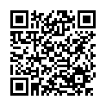
Goals and Learning Objectives
What You Learn
By the end of the semester, you will be able to:
In this seminar class, you will engage with the science and policy challenges of regulating human-algorithm behavior. Along the way, you will work with scientific issues of methods, theory, and ethics, policy questions about how to govern these situations, and how to bridge between science and policy in a democracy. For a final project, student teams (3-4) will produce a novel project that makes a contribution at the intersection of science and policy.
Identify, analyze, and evaluate claims about how human and AI behavior interact
Summarize and criticize major approaches to making claims about AI failures, from the perspective of computer science and the social sciences
Describe and evaluate major governance approaches
Design and analyze research methodologies for for transparency, accountability, and product improvement
Understand the uses of social science and computer science research in the policy process
Design an intervention into scholarly and policy conversations on alleged AI failures

Slide 9
A note on commitment
Doing this class as if it actually matters to people’s lives
Notes:
This is a class for discussing things that really matter. So people are expected to read, do the work,etc. We are here to save lives, and possibly to save companies from billions of dollars in needless regulation. State of New York expects a 2X time commitment to what you do in class, so I am expecting about 6 hours of reading and writing per week to take this class. Find a place to read and think without distraction. Give yourself space to go for a walk, or talk with someone else about it.

Slide 10
Pre-requisites: quantitative methods
Required abilities
CSV files in R or Python
Basic data cleaning
Summarizing continuous, binary, categorical, and time-series, variables
Transforming dataset dimensionality (aggregating etc)
Null hypothesis testing (t-tests, correlations etc)
Multiple regression, including goodness-of-fit evaluation
Interpreting coefficients & p-values
This course requires students to have taken introductory statistics and be able to conduct multiple regression. This could include ILRST2110, AEM 2100, CRP 1200, ENGRD 2700, HADM 2010, MATH 1710, PUBPOL 2100, PUBPOL 2101, PSYCH 2500, SOC 3010, STSCI 2100, STSCI 2150, BTRY 3020, STSCI 2110, STSCI 3200. If you have any questions about this requirement, please contact the instructor.

Slide 11
Arc of the semester
Final projects
Introductory sessions
Midterm (before Spring Break) incident analysis
Final project (in teams)
An in-depth case study and/or forensic analysis of some failure of an adaptive algorithm
A proposal for a "black box" or data schema of what to record to inform future analysis of incidents
An independent project involving a graduate student team member

Slide 12
Weekly activities
Once projects begin
Read two articles per class
Post a comment by 9pm the night before, and reply to another student’s comment
Post at least one news article to Canvas and comment on another student’s post, each week
Submit progress reports on the team project

Slide 13
Grading
Participation in class & online: 30%.
Midterm: 30%.
Final project: 40%.
Attendance is expected and part of the participation grade
(recording staring week 2)

Slide 14

Approved AI Technologies
Because my main goal is for you to develop the ability to read, think, develop ideas, and analyze data, this course is an "Approved Tools Only" class for Generative AI.
If you are thinking about using a generative tool, please consult the professor in advance, consult any team-mates, and acknowledge its use in any submissions.
Notes:
The list of approved generative AI tools is on the official syllabus .

Slide 15
Mental Health Resources
This class is covering some very difficult topics that relate to severe harms.
If you are someone who wrestles with mental health issues, I encourage you to take a moment to ensure that you have the support you need to take this class effectively. If you're unsure what kind of support would be helpful, we can discuss ideas in office hours.
Below I have provided the contact information for some of the mental health services available to Cornell University students so that you will know where you can go if you or a friend would like to take advantage of these resources.
Cornell Health: 110 Ho Plaza, Ithaca NY. Phone: 607-255-5155.

Slide 16
Reading for Thursday
1.2 Tech and Methods: How Do AI Systems Work? What Does It Mean to Fail?
In this class, we will discuss the code and mathematics behind adaptive algorithms, as well as what it means for an AI system to fail.
Paresh Dave (2023) The 5 Instagram Features That US States Say Ruin Teens’ Mental Health. WIRED
Narayanan, A. (2023). Understanding social media recommendation algorithms . Knight First Amendement Institute.
Graduate student reading:
Angel, M. P., & boyd, d. (2024, March). Techno-legal solutionism: Regulating children's online safety in the United States. In Proceedings of the 2024 Symposium on Computer Science and Law (pp. 86-97).

Slide 17
Upcoming Statistics Assignment
Assigned on Thurs 1/22
Due on Thurs 1/29

