Slide 1
Energy of Molecules through Quantum Mechanics
A sequence of terrible quality images and equations
I already know people are going to complain

Slide 2


Why do we care
Energy is important
Variationally changing the orbitals, we can obtain the ground state energy
Find the ground state electronic wavefunctions
All molecular properties are computed using the electronic wavefunctions
  Dipole moments
  Polarizatibilities
  Reactivity
  So on…

Slide 3

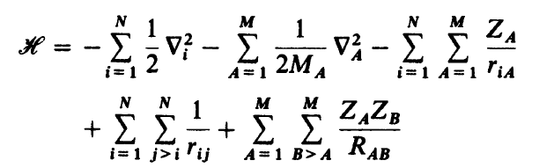

Molecular Schrödinger Equation
= Electronic
= Nuclear
Notes:
M_A is the ratio of the nuclei mass to the mass of an electron

Slide 4
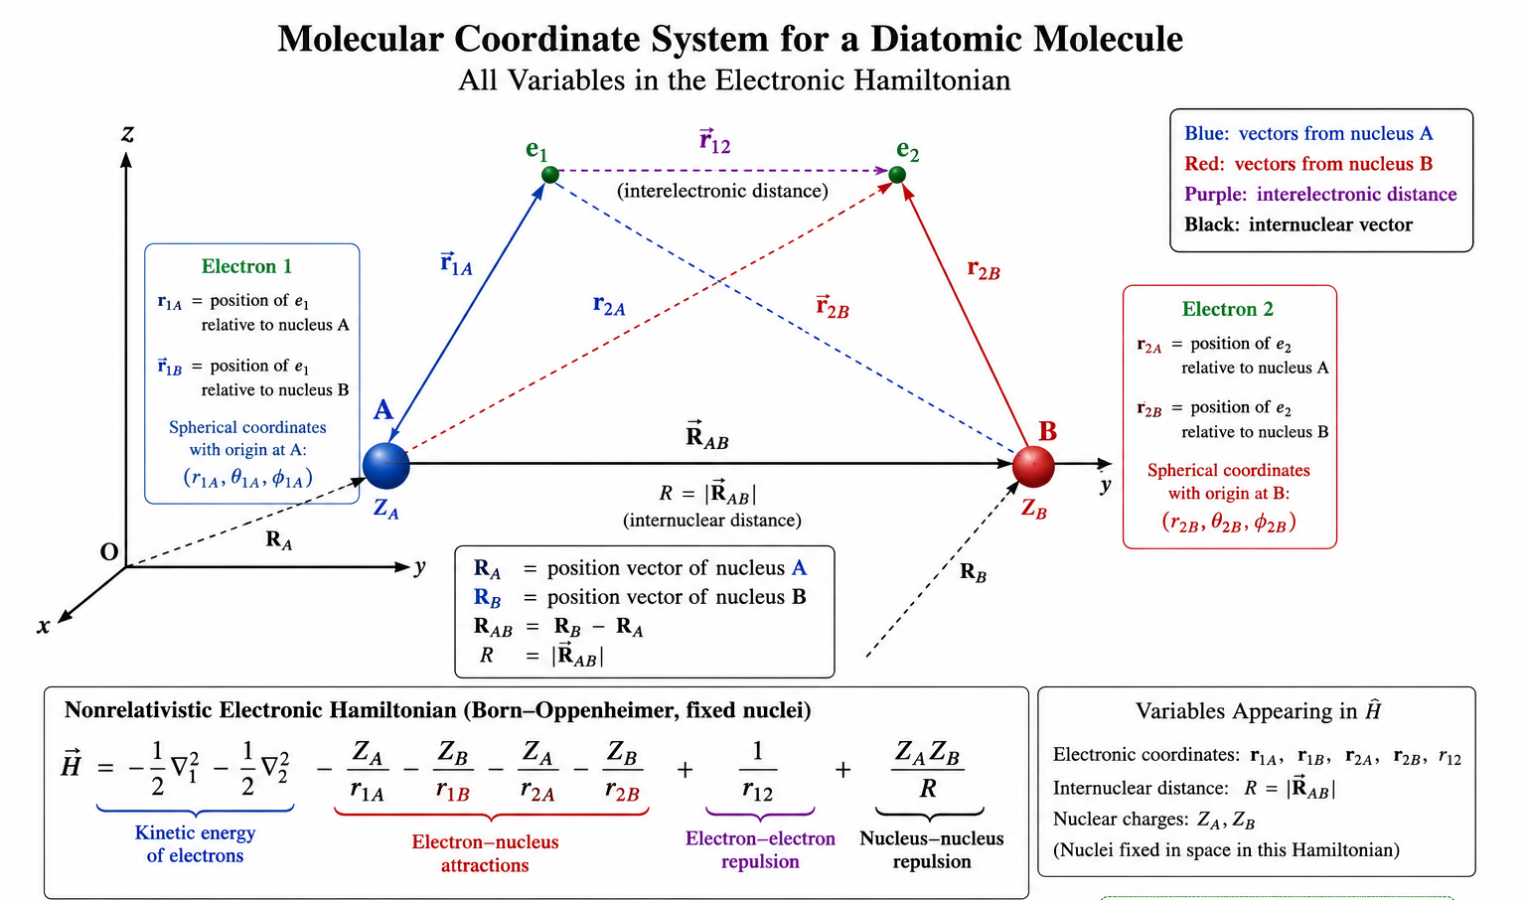


Born-OppenHeimer Approximation
Notes:
M_A is the ratio of the nuclei mass to the mass of an electron

Slide 5
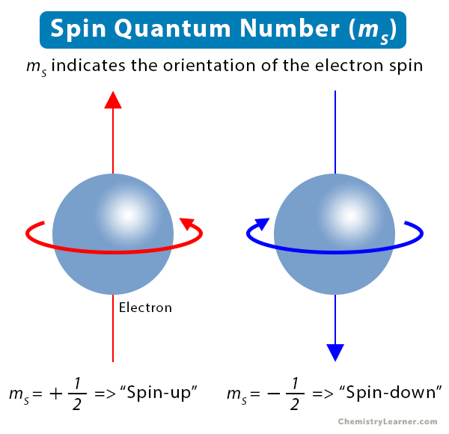
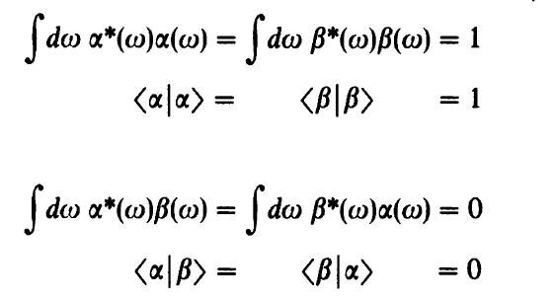

Spin
Spin coordinate
Spatial coordinate
Spin coordinate

Slide 6
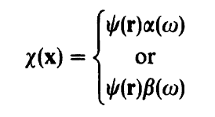


Spin
Spatial
Spin

Slide 7



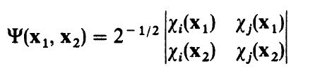
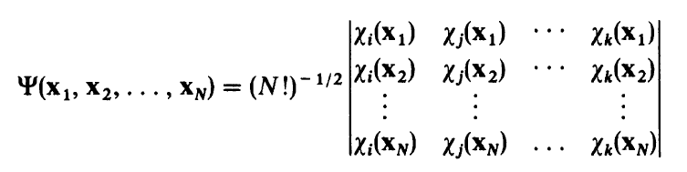
Slater Determinant
First guess
  Total molecular wavefunction is a product of molecular spin-orbitals
Antisymmetry principle not satisfied
Also will give the same energy for all possible spin cases
Hartree Product

Slide 8
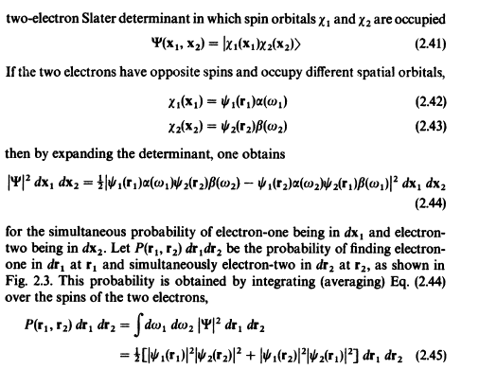
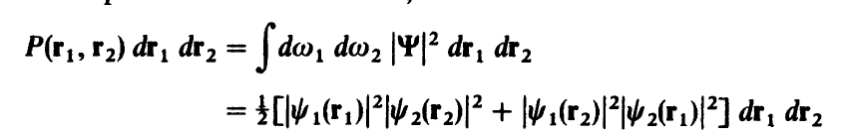
Probability Density
?

Slide 9
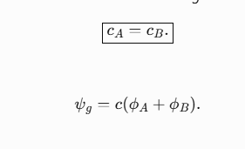
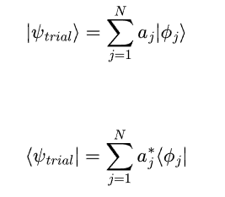

Single particle MO representations
Single particle molecular orbitals can be represented as a linear combination of some basis set with complex coefficients a_{j}
For molecules, a common basis is the linear combination of Atomic orbitals
The molecular orbitals are orthogonal, the atomic orbitals don’t need to be
  Overlap integral

Slide 10
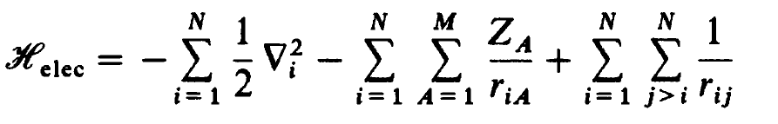
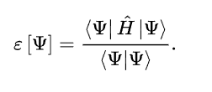
Variational Principle

Slide 11
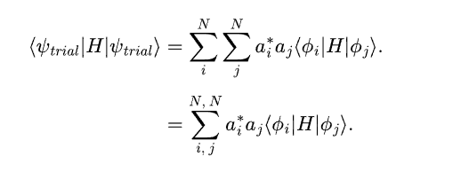

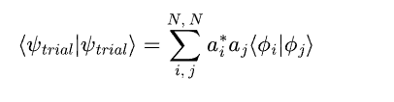


Variational Principle and Secular equations
?
Notes:
Derive denominator. What happens if you take it all to one side?

Slide 12
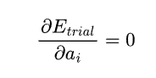
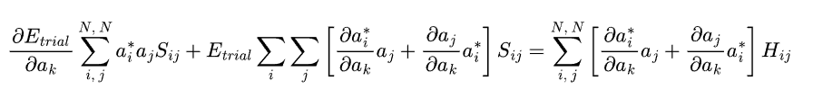
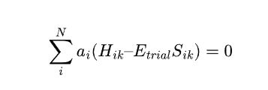

Energy minimization
Secular Equations
Notes:
Nontrivial solutions of the third equation only arise if Hij –Esij are singular. So it must vanish

Slide 13

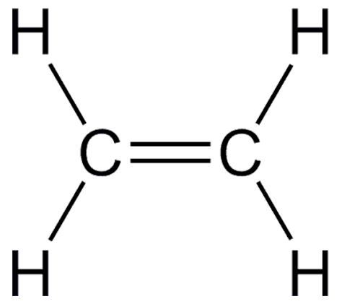
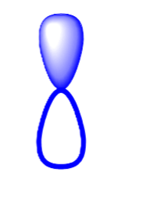
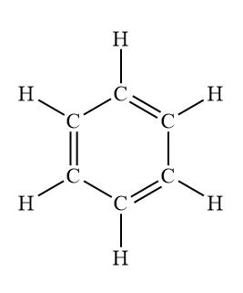
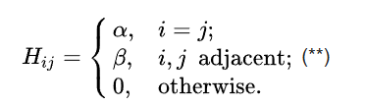

Huckel Theory and conjugated molecules
Predicts the molecular orbitals for conjugated molecules like ethylene, benzene and so on
  4n +2 pi electrons rule for aromaticity
Linear combination of atomic p-orbitals

Slide 14


Huckel Theory For C₂H₄
?

Slide 15



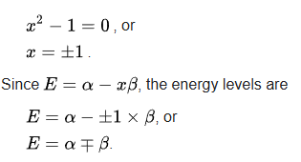
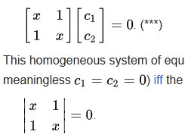
Huckel Theory and conjugated molecules
?

Slide 16



Huckel Theory and conjugated molecules
?
Ψ need to be orthonormal
Two cases….

Slide 17
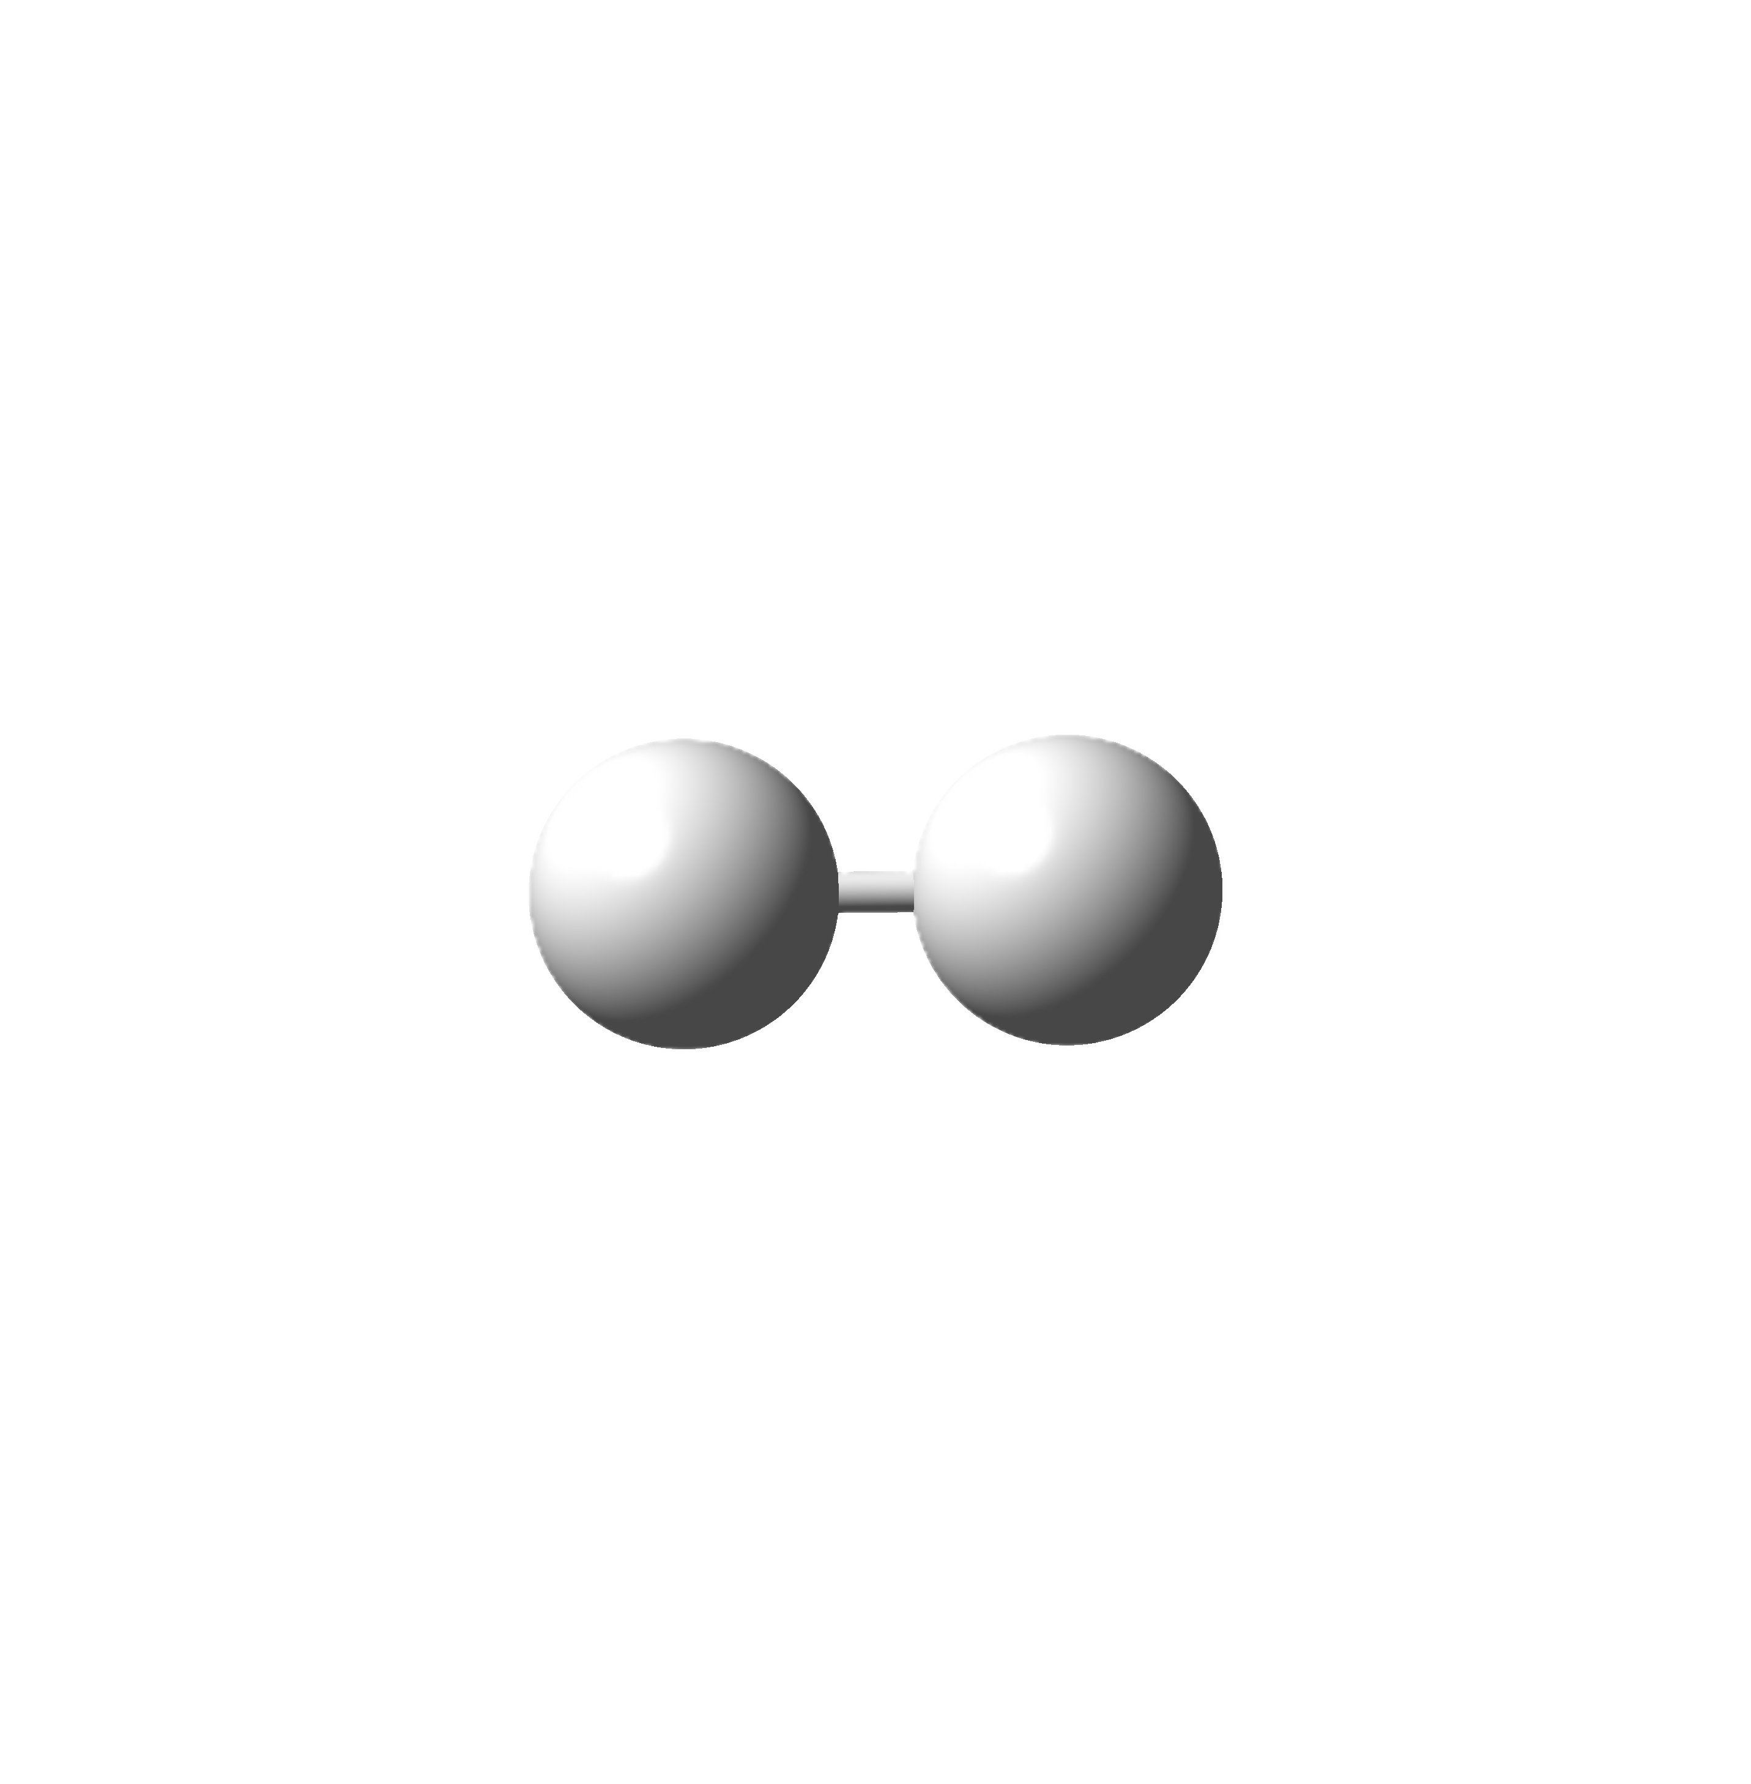
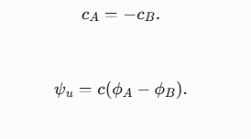
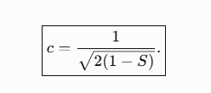

Extension to H₂ molecule
?
Similar derivation can be done with H₂
Ψ is now a linear combination of two s orbitals
Molecular orbitals must be orthonormal
  Two cases..
In this case S_{ij} is nonzero for the two orbitals

Slide 18
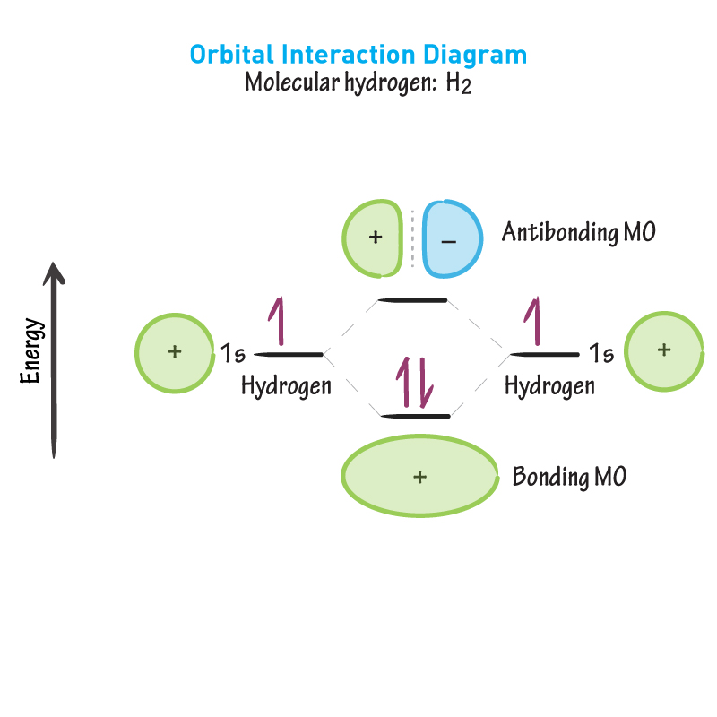
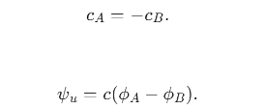
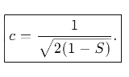
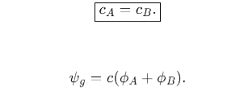

H₂ molecule orbitals

Slide 19
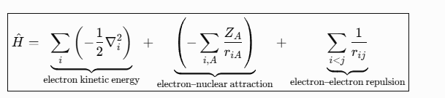
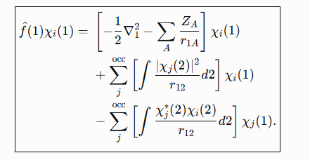



Hartree Fock Approximation
The question is now what is your actual Hamiltonian and how do you get energies?
Treat electron orbitals separately and the overall electron-electron interaction is treated as an average potential/mean field
  Hartree-Fock Theory
    Single Slater determinant

Slide 20
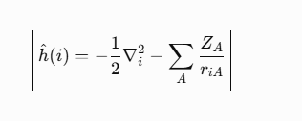

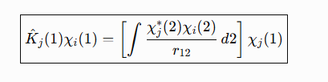
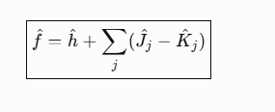
Hartree Fock Nomeclature
One electron operators
Coloumb Operator
Exchange Operator
Notes:
J and K are always greater than 1

Slide 21

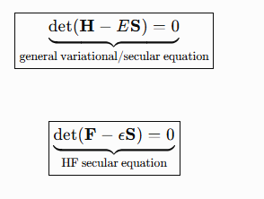
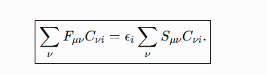
Analogy to Secular Equations

Slide 22
HArtEE Fock Energy of H₂
Bond distance of 0.7414 Å
HF Calculated to be -1.133 Hartrees
Exact energy is -1.174 Hartrees
What is wrong?
Hartree Fock makes electron-electron interactions an approximate mean field
White = Hydrogen

Slide 23
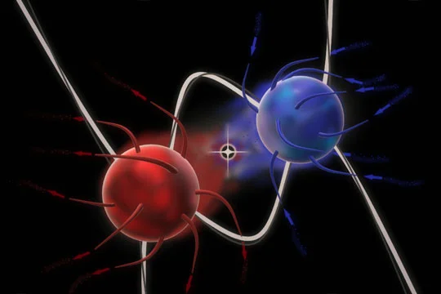
How do We do Better
Hartree fock is an averaged potential approximation
Electrons are not static and move
  Their movement impact other electrons and vice versa
This is called correlation
Artist rendition*

Slide 24

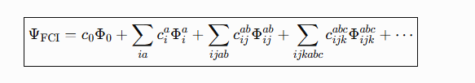
Including Correlation
One way is explanding your single slater determinant to include excited state configurations
  Exact if all included
In a real calculation you have to do a finite expansion
This specific expansion is called Configuration Interaction (CI)
  Including all excitations is called Full CI (FCI)

Slide 25
Including Correlation
White = Hydrogen

Slide 26
Brillouins theorem and Restricted Wavenfunctions
Single excitations will not interact directly with the ground state reference Hartree-Fock determinant
  For H₂ there are no single excitations that couple
Only the same spin states couple together
0
0
0

Slide 27
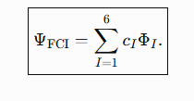
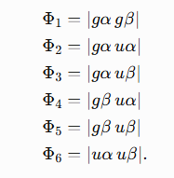
H₂ Molecule
?
BT
BT
u
S ≠ 0
S ≠ 0
g
α
β
White = Hydrogen

Slide 28





Configuration interaction
HF Calculated to be -1.133 Hartrees
Exact energy is -1.174 Hartrees
“CI” calculated to be -1.174 Hartrees
  We actually just did FCI
    Why?
White = Hydrogen

Slide 29
Thank you
I want to awknoledge ChatGPT, Kahoot, and Szabo and Ostlund

Slide 30
Constant

Slide 33
From page 52 in Szabo if want to do derivation

Slide 34
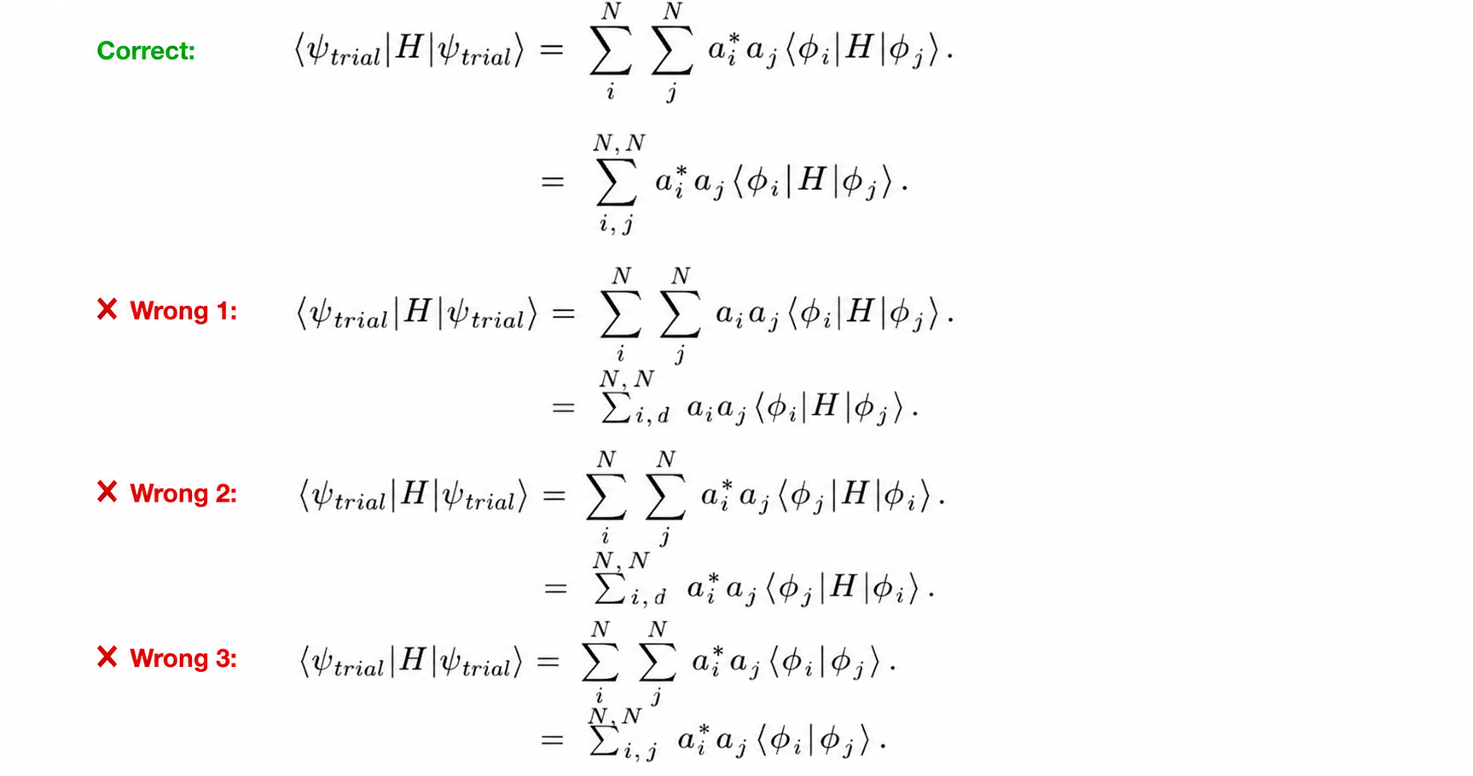

Slide 35
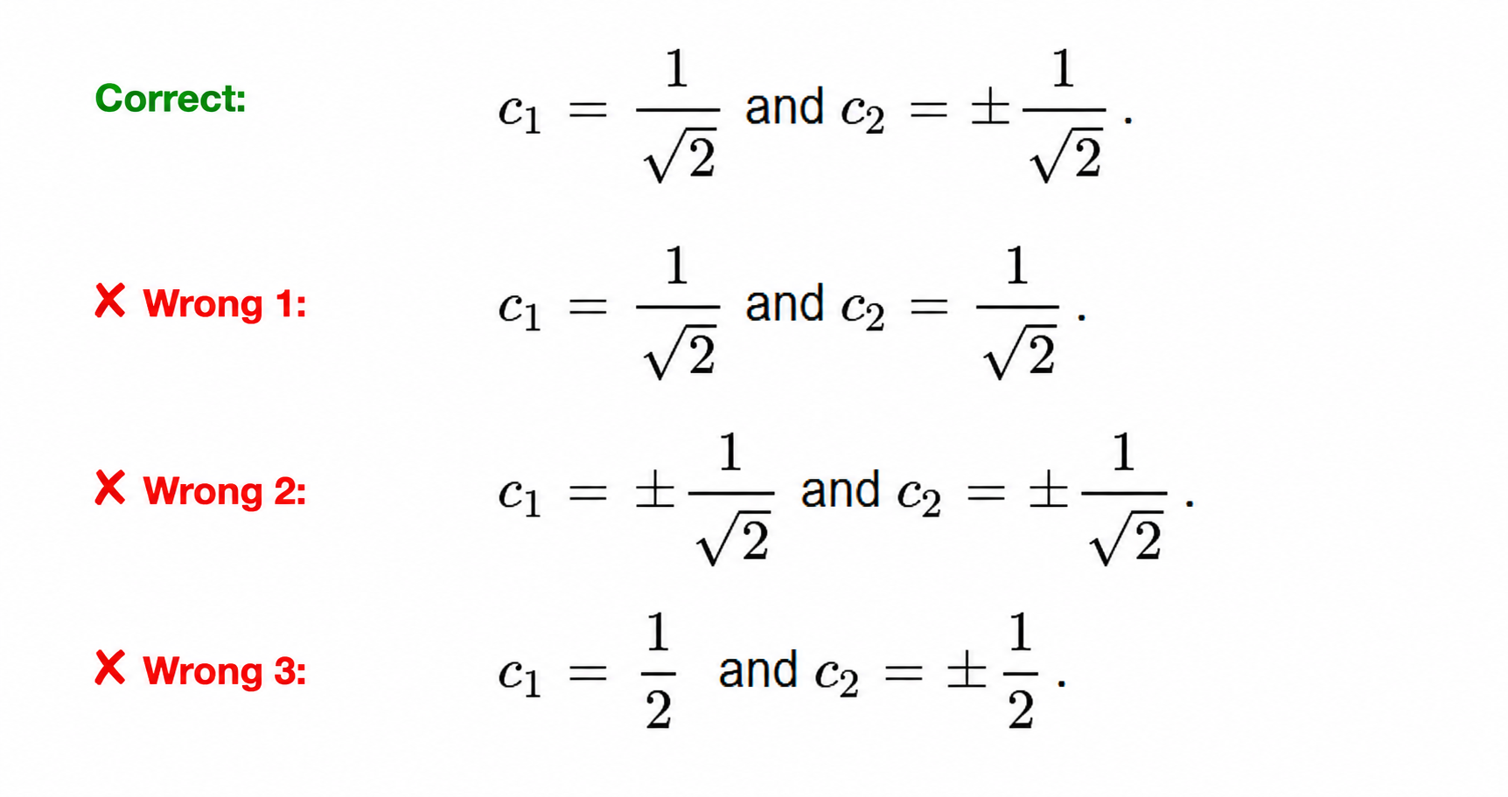

Slide 36
u
g
α
β

Slide 38

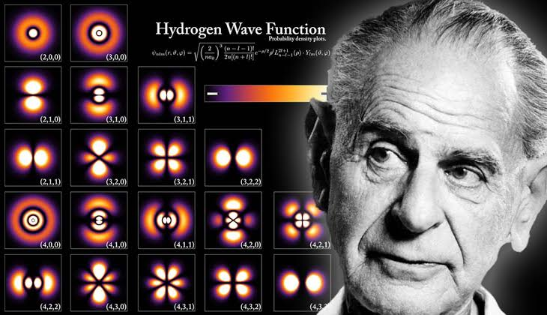

Slide 39
