Slide 1

The Hellman-Feynman Theorem: An underutilized tool
Nathan McLane
$$\frac{dE}{dλ}=\left\langle ψ\right|\frac{dH}{dλ}\left|ψ\right\rangle$$
Powered by ChatGPT

Slide 2
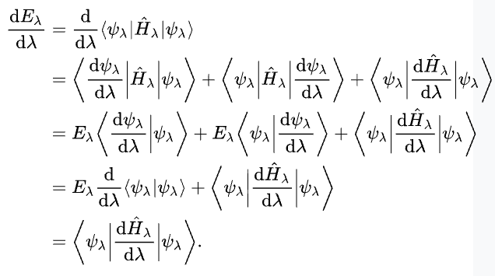
Derivation
White-Hydrogen
Notes:
.

Slide 3
History
Hellman and Feynman derive
Musher said it was trivial
Berlin saved it
1939
1951
1966
1945
1962
1972
Coulson and Bell said it was invalid
Wilson used it to get exact molecular energies
Slater said it was the most powerful theorem in molecular chemistry

Slide 4


Coulson and Bell invalidity
Notes:
Psi is the eigenstates of H not T and V

Slide 5
Coulson and Bell invalidity
Notes:
Psi is the eigenstates of H not T and V

Slide 6
Applications
Evaluating expectation values without knowing electronic wavefunctions
Molecular geometries
NMR
Dispersion interactions
Virial Equation

Slide 7
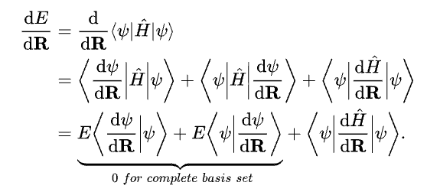
Caveats
Have to have the exact electronic wavefunction
  This will be shown later

Slide 8
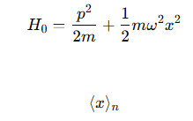

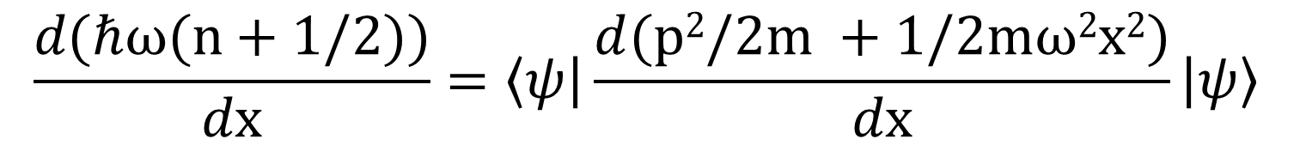

Simple expectation value determination:HO
$$\frac{dE}{dx}=\left\langle ψ\right|\frac{dH}{dx}\left|ψ\right\rangle$$
= ?
E_{n} =
$$\frac{d\text{(}\text{ℏ}ω(n+1/2))}{dx}=\left\langle ψ\right|\frac{d(p2/2m +1/2mω2x2)}{dx}\left|ψ\right\rangle$$
$$0=\left\langle ψ\right|x\left|ψ\right\rangle = <x>$$

Slide 9

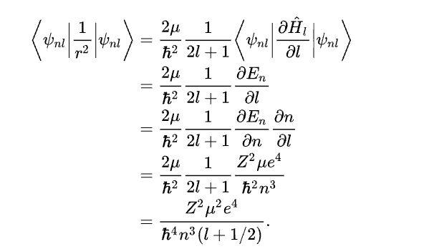




Simple expectation value determination
?
$$\frac{dE}{dλ}=\left\langle ψ\right|\frac{dH}{dλ}\left|ψ\right\rangle$$

Slide 10

Simple expectation value determination
Number of radial nodes are fixed
  n – l -1 = # of nodes

Slide 11


Molecular geometries
Optimization of molecular geometries using just classical Coulombic interactions
= 0
White-Hydrogen
Notes:
.

Slide 12
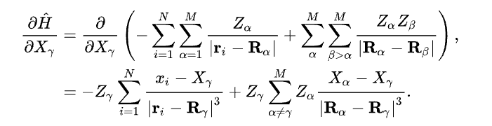

Derivation

Slide 13
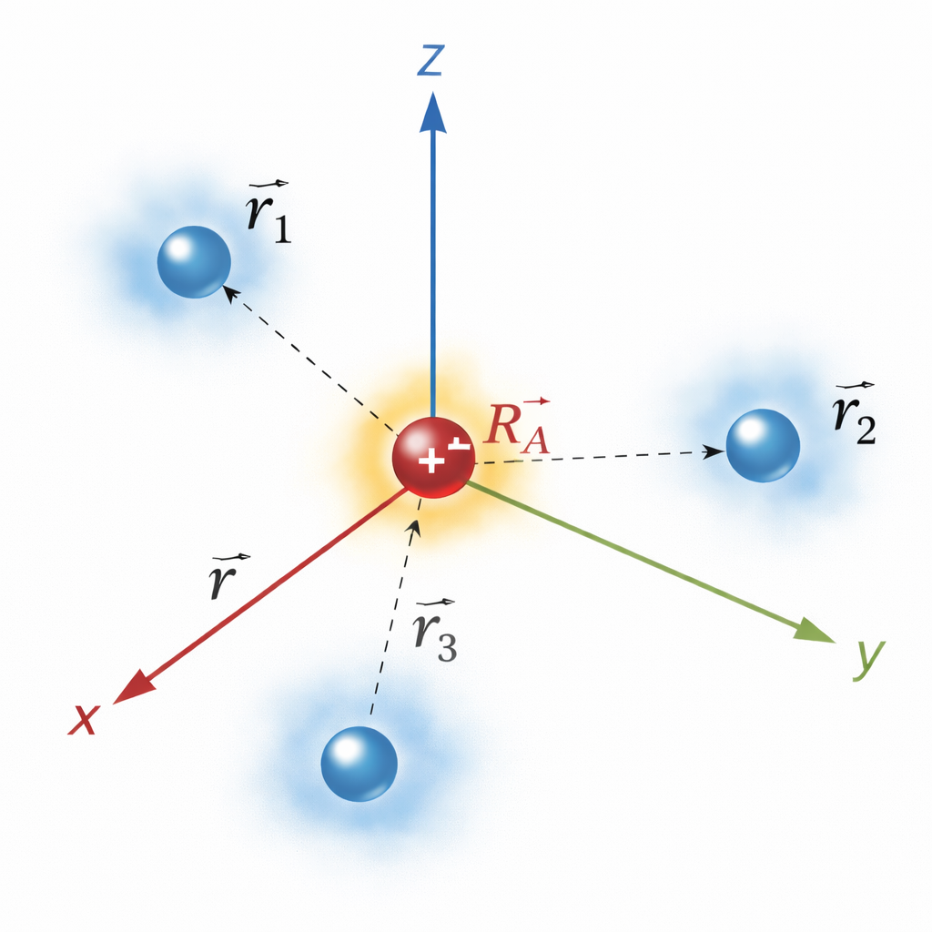

Derivation
r

Slide 14



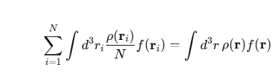
Derivation

Slide 15
Derivation
Entirely Coulombic! No quantum

Slide 16


H₂⁺ molecule
$$\frac{dE}{dλ}=\left\langle ψ\right|\frac{dH}{dλ}\left|ψ\right\rangle$$
R_{e} = 0.741 Angstroms
= 0

Slide 17
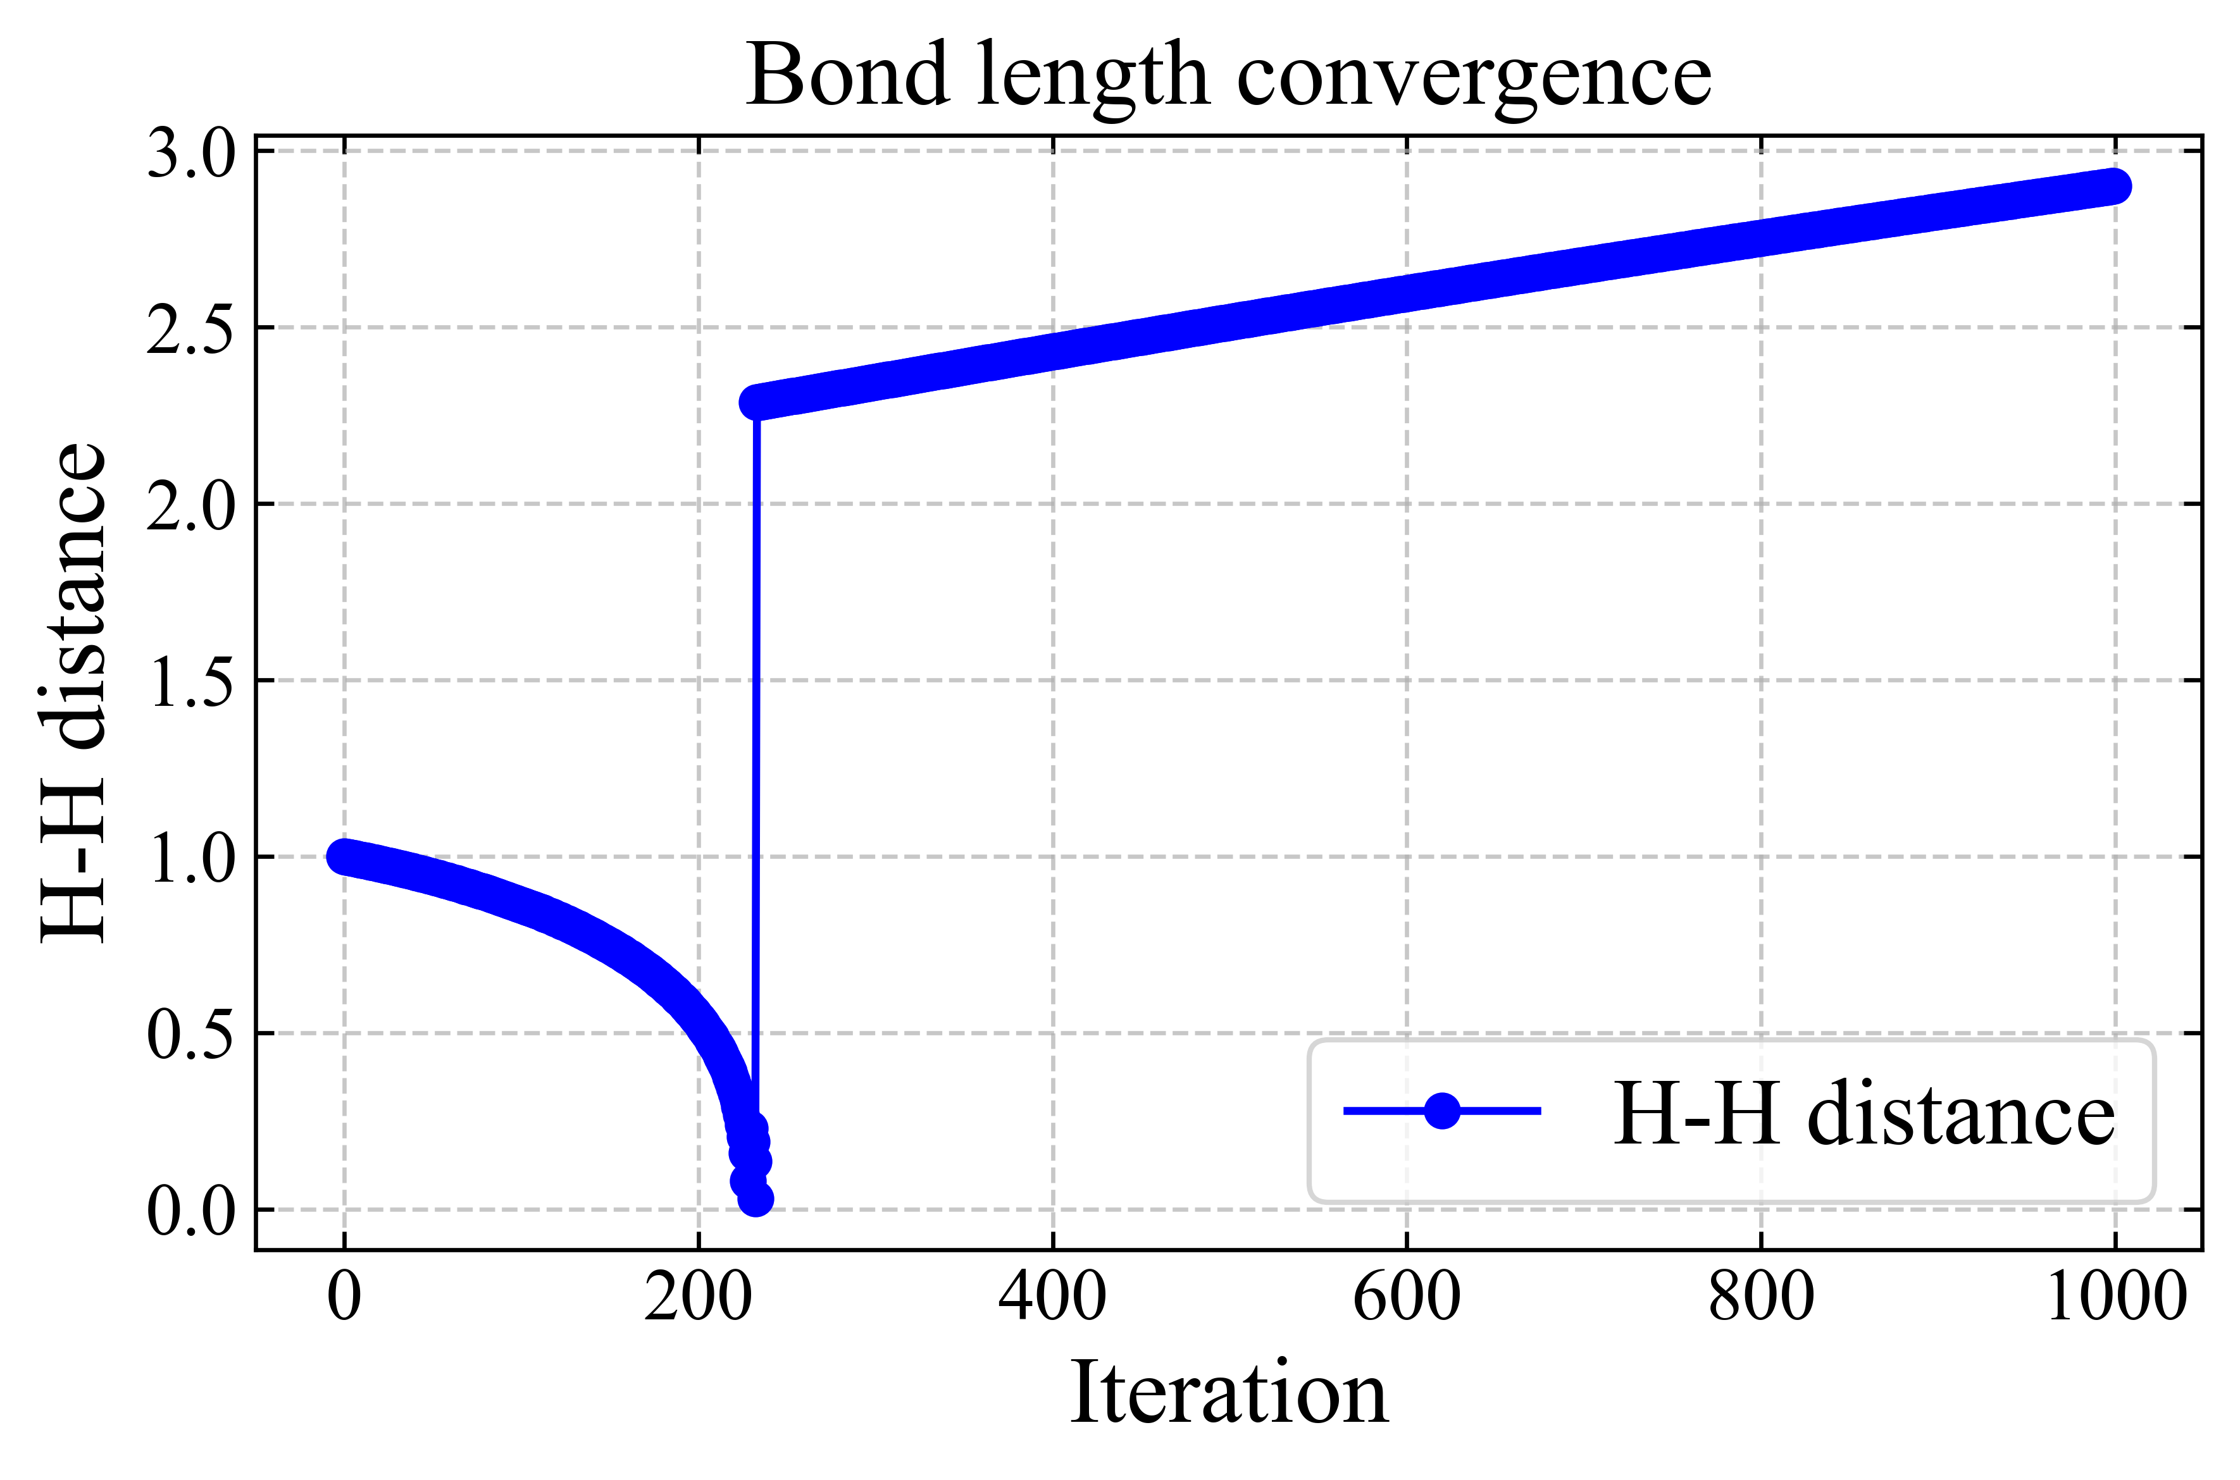
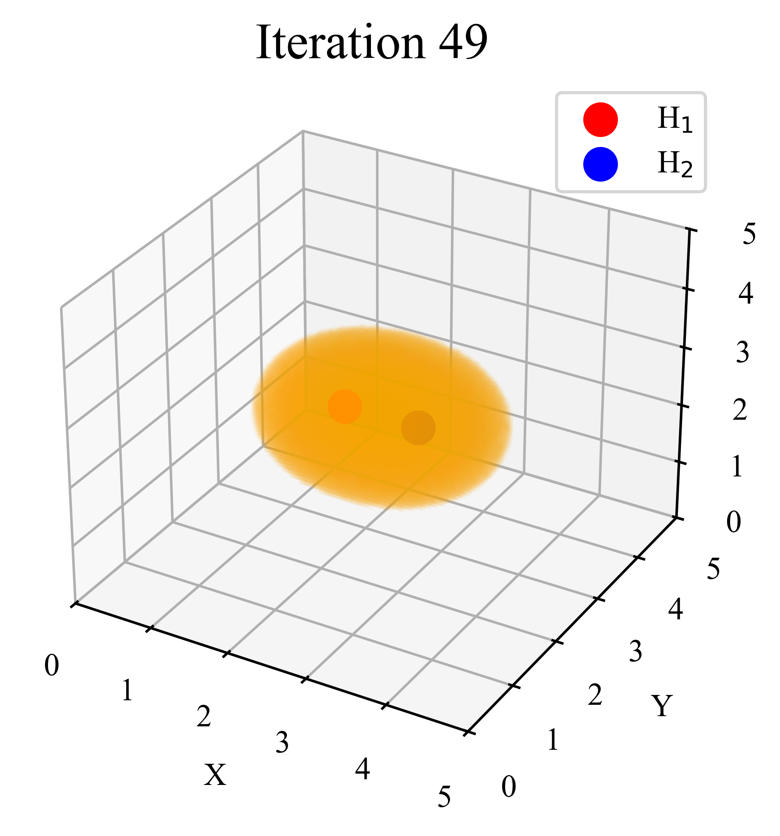
H2+ molecule

Slide 18
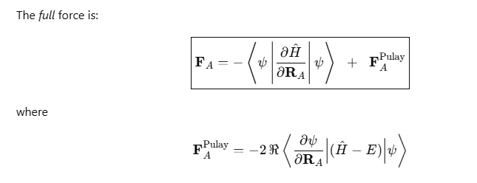
Pulay Forces

Slide 19
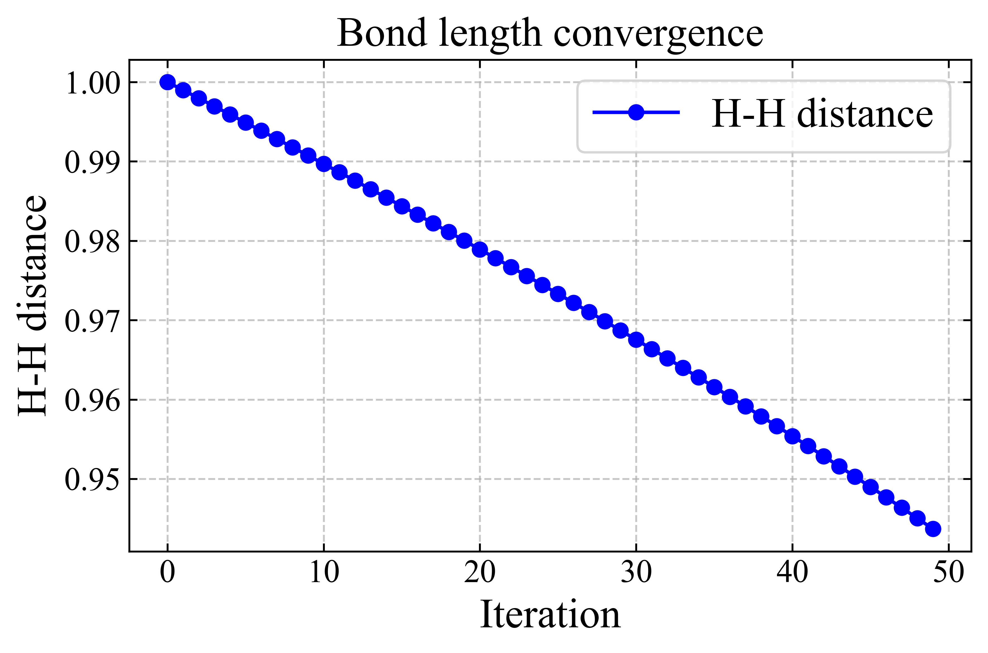
H2+ molecule
5 Radial functions with Pulay Forces
3 Radial functions no Pulay Forces
0.741 Angstroms distance

Slide 20
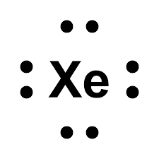

Dispersion Interactions
Xe – Xe dimer
What causes the interaction between the two
From perturbation theory gives induced dipole-dipole interactions
1/r⁶
r
White-Hydrogen
Notes:
.

Slide 21
Dispersion Interactions
Hellman-Feynman theorem says it is the induced polarizabilities of the molecules
1/r⁶
r
White-Hydrogen
Notes:
.

Slide 22
Dispersion Interactions
Induced dipole interactions?
Polarizability induced interactions?
Hotly debated to this day
Taught (1)
(2) has been proven experimentally and theoretically
White-Hydrogen
Notes:
.

Slide 23
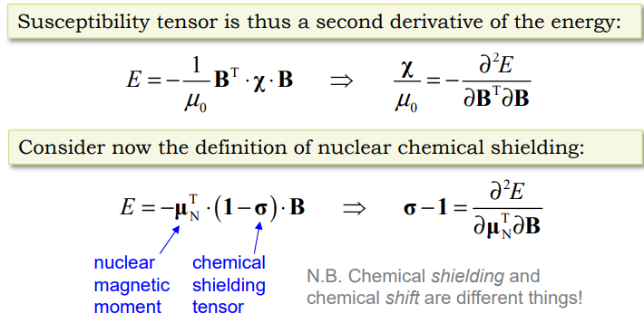
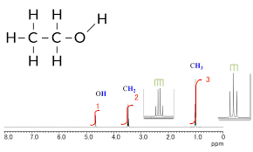
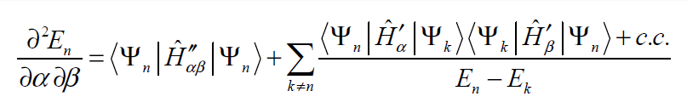
NMR
White-Hydrogen
Notes:
.

Slide 24
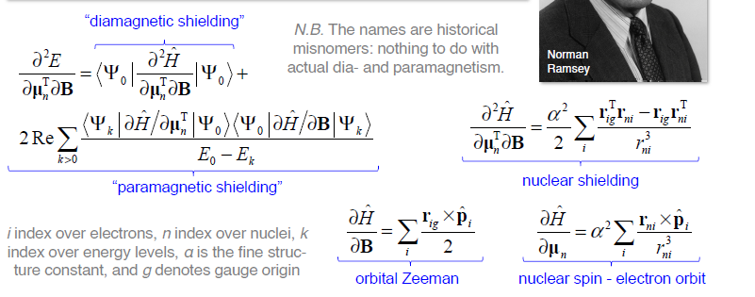
NMR
White-Hydrogen
Notes:
.

Slide 25
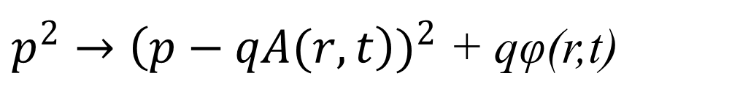
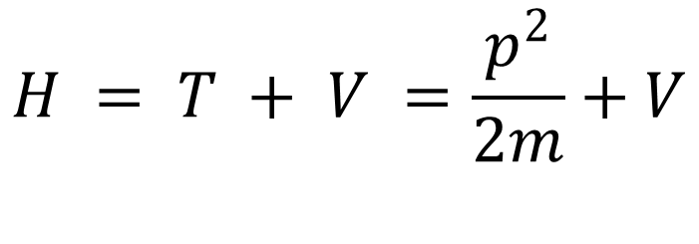
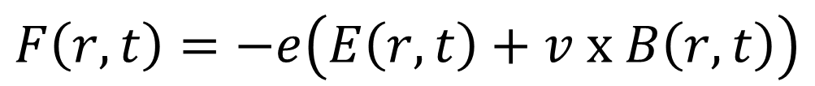
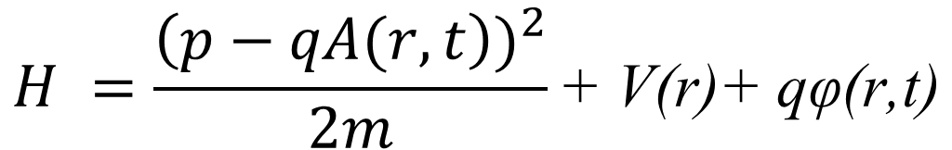
Interaction of particles with EM fields
$$H = T + V =\frac{p^{2}}{2m}+V$$
$$F\left(r,t\right)=−e\left(E\left(r,t\right)+v x B\left(r,t\right)\right)$$
Canonical
$p^{2}→{\left(p−qA(r,t\right))}^{2}$ + qφ(r,t)
Mechanical
$$H =\frac{{\left(p−qA(r,t\right))}^{2}}{2m}\text{+ }\text{V}\text{(}\text{r}\text{)+ }\text{q}\text{φ}\text{(}\text{r}\text{,}\text{t}\text{)}$$

Slide 26
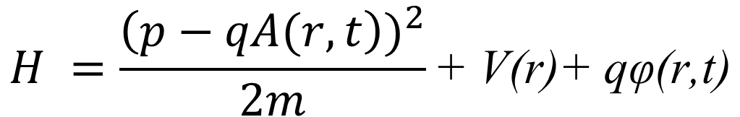
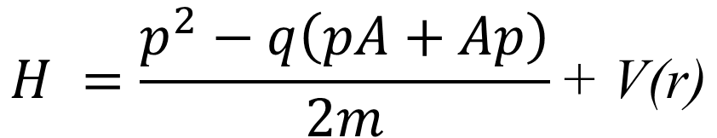

Interaction of particles with EM fields
$$H =\frac{{\left(p−qA(r,t\right))}^{2}}{2m}\text{+ }\text{V}\text{(}\text{r}\text{)+ }\text{q}\text{φ}\text{(}\text{r}\text{,}\text{t}\text{)}$$
$${\left(p−qA\right)}^{2}=p^{2}−q\left(pA+Ap\right)+A^{2}$$
In the case of the EM field is weak and does not originate from a point charge
$$A^{2} = 0$$
$$\text{q}\text{φ}\text{(}\text{r}\text{,}\text{t}\text{) }→0$$
$$H =\frac{p^{2}−q\left(pA+Ap\right)}{2m}\text{+ }\text{V}\text{(}\text{r}\text{)}$$

Slide 27
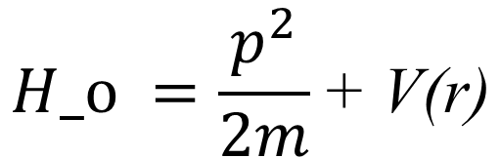
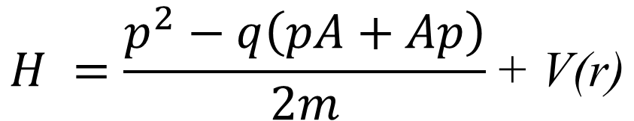
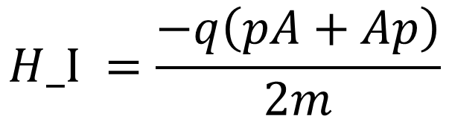
Interaction of particles with EM fields
$$H =\frac{p^{2}−q\left(pA+Ap\right)}{2m}\text{+ }\text{V}\text{(}\text{r}\text{)}$$
$$H_o =\frac{p^{2}}{2m}\text{+ }\text{V}\text{(}\text{r}\text{)}$$
$$H_I =\frac{−q\left(pA+Ap\right)}{2m}$$

Slide 28
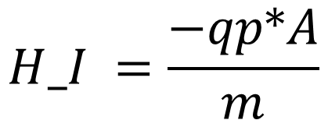
Interaction of particles with EM fields
$$Coulomb gauge$$
$$∇∗A→\left(pA=Ap\right)$$
$$H_I =\frac{−qp∗A}{m}$$
$$Plane wave$$
A = A_o*ϵ*exp(i(kr-wt)

Slide 29
History
Derived separately by both Hellman and Feynman in 1939
Coulson and Bell said it was invalid in 1945
Berline saved it 1951
  How it could be used for chemical binding
Wilson in 1962 used it to get exact molecular energies
Musher ins 1966 said it is so trivial it is not a theorem
1972 Slater said it was the most powerful tool for molecular and condensed phase systems

