Slide 1
Grand Wham Presentation Datafest 2022
Vincent Purr
Pranay Muthineni
Ted Zerbe
Nathan Tack
Veronica Muth

Slide 2
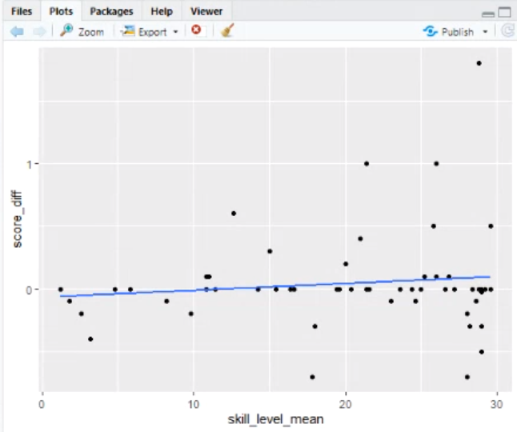
Data Visualization
Correlation = 0.12
As skill level increases, the efficacy increases. A high efficacy indicates a high chance of refusing peer-offered drugs and alcohol by students.
We found most of the students quit playing the game after 3 weeks. So, we chose 3 weeks to utilize more of our data.
Notes:
Introduction: We are taking the skill level for the first 3 weeks of playing the game and observing, after 3 weeks of gameplay, what value the player’s skill level has reached, and whether or not that skill level is associated with increasing drug efficacy after those 3 weeks, as measured by the Section 5 Self-Efficacy for drug use resistance. This tells us the learning rate/pace for every student and how the game is accommodating these learning rates.

Slide 3
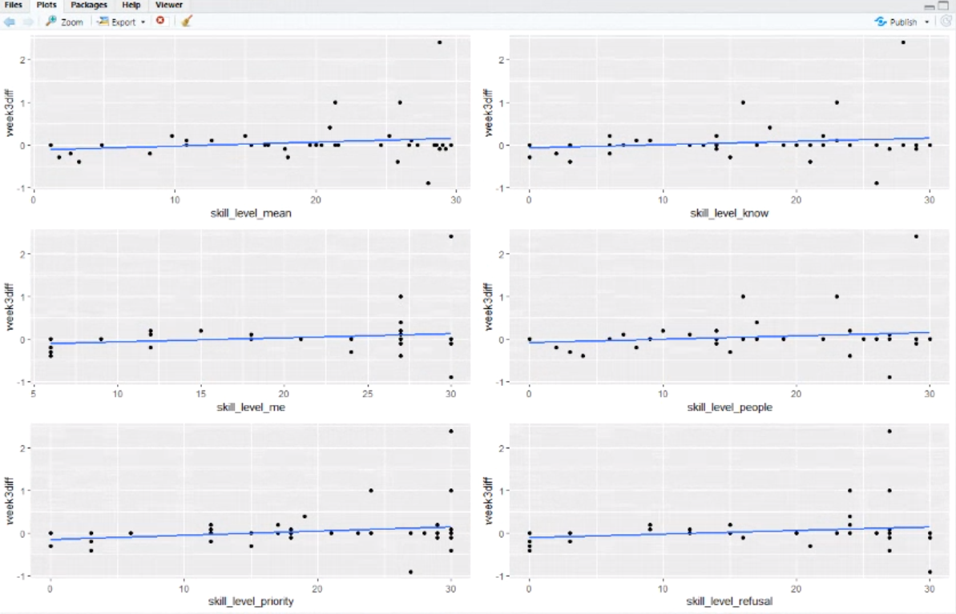
Data Visualization (cont’d) - Correlations
A = 0.178
B = 0.158
C = 0.169
D = 0.152
E = 0.208
F = 0.175
Notes:
We accumulated/aggregated each skill for every player, so every player has a skill_level_mean variable.
Explain what skill_level_mean is

Slide 4
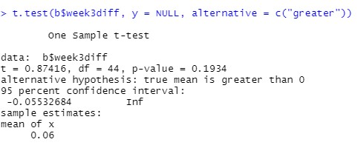
T-Test slide
Null hypothesis: The skill level mean difference is 0 after 3 weeks, indicating no improvement.
Alternative hypothesis: The skill level mean is greater than 0, indicating improvement. (matched-pairs test)
We fail to reject the null hypothesis. There is insufficient evidence to prove the skill level mean after an efficacy period of 3 weeks is greater than 0.
Notes:
Talk mre about skill_level_mean

Slide 5
Conclusion
As the player’s skill level increases in-game, some correlation is evident that the player’s efficacy of resisting peer-offered drugs and alcohol increases, which means students are getting more comfortable with refusing drugs and alcohol.
We concluded that while the game does have positive effects as evidenced by the slightly positive correlations, the game could be vastly improved to accommodate for different learning rates.

