Slide 1
Grand Wham Presentation Datafest 2022
Pranay Muthineni
Vincent Purr
Ted Zerbe
Nathan Tack
Veronica Muth

Slide 2
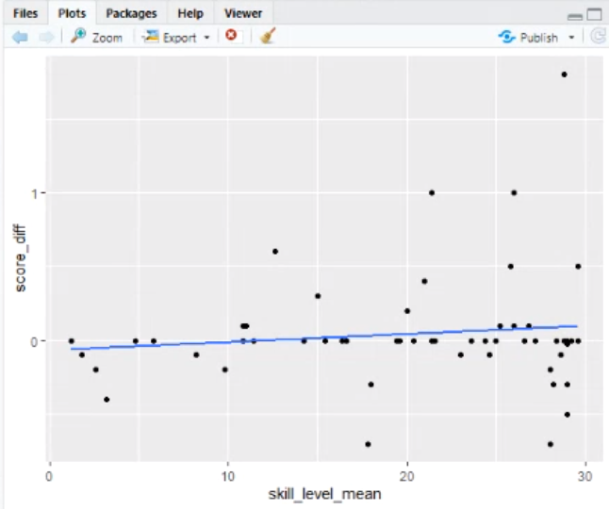
Data Visualization
As skill level increases, the efficacy increases. A high efficacy indicates a high chance of refusing peer-offered drugs and alcohol by students.
Correlation = 0.12
Notes:
Introduction: We are taking the skill level for the first 3 weeks of playing the game and observing, after 3 weeks of gameplay, what value the player’s skill level has reached, and whether or not that skill level is associated with increasing drug efficacy after those 3 weeks, as measured by the Section 5 Self-Efficacy for drug use resistance. This tells us the learning rate/pace for every student and how the game is accommodating these learning rates.

Slide 3
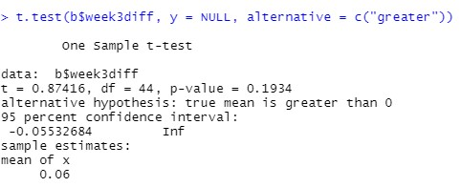
T-Test slide
Null hypothesis: The skill level mean is equal to 0.
Alternative hypothesis: The skill level mean is greater than 0. (matched-pairs test)
We fail to reject the null hypothesis. There is insufficient evidence to prove the skill level mean after an efficacy period of 3 weeks is greater than 0.

Slide 4
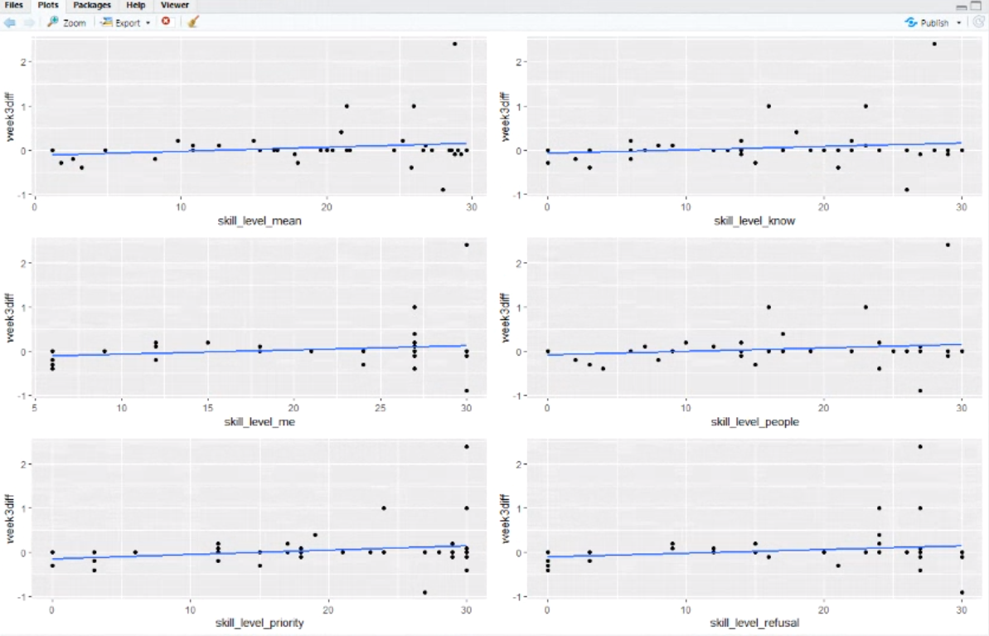
Data Visualization (cont’d)
Correlations
A = 0.178
B = 0.158
C = 0.169
D = 0.152
E = 0.208
F = 0.175

Slide 5
Analysis
As skill level in the game increases, the efficacy increases. A high efficacy indicates a low chance of accepting drugs from friends. This means as players continue acquiring skill points in the game, the players are less likely to accept drugs or alcohol from friends.

Slide 6
Conclusion
As the player’s skill level increases in-game, some correlation is evident that the player’s efficacy of resisting peer-offered drugs and alcohol increases, which means students are getting more comfortable with refusing drugs and alcohol.
We concluded that while the game does have positive effects, the game must be vastly improved to accommodate for different learning rates.

