Slide 1
InDelDuper BioPython Fall Update
Nate Poresky

Slide 2
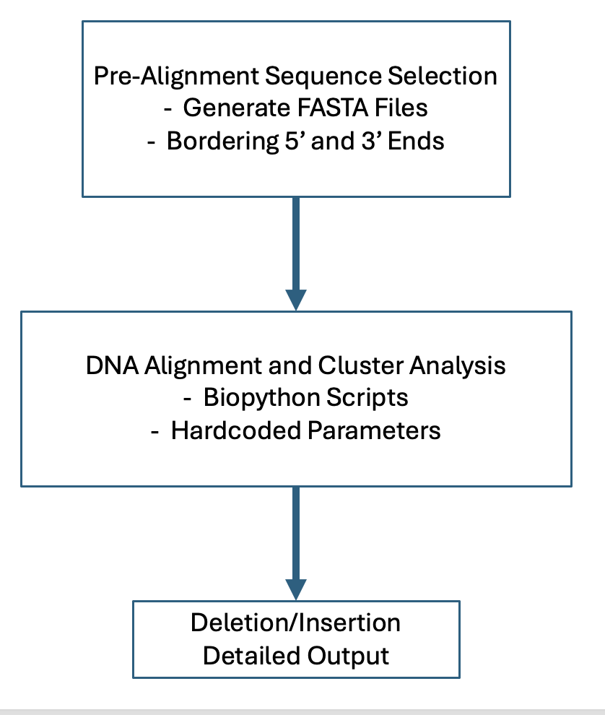
From Last Meeting
Add Duplication portion of the Insertion program
Externalize hardcoded environmental variables
Integrate to be used as a part of a bash file run as a part of a larger pipeline, rather than run individually as python scripts locally
Fix issue with differing Grep’ed sequences between 5’ and 3’ end
Change to fuzzy search in python script

Slide 3
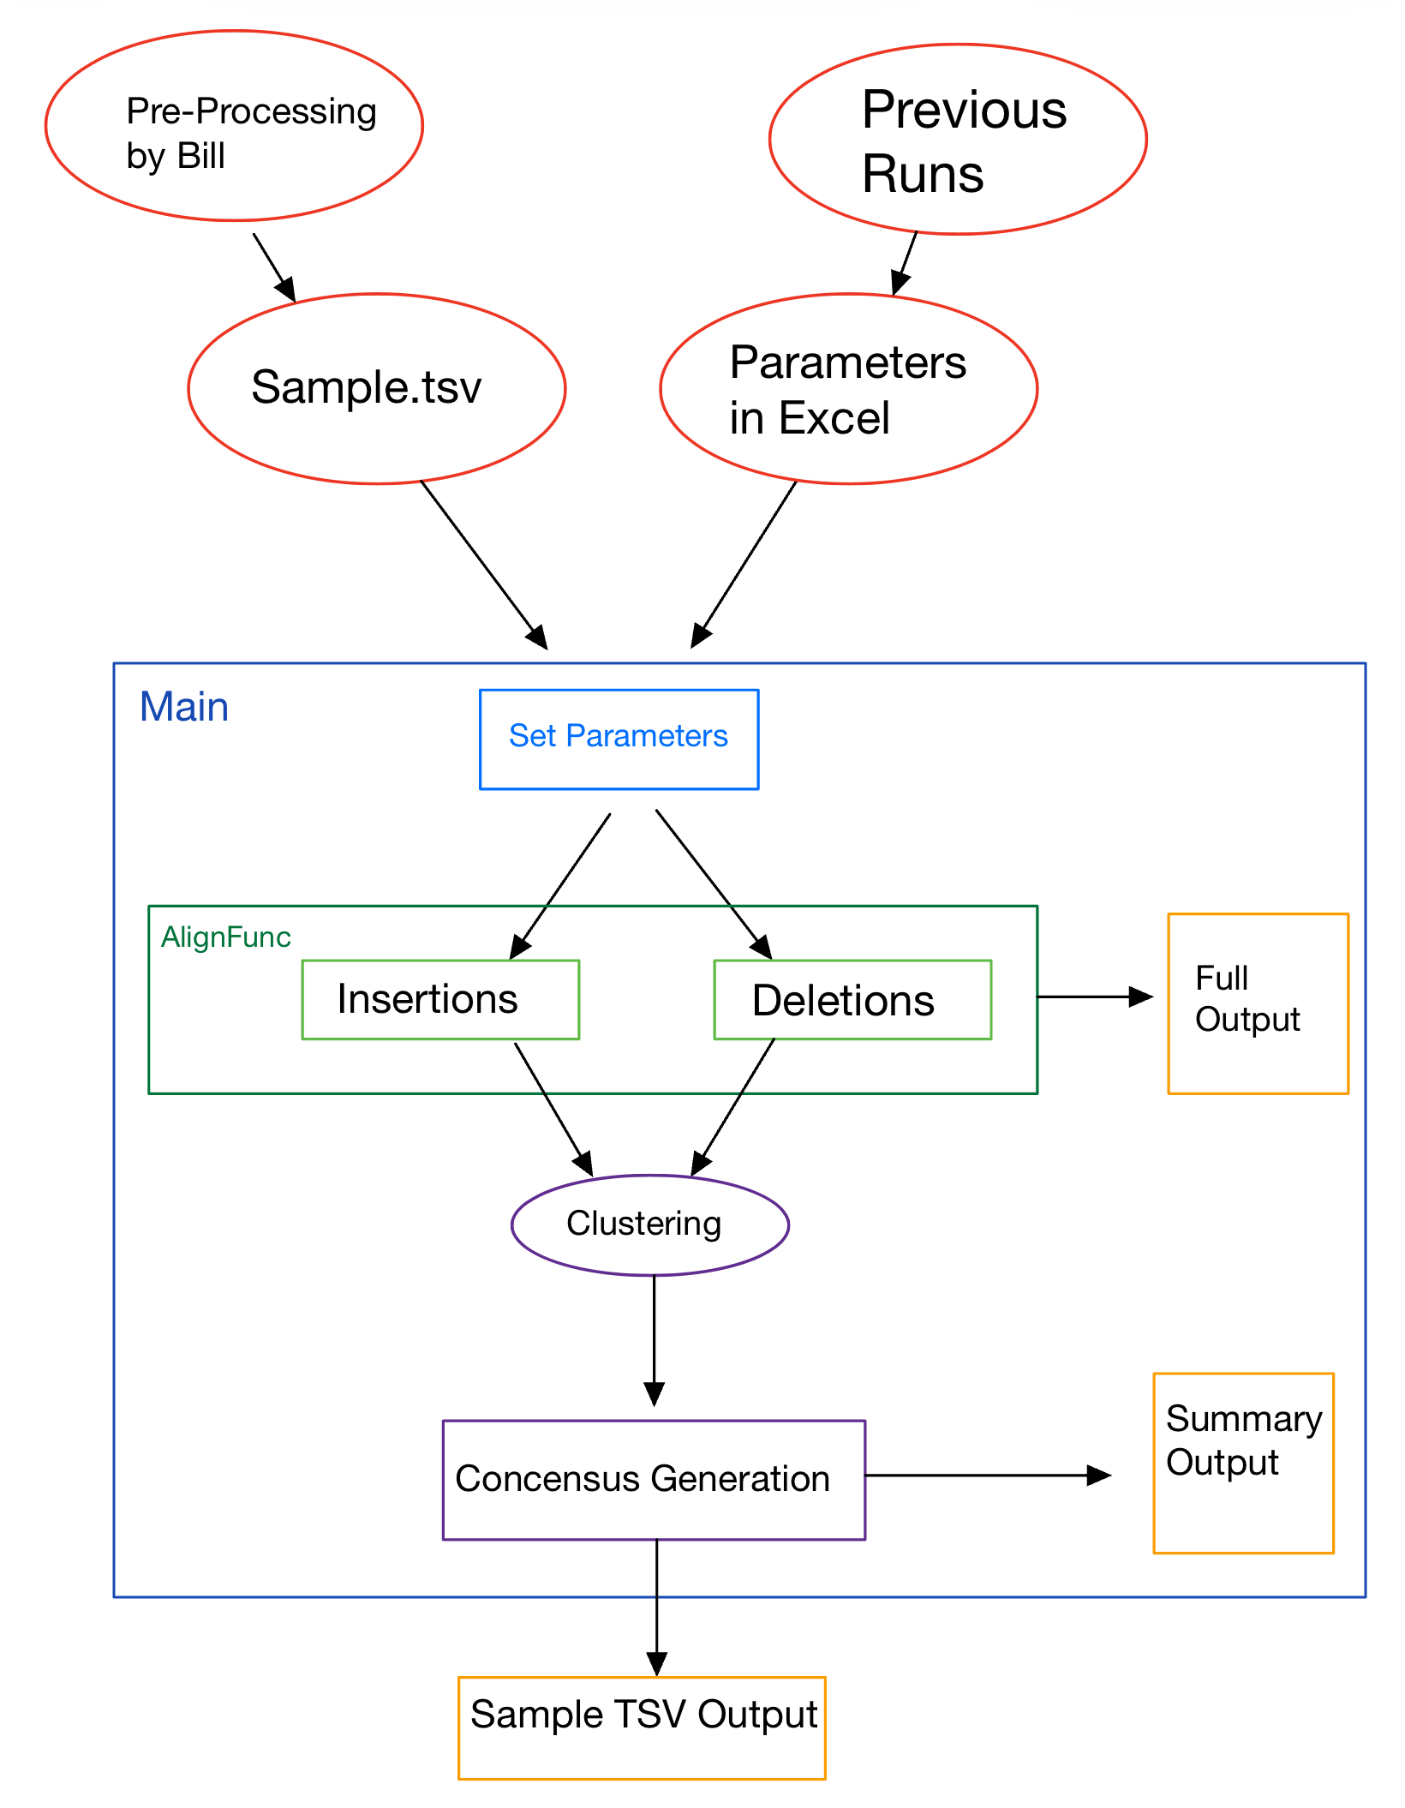
Current Workflow
Updates since last meeting:
Before ran only one gene segment with one defined set of parameters, hard-coded in
Now runs multiple sample files, containing multiple genes (Kit 1-9 and Met 1-10) together for any sample
Exported Parameters in Excel
Full process 20x more efficient
Fully Annotated with instructions on future use
AmpID = Specific location of specific gene
Ex. “KIT-04”

Slide 4
New Outputs
Full Output - records all alignments done for each AmpID
Summary Output - now includes example of Consensus Sequence Alignment for each AmpID
Sample TSV Output – reports summary statistics in TSV form for ALL AmpIDs from a given sample

Slide 5
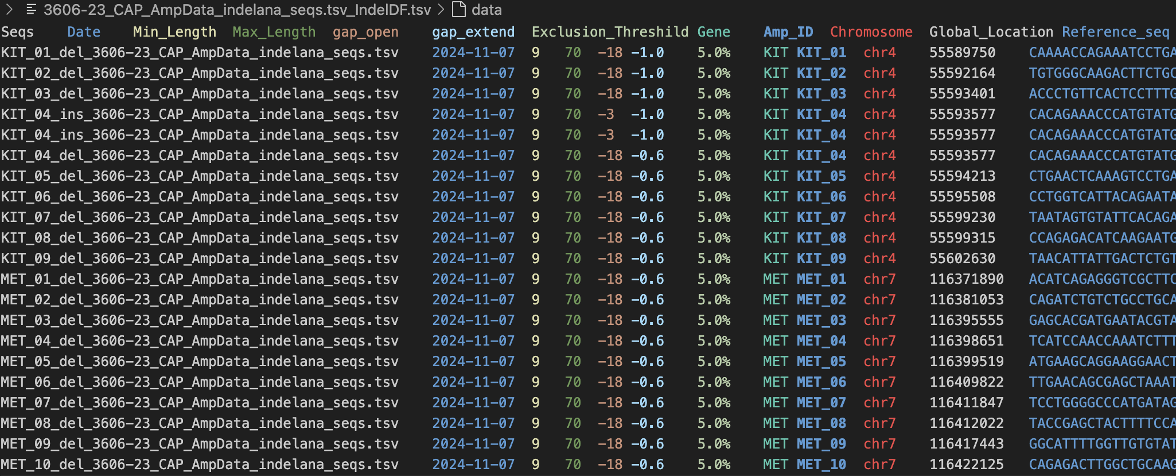
Real Sample Example, 3606: 13bp MET Deletion

Slide 6
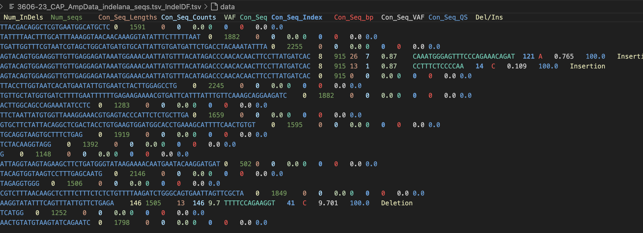
Real Sample Example, 3606: 13bp MET Deletion

Slide 7
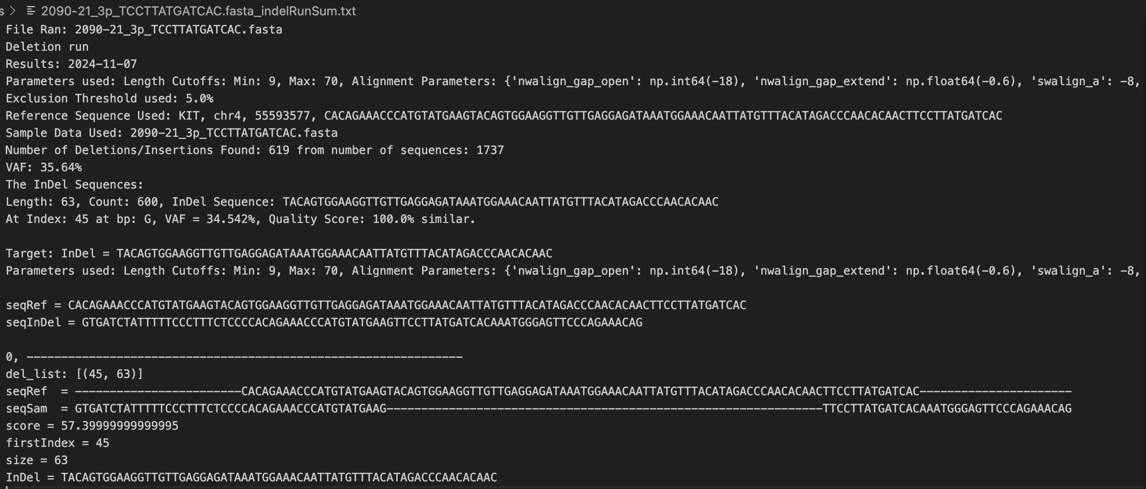
Real Sample Example, 2090-21: 63bp KIT Deletion

Slide 8
Goals Accomplished in Fall
Fully Externalized all Parameters
Integrated into Developmental Pipeline
Able to run multiple sequences and genes together
Added example Alignment into Summary Outputs for each InDel detected
Renamed and Documented Script for intuitive future use
Added full alignment outputs for each run if needed
New TSV Output includes all gene location alignments for each sample
Still able to detect same difficult InDels as before

Slide 9
Future Updates
While there are default parameters for most cases, fine tuning will likely be required for detecting known small or large indels
Especially Insertion Sequences
Not a one size fits all
Validation Grading on Complete Runs
Documentation with Full Work-Flow Diagram
Integration into Production Pipeline (Go-Live)
Add Duplication Detection, if needed (After Go-Live)

