Slide 1
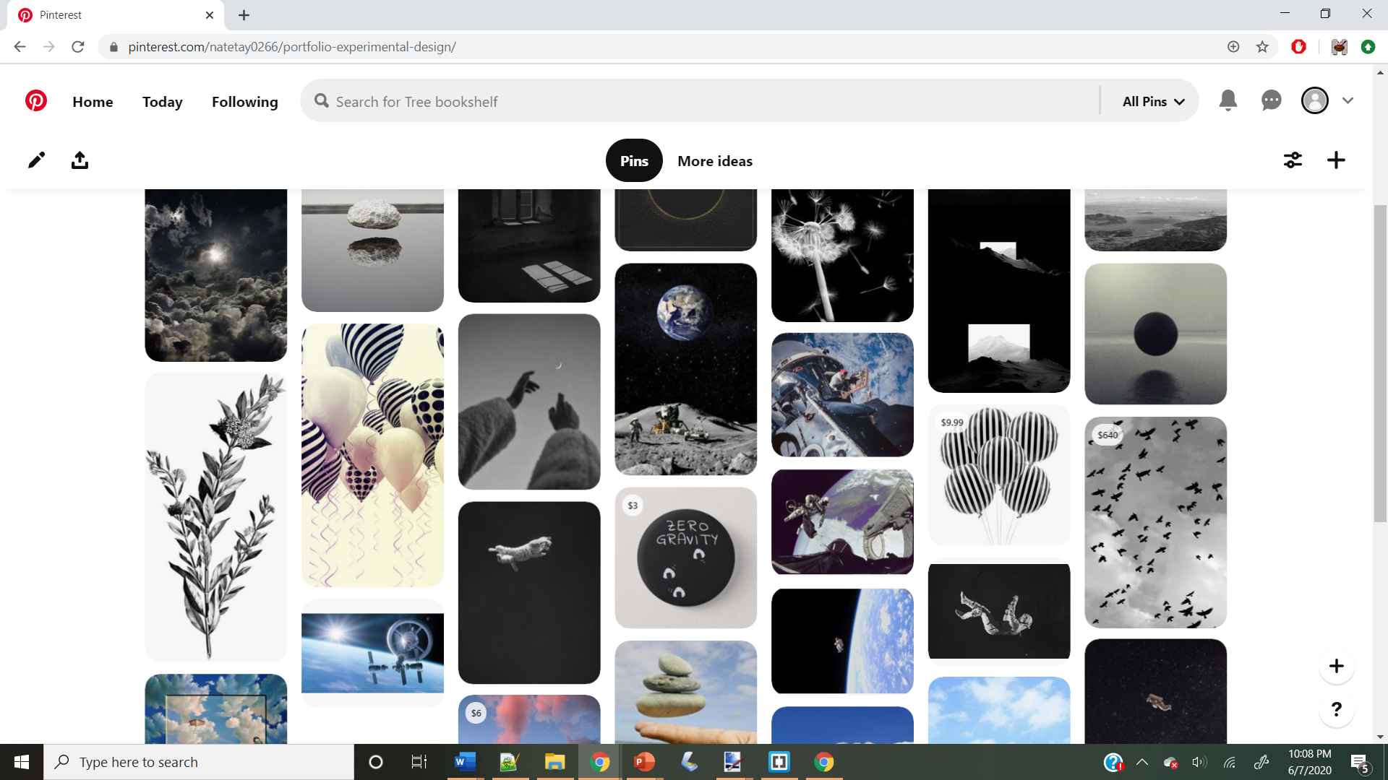
https://www.pinterest.com/natetay0266/portfolio-experimental-design/

Slide 2
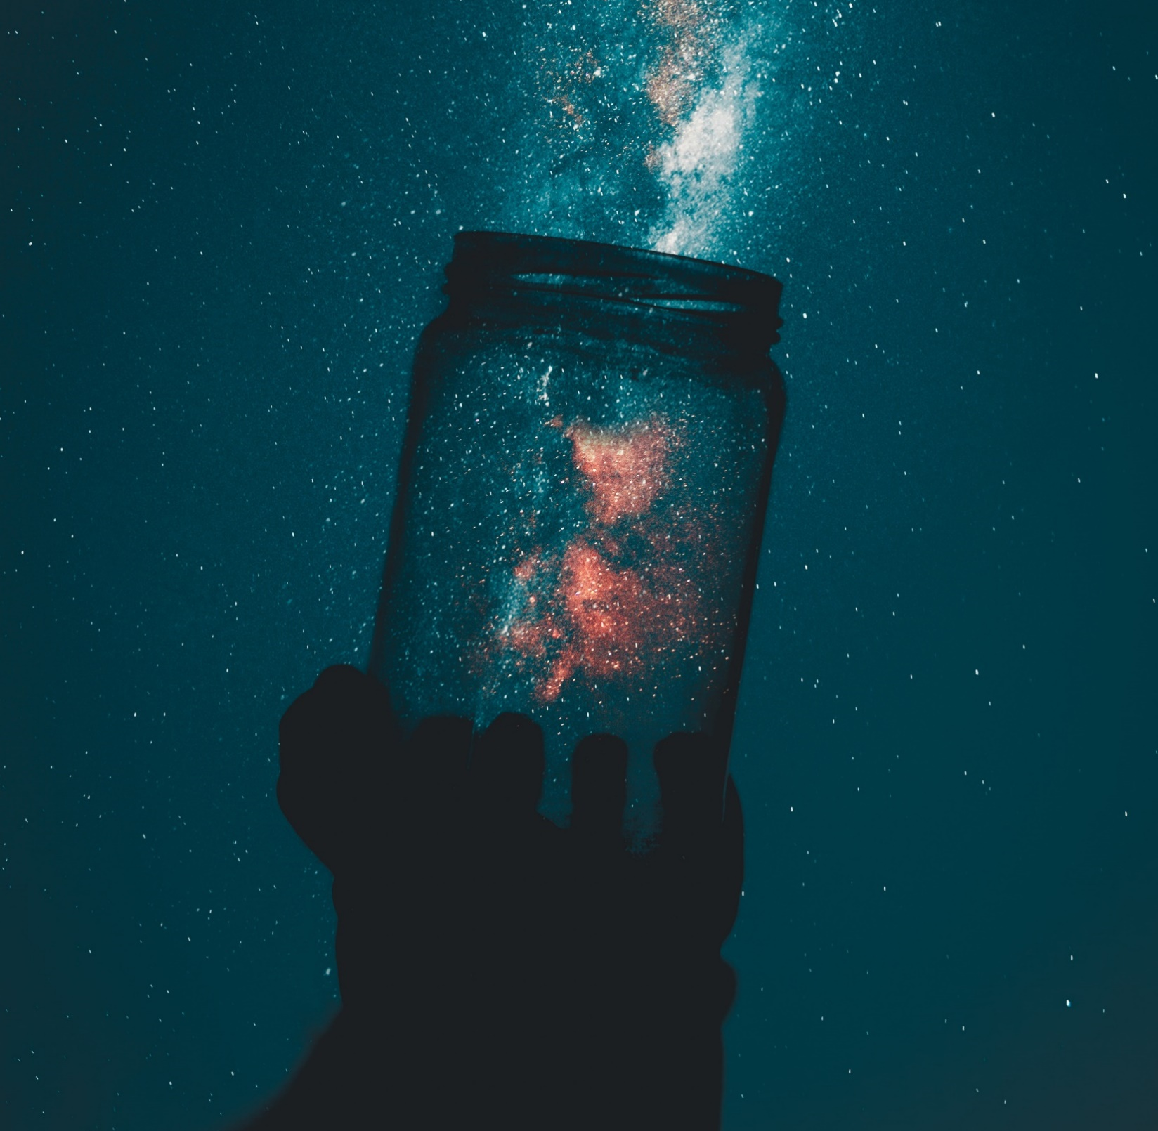
Article Title
Description text
Keys: Astro Space
Regular Headings: Orbitron
Body and other copy: Armata, Sans-Serif
Mobile Style Tiles
https://www.fontspace.com/help#license-3
https://scripts.sil.org/cms/scripts/page.php?site_id=nrsi&id=OFL

Slide 3
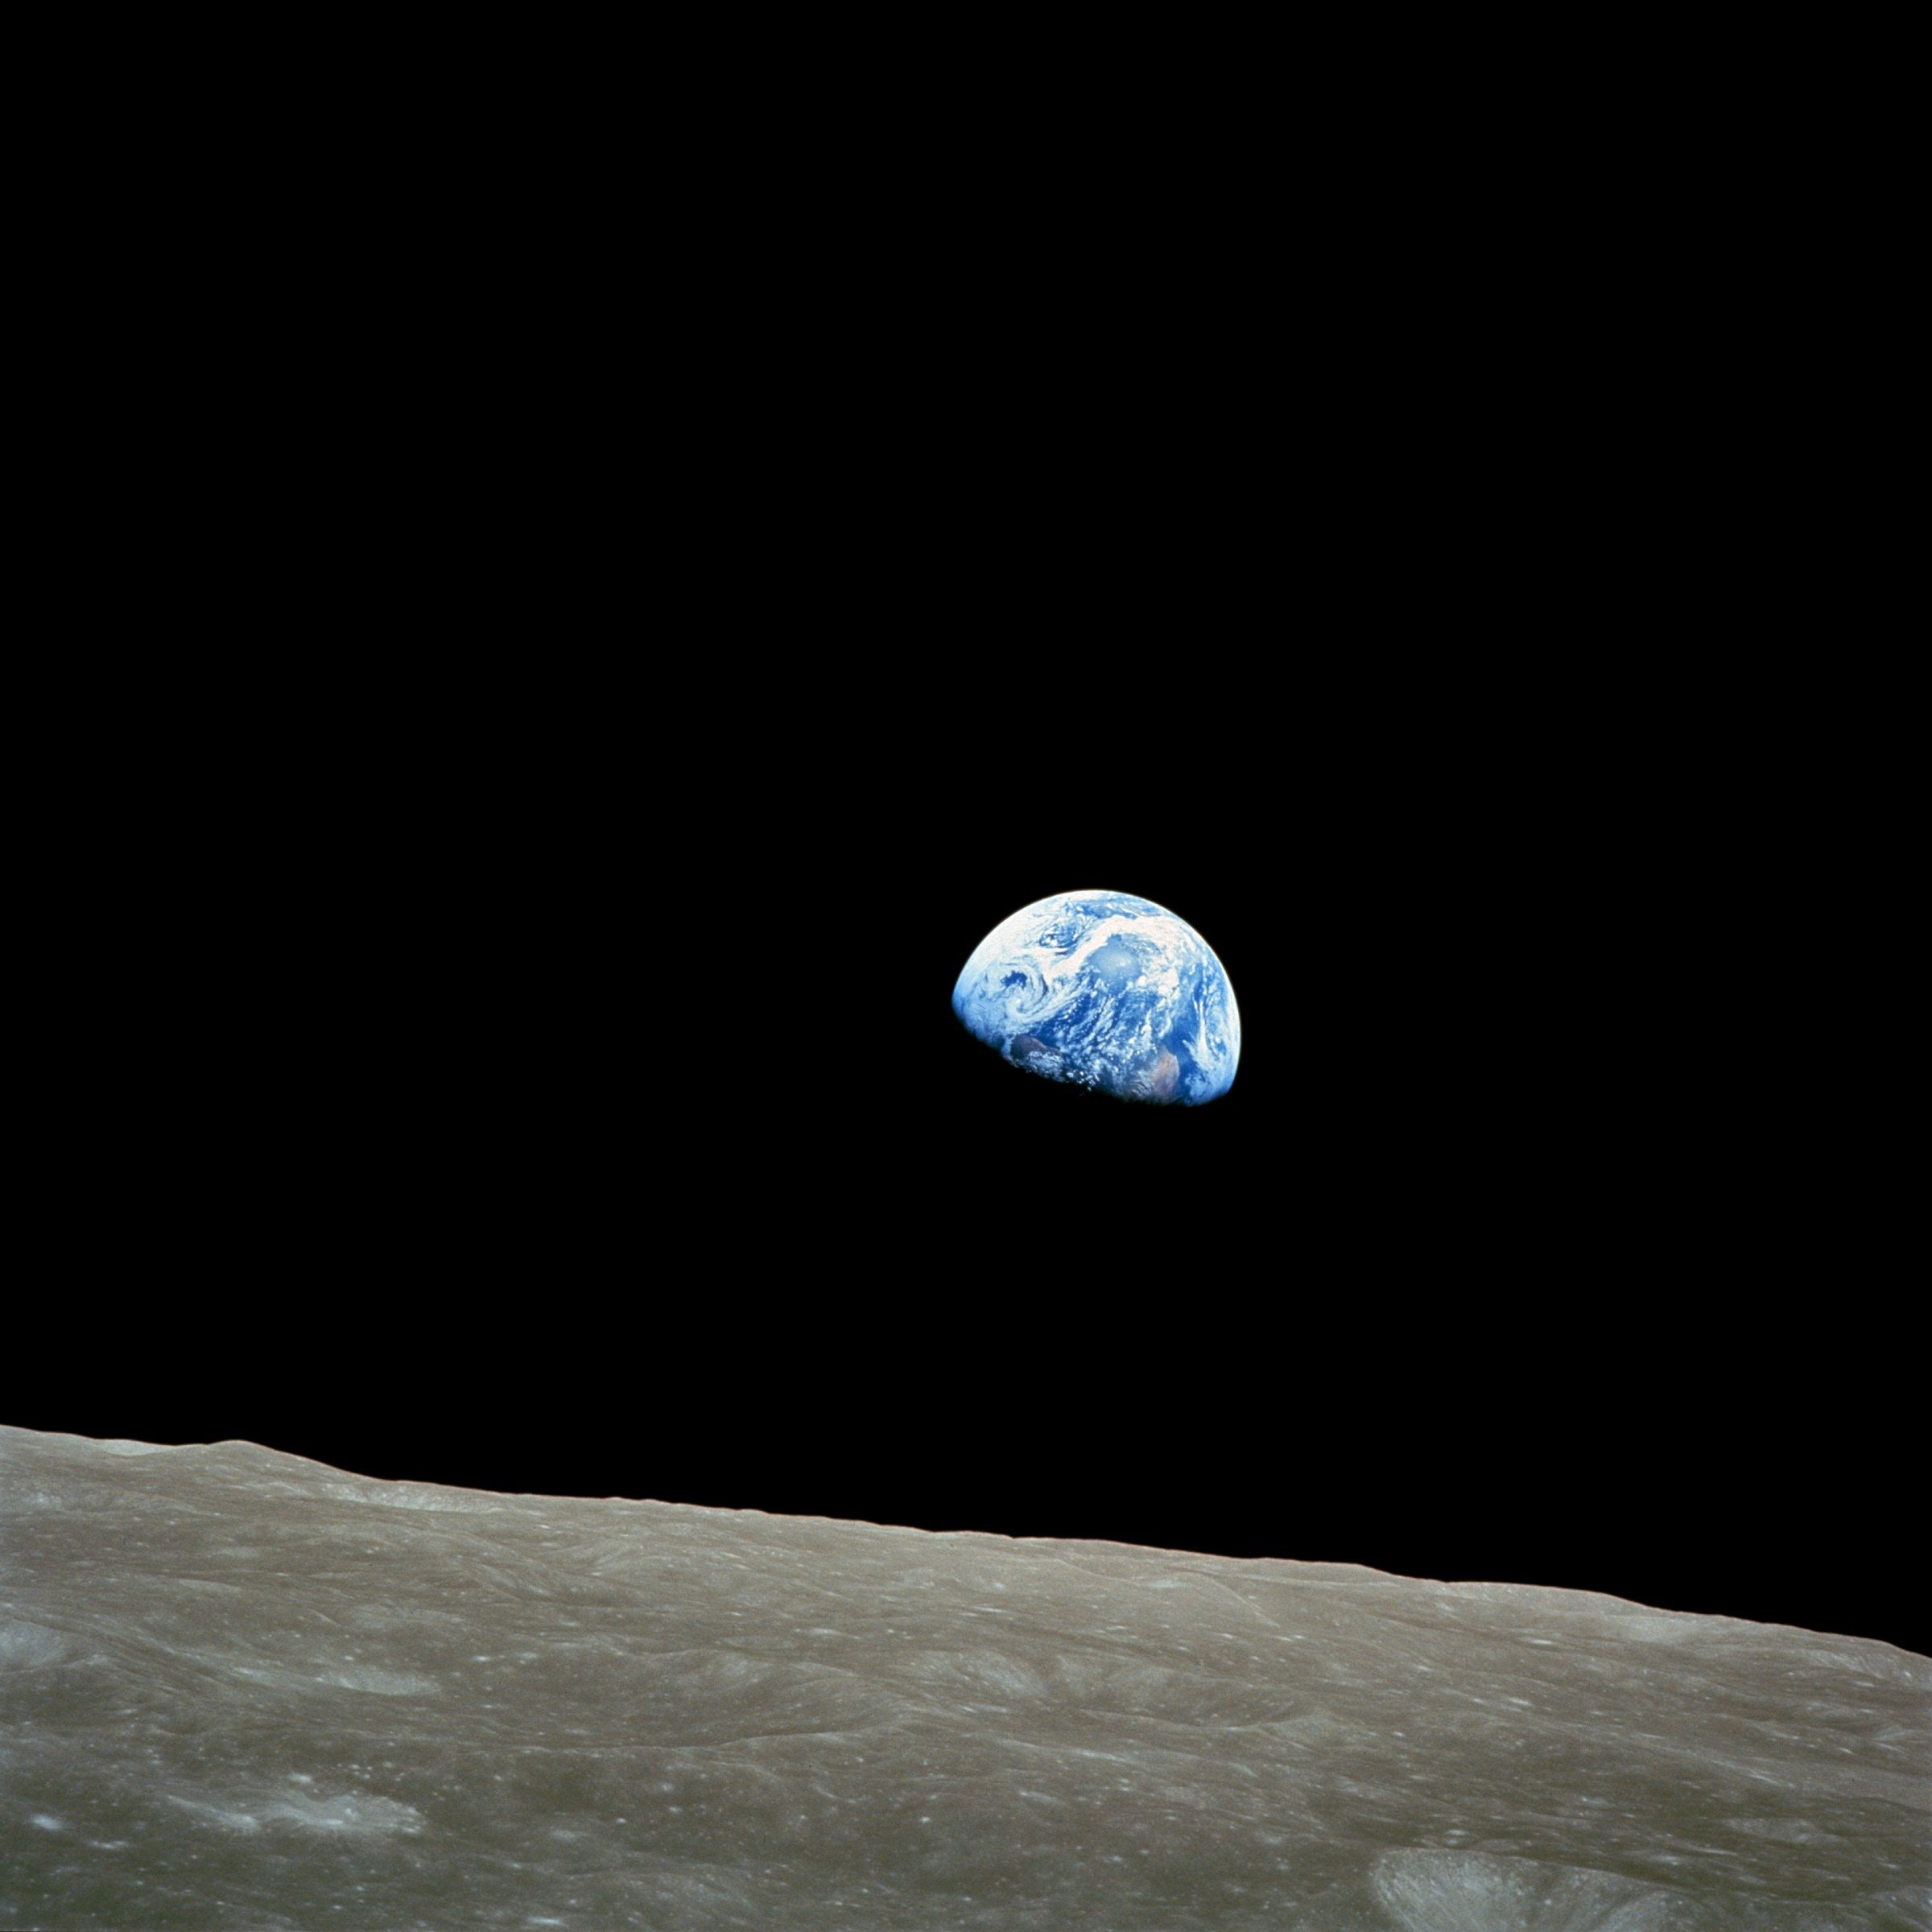
Keys: Astro Space
Article Title
Regular Headings: Orbitron
Body and other copy: Armata, Sans-Serif
Mobile Style Tiles
https://www.fontspace.com/help#license-3
https://scripts.sil.org/cms/scripts/page.php?site_id=nrsi&id=OFL
Article Title

