Slide 1

Identifying transport profiles of England and Wales
Philip Wilkinson
Cheyne Campbell
Alicja Kotarba
Nathanael Sheehan
Hussein Mahfouz
Notes:
Good evening, we are the Spider Cartographers, and we’re going to explain how we chose to analyse and visualize transportation in the UK….so buckle up
We will first begin with a presentation of the data side, which will be followed up by an exploration of the website

Slide 2
Purpose & AIMS
Purpose
Inform policy and the general public of the differences in transport usage to travel to work across England and Wales
Aims
Identify different transport profiles
Map the transport profiles and flows
Look at how demographic factors are related to these transport profiles
Notes:
Ok what was our purpose? We want to gain a better understanding of how transport is experienced throughout the UK. Such an understanding can be used to inform both policy and the general public.
As the UK shifts towards more sustainable modes of transport, our work aims to improve understanding of the current transportation ecosystem so as to better inform such a shift.
Therefore, the aims of our analysis and website was to be able to identify and group different transport profiles across England and Wales at the MSOA level. These groups could then be mapped, along with transport flows, to see the geographic distribution of transport usage.
We also demonstrate how we can use the identified profiles to see what demographic factors relate to the way in which we may use transport

Slide 3
Pre-processing
Collection: gather data to be used for analysis
Transformation: reduce skewness of the data
Standardisation: put variables in the same units and scale
Cleaning: get data in the correct format and units
Notes:
Before identifying these transport profiles, there were a few steps we had to go through: gathering the data, cleaning it, transforming it and standardizing it

Slide 4
Data
Public transport stops – Department of Transport (2014)
Car ownership – 2011 census
Commuter Flow Data – 2011 census
Travel Time Data – Quant Project CASA
Notes:
For this to work we required data on transportation usage across England and Wales. This was gathered at the MSOA level given that this was the lowest geographical scale for which all data was available. The datasets covered transport access nodes, car ownership, commuter flow data between MSOAs and travel time, the latter being a proxy for accessibility.

Slide 5
Cleaning
Group flows by origin MSOA and turn into percentages
Perform a point in polygon analysis for transportation access nodes
Turn commuting flows into average travel time data and accessibility measures
Notes:
The data that was received was in different formats and not all fit for our purpose. Some of the cleaning process we did included
Grouping the flows by origin MSOA and turning them into percentages so that they could be readily compared.
Conducting a point in polygon analysis was for transport access nodes to see how many transport access nodes were in each MSOA.
Weighing travel times between MSOAs by the flows that occur between them. This allowed us to get an average of actual commuting times by mode for each MSOA, which was used as an accessibility metric

Slide 6
Transformation and standardisation
Transformation
Log transformation
Standardisation
Z-score
Yeo-Johnson transformation
Range
Inter-Decile Range
Notes:
Once the data was cleaned, we had to transform and standardise it. Firstly transformation was used because extremes and outliers are likely influence cluster formation, especially for algorithms using distance-based metrics. Our variables were not skewed in the same degree or necessarily in the same direction, so we used two different transformation techniques
Clustering results will also be affected by differences in units, ranges and variations. Therefore the data was standardised after transformation. Again due to the different variable distributions, no single standardization technique fit our data best, so we used three in order to compare the result.
The resulting outputs were all pushed to a single csv.

Slide 7
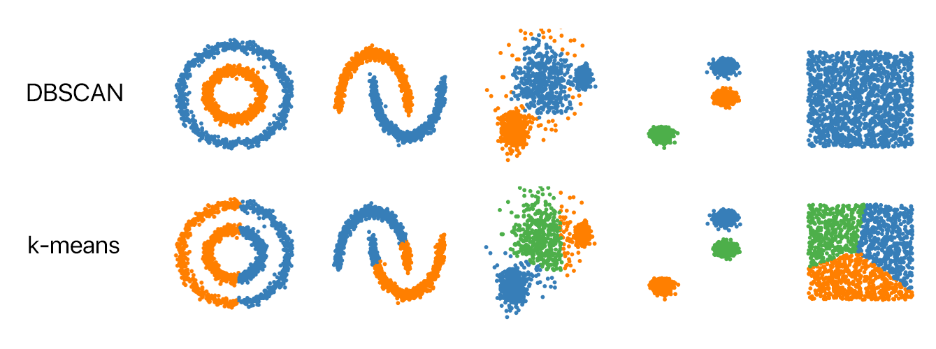
Clustering
Kmeans
Hierarchical (Agglomerative)
DBScan
Picture taken from: https://github.com/NSHipster/DBSCAN
Notes:
Once the data had been cleaned, transformed and standardised we could then perform the clustering process. To this end we could not explore the data before hand due to the high dimensionality of using many different factors. Therefore we performed three different clustering methodologies to be able to compare the results given the different underlying assumptions and the way the analysis is performed. This included Kmeans, hierarchical and DBScan clustering algorithms from the SKLearn package in Python.

Slide 8
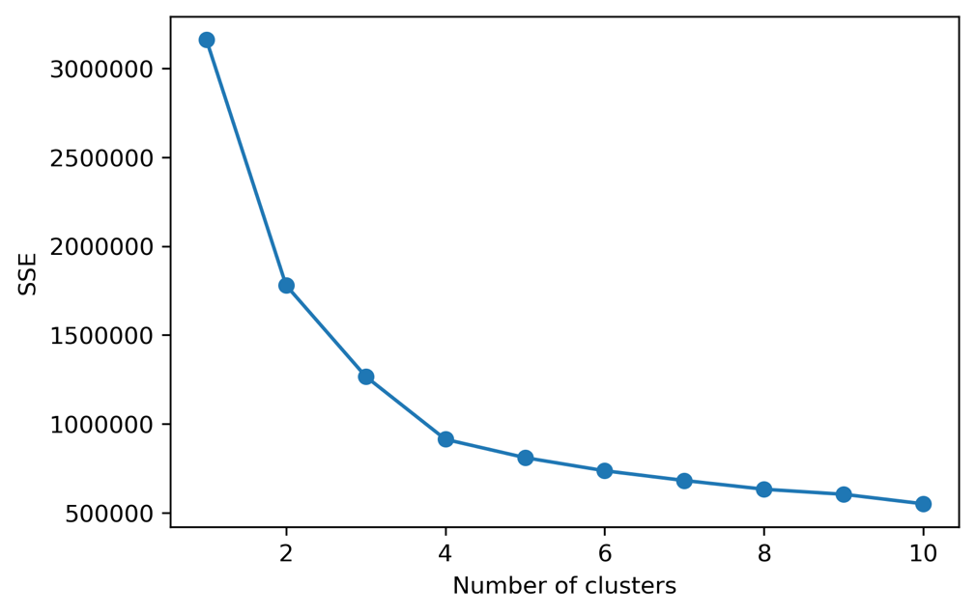
Clustering: Performance measures
Elbow plots
Silhouette scores
Figure X: elbow plot for log-idr-kmeans indicating that 4 clusters should be used
Notes:
In order to be able to measure the performance of each of these methodologies, and to get the correct number of clusters for both kmeans and hierarchical clustering, both elbow plots and silhouette scores were used. Both were used because they did not always agree and so a degree of judgement had to be used. The resulting outputs could then be evaluated.

Slide 9
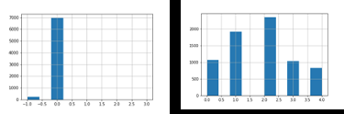
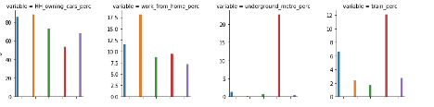
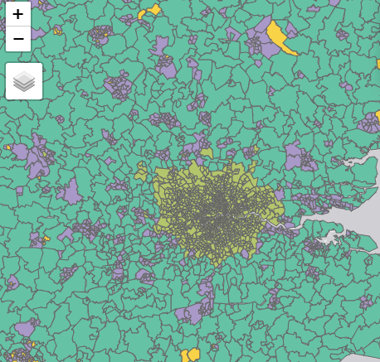
Clustering: Evaluating outputs
Notes:
In order to evaluate the clustering outputs and choose the one that best represented reality we first plotted the distribution of MSOAs assigned to each cluster. This was because a clustering output that assigned MSOAs to a single cluster could not be said to be representative and therefore potentially biased. The second step to interpret these was to explore the distribution of variables within each cluster to see whether there was meaningful differentiation and there was interpretability. Finally, we plotted the results to see whether the different cluster profiles matched with geographic reality.

Slide 10
CLUSTERING: CHOSEN WORKFLOW
log transformation
z-score standardization
k-means clustering
Notes:
The final workflow chosen was that following log transformation, z-score standardisation and then k-means clustering.

Slide 11
CLUSTERING: RESULTS
Profile 1: Good train accessibility but car dependant
Profile 2: Solely car dependant
Profile 3: Lack of accessibility across all Transport mode
Profile 4: High public transport and good accessibility
Profile 5: Car reliant but high public transport
Notes:
The result of this were five different transport profiles across England and Wales that made intuitive sense. This included:
Good train accessibility but car dependant
Solely car dependant
Lack of accessibility across all Transport mode
High public transport and good accessibility
Car reliant but high public transport
Which can all be seen on the map

Slide 12
Classification
Data Used
Net annual income (£)
Population Density
Unemployment Rate
Education Level
Household Ownership
Household Size
Health
Age
Religion
Employment
Female Employment
Full-time Employment
Notes:
To explore our final aim we ran a classification algorithm to see which demographic factors were related to each of the transport profiles. The data for this included income, population density, employment etc which previous literature had suggested was related to transport usage.

Slide 13

Classification
Random forest
100 trees with a max depth of 3 to aid interpretability
Accuracy shows that 65% of MSOAs are correctly classified by the model
Most important features: population per hectare and net annual income (£)
Interpretability could come from exploring the individual trees
Notes:
The algorithm used for this was random forest with 100 trees and a max depth of 3. This latter condition was to help aid interpretability when examining individual trees. The accuracy of this shows that given the training data, the algorithm was able to correctly predict 65% of the test MSOAs. The most important features for this were population per hectare and net annual income. We can begin to understand how the algorithm worked and performed by exploring individual decision trees.

Slide 14
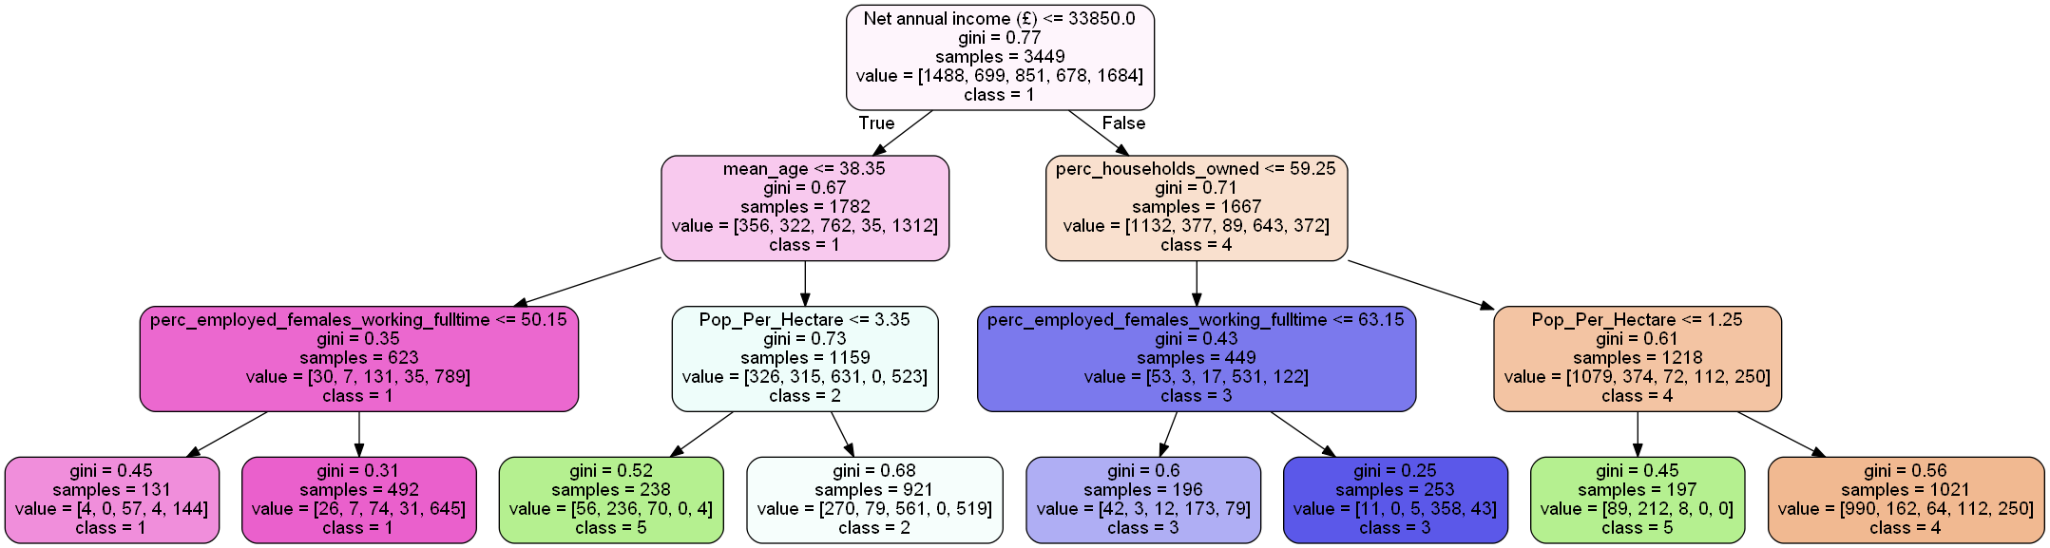
Classification RESULTS
Notes:
An example of one of the decision trees is provided here. As can be seen, cluster 4 with ‘high public transport and good accessibility ’ is suggested to have an income above £33,850 and the percentage of households owned is greater than 59.25%. While in contrast, cluster 1 ‘good train accessibility but still car dependent’ is associated with an income below £33,850 and a mean age less than 38.25.
If given more time and resources these trees would be explored more in depth to get a better understanding of the factors that are related to transport behaviour in the UK.
We will now hand over to the web team to explore the website.

