Slide 1
SLIDE TYPE — INTRO
WEEK 1
LOOP 1
PRODUCT/PROCESS
SDLC Pipeline + Epics & Stories
Today you'll see the full SDLC pipeline you'll build over the next 3 sessions, learn what makes AI work possible — Prompt, Harness, and Model — and build your first skill: epics-and-stories, the foundation everything downstream depends on.
Notes:
Welcome participants. Confirm everyone knows this is Week 1, Loop 1, Product/Process focus, before moving to check-in.

Slide 2
SLIDE TYPE — CHECK-IN
CHECK-IN
Before we start: when you use AI today, what exactly are you using? Where does the AI end and your tool begin?
Think about what the AI can and cannot do on your machine. Discussion prompt — instructor asks, participants answer live. Not rhetorical.
Notes:
This question sets up the Prompt/Harness/Model definition and surfaces assumptions participants bring into the program.

Slide 3
SLIDE TYPE — SESSION GOALS
Session Goals (1 of 2)
Goal 1: Understand Prompt, Harness, and Model as distinct concepts
PRODUCT/PROCESS
DEVELOPMENT
TESTING
The AI can only do what your tool allows. The harness determines what context it can see and produce.
The harness is the capability boundary — what files can be read, commands run, and how output reaches you.
The harness mediates everything — evaluation, output, and integration. Review skills work within its boundaries.
Goal 2: See the full SDLC pipeline and understand the 7 skeleton skills
PRODUCT/PROCESS
DEVELOPMENT
TESTING
You'll see demo PRD, Architecture, and UX outputs feeding your epics-and-stories skill.
You'll see where Plan and Code (Session 2) fit. The epics-and-stories output is your input.
You'll see where Review (Session 3) fits — the pipeline ends with your domain.
Notes:
Walk each goal and its per-role relevance; invite each role to react.

Slide 4
SLIDE TYPE — SESSION GOALS
Session Goals (2 of 2)
Goal 3: Build the epics-and-stories skill using RTCC and EDD
PRODUCT/PROCESS
DEVELOPMENT
TESTING
Your primary artifact. Add Context (WHY) and Constraints (HOW) to the RT-only skeleton, and iterate for 12 weeks.
Understanding how stories are generated makes you a better consumer of them when planning and coding.
Understanding how stories are generated tells you what to look for when reviewing implementations.
Goal 4: Write Evaluation Criteria (EC) before building the skill
PRODUCT/PROCESS
DEVELOPMENT
TESTING
Your EC define good output. NOT the same as Acceptance Criteria (AC) inside stories — EC grades the skill; AC is what a story must satisfy.
Seeing how EC is written teaches the discipline you'll apply to Plan and Code in Session 2.
This is the EC pattern you'll follow for your review skill in Session 3.
Notes:
Walk each goal and its per-role relevance; invite each role to react.

Slide 5
SLIDE TYPE — LECTURE
Prompt, Harness, Model
Prompt
Harness
Model
The instructions you give a model — what you want done, how, and what constraints it must follow.
The environment between you and the model — what files it reads, what commands it runs, how output reaches you. Claude Code, Devin, Copilot, and ChatGPT web are different harnesses.
The AI itself — generates text from training and prompt, but can't do anything the harness doesn't offer.
The harness is the capability boundary; the model is the intelligence; the prompt is the instruction.
Notes:
Teaching points and pacing live here, never on the slide face.

Slide 6
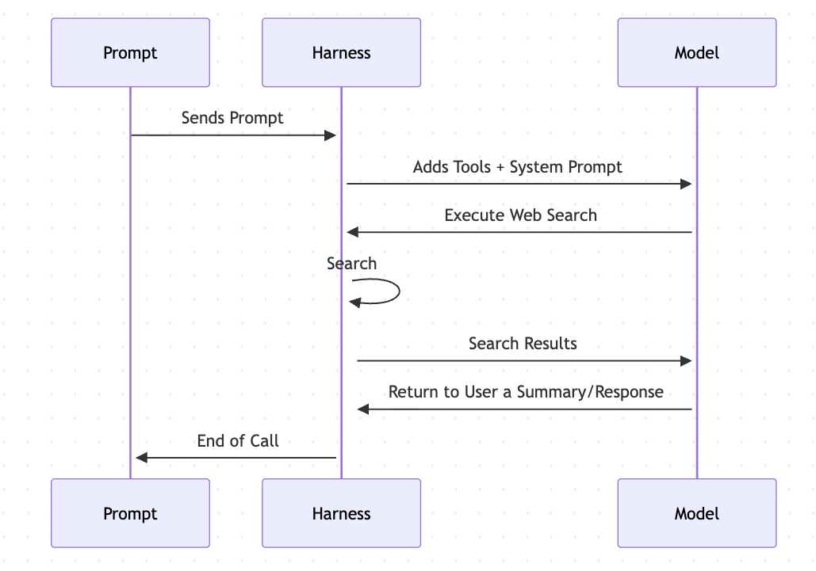
SLIDE TYPE — LECTURE
Prompt, Harness, Model
Notes:
Teaching points and pacing live here, never on the slide face.

Slide 7
SLIDE TYPE — LECTURE
Skills with disable-model-invocation: true
Everything we build in this program is a skill — a structured file using RTCC format that lives in the student workspace and can be invoked by anyone on the team.
We start every skill with disable-model-invocation: true . The skill only runs when you explicitly invoke it via slash command — the model will not auto-invoke it based on context.
Session 5 covers when and why to enable model invocation. We start with explicit invocation because you need to understand what your skill does before you trust the model to decide when to use it.
Notes:
Teaching points and pacing live here, never on the slide face.

Slide 8
SLIDE TYPE — LECTURE
The SDLC Pipeline
7 SDLC skeleton skills. Each is an RT-only stub — Role and Task defined, Context and Constraints intentionally empty. Sessions 1–3 build them out using EDD discipline.
1
create-prd → Product requirements
2
create-architecture → System architecture
3
create-ux → UX design guidance
4
create-epics-stories → Epics and stories breakdown — Session 1 builds this
5
plan-story → Story planning — Session 2 builds this
6
implement-story → Story implementation — Session 2 builds this
7
review-implementation → Implementation review — Session 3 builds this
Notes:
Teaching points and pacing live here, never on the slide face.

Slide 9
SLIDE TYPE — DEMO
Demo: RT-Only Skeleton Outputs
DESCRIPTION
The instructor runs the RT-only create-prd, create-architecture, and create-ux skeleton skills against a realistic feature ("Pantry Tracker PWA"). This shows what the pipeline produces when Context and Constraints are empty — plausible-looking output with gaps, wrong assumptions, and missing domain detail. Without Context and Constraints, the model guesses, and the guesses are wrong.
WHAT TO FOCUS ON
Notice what the model assumed that nobody told it to assume. Notice what's missing — domain detail, team standards, specific format requirements. These gaps are what Context and Constraints fix.
Notes:
Run the RT-only create-prd, create-architecture, and create-ux skeleton skills live against the Pantry Tracker PWA feature.

Slide 10
SLIDE TYPE — LECTURE
RTCC Prompt Structure
R — Role (WHO)
T — Task (WHAT)
Who is the model acting as — a specific, credentialed persona that shapes tone and default assumptions.
What should they do? Verb-first, unambiguous, the specific action to perform.
C — Context (WHY)
C — Constraints (HOW)
Why do we want this done? The intent behind the task — the purpose that shapes how the model interprets its role and task.
What data and rules does the model need? What must the output follow, or never do? What format is required?
WHO and WHAT define the contract. WHY gives it purpose. HOW provides the data and rules.
Notes:
Teaching points and pacing live here, never on the slide face.

Slide 11
SLIDE TYPE — LECTURE
EDD: Define Your Evaluation Criteria Before You Build
Before building the epics-and-stories skill, participants write their Evaluation Criteria (EC) — the quality bar for the skill's output. If you define EC after seeing the output, the model has already shaped your expectations. Writing EC first forces an honest definition of the target before you see whether it was hit.
Acceptance Criteria (AC)
Evaluation Criteria (EC)
The product artifact — what a story must satisfy. This is what the epics-and-stories skill produces inside each story.
The quality bar for the skill's output. This is what you write before building the skill.
Notes:
Teaching points and pacing live here, never on the slide face.

Slide 12
SLIDE TYPE — COMPARE/CONTRAST
Basic Prompting vs. DLP Completion
LEAVING BEHIND
ADOPTING
Ad-hoc prompts, never committed
→
Skills with RTCC structure, committed to repo
No way to know if changes improve or just change
→
EC written first; evaluation is non-negotiable
AI used occasionally, off-the-shelf
→
AI-assisted work is default behavior
No shared artifacts across the team
→
Skills are transferable, repeatable, shareable
"It seemed better" is the quality bar
→
Documented iteration cycles with evidence
Notes:
Land each row as a real behavior shift participants recognize in themselves.

Slide 13
SLIDE TYPE — DEMO
Demo: What Good Epics and Stories Look Like
DESCRIPTION
Three examples of epics and stories from the sample-stories/ directory: one good (pantry-inventory.md / shopping-list.md — clear AC, testable, edge cases covered), one vague (vague-pantry-stories.md — plausible-sounding but untestable, missing AC detail, no edge cases), and one AI-generated-without-care ( ai-generated-pantry-stories.md — polished-sounding but AC describe implementation detail like PostgreSQL/JWT/Redux, epics too large, edge cases missing). This shows what the epics-and-stories skill should produce and what it shouldn't, making the quality bar concrete before you build your own skill.
WHAT TO FOCUS ON
Notice the difference between "plausible-sounding but untestable" and "specific and testable." Watch for what AI gets wrong: stories without clear acceptance criteria, epics that are too large, missing edge cases.
Notes:
Show 3 examples from a realistic backlog: one good, one vague, one AI-generated-without-care.

Slide 14
SLIDE TYPE — EXERCISE
Lab 1: IDE Setup + Rules File
⏱ 20 MINUTES
Configure your harness of choice (M365 Copilot, Claude Code, Devin, GitHub Copilot, or equivalent)
Create a project directory you will use throughout this project. Install the skill if you are in a Harness that supports skills.
Verify the harness is running by running the Pantry Inventory Tracking file.
If you hit setup issues, pair with someone in your breakout room
YOU'LL KNOW WHEN YOU'RE DONE BECAUSE…
You have a running agentic IDE with a committed rules file that gives the model context about the student workspace.
STRETCH GOALS (FOR ADVANCED USERS) — OPTIONAL
Configure rules with specific TypeScript/React conventions for the pantry app — naming, ShadCN/Tailwind, Express routes, strict mode.
Notes:
Timing checkpoints, common blockers, and what to watch for while circulating.

Slide 15
SLIDE TYPE — EXERCISE
Lab 2: Write Evaluation Criteria for Your Epics-and-Stories Skill
⏱ 15 MINUTES
For your epics-and-stories skill: write 4–6 EC that define what good output looks like
Suggested starting EC: every story has clear Acceptance Criteria; stories are independently deliverable; 3–8 stories per epic; at least one story covers a failure or edge case; no story describes implementation detail
Remember: EC evaluates the skill's output quality. AC is what each story must satisfy. Don't confuse them.
Write your evaluation criteria into a file stored in your class directory.
YOU'LL KNOW WHEN YOU'RE DONE BECAUSE…
You have 4–6 written EC for your epics-and-stories skill, each specific and measurable, committed before building the skill.
Notes:
Timing checkpoints, common blockers, and what to watch for while circulating.

Slide 16
SLIDE TYPE — EXERCISE
Lab 3: Build the Epics-and-Stories Skill
⏱ 45 MINUTES
Open the create-epics-stories.skill.md (renamed SKILL.md during Lab 1 in some harnesses) skeleton — Role and Task defined, Context and Constraints empty
Using RTCC, fill in Context (WHY) and Constraints (HOW: story format, team standards, domain details)
The skill has disable-model-invocation: true — invoke it via slash command
The skill writes to stories.yaml in the workspace root — Session 2's plan-story skill reads it
Run the skill on the demo PRD/Architecture/UX outputs, then evaluate against your EC and commit
Compare the results to your EC, modify the prompt in a way that brings it closer to your skills, and then run Step 5 again.
YOU'LL KNOW WHEN YOU'RE DONE BECAUSE…
A committed skill with RTCC structure filled in, every instruction mapped to an EC, and output evaluated against your EC on the demo inputs.
STRETCH GOALS (FOR ADVANCED USERS) — OPTIONAL
Write down criteria data-elements that have specific bounds/constraints on them and what those constraints are.
Notes:
Timing checkpoints, common blockers, and what to watch for while circulating.

Slide 17
SLIDE TYPE — LECTURE
Baseline Self-Assessment
21
A–D
21–84
questions across 7 dimensions
answer choices, 1–4 points each
total score range
The AI Adoption Maturity Assessment is the Week 1 baseline. Not graded — the only instruction is honesty. The value of the baseline is comparison at Week 7 and Week 12, not accuracy at Week 1.
Notes:
Give participants time to answer honestly; this is not graded.

Slide 18
SLIDE TYPE — CLOSING
Before you go… (1 of 2)
Goal 1: Prompt, Harness, Model
Product/Process — Your epics-and-stories skill is a Prompt, running through your IDE Harness, powered by a Model. The harness limits what your skill can access.
Development — The harness is the capability boundary for everything you'll build — Plan, Code, evaluation scripts.
Testing — The harness mediates evaluation and output — your review skills will work within the same boundaries.
Goal 2: See the full SDLC pipeline
Product/Process — You've seen the 7 skeleton skills and where your epics-and-stories work fits — and why Context and Constraints matter.
Development — You've seen where Plan and Code fit. Your input is the epics-and-stories output.
Testing — You've seen where Review fits. The pipeline ends with your domain.
Notes:
Give participants a beat of silence after each reflection prompt before moving on.

Slide 19
SLIDE TYPE — CLOSING
Before you go… (2 of 2)
Goal 3: Build the epics-and-stories skill
Product/Process — You own this skill. You'll iterate on it for 12 weeks. It's your primary artifact.
Development — You've seen the skill format and RTCC structure. You'll apply the same format to Plan and Code in Session 2.
Testing — You've seen how stories are generated. You'll use this understanding when building review skills in Session 3.
Goal 4: Write EC before building
Product/Process — Your EC defines what good output looks like. You'll evaluate every iteration against it. EC evaluates the skill; AC is what each story must satisfy.
Development — You've practiced the EC-first discipline. You'll apply it to your Plan and Code skills next session.
Testing — You've seen the EC pattern. You'll use it when writing EC for your review skill in Session 3.
Notes:
Give participants a beat of silence after each reflection prompt before moving on.

