Slide 1
INFO 101 Social Networking Technologies
Intro to Queries

Slide 2
What’s a query?
It’s a question
About “stuff” in a “place” (Data in tables)
It says what you want
What place (tables)
What stuff (what rows in the tables and columns in the rows)
It says how to sort the answer
What order
What sub-order

Slide 3
The Usual questions
Who
What
Where
When
Why
The Query questions
What
Fields (attributes) do I want
Where
From what tables in the database
When
Under what conditions do I want the fields
How
How do I want the results sorted

Slide 4
How queries work
You make a query asking for
Fields
Tables
Conditions
Ordering
The database
Opens the tables you specified
Looks in each row of each table you asked for
Compares the row to the conditions you asked for
Gives you back
the fields you asked for
from the tables you asked for
But only the ones that meet the conditions you asked for
In the order you asked for

Slide 5
There’s a KEYWORD for each part of the query
Fields = Select
Tables = From
Conditions = Where
Ordering = Order By

Slide 6
Let’s query Facebook

Slide 7
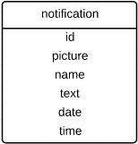
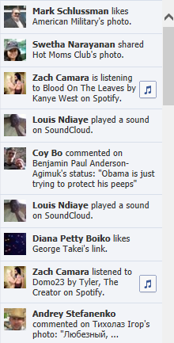
Simple
SELECT: picture, name, text
FROM: notification table
WHERE: person’s id is my friend
ORDER BY: date and time descending

Slide 8
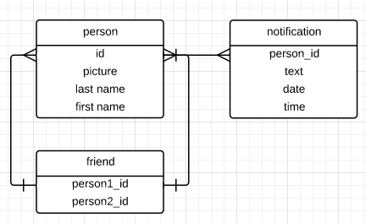
More realistic
SELECT: picture, name, text
FROM: notification + person + friend tables
WHERE: friend.person1_id or friend.person2_id is me BUT person is not me
ORDER BY: date and time descending

Slide 9
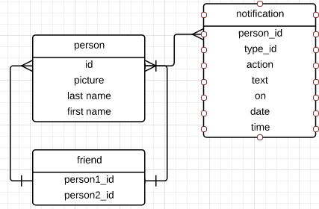
Even more realistic
SELECT: picture, name, text, action, on
FROM: notification + person + friend
WHERE: friend.person1_id or friend.person2_id is me BUT person is not me
ORDER BY: date and time descending

Slide 10
Original Work
Choose a level
Point from database to UI
Fill in the query
Show it to your TA

Slide 11
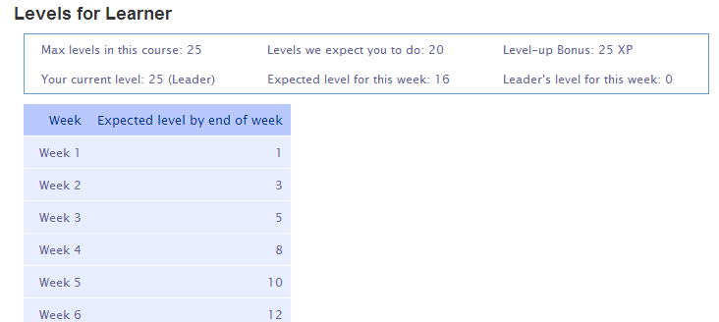
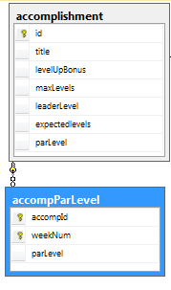
Original Work: Newbie
SELECT:
FROM:
WHERE:
ORDER BY:

Slide 12
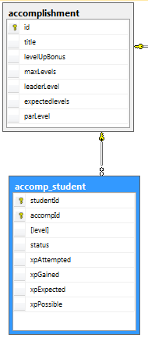
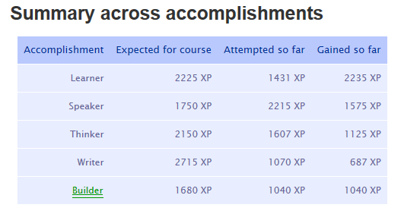
Original Work: Apprentice
SELECT:
FROM:
WHERE:
ORDER BY:

Slide 13
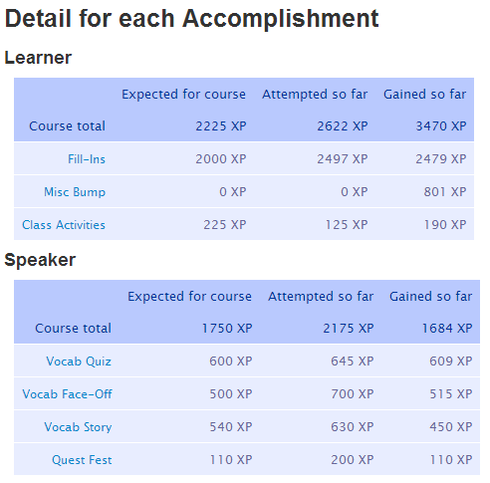
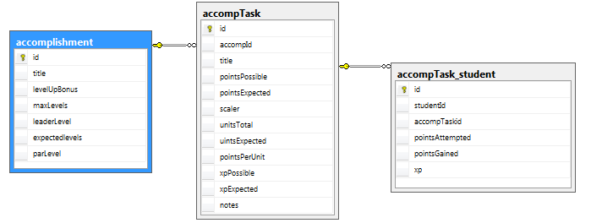
Original Work: Master
SELECT: title (accomp), title (task), xpExpected, pointsAttempted, pointsGained, scaler
FROM: accomplishment + accompTask + accompTask_student
WHERE: studentID matches loginID
ORDER BY:

