Slide 1
Enterprise risk management
INFO 312
AUTUMN 2016
UNIVERSITY OF WASHINGTON INFORMATION SCHOOL
WEEK #1
SEPTEMBER 28, 2015

Slide 2
Welcome
Office hours are Wednesdays and Fridays from 3:30-4:30pm in MGH330J or by special arrangement
Please review syllabus carefully for academic policies on
Academic Integrity and Proper Citations
Copyright
Privacy
Code of Conduct
Standard Manuscript Format (on home page)
Retrieving Canvas Assignments Feedback (home page)
All assignments should be submitted from Canvas. Announcements or discussions are also handled from Canvas.
Please set your alerts in Canvas for immediate notification of announcements.

Slide 3
Annie’s Background
15 years as co-founder and CEO of Delphi Computers
Lifetime member, American Institute of Entrepreneurs
Northwest Entrepreneur of the Year
Matrix Table Woman of Achievement
10 years divisional executive at Washington Mutual
Research & planning, technology architecture, crisis management
Technology audit & regulatory assurance, technology change management, continuity assurance, some aspects of InfoSec.
Loaned to Departments of Treasury and Homeland Security; also to the Financial Services Roundtable for national and international public-private sector work efforts.
6 years at ASA: research, consulting and publications
ASA News & Notes monthly; quarterly column for Risk Universe.
Pro bono work with the City of Seattle and FEMA.
Author, commentator, public speaker, full time UW Lecturer

Slide 4
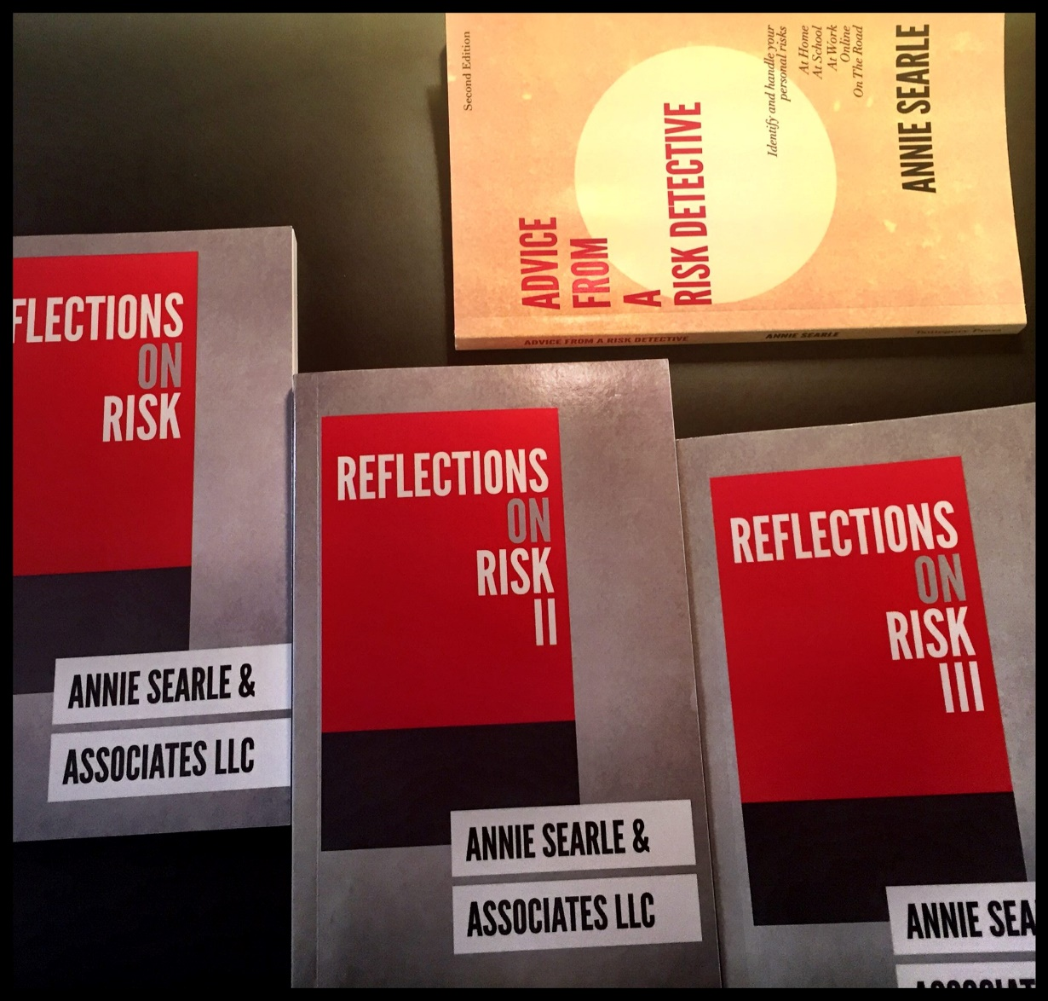
Books

Slide 5
My expectations
That you will be present in class and participate actively, without the use of electronic devices.
That you’ll monitor the world over the next 10 weeks and bring in examples of enterprise risk you see or read about.
That your papers will not simply be an assemblage of research you have done, but will have your own conclusions and recommendations as well.
That your final written presentation will be of such quality and so polished that it could be published.
That the work we do in this course could be passed along to public organizations or private sector companies.

Slide 6
Bloomberg MBA Job Skills Report
It’s interactive, so you can play with it.
Please note that, no matter which industry you pick, here are the less common, more desired skills:
Strategic thinking
Creative problem solving
Leadership skills
Communications skills
Here are the more common, more desired skills
Analytical thinking
Ability to work collaboratively
Motivation/drive
We will be working on all those skills in this course.

Slide 7
Class format
Mondays and Wednesdays will each have their own rhythm.
Mondays -- Lecture/discussion, during which I expect to be asked questions and engage in discussion with you. The lecture may or may not be focused primarily on the reading assignments. Its PowerPoint will be posted after class on the website. This is also the day we will hear presentations from groups in the class on a current or historic risk event.
Wednesdays – A UW risk leader is our guest each week. You read about them before class and submit at least one question about their work by Wednesday noon. Where possible, speaker aligns to topics being discussed that week. We will take a 10 minute break after the speaker, then discuss readings for week.

Slide 8
Weekly assignments
There are readings each week.
At least one group will present each week on Mondays, starting in Week #3. We’ll draw out of a hat next Monday.
You need to submit a question each week that you are ready to ask the guest speaker. Due by Wednesday noon.
We’ll have pop quizzes during the course that will be multiple choice. They’ll be graded by the person sitting to your right. If the grade is incorrect, the grader will also take a hit.
Also:
Review the writing assignments carefully and ask questions if not clear. There is also an oral presentation based on your final long paper.
Please note Wikipedia not a valid source for research. Go to the footnotes in Wikipedia to find and cite actual source material.

Slide 9
UW Guest Speakers
October 5 Kirk Bailey, UW Chief of Information Security
October 12 Chuck Benson, Assistant Director for IT, UW Facilities Services
October 19 Sue Clausen, Chief Compliance Officer, UW Medicine and Associate Vice President Medical Affairs, UW
November 2 Steven Charvet, Director of UW Emergency Management
November 9 Jude Van Buren, Director of UW Environmental Health & Safety
November 16 Vikram Jandhyala, Prof. Engineering, UW Vice President for Innovation Strategy
November 23 Dr. John Vinson, UW Chief of Police

Slide 10
Lectures and Discussion
The lectures make sense if you have read the assignment in advance of the class.
The material is often dense. Leave yourself enough time to do the readings.
Majority of your grade for “participation” comes from being prepared to discuss issues when called upon.
Don’t forget to sign in each week. Clipboard near door.
You’ll form into teams next Monday to pick the topic and date for your class presentation.

Slide 11
Group Presentations
Your group will create a 15 minute presentation on one of these current or historic events within the time constraints.
Shadow Brokers NSA Tools Leak (2016)
Panama Papers Data Leak (2016)
Wells Fargo $185 million fraud fine (2016)
Japanese earthquake/tsunami/nuclear reactor (2011)
U.S. Office of Personnel Management data breach (2015)
Volkswagen's Emissions Scandal (2016)
Destruction of the World Trade Center (9/11/2011)

Slide 12
introductions
Your name
Your major
What would you like to be doing in five years?

Slide 13
What is an “enterprise?”
Another name would be “business” or “corporation” when we are talking about the private sector, and companies like Starbucks, Nordstrom, Microsoft, Target, or Volkswagen.
When we are talking about government agencies or non-profit institutions, we could be talking about the Department of Homeland Security or the University of Washington or the Gates Foundation.
Such enterprises are built out to include basic functions that you would find inside any business once it started to grow into a large company. A good example is the ERM Report from the University of Washington that you read this week, that provides a context for all the guest speakers we’ll hear from.

Slide 14
What’s inside an enterprise?
Companies like Starbucks or even the UW itself have developed back end structures to create “enterprise” level support that may be required to do business or for legal or regulatory reasons. They include:
Finance – accounting for both expense and revenue and for providing true reports of the financial condition of a business to their regulators. Human Resources – managing people front to end: “recruitment, orientation, job descriptions, job grading, payroll, compensation plans, benefit plans, performance management programs, succession plans, employment-related policies and employment verification” [ERM: Straight to Point, p.57]
Information Technology – external and internal face of the enterprise, carrying significant amounts of risk. [ERM: Straight to Point, p. 79]
Marketing – “advertising, merchandising, sales promotions, website and social media, special events, and all marketing materials.” [p.68]

Slide 15
What type of enterprises have you worked in?

Slide 16
“Against the Gods:” Quick history of risk
“By showing the world how to understand risk, measure it,, and weigh its consequences, they converted risk-taking into one of the prime catalysts that drives modern Western society.” (1)
“The word ‘risk’ derives from the early Italian risicare, which means “to dare.” In this sense, risk is a choice rather than a fate.” (8)
Before 1200:
“Earliest known work in Arabic arithmetic was written by al-Khowarizmi, a mathematician who lived around 825, some 400 years before Fibonacci.”
Established “rules for adding, subtracting, multiplying and dividing with the new Hindu numerals.” Algorithms = rules for computing.
Omar Khayyam (1050-1130) “used the new numbering system to develop a language of calculation that…served as a basis for the more complicated language of algebra.”

Slide 17
Why should we care about risk & inquiry?
“The ability to define what may happen in the future and to choose among alternatives lies at the heart of contemporary societies. Risk management guides us over a vast range of decision-making, from allocating wealth to safeguarding public health, from waging war to planning a family, from paying insurance premiums to wearing a seatbelt, from planting corn to marketing cornflakes.” (2)
“The revolutionary idea that defines the boundary between modern times and the past is the mastery of risk: the notion that the future is more than a whim of the gods and that men and women are not passive before nature.” (1)

Slide 18
“They’re not asking enough questions.”
Warren Berger suggests that employers are looking for more curious employees in his NY Times opinion piece.
Organize inquiry around what we do not know.
Why does the problem exist?
How could it be handled?
Employees may worry that they will appear ignorant or slow things down.
Encouraging a culture of question askers may be quite hard on senior management.
But this quarter we’ll have 7 UW senior risk execs answering your questions.
We want them to be good questions. (Examples?)

Slide 19
What is risk?

Slide 20


What is Risk?
“The effect of uncertainty on objectives.“ (ISO)
Risks can be positive or negative events, actions, threats, gaps or variability that creates uncertainty for business or institutional objectives.
Risk management is the architecture for managing risks.
The risk management process is the active use of the architecture.

Slide 21

Operational Risk Definition
Operational risk defined by Basel financial consortium in 2001 as “the risk of direct or indirect loss resulting from inadequate or failed internal processes, people and systems or from external events.”
First mandate for leaders to adopt sound risk management and disclosure practices to shareholders came after Enron and Worldcom debacles via Sarbanes-Oxley Act in 2002.
Publicly traded companies must report quarterly to the Securities & Exchange Commission (SEC) and list significant risks they are managing or failures they are correcting.
Current examples in the news?

Slide 22
Manage Risk Five Ways
Tolerate
Treat
Transfer
Terminate
Take Advantage

Slide 23


Enterprise = Risk to strategic objectives or multiple levels.
Program = Group of related strategic projects managed together to obtain benefits and control. (PMI).
Project = Specific to individual projects.
Activity = Coordinated, ongoing actions that support programs or projects.
Risk lies in stratified levels inside a company.

Slide 24
Most critical infrastructure sectors use this model.
Strategic Objectives
Asset
Management
Risk Management
Performance Management
Risk management
as an enabler.

Slide 25
Operational risk failures = one or more of these areas = financial loss is probable
People – human error, failure to follow procedures
Process – inadequate or failed processes and procedures
Systems – inadequate systems or breakdown of automated systems, especially in technology infrastructure
External – Mother Nature, critical dependencies on other sectors, vendors
We’re also going to look at legal and reputation risk in this class.
Enterprise risk management sets tone from the top via the risk control environment, then it’s a cycle:
Actively manage (identify, assess, mitigate)
Monitor on ongoing basis
Disclose issues or control failures or gaps (39)

Slide 26
example: JPMorgan Chase
The London Whale Event of 2012

Slide 27
JPMorgan Chase: 2012
JPMC had no treasurer in place to oversee the Chief Investment Office for five months…previous treasurer had expressed concern about size of the bets (NYT, FT, Bloomberg)
Chief Investment Officer contracted Lyme Disease and was out of office on sick leave – in house fighting in her absence (NYT)
Irvin Goldman, who was installed as chief risk officer for the Chief Investment Office this past February before being relieved of his duties this month, suffered between $10 million and $15 million in losses on one bet in 2008 in his prior role as a trader for the bank, these people said. J.P. Morgan halted Mr. Goldman's trading in late 2008 and put him on leave when it learned that regulators were separately probing trading practices at Cantor Fitzgerald, where Mr. Goldman had served as an executive until late 2007, the people said (WSJ, 2013).
Large gaps in oversight of critical risk areas.

Slide 28
JPMorgan Chase 2012, continued
It caused a crisis of confidence in CEO Jamie Dimon, which caused the stock to fluctuate.
It shook the banking sector as well as regulators, since JPMC has been opposed to additional regulation.
It shows dramatically how operational risk can burst into flames, particularly when executives (Dimon, Ina Drew) take their eyes off operations – she moved up to the 42nd floor, a good metaphor for what happened.
As of the end of 2013, JPMC had $6.2 billion loss and paid $920 million in penalties.
Regulators continue to find other problems to fine or settle with the bank on, even though JPMC has deployed new tools.
Establish and communicate risk management principles and objectives
Approve an Operational Risk Management (ORM) structure with policies, procedure and governance
“Operational risk is the risk of loss resulting from inadequate or failed processes or systems, human factors, or external events.”
JPMorgan Chase & Co., Annual Report, 2008, p. 117
Set risk appetite – what will the company not do is as important as what it will do

Slide 29
Why do we care about how large firms like banks behave?
Our government handles general safety & security, including public health and emergency services
Expectation = that government will ensure that critical infrastructure works via oversight or regulation
But private sector owns or controls 85% of the critical infrastructure, therein the conundrum
Electricity, natural gas, oil
Water, waste, sanitation
Telecom & IT
Shelter and food
Financial services

Slide 30
Don’t forget to do the readings for next week
Best if you do the readings over the weekend so that you are ready on Monday to discuss them.
Both the UW ERM Report and the 2014 Report of the Chief Information Security Officer will be relevant to our Monday discussion, even though Kirk Bailey will not appear until Wednesday.
I’ll set up more context for understanding both the enterprise and where risk management can fit within it next week.
In the meantime, keep an eye on the news since we’ll reference current events in our discussions.

Slide 31
Questions?
asearle@uw.edu
@anniesearle = Twitter
https://www.facebook.com/Annie-Searle-Associates-LLC-160459733992530/ = Facebook business page

