Slide 2

InDesign Content Solution Proposal
Nathan Wheeler
August 31, 2015

Slide 3


The Problem
Extreme market demands.
Massive inefficiencies in our project lifecycle.
[1]
Flats Finalized
[3]
Copydeck Finalized
[5]
Copydeck Translation (If Applicable)
[7]
CMS Manually Creates Mapping Document
[2]
Flats Legally Approved
[4]
Copydeck Legally Approved
[9]
CMS Manually Creates Content IDs
[10]
CMS manually attaches Content to Jobs and Deploys into Test Environment
[8]
CMS Performs Design Development Review
Too Long!

Slide 4


Content Implementation Process (Before and After InDesign Automation)
Current Process
Creative Team
Legal/Business
Copywriter& Creative
Legal
Translator
CMS
CMS
CMS
CMS
Flats Finalized
Copydeck Legally Approved
Copydeck Finalized
Flats Legally Approved
Copydeck Translation
CMS Manually Creates Mapping Document
CMS Performs Design Development Review
CMS Manually Creates Content IDs
CMS Manually Attaches Content to Jobs and Deploys into Test Environment
Risks Associated with Current Process
1. Misunderstanding of Requirements 2. Versioning and Quality Control Issues 3. Compounding Effects of Late Deliverables
4. Massive Potential for User Error Throughout 5. Incompatible with Agile Methodologies
Future Process
Creative Team/Translator Business
Creative Team/Translator Business / Legal
InDesign Document Finalized
CMS Exports Content from InDesign and Uploads it to TeamSite
InDesign Document Legally Approved
CMS
Execute XML
Execute XML
Benefits to NEW Process
1. Drastically Reduced Error Rate 2. Substantially Increased Efficiency 3. Faster Legal Approval for Copy
4. Gxt Is Freed Up for More Complex Tasks. 5. Less GxT members needed for projects 6. Auditable Repository of Past Projects
7. Ties In With Citi’s API Strategy

Slide 5


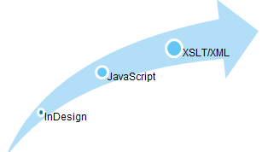
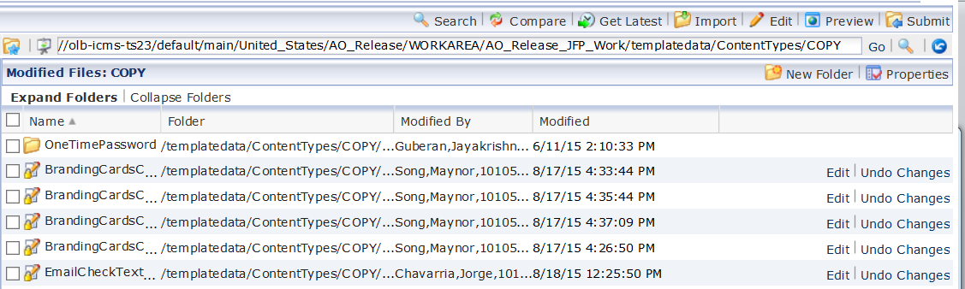
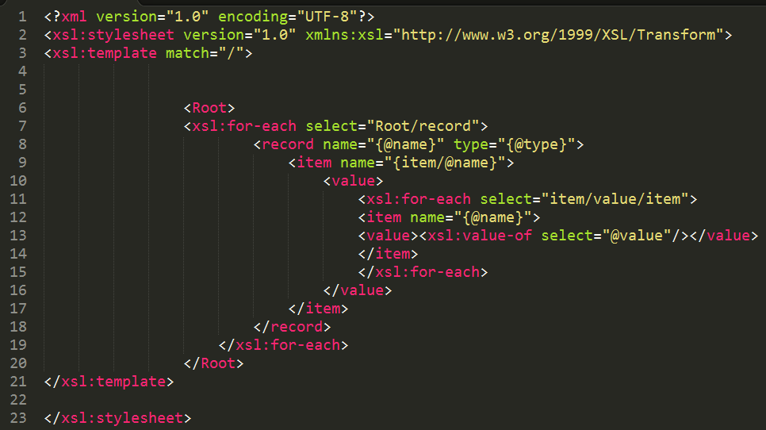
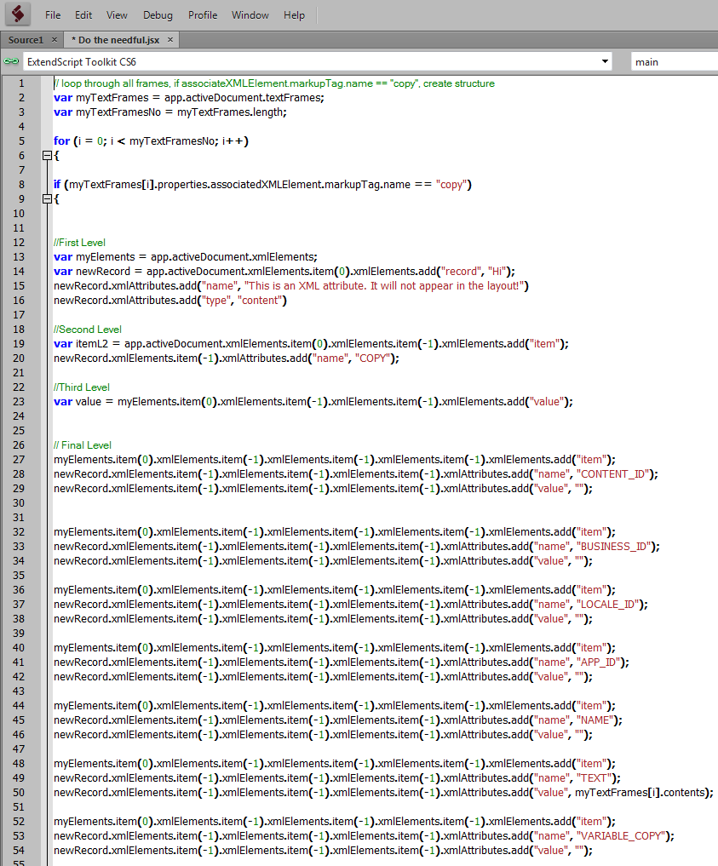

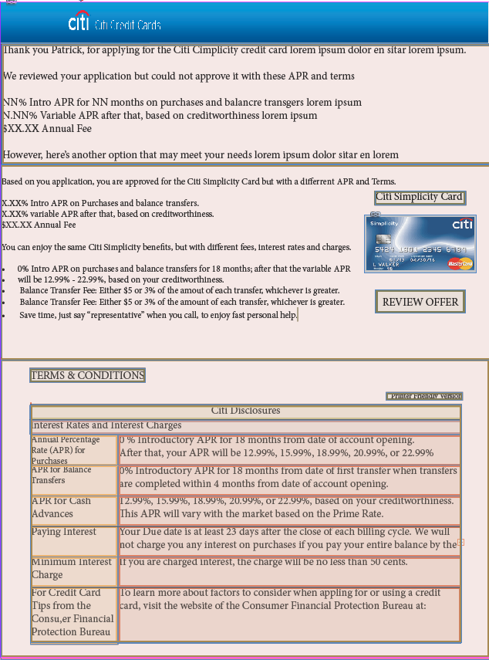

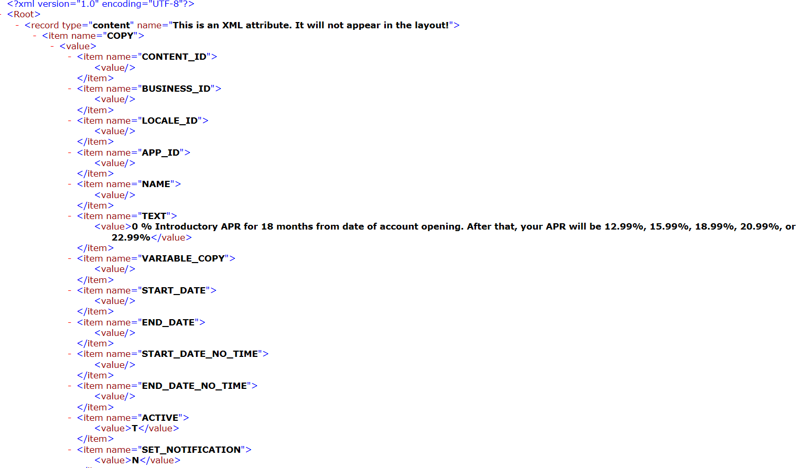
Our Solution
(Automatic)
(Minimal Content Tagging)
(Automatic)

Slide 6



Road to Success
Obtain additional licenses and training for InDesign.
Continue to bolster support from the creative team.
Build upon the current functional prototype, integrating it seamlessly with our current CMS.
It has been proposed to use InDesign on the following projects in July:
Projects | CMS | FEDS
C-0861109 -- EMV Chip Migration -- for business card | Yes | No
C-0952901 -- OCS-AO Express Request Expansion Phase 2 | Yes | Yes
C-0870821 -- Real-Time CoBrand Rewards | Yes | No
C-0918909 -- Special Purpose Lending Offer Enhancements | Yes | Yes

