Slide 1
COMP 232– Project Presentation
Nate Tsang
4/10/2019

Slide 2
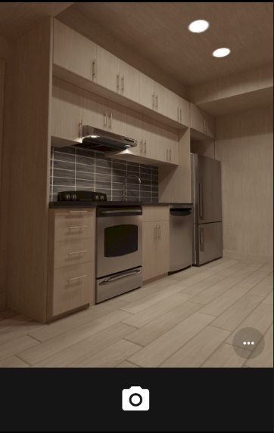
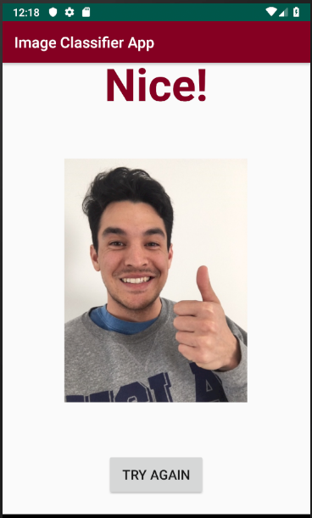
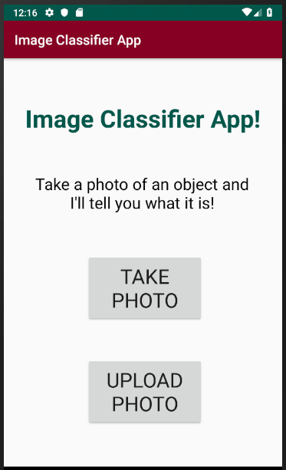
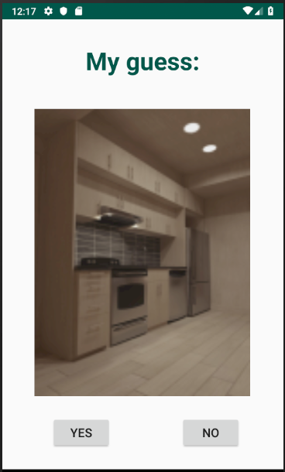
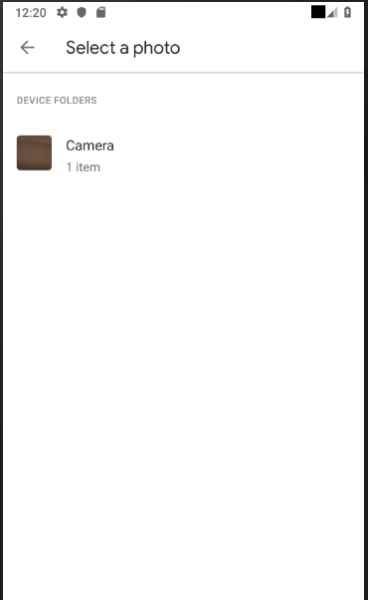
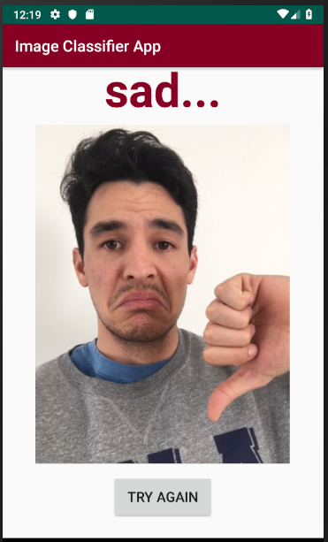
Image Classifier App
TBC
YesActivity.java
SecondActivity.java
MainActivity.java
NoActivity.java

Slide 3
To do
Try Camera or Camera2 API
Do I even need it?
Save image AND show thumbnail
How to pass in image pixels to algorithm?
Write algo in Tensorflow Lite (java)
Convert python to .pb format to feed directly into Android Studio
Get classification to work

Slide 4
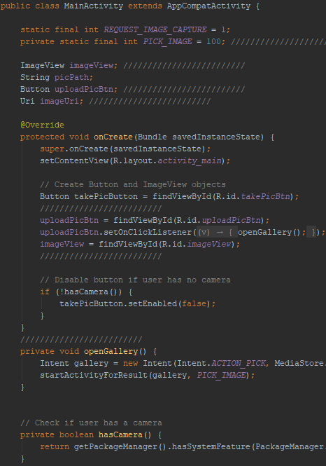
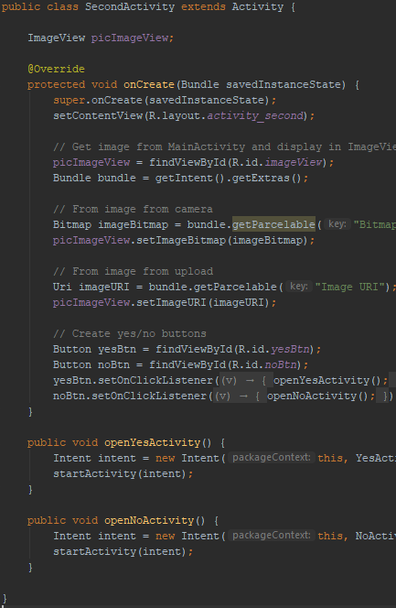
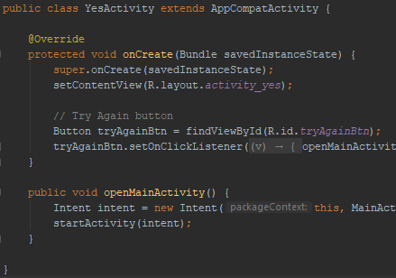
Code snapshots

