Slide 1
Nature paper structure

Slide 2
General structure
Abstract
Introduction + “experiment” description (doesn’t usually have a title it seems)
Discuss data and how model results look like data
Clonal expansions decelerate with age
Variability between individual clones, even for identical mutations

Slide 3
Introduction + “experiment” description
What is CH
Describe current knowledge concerning it:
Prevalence in elderly
Relation to CV afflictions
Understanding of clone dynamics
Describe open questions relating to dynamics
Why is there so much inter-individual variability?
Do the dynamics change with age?
Introduce model of clone competition:
Fit clones arise stochastically
Total population size is fixed -> clones compete
Explain that mathematical prediction for a single(!) advantaged clone in a fixed-size population describes a logistic growth function: fast (exponential) initial growth with a deceleration as the clone approaches fixation
Maybe put equation? (Refer to methods for derivation, etc.)
Maybe figure or box to explain model?
Stochastic trajectories in conceptual figure?

Slide 4
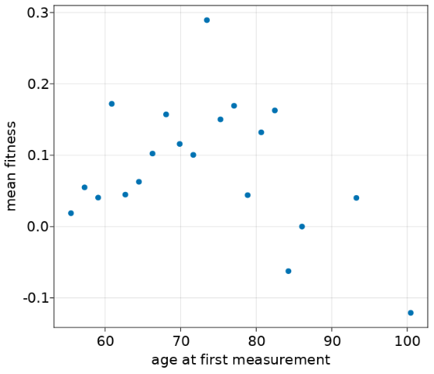
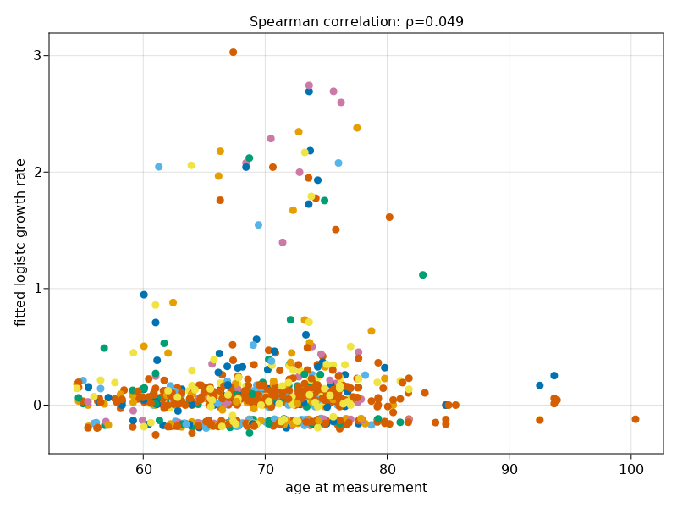
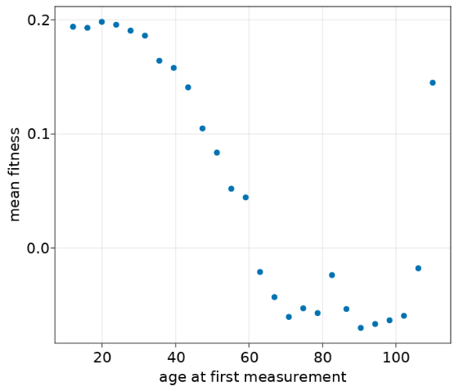
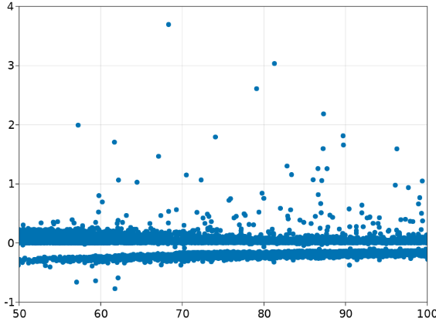
Clone expansion rate decreases with age under clonal competition
Explain that mathematical prediction for a single(!) advantaged clone in a fixed-size population describes a logistic growth function: fast (exponential) initial growth with a deceleration as the clone approaches fixation.
Show data trajectories fitted to logistic growth
Show different cases: Increase, decrease, etc.
Note that in individuals expansion appears to decelerate:
Show Fabre data with decreasing logistic fitness
Discuss shape of mean fitness here or later?
Show how competition would decelerate clones compared to logistic growth:
Illustrate with equation
Show plot of logistic fits to decelerating clones
Talk about “negative selection”/decreasing clones
Change in fitness landscape!
These can’t occur without competition
Summary statistics:
Variance of first vs second hit
Timing of second hit
Variance changes over time

Slide 5
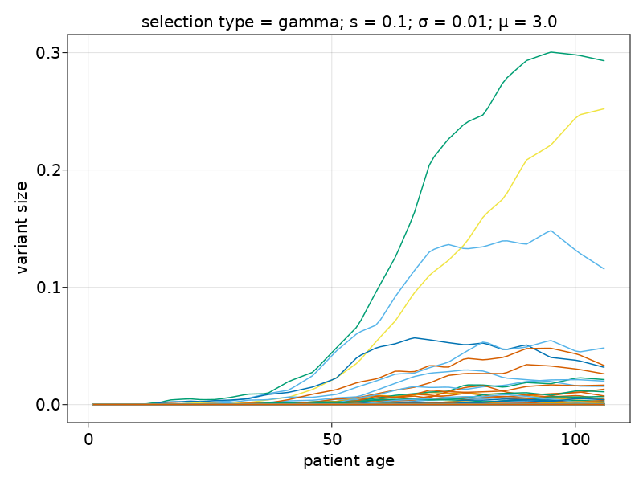
Randomness in arrival times causes inter-patient variability
Explain how individual clone fitness (and therefore growth trajectory) depends on environment, in particular on existence and size of other clones. Stochasticity of clone arrival times thus causes distinct environments for different individuals. This leads to high variability, even for identical mutations.
Illustrate this with figure of:
Individual trajectories
Comparison of inter-patient growth rates? Observed fitness distribution?
Talk about effect of fitness distribution: Causes clones decreasing clones as well.
(perhaps worth noting that such inter-patient variability can also arise from more purely biological sources, e.g. chronic inflammation, etc.
Decreasing clones
high fitness clone
Late and/or low-fitness clones

Slide 6
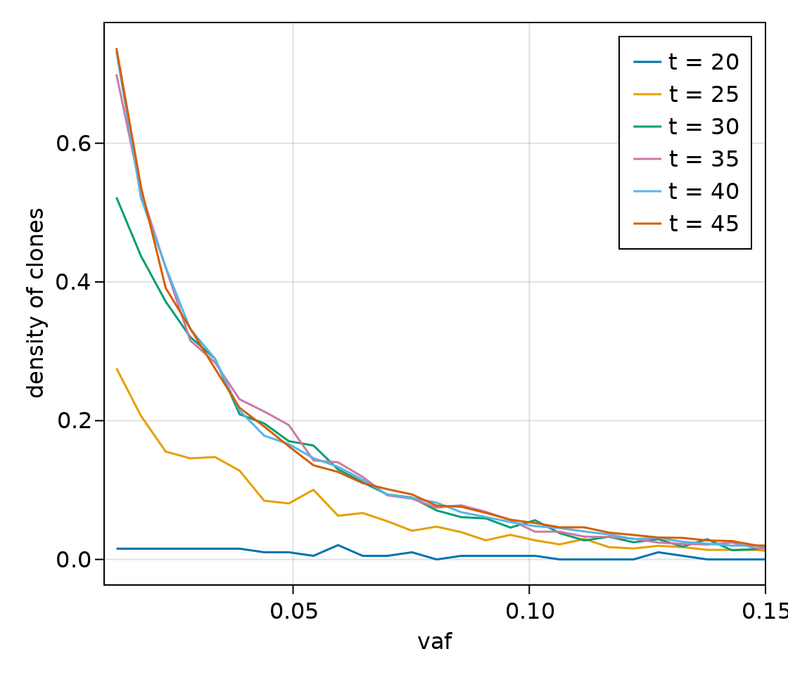
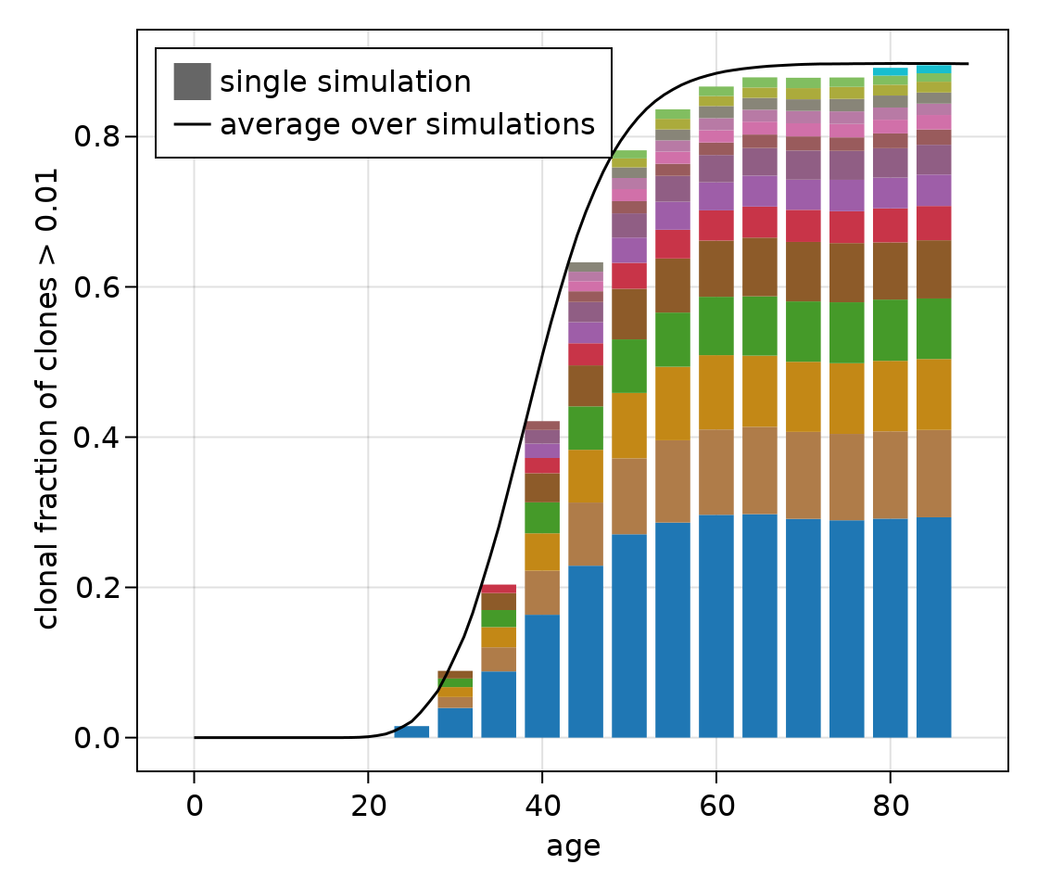
Clone size distributions
Size distribution is heavily tailed: Large abundance of “low-fitness” clones, much fewer high-fitness clones.
Because high-fitness clones have a lower chance of occurring, we tend to see them later in life.
By late life: large number of low-fitness “invisible clones” contribute strongly to competition induced slowdown effect.

