Slide 1
A Database Management System for Banking
Team 11
Joshua Rivas-Ferreira, Nathaniel Navarro, Quan Nguyen, Sheng Rao, Spencer Durell

Slide 2
Members & Roles
Joshua Rivas-Ferreira - Branches & ATMs tables and queries, GUI
Nathaniel Navarro - Transactions & LoanPayments tables and queries
Quan Nguyen - Customer & Owns tables and queries
Sheng Rao - Employee, Teller, & Manager tables and queries
Spencer Durell - Accounts, Cards, & Loans tables and queries

Slide 3
Overview
Banking database for an organization to serve the banking needs of its customers
Tracks important metrics in relation to consumer banking
Account & Customer information
Branch information
Employee information
Transaction information

Slide 4
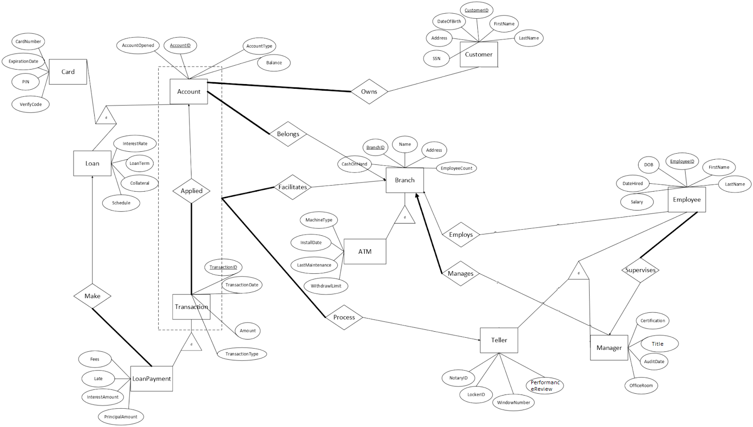
ER Diagram
Entities - Rectangles
Attributes - Ovals
Relationships - Diamonds
One - Arrow
Many - No arrow
Participation
Total - Thick line
Partial - Thin line
Aggregation - Dashed Line
Disjoint - Triangle w/ “d”

Slide 5
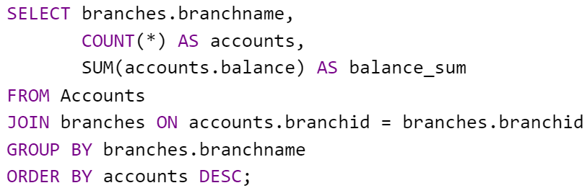
Query/View 1: High Average Balance Branches
Purpose: Identify branches with higher average account balance than average across all branches.
Compares each branch’s average account balance to overall average balance.
Utilizes a subquery to calculate overall average.
Highlights high-performing branches, aiding in targeted strategies.

Slide 6
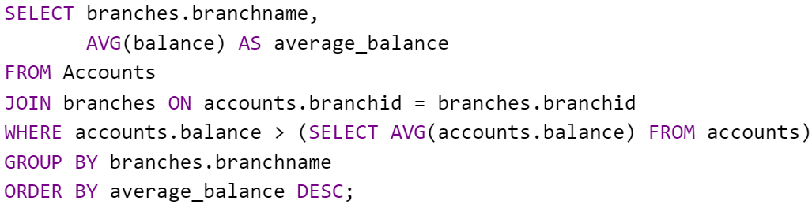
Query/View 2: Accounts and Balances by Branch
Purpose: Identify number of accounts and each branch’s total balance to evaluate branch performance.
Aggregates account data for each branch.
Calculates account number and each branch total balance.
Orders results by the descending account number, highlighting branches with most customers and highest deposits

Slide 7
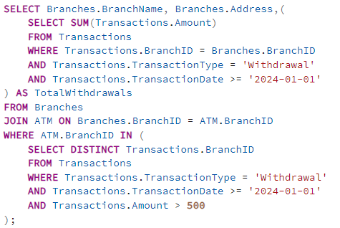
Query/Views 3: ATM Withdrawals since Start of Year
Purpose: Get total withdrawals from ATMs since the start of the year.
Uses subqueries to fetch data past a certain date.
Aggregates total transactions per ATM.
Displays ATM data with total withdrawals.

Slide 8
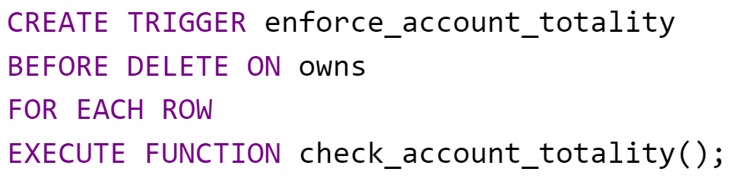
Trigger/SP 1: Enforcing Totality in Owns Association
Purpose: Ensures every account in Accounts table is associated with at least one record in Owns table.
Trigger before deleting a row from Owns table.
Prevent orphaned accounts by ensuring no account in Accounts is without a corresponding Owns record.
Executes the check_account_totality function to enforce the constraint.

Slide 9
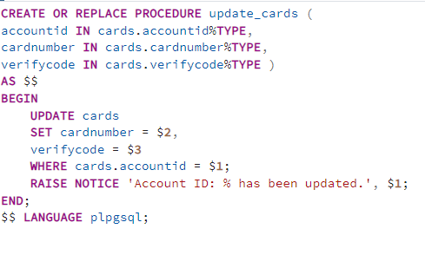
Trigger/SP 2: Update Existing Card Accounts
Purpose: Useful if account holder loses their card.
Updates credit card number and verification number.
Uses existing account.
Customer only has to replace their credit card.

