Slide 1
Exploring the Weak Temperature Gradiennt
Presented By: Nathanael Wong

Slide 2
Outline
What is the Weak Temperature Gradient (WTG)?
A brief introduction for people who have not heard me present before
Using the WTG approximation in climate modelling
Research Updates!
Bulk surface flux experiments
Comparison to large-scale self-aggregation experiments
Applications to other research interest areas
Bulk surface flux experiments
The different P-r relationships over oceans and land

Slide 3
The Weak Temperature Gradient Approximation
And why are we so interested in it?

Slide 4
The Weak Temperature Gradient
Temperature gradients (technically buoyancy gradients) within the Tropics are invariant in both time and space.
Due to the weak Coriolis force
Localized heating is balanced by vertical ascent in the atmosphere
Buoyancy gradients are smoothed rapidly by gravity waves

Slide 5
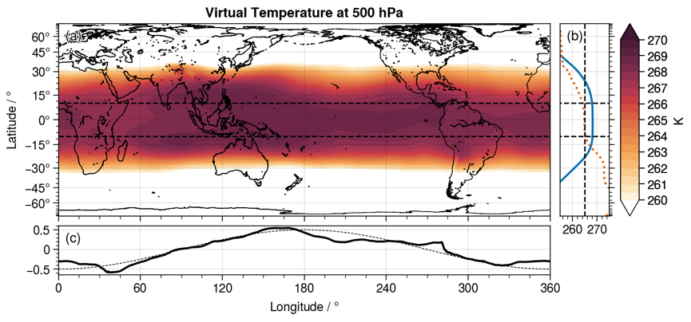
The Weak Temperature Gradient

Slide 6
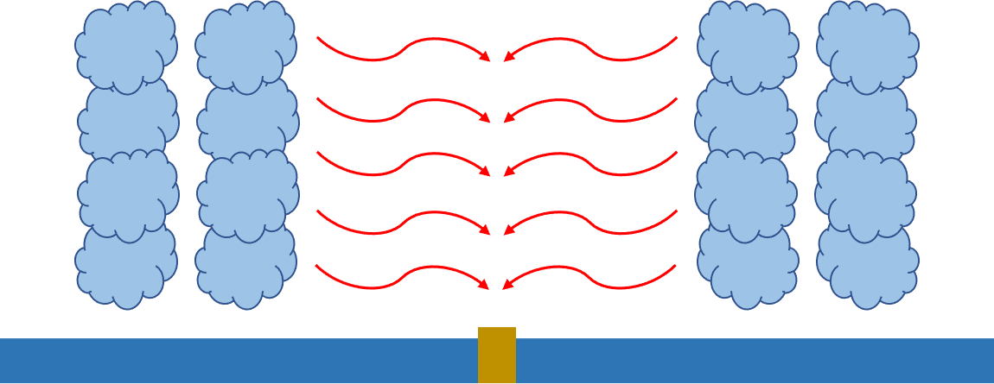
The WTG Framework
Model Domain
Gravity Wave adjustment (WTG)
Large-scale atmospheric profile of T and q
Large-scale atmospheric profile of T and q
Ocean w/ fixed SST
Domain surface
Ocean w/ fixed SST
Notes:
Add annotations

Slide 7
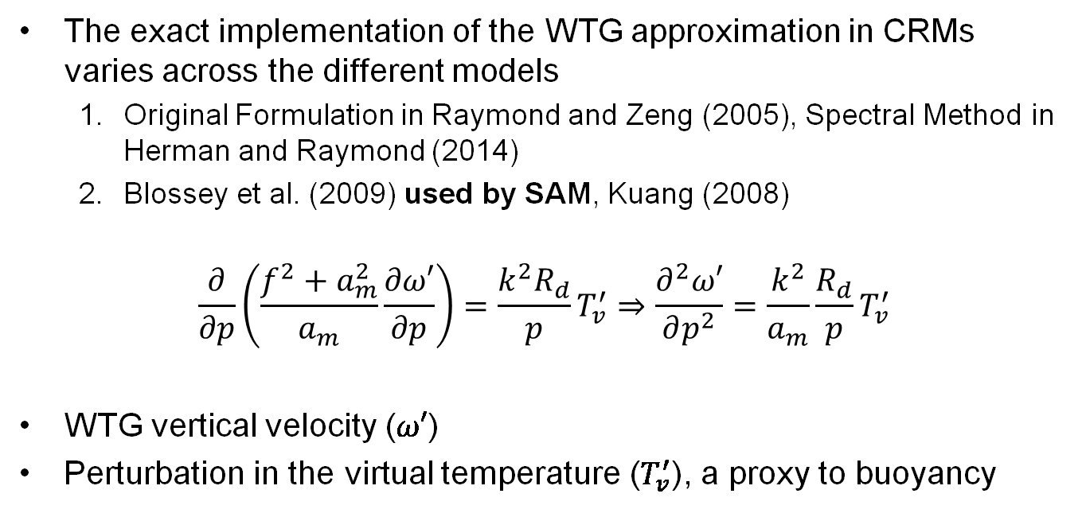
The WTG Framework
The exact implementation of the WTG approximation in CRMs varies across the different models
Original Formulation in Raymond and Zeng (2005), Spectral Method in Herman and Raymond (2014)
Blossey et al. (2009) used by SAM, Kuang (2008)
$$\frac{∂}{∂p}\left(\frac{f^{2}+a_{m}^{2}}{a_{m}}\frac{∂ω′}{∂p}\right)=\frac{k^{2}R_{d}}{p}T_{v}^{′}⇒\frac{∂^{2}ω′}{∂p^{2}}=\frac{k^{2}}{a_{m}}\frac{R_{d}}{p}T_{v}^{′}$$
WTG vertical velocity ($ω′$)
Perturbation in the virtual temperature ($T_{v}^{′}$), a proxy to buoyancy

Slide 8
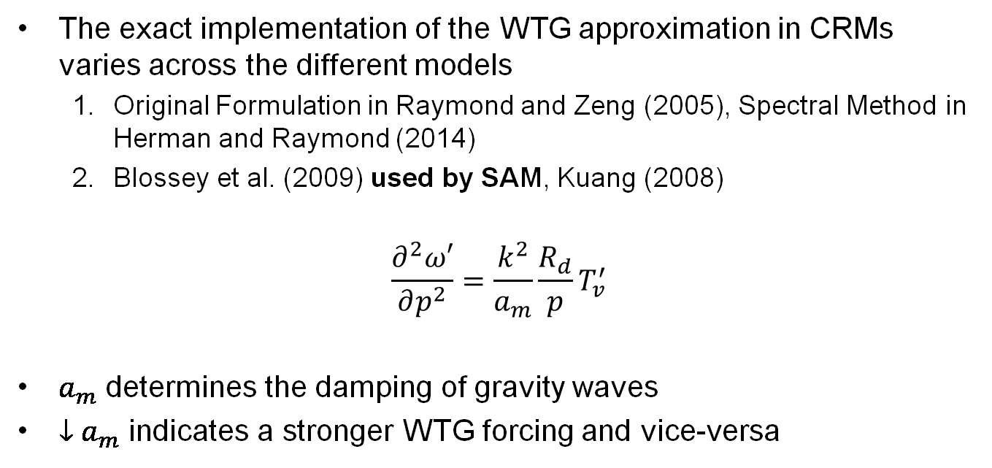
The WTG Framework
The exact implementation of the WTG approximation in CRMs varies across the different models
Original Formulation in Raymond and Zeng (2005), Spectral Method in Herman and Raymond (2014)
Blossey et al. (2009) used by SAM, Kuang (2008)
$$\frac{∂^{2}ω′}{∂p^{2}}=\frac{k^{2}}{a_{m}}\frac{R_{d}}{p}T_{v}^{′}$$
$a_{m}$ determines the damping of gravity waves
${↓a}_{m}$ indicates a stronger WTG forcing and vice-versa

Slide 9
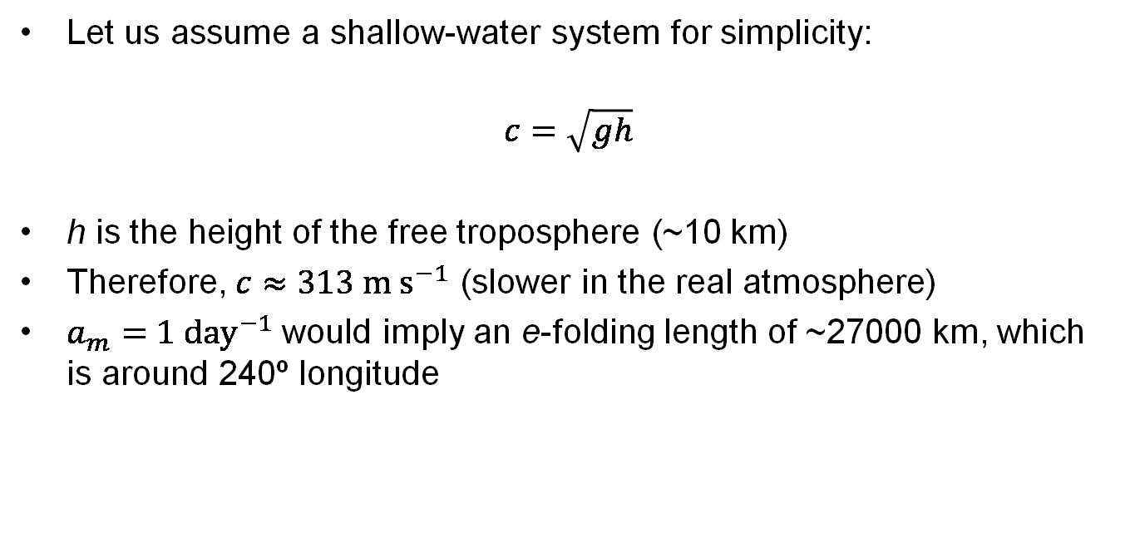
The WTG Framework
Let us assume a shallow-water system for simplicity:
$$c=\sqrt{gh}$$
h is the height of the free troposphere (~10 km)
Therefore, $c≈313 m s^{−1}$ (slower in the real atmosphere)
$a_{m}=1 day^{−1}$ would imply an e-folding length of ~27000 km, which is around 240º longitude

Slide 10
Current Focus
Wing and Emanuel (2014); Emanuel et al. (2014) demonstrated that models in RCE are actually in an unstable equilibrium
When the WTG forcing is applied to a model in RCE, the model collapses into 1 of 2 states:
A dry (often non-precipitating) state
A wet, high-precipitation-intensity state
These are the two different regimes in self-aggregated convection
Observed in both observations and large-domain model simulations

Slide 11
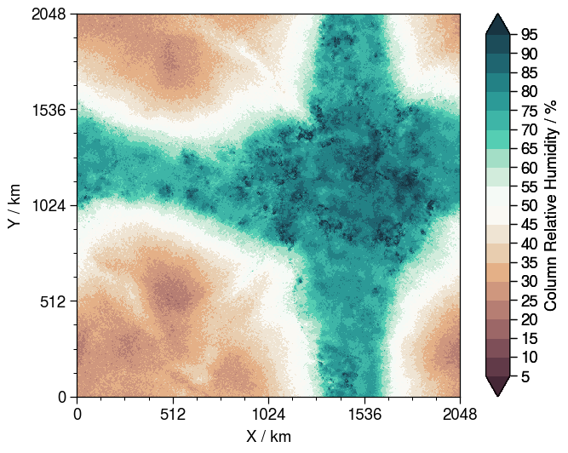
Current Focus
Aggregated Convection
My model domain could be here (wet) …
… or here (dry, non-precipitating)
~O(10³ km)

Slide 12
Results
Recap of previous findings, and some new stuff

Slide 13
Basic Model Configuration
System of Atmospheric Modelling (SAM) v6.10.9
Domain Size: 64 km x 64 km, 1 km resolution, 64 vertical levels
Interactive radiation (RRTMG)
Insolation: Tropical Insolation
Sea Surface Temperature: 295-305 K
Notes:
1-moment microphysics, be able to explain

Slide 14
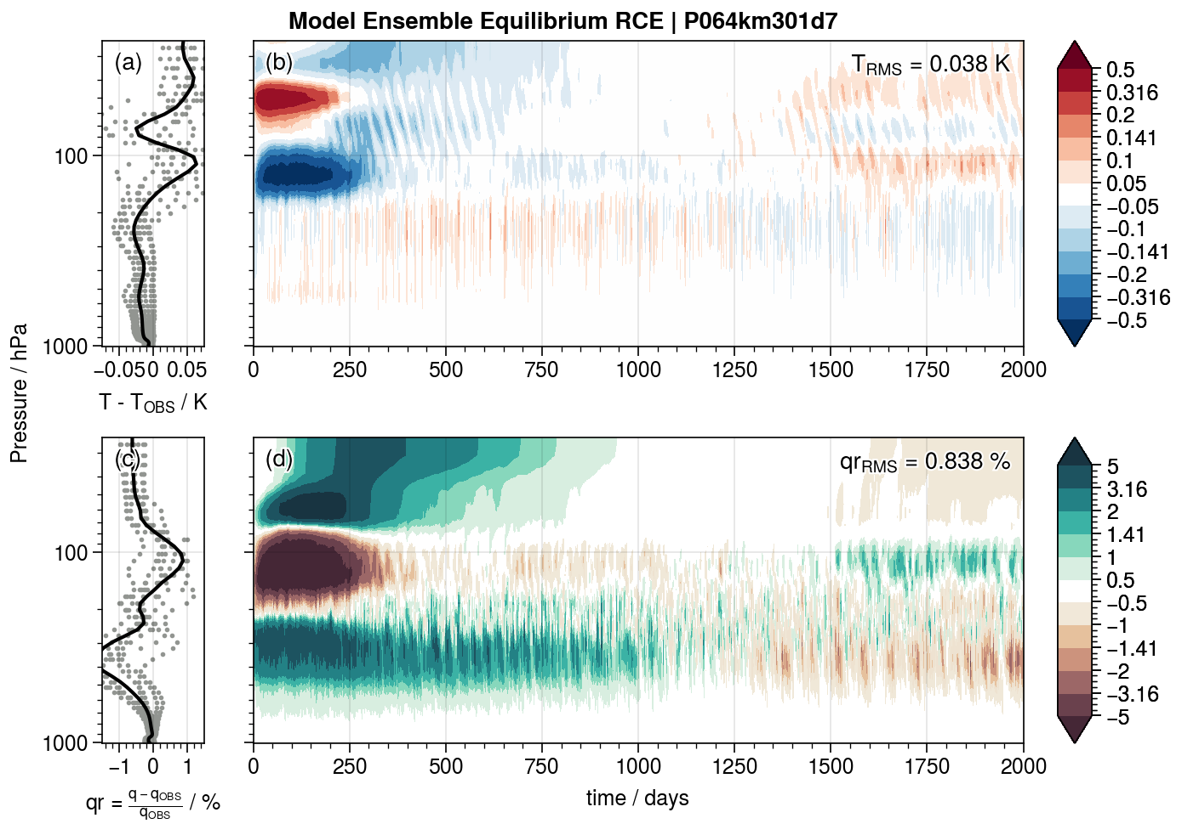

Slide 15
Basic Model Configuration
10-member ensemble run in basic RCE state for 1500 days until equilibrium, take temperature and humidity profile as large-scale.
WTG approximation applied, relaxed to the RCE profile constructed
Ran 5- to 10-member ensemble for 500 days, last 100 days analysis

Slide 16
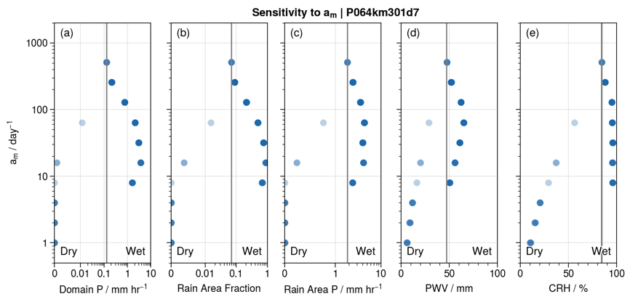
Old Results Recap
We observe the bifurcation over a range of different experiments

Slide 17
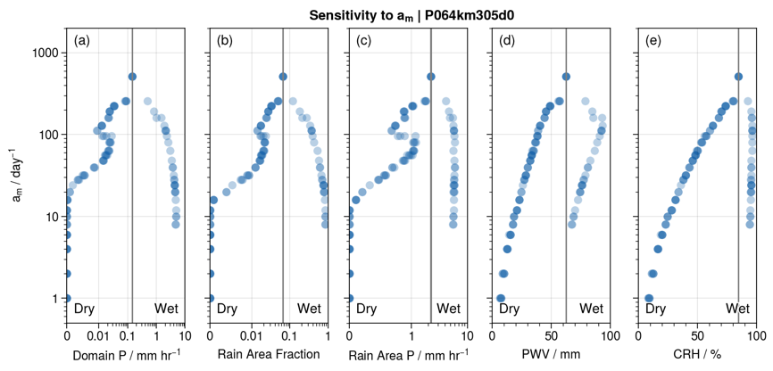
Old Results Recap
We observe the bifurcation over different sea-surface temperatures

Slide 18
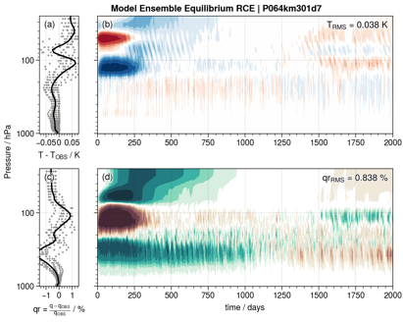
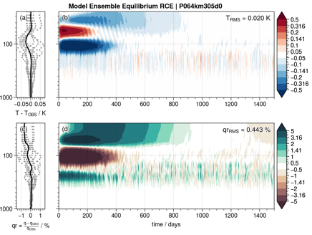
Old Results Recap
Missing points are likely because we didn’t run the RCE to a fully stable state

Slide 19
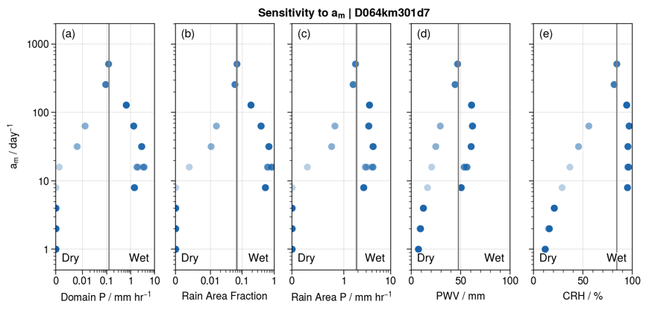
Old Results Recap
We observe the bifurcation in both perpetual and diurnal insolation

Slide 20
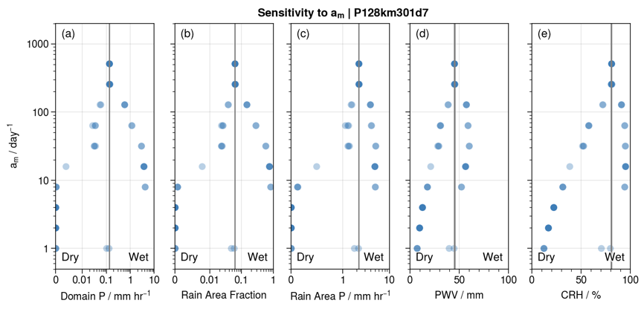
Old Results Recap
We observe the bifurcation over different domain sizes

Slide 21
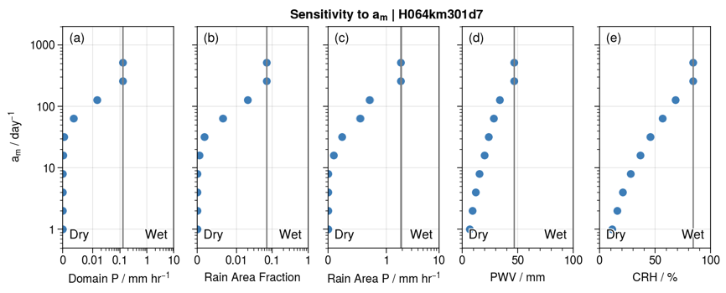
Old Results Recap
We observe the bifurcation even in homogenized radiation

Slide 22
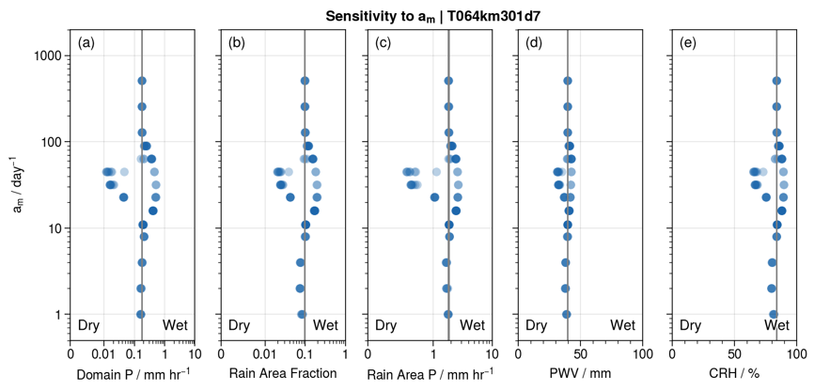
New Results
Turning off interactive radiation seems to reduce the bifurcation

Slide 23
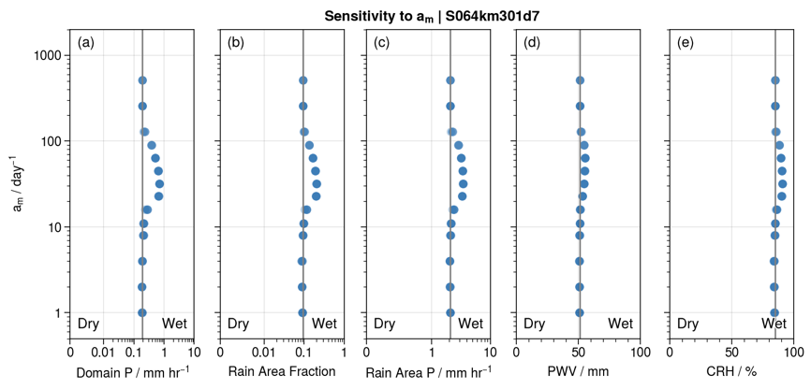
New Results
But there does appear to be some resonance impact at certain a_{m}

Slide 24
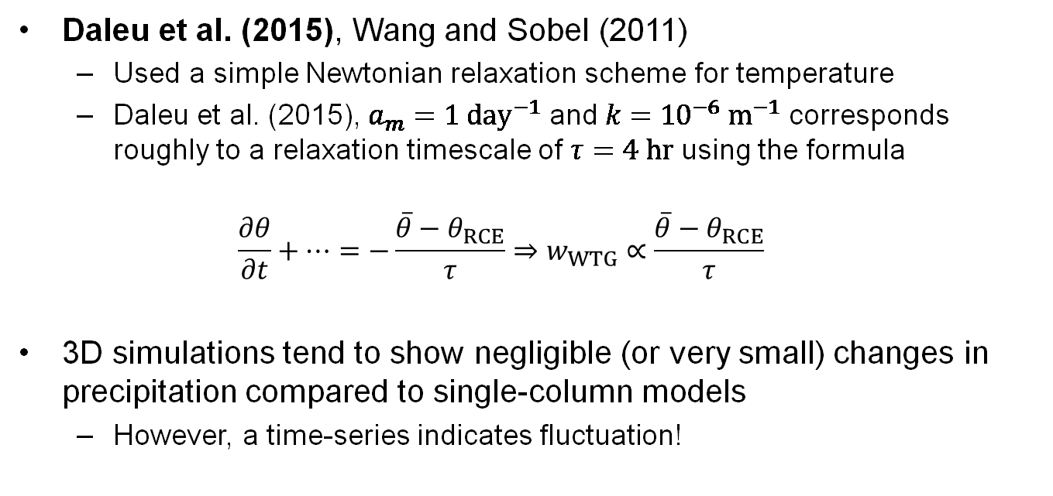
Some relevant previous studies …
Daleu et al. (2015), Wang and Sobel (2011)
Used a simple Newtonian relaxation scheme for temperature
Daleu et al. (2015), $a_{m}=1 day^{−1}$ and $k={10}^{−6} m^{−1}$ corresponds roughly to a relaxation timescale of $τ=4 hr$ using the formula
$$\frac{∂θ}{∂t}+…=−\frac{\overline{θ}−θ_{RCE}}{τ}⇒w_{WTG}∝\frac{\overline{θ}−θ_{RCE}}{τ}$$
3D simulations tend to show negligible (or very small) changes in precipitation compared to single-column models
However, a time-series indicates fluctuation!
Notes:
Moar lit reviewsssss

Slide 25
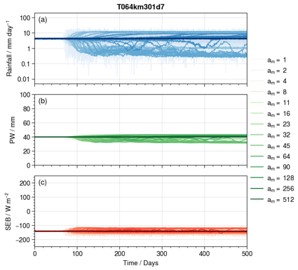
Some relevant previous studies …
3D simulations tend to show negligible (or very small) changes in precipitation compared to single-column models
However, a time-series indicates fluctuation!
Not explored/mentioned in Daleu et al. (2015)
Although overall the mean-precipitation average is the same, there is a huge fluctuation between wet and dry states.
Notes:
Fourier analysis for resonance analysis

Slide 26
Some relevant previous studies …
So the bifurcation / separation into wet and dry states still exists
But the model is now free to oscillate between the two regimes

Slide 27
Using lower spatial resolution
4 km resolution, 32x32 grid points
28 vertical levels (instead of 64)
There are some … weird results

Slide 28
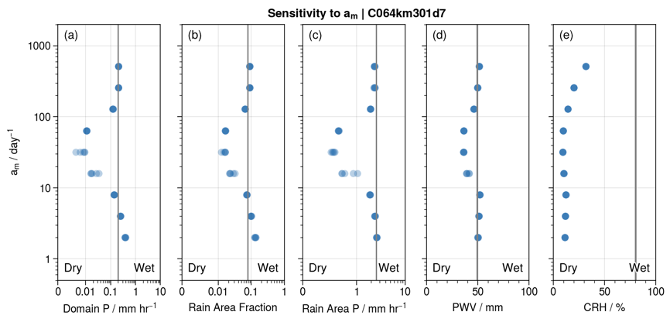
Using lower spatial resolution
The results don’t really make sense

Slide 29
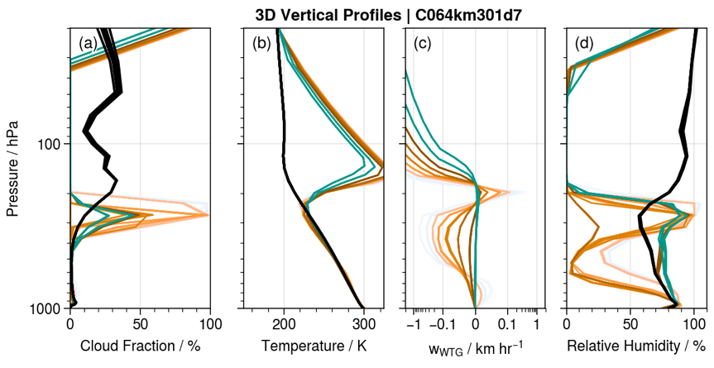
Using lower spatial resolution
This becomes more obvious when looking at the 3D profiles

Slide 30
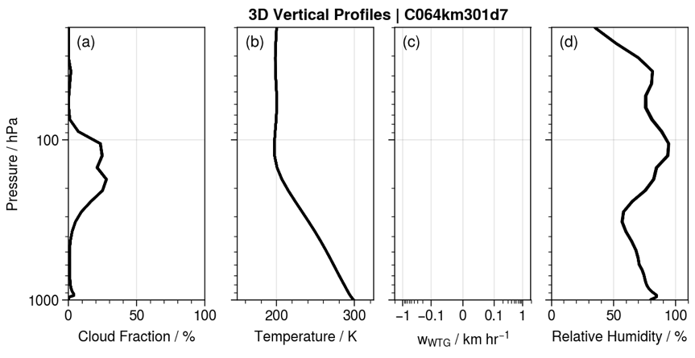
Using lower spatial resolution
Seems to be an issue with the vertical resolution (below is 42 levels)

Slide 31
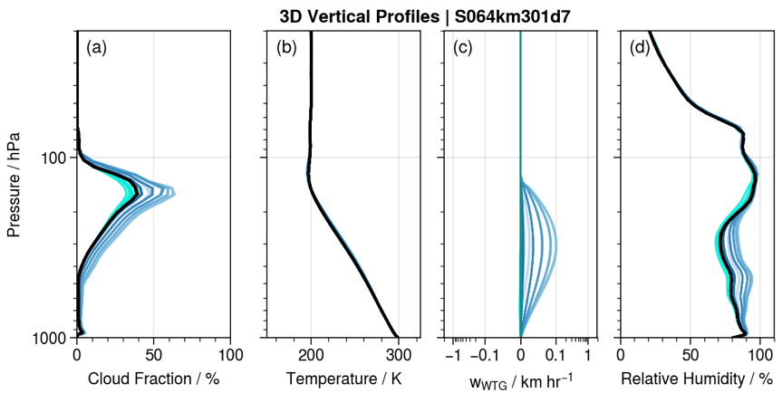
Using lower spatial resolution
Compare this to the model runs with the original resolution

Slide 32
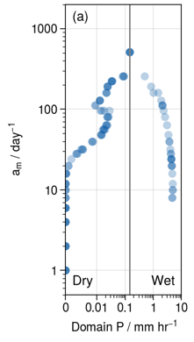
Another Question …
How well does the bifurcation when a_{m} is larger represent the range of states in self-aggregated convection?

Slide 33
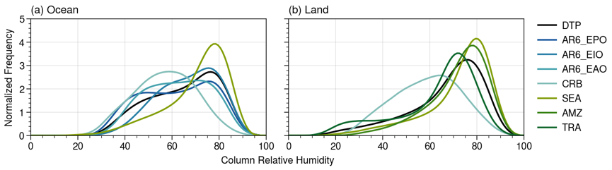
Another Question …
We see over ocean that there is a significant chance that CRH is within 40-70%, which cannot be captured when a_{m} is small
Likely correspond to transition zones in self-aggregated convection
When a_{m} is large, does the profile look like the transition zones of self-aggregated convection in large-scale domains?

Slide 34
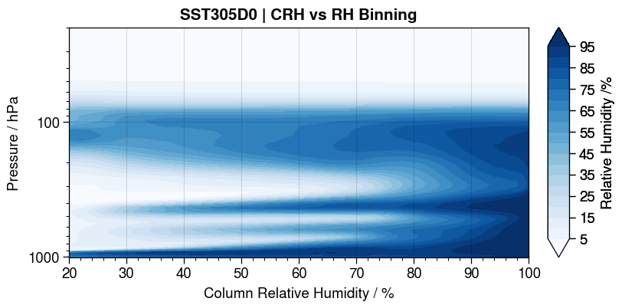
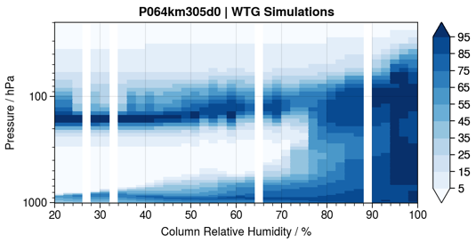
Preliminary Exploration
At sea-surface temperature 305 K
Qualitatively similar, but not the same
Strong convective overshoot
No overshooting here (resolution dependent?)

Slide 35
Preliminary Exploration
At sea-surface temperature 305 K
Qualitatively similar, but not the same
No intermediate cloud layers
Several different cloud layers

Slide 36
And that’s all!!
Thanks for listening haha any questions?

