Slide 1
From Zero to Hero: A gradual implementation of the WTG approximation in SAM
Part 1 of TroPrecLS

Slide 2
Background
A recap on the Weak-Temperature Gradient Approximation and its implementation in models

Slide 3
A Recap on the WTG Approximation
First formalized in Sobel et al. (2001)
Basic Principle:
Near equator, Coriolis force is weak → gravity waves dominate and are responsible for redistributing buoyancy anomalies
WTG assumes that this process is very effective
Therefore, temperature gradients are
small
time-invariant

Slide 4
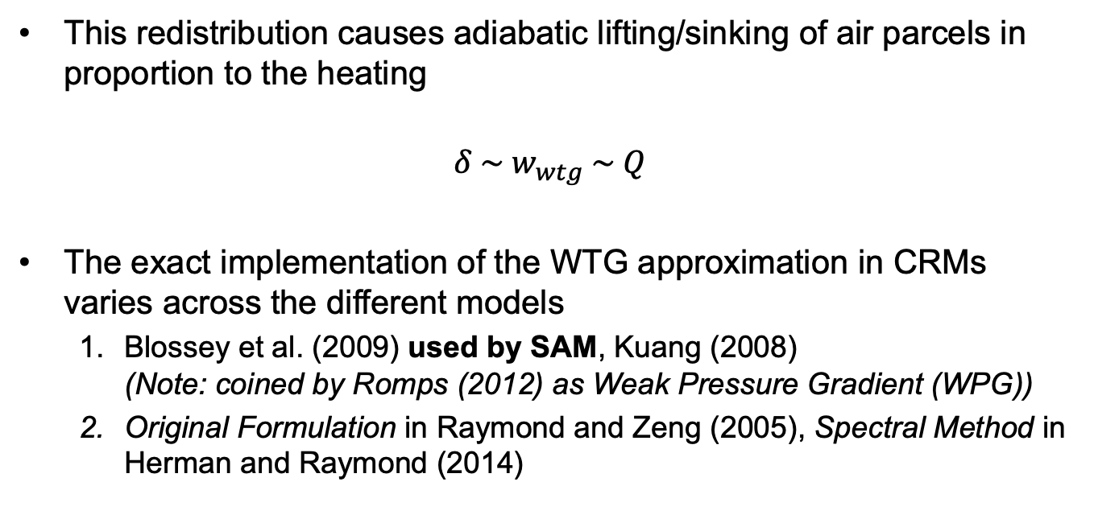
A Recap on the WTG Approximation
This redistribution causes adiabatic lifting/sinking of air parcels in proportion to the heating
$$δ \sim w_{wtg} \sim Q$$
The exact implementation of the WTG approximation in CRMs varies across the different models
Blossey et al. (2009) used by SAM, Kuang (2008) (Note: coined by Romps (2012) as Weak Pressure Gradient (WPG))
Original Formulation in Raymond and Zeng (2005), Spectral Method in Herman and Raymond (2014)

Slide 5
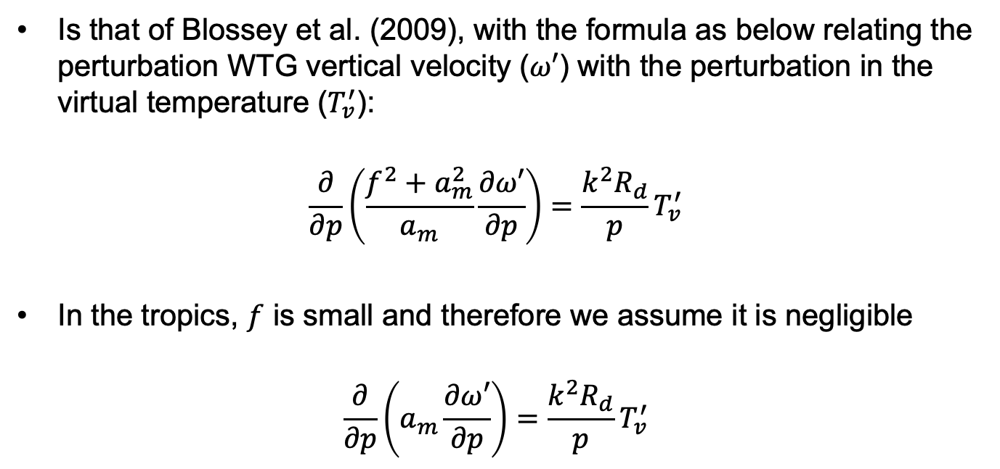
WTG implementation in SAM
Is that of Blossey et al. (2009), with the formula as below relating the perturbation WTG vertical velocity ($ω′$) with the perturbation in the virtual temperature ($T_{v}^{′}$):
$$\frac{∂}{∂p}\left(\frac{f^{2}+a_{m}^{2}}{a_{m}}\frac{∂ω′}{∂p}\right)=\frac{k^{2}R_{d}}{p}T_{v}^{′}$$
In the tropics, $f$ is small and therefore we assume it is negligible
$$\frac{∂}{∂p}\left(a_{m}\frac{∂ω′}{∂p}\right)=\frac{k^{2}R_{d}}{p}T_{v}^{′}$$

Slide 6
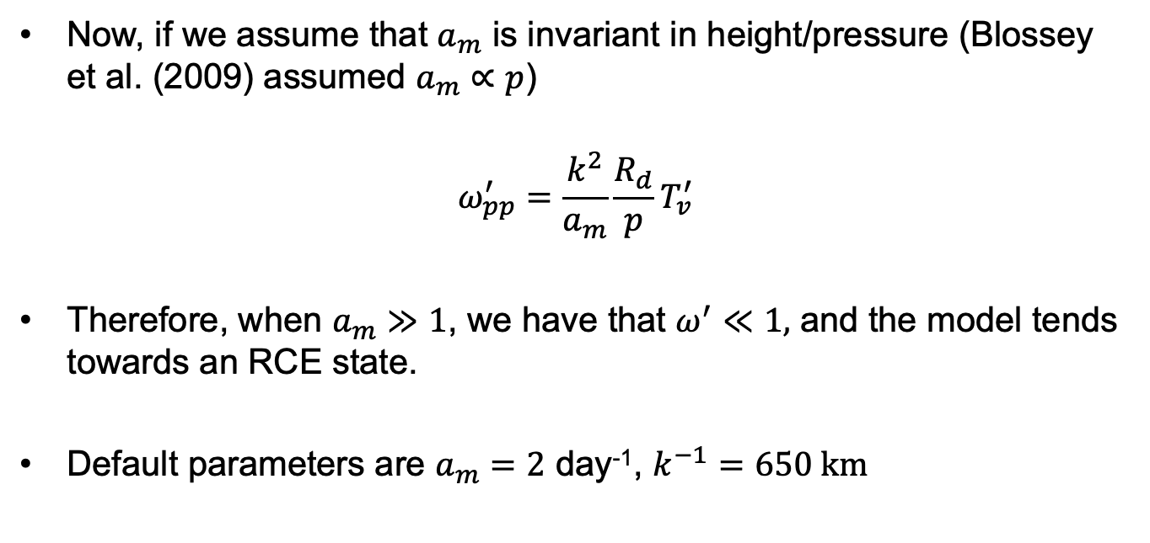
WTG implementation in SAM
Now, if we assume that $a_{m}$ is invariant in height/pressure (Blossey et al. (2009) assumed $a_{m}∝p$)
$$ω_{pp}^{′}=\frac{k^{2}}{a_{m}}\frac{R_{d}}{p}T_{v}^{′}$$
Therefore, when $a_{m}≫1$, we have that $ω^{′}≪1,$ and the model tends towards an RCE state.
Default parameters are $a_{m}=2$ day⁻¹, $k^{−1}=650 km$

Slide 7
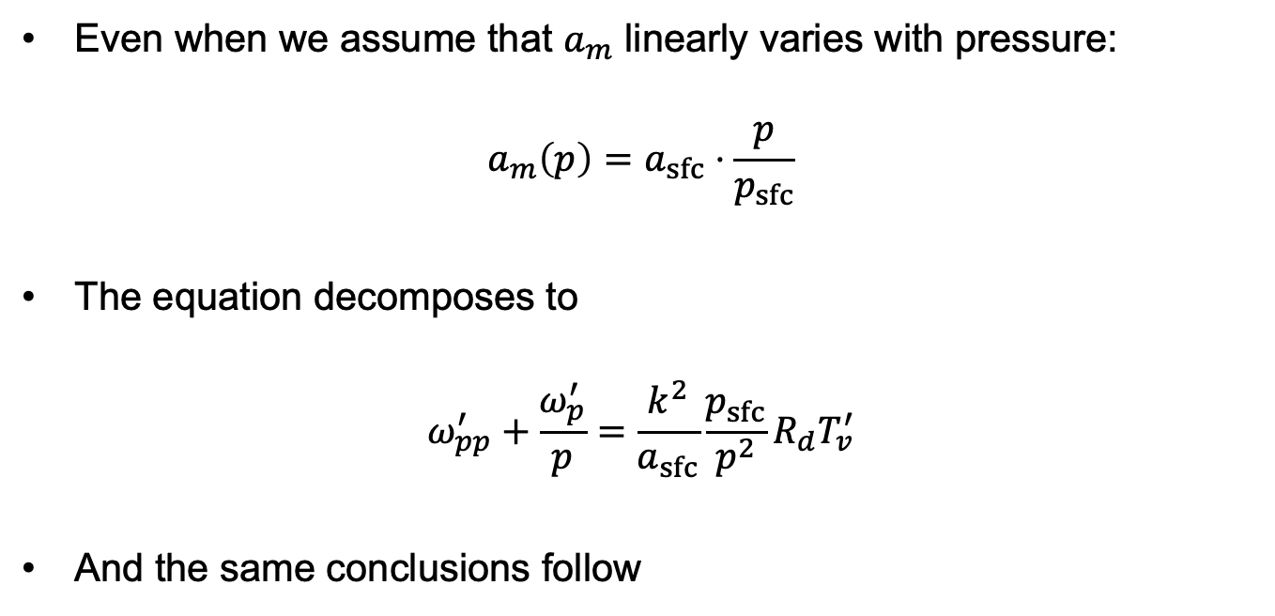
WTG implementation in SAM
Even when we assume that $a_{m}$ linearly varies with pressure:
$$a_{m}\left(p\right)=a_{sfc}⋅\frac{p}{p_{sfc}}$$
The equation decomposes to
$$ω_{pp}^{′}+\frac{ω_{p}^{′}}{p}=\frac{k^{2}}{a_{sfc}}\frac{p_{sfc}}{p^{2}}{R_{d}T}_{v}^{′}$$
And the same conclusions follow

Slide 8
A Gradual Implementation of the WTG
Scaling up the WTG forcing from Zero to Hero

Slide 9
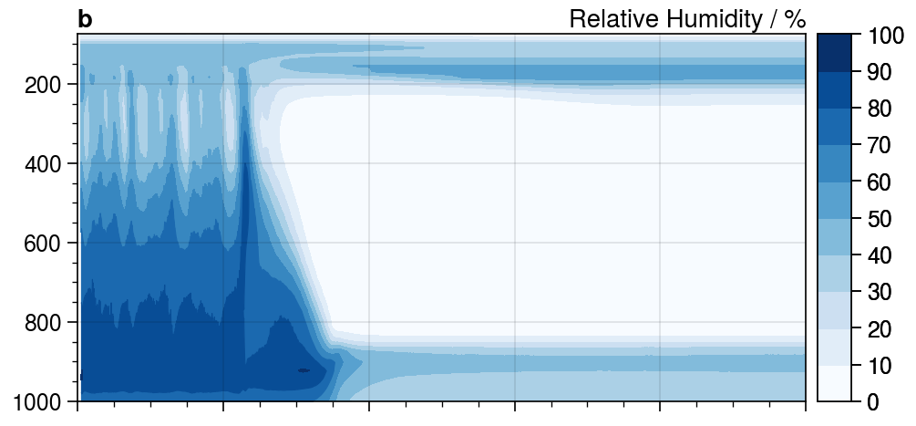
WTG implementation in SAM
The implementation of the WTG approximation, however, can cause a “shock” to the model that often arbitrarily forces it into a dry regime state.

Slide 10
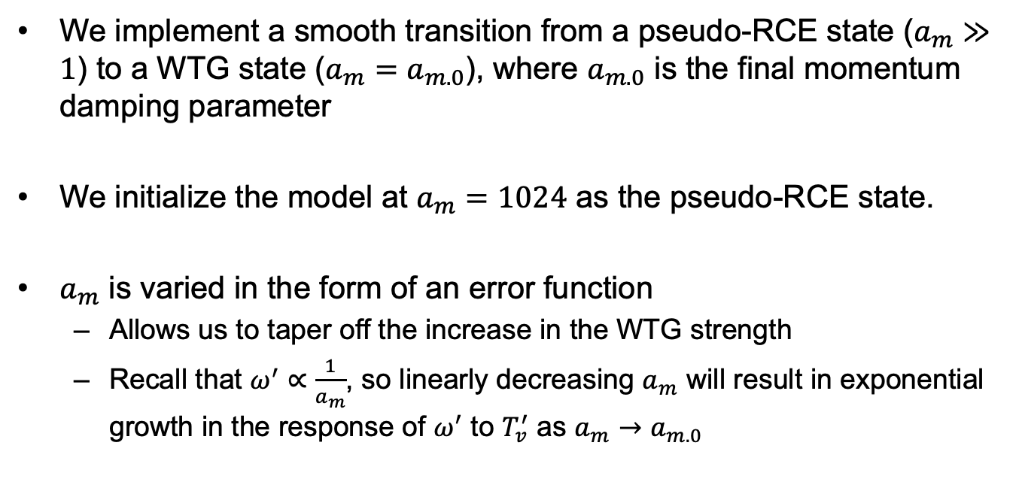

How should $a_{m}$ be varied?
We implement a smooth transition from a pseudo-RCE state ($a_{m}≫1$) to a WTG state ($a_{m}=a_{m.0}$), where $a_{m.0}$ is the final momentum damping parameter
We initialize the model at $a_{m}=1024$ as the pseudo-RCE state.
$a_{m}$ is varied in the form of an error function
Allows us to taper off the increase in the WTG strength
Recall that $ω^{′}∝\frac{1}{a_{m}}$, so linearly decreasing $a_{m}$ will result in exponential growth in the response of $ω^{′}$ to $T_{v}^{′}$ as $a_{m}→$ $a_{m.0}$

Slide 11
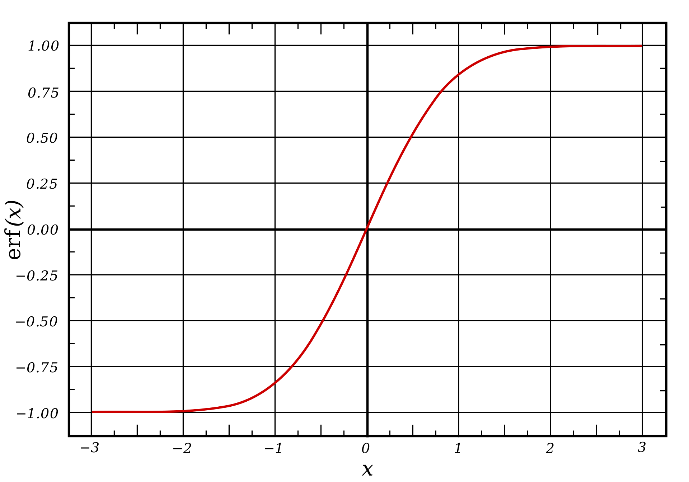
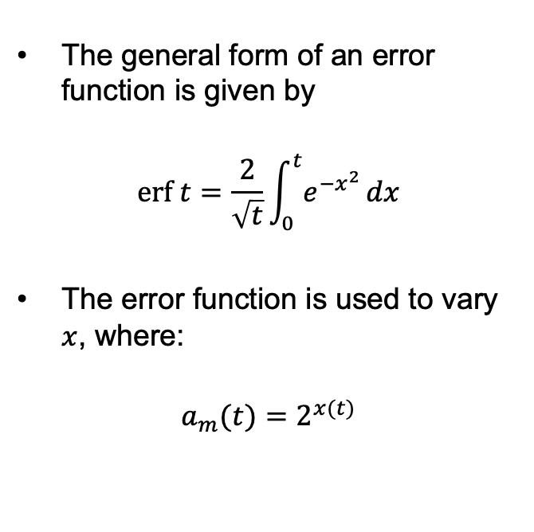
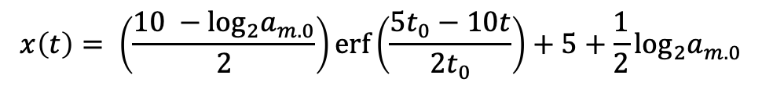
Using an Error Function
The general form of an error function is given by
$$erf t=\frac{2}{\sqrt{t}}\int_{0}^{t}{e^{−x^{2}}}dx$$
The error function is used to vary $x$, where:
$$a_{m}(t)=2^{x(t)}$$
$$x\left(t\right)= \left(\frac{10 −\log_{2}a_{m.0}}{2}\right)erf\left(\frac{5t_{0}−10t}{2t_{0}}\right)+5+\frac{1}{2}\log_{2}a_{m.0}$$

Slide 12
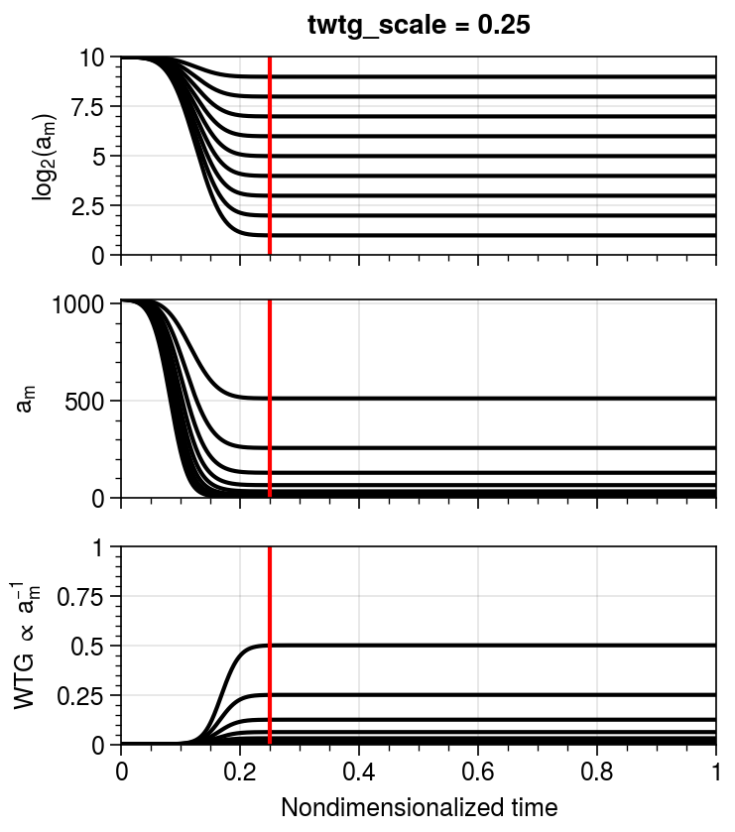
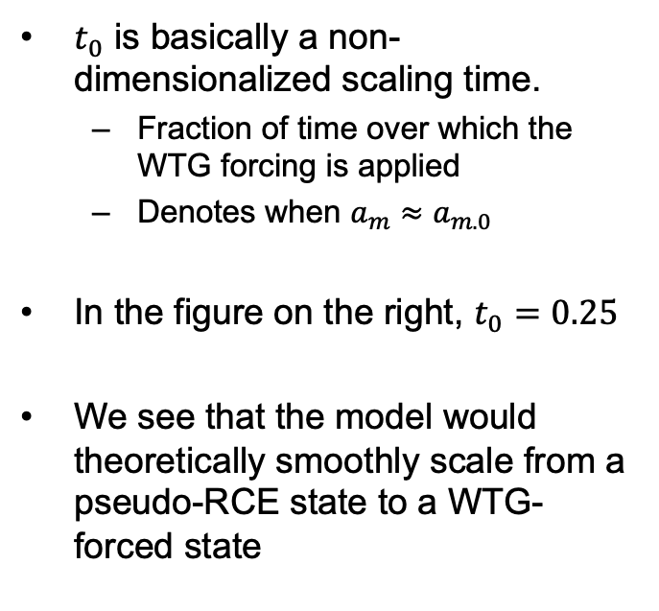
Using an Error Function
$t_{0}$ is basically a non-dimensionalized scaling time.
Fraction of time over which the WTG forcing is applied
Denotes when $a_{m}≈a_{m.0}$
In the figure on the right, $t_{0}=0.25$
We see that the model would theoretically smoothly scale from a pseudo-RCE state to a WTG-forced state

Slide 13
Model Runs
RCE and WTG runs

Slide 14
Model Setup
64 x 64 grid points, 1 km grid spacing, 64 vertical levels
SST = 301.7 km, Insolation = 1354.23 W m⁻²
Experiments were conducted with and without diurnal cycle
RCE was continuously spinup in batches of 1000 days until equilibrium sounding was reached.
Last 200 days were used to get sounding profile
When equilibrium was reached (sounding used to initialize RCE returns approximately the same profile), sounding was used for WTG forcing.
Note to Zhiming: Yes, I needed to enforce a model top.

Slide 15
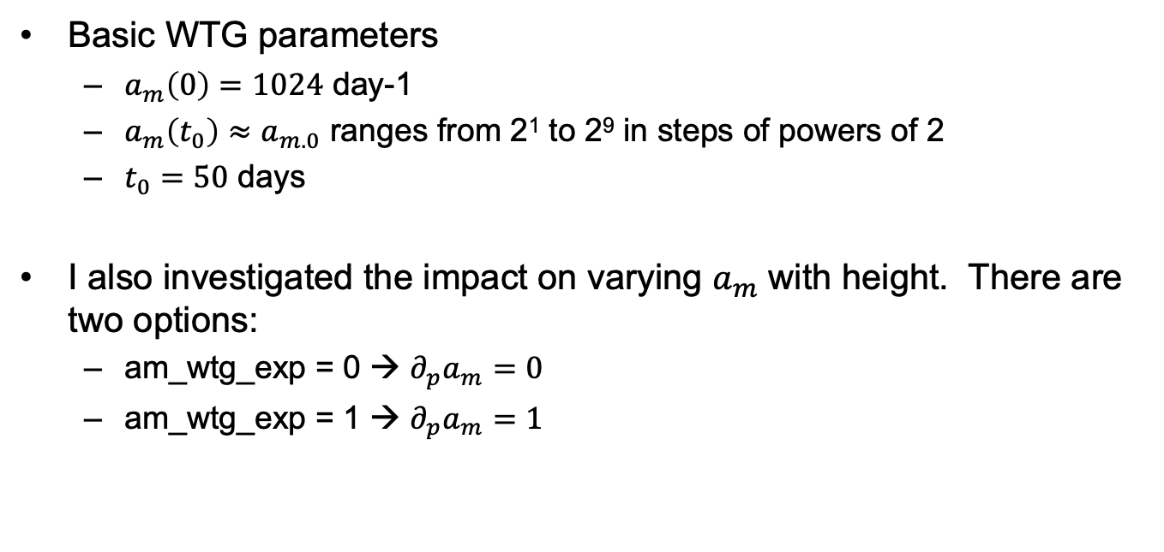
Model Setup
Basic WTG parameters
$a_{m}\left(0\right)=1024$ day-1
$a_{m}\left(t_{0}\right)≈a_{m.0}$ ranges from 2¹ to 2⁹ in steps of powers of 2
$t_{0}=50$ days
I also investigated the impact on varying $a_{m}$ with height. There are two options:
am_wtg_exp = 0 → $∂_{p}a_{m}=0$
am_wtg_exp = 1 → $∂_{p}a_{m}=1$

Slide 16
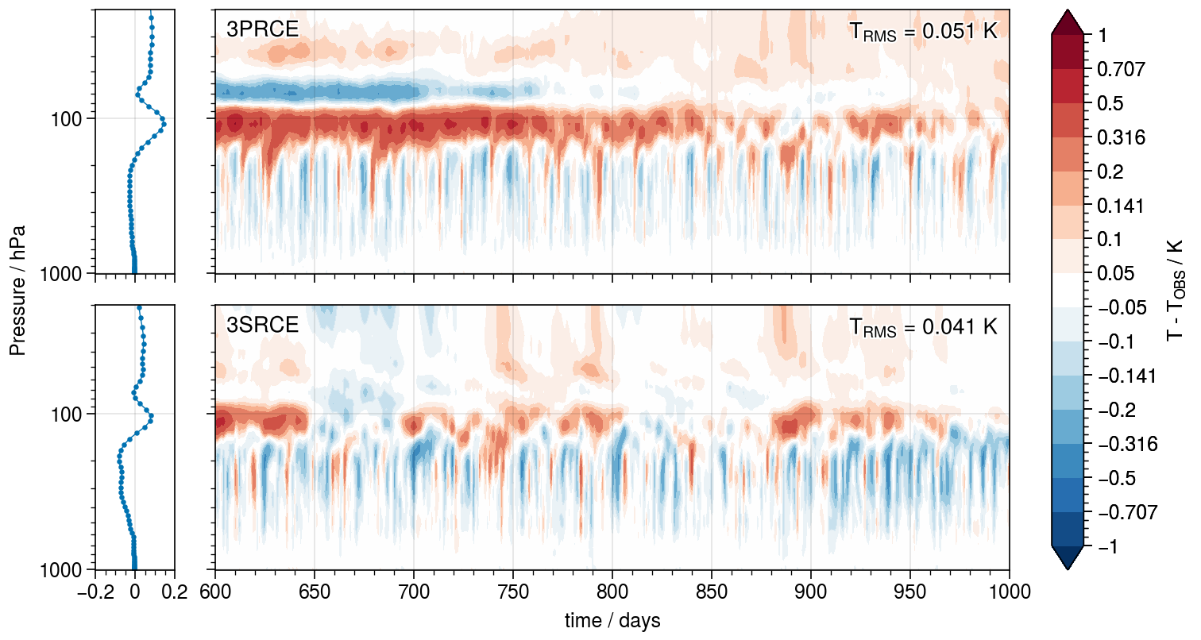
RCE Spinup

Slide 17
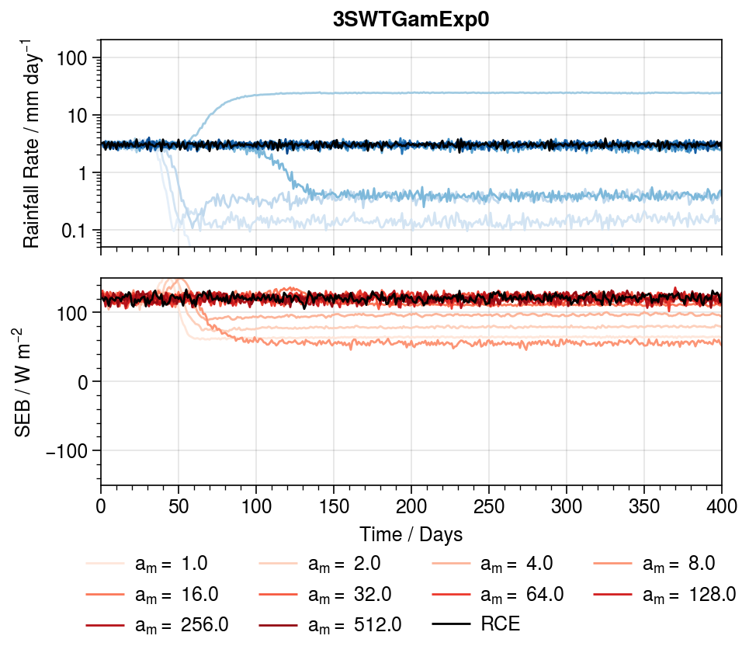
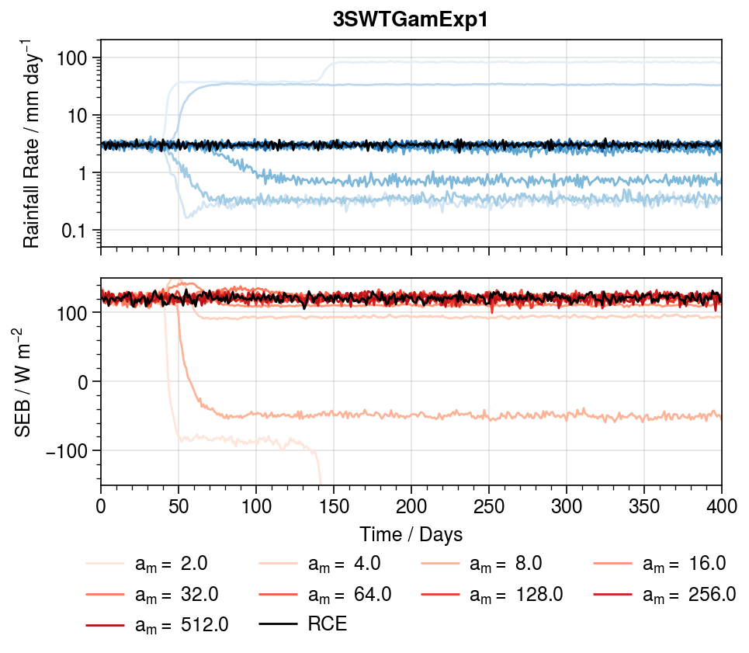
Now things start getting tricky …

Slide 18
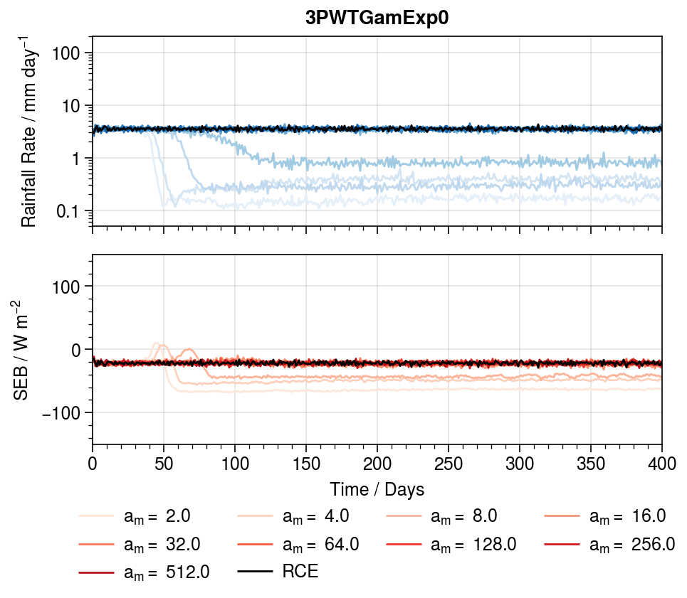
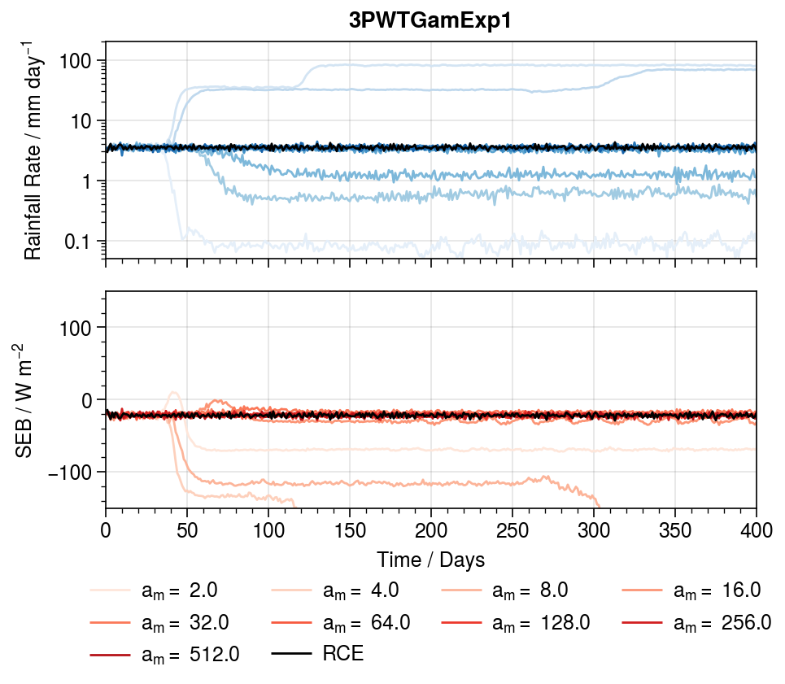
Now things start getting tricky …
Note: Insolation was too low, currently rerunning experiments

Slide 19
Wet States
Dry States
Wet States

Slide 20
Wet State
Dry States
Dry States
Wet State

Slide 21
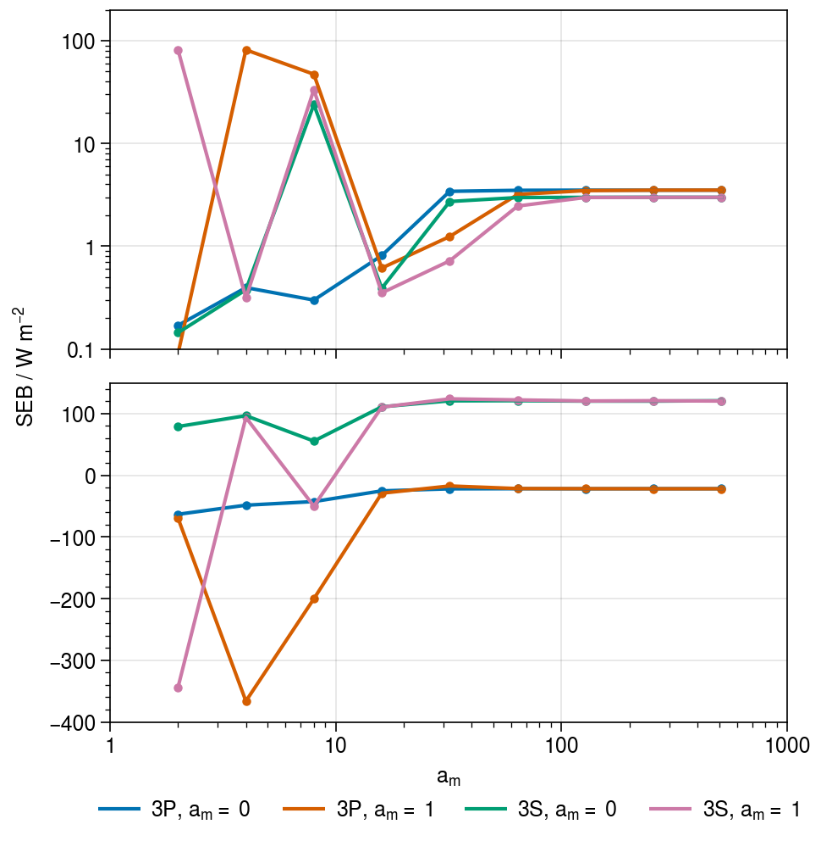
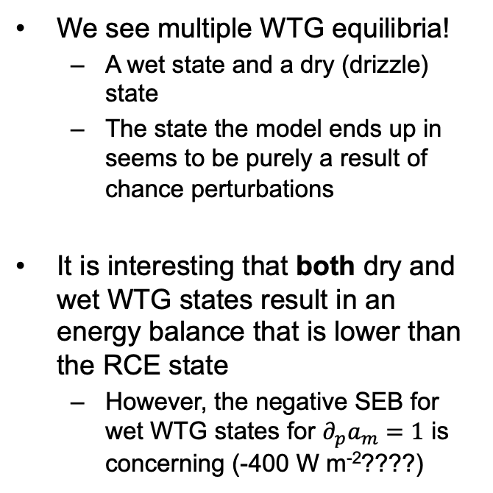
My Thoughts …
We see multiple WTG equilibria!
A wet state and a dry (drizzle) state
The state the model ends up in seems to be purely a result of chance perturbations
It is interesting that both dry and wet WTG states result in an energy balance that is lower than the RCE state
However, the negative SEB for wet WTG states for $∂_{p}a_{m}=1$ is concerning (-400 W m⁻²????)

Slide 22
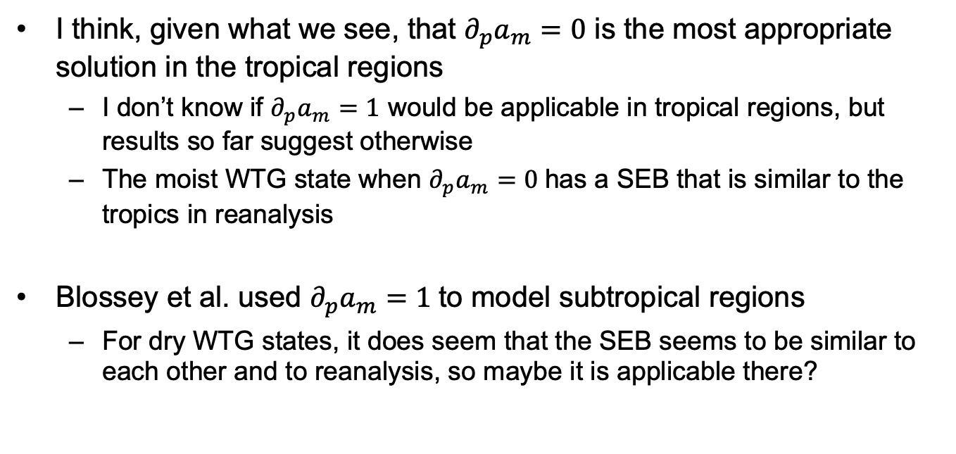
My Thoughts …
I think, given what we see, that $∂_{p}a_{m}=0$ is the most appropriate solution in the tropical regions
I don’t know if $∂_{p}a_{m}=1$ would be applicable in tropical regions, but results so far suggest otherwise
The moist WTG state when $∂_{p}a_{m}=0$has a SEB that is similar to the tropics in reanalysis
Blossey et al. used $∂_{p}a_{m}=1$to model subtropical regions
For dry WTG states, it does seem that the SEB seems to be similar to each other and to reanalysis, so maybe it is applicable there?

Slide 23
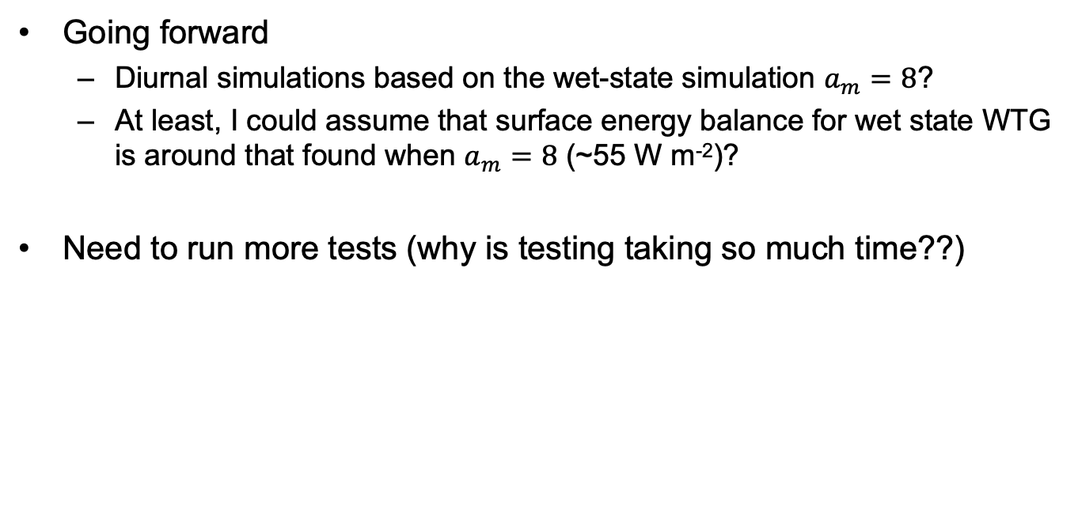
My Thoughts …
Going forward
Diurnal simulations based on the wet-state simulation $a_{m}=8$?
At least, I could assume that surface energy balance for wet state WTG is around that found when $a_{m}=8$ (~55 W m⁻²)?
Need to run more tests (why is testing taking so much time??)

Slide 24
Some Concerns
Does anyone know how statistical output affects large-scale forcing in SAM?
When I set statistical output frequency at different values, I get different results for WTG simulations
I might try to use the updated UW version of SAM (clone from their GitHub) to see if there are any changes

Slide 25
THE END
Any Questions?

