Slide 1
CIC-IDS2017 Intrusion Detection
Machine Learning & AI-Assisted Analysis
Capstone Project | Hacktiv8 | IBM Granite Support
Nathan Alvino Fam

Slide 2
Project Overview
Background: Cyberattacks are increasing and Intrusion Detection Systems (IDS) are critical.
Objective: Detect anomalies in network traffic using CIC-IDS2017 mirrored dataset in kaggle.
Approach: Supervised ML (RandomForest, XGBoost, Logistic Regression) + Unsupervised (IsolationForest).

Slide 3
Dataset (CIC-IDS2017)
• Source: CIC-IDS2017 (mirrored from Kaggle)
• Size: 2.8 million rows (Actual), 79 features
• Labels: BENIGN vs ATTACK
• Sampling: 300k stratified sample
• Challenge: Highly imbalanced data (BENIGN >> ATTACK)
Dataset Link :
https://www.kaggle.com/datasets/chethuhn/network-intrusion-dataset

Slide 4
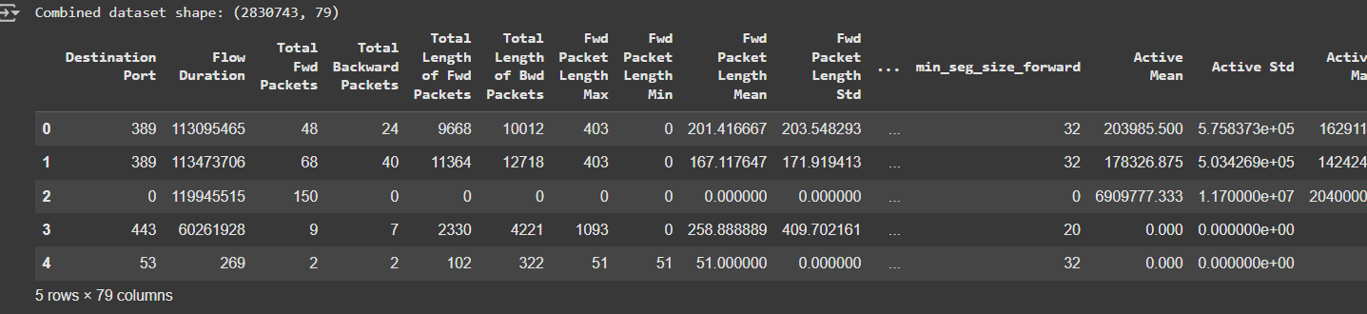
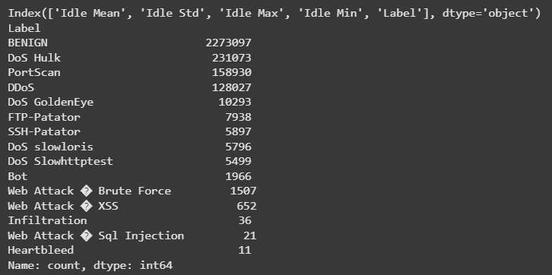

Slide 5
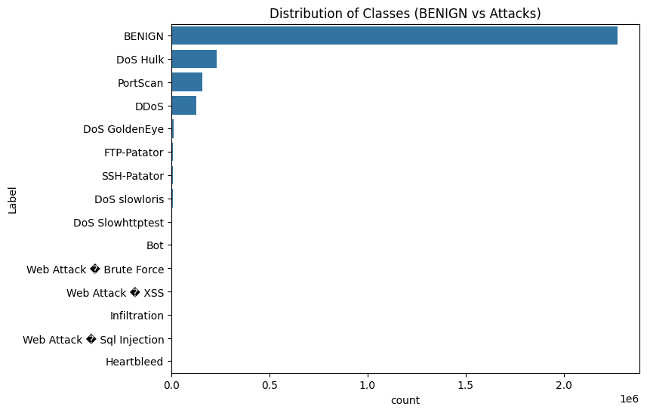

Slide 6
Analysis Process
1. Data Loading & Cleaning
2. Sampling & Splitting
3. Feature Scaling
4. Modeling: RF, XGB, Logistic Regression
5. Evaluation: Precision, Recall, F1, ROC-AUC
6. Explainability: SHAP
7. Granite Summarization

Slide 7
Random Forest Results
• Precision: ~0.9985
• Recall: ~0.9985
• F1: ~0.9985
• ROC-AUC: ~0.9985
Confusion matrix shows balanced high accuracy on both BENIGN and ATTACK.

Slide 8
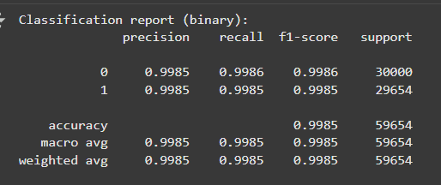
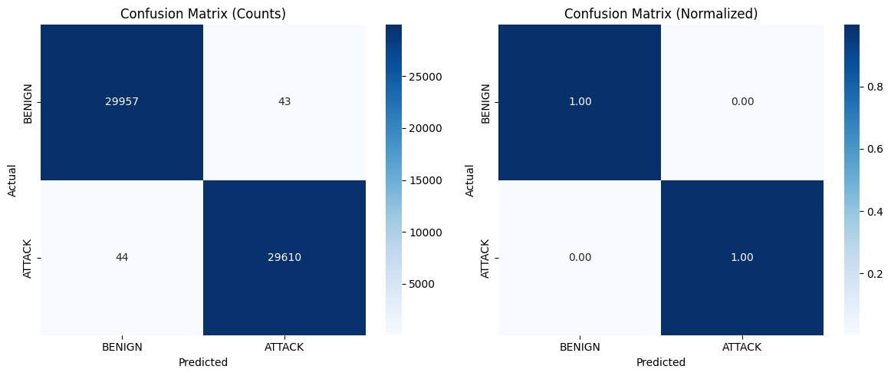

Slide 9
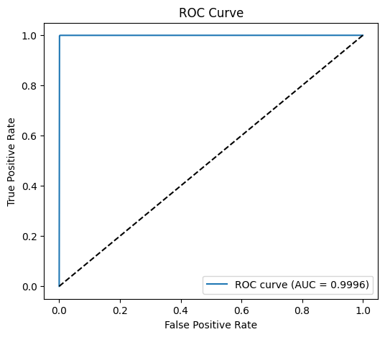
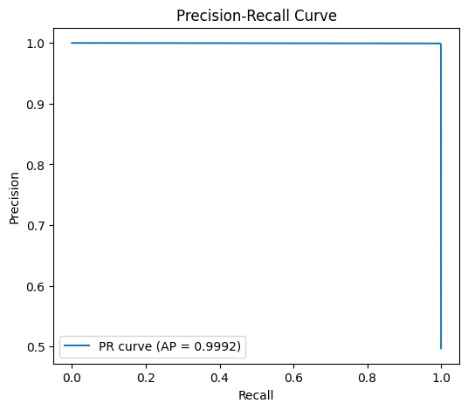

Slide 10
XGBoost & Logistic Regression
• XGBoost: Comparable to RF, slightly better recall in some cases
• Logistic Regression: Lower overall performance
• Insight: Tree-based models outperform linear methods on CIC-IDS2017
ROC curve shows RF/XGB >> LR.

Slide 11
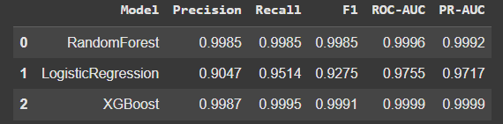
Comparison 3 Supervised Models

Slide 12
IsolationForest (Unsupervised)
• Trained on benign-only data (n=120,000)
• Tested contamination values: [0.001 – 0.1]
• Best recall: 0.0002 (poor)
• Conclusion: Anomaly detection not effective here since attacks are not always outlier
Supervised ML is superior for CIC-IDS2017.

Slide 13
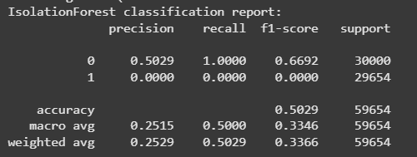
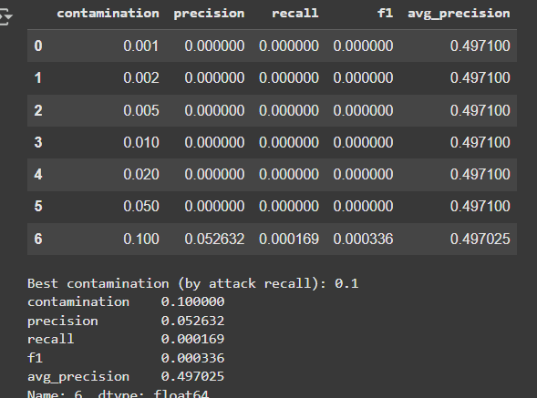
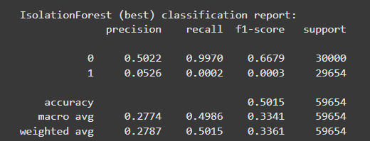

Slide 14
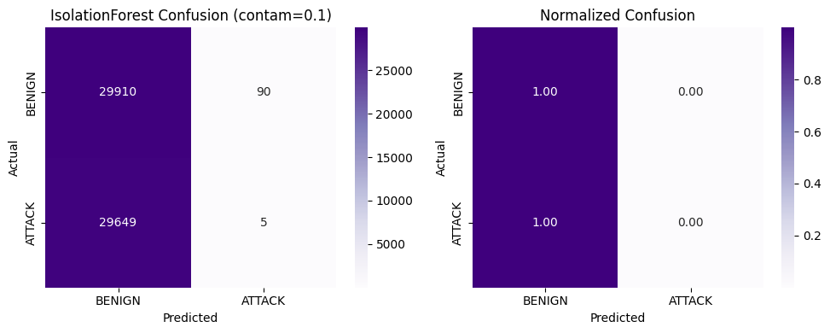
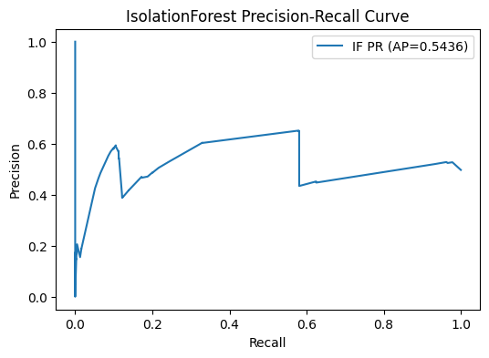

Slide 15
SHAP Feature Importance
Top features influencing detection:
Port-related behavior (Destination Port, Init_Win_bytes_forward/backward) is a strong indicator of attack traffic.
Packet size statistics (average, min, max, variance, std) consistently dominate, meaning abnormal distribution of packet lengths is highly correlated with intrusions.
Timing-based features (like Flow Duration, Fwd Packets/s) are less important in RF compared to size/port-based metrics, at least in this dataset sample.
Insight: Timing and packet size distribution are key indicators.

Slide 16
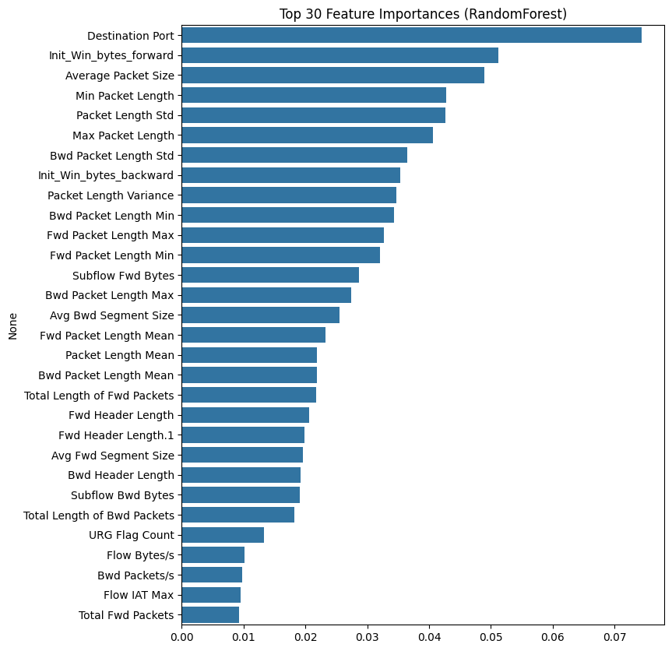

Slide 17
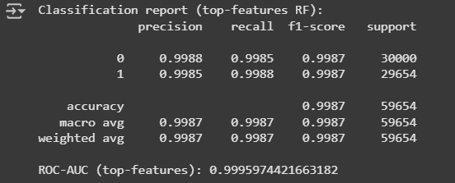
Classification Using Top Features and Random Forest Models

Slide 18
Why I’m Using SHAP ?
RandomForest Feature Importances ≠ True Causality : The default .feature_importances_ in RandomForest only measures how much a feature reduces impurity across trees.It can be biased toward high-cardinality or correlated features (e.g., Destination Port looks huge in your bar chart).
SHAP explains at the sample level : SHAP gives local explanations: for each prediction, it tells you how much each feature pushed the model towards “attack” vs “benign.”This helps us see not just “which features are important overall” but also why a specific flow was classified as an attack.
Balanced and interpretable importance : SHAP aggregates local contributions into global importance.This avoids over-emphasizing correlated features and often surfaces more interpretable indicators (e.g., Flow Duration, Packet Length Variance) that domain experts can understand.

Slide 19
AI Support (IBM Granite)
Granite assisted in:
• Summarizing analytical results
• Generating executive-level insights
• Providing actionable cybersecurity recommendations
Example: Converting raw metrics into stakeholder-friendly narratives.

Slide 20
Conclusion
• Supervised ML (RF, XGB) are highly effective (>99% accuracy)
• Logistic Regression is weaker baseline
• IsolationForest performed poorly for anomaly detection
• SHAP improves explainability of models

Slide 21
Recommendations
• Deploy RF/XGB for real-world IDS
• Add real-time feature engineering (sliding windows)
• Extend dataset with latest cyberattack patterns
• Use anomaly detection only as early-warning system

Slide 22

Closing

