Slide 1

Implementation of Apriori Algorithm Using Hadoop Map-Reduce
ITCS 6162 Knowledge Discovery in Databases
Submitted By
GROUP 5

Slide 2
PROJECT DESCRIPTION
Steps:
Map-Reduce Word Count Program
Action Rules AROGS Program
MR – Distributed Action Rules Using Apriori Action Rules Algorithm

Slide 3
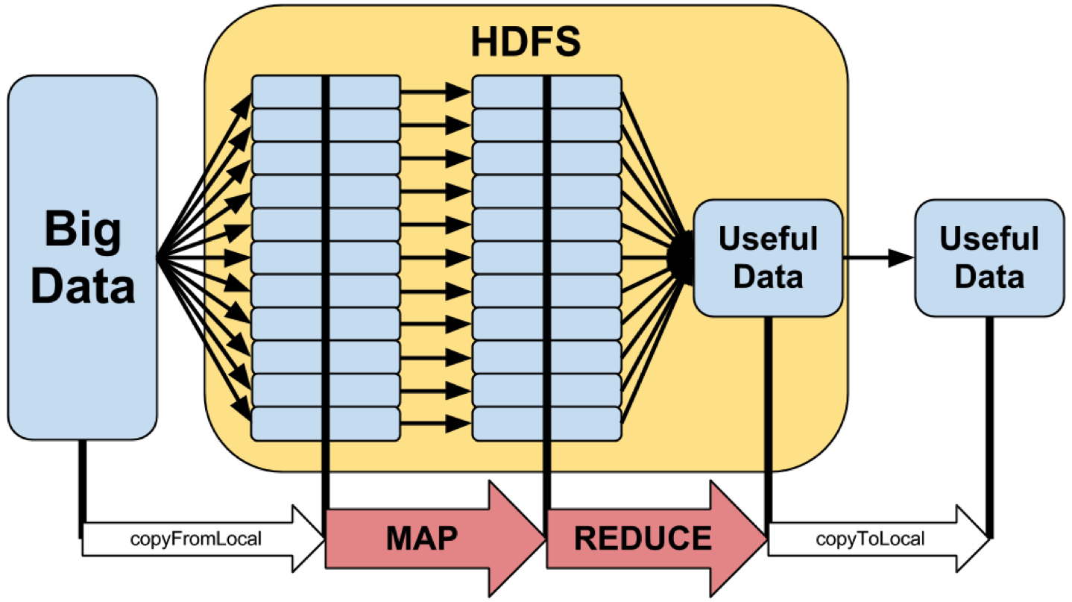
Hadoop
Hadoop is an open-source framework that allows to store and process big data in a distributed environment across clusters of computers using simple programming models.

Slide 4
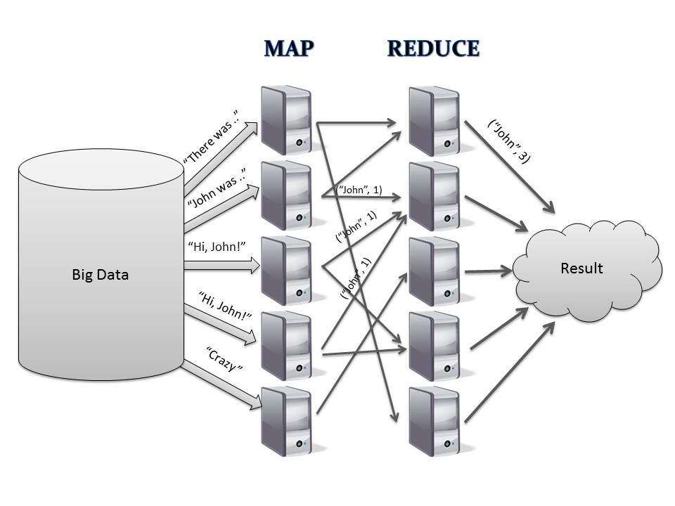
Map Reduce in Hadoop
Map Reduce is the heart of Hadoop
Hadoop MapReduce is a software framework for easily writing applications which process vast amounts of data in-parallel on large clusters of commodity hardware in a reliable, fault-tolerant manner.

Slide 5
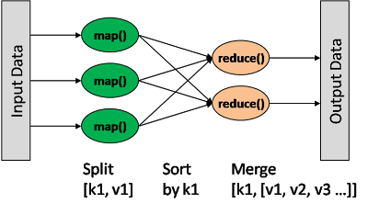
What Is a Map Reduce Job?

Slide 6
Map Reduce Job
A MapReduce job usually splits the input data-set into independent chunks which are processed by the map tasks in a completely parallel manner
The framework sorts the outputs of the maps, which are then input to the reduce tasks.
The input and output of the job are stored in a file system

Slide 7
Step 1: Map reduce Program
Installed all the required software for the project.
We ran Word Count Version 1 program in local Hadoop cluster.
WordCount Version 1 runs on local cluster.
WordCount Version 2 runs on remote cluster.
Both programs gives the each word count as the output.

Slide 8
Step 2: Action Rules ARGOS program
We implemented Action rules extraction in java.
We downloaded the Mammographic Mass dataset and Car evolution Dataset and run this with the program.
We created Graphical User Representation and showed the final output as list of action rules in a textfile.

Slide 9
Step 3 : MR Distribution Action Rules
The improved Apriori algorithm is implemented with MapReduce Programming model as shown below, here we named MR-Apriori algorithm.
1) Partitioning and Distributing data
Transaction database is divided into m subsets by MapReduce Library and are sent to m nodes executing Map tasks.
2) Formatting the data subsets
Format m data subsets as <key1,value1> pair where key is transaction id.
3) Generating set of global frequent itemsets L1
a) Set the value of k to 1
b) The task of Map function is to scan each record of the input item subset and generating Candidate itemsets Cp1.
c) Operate combiner option
Combiner function firstly combines the Map function outputs in the local and outputs <itemset,support_count>. Combiner function then uses partition function to divide the
intermediate pairs generated by combiner function into r different partitions.
d) Execute Reduce task to get the frequent itemsets L1
At Reduce function, the key itemsets are first sorted. After sorting the Reduce function add up the support count of the same candidates and get the actual support count of the
candidate in the whole transaction database. Then comparing with the minimum support count and getting the frequent itemsets L1.

Slide 10
Step 3 : MR Distribution Action Rules
4) Prepare for MapReduce
The value of k is increased by 1. The global frequent itemsets Lk-1 is sent to each node.
5) Execute Map task
The task of Map function is to scan each record of the input item subset, generate and filter set of Candidate itemsets Cpk according to the Apriori property that all subsets of a frequent itemset must also be frequent.
6) Operate Combiner option
Combiner function firstly combines the Map function outputs in the local and outputs <itemset,support_count> . Combiner function then uses partition function to divide the
intermediate pairs generated by combiner function into r different partitions.
7) Execute Reduce task
At Reduce function, the key itemsets are first sorted. After sorting the Reduce function add up the support count of the same candidates and get the actual support count of the candidate in the whole transaction database. Then comparing it with the minimum support count and getting the frequent itemsets Lk.
8) Repeat steps4)-7), until no more frequent itemsets can be found.

Slide 11
Apriori Action Rules Algorithm
Apriori is an algorithm for frequent item set mining and association rule learning over transactional databases
It uses breadth-first search and a Hash tree structure to count candidate item sets efficiently
Frequent item sets determined by Apriori can be used to determine association rules which highlight general trends in the database
Used in Market Basket Analysis

Slide 12
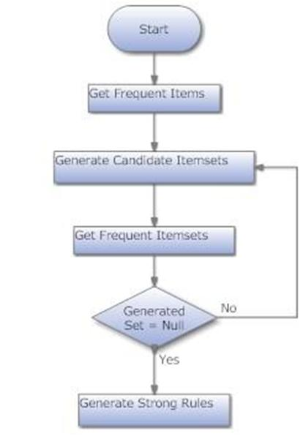
Apriori Action Rules Algorithm

Slide 13

Project Demo

