Slide 1
FreeSurfer - Euler Number

Slide 2
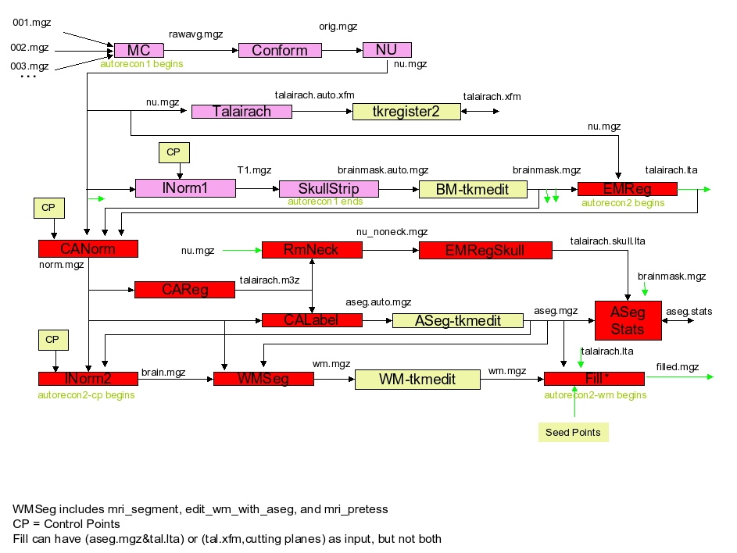
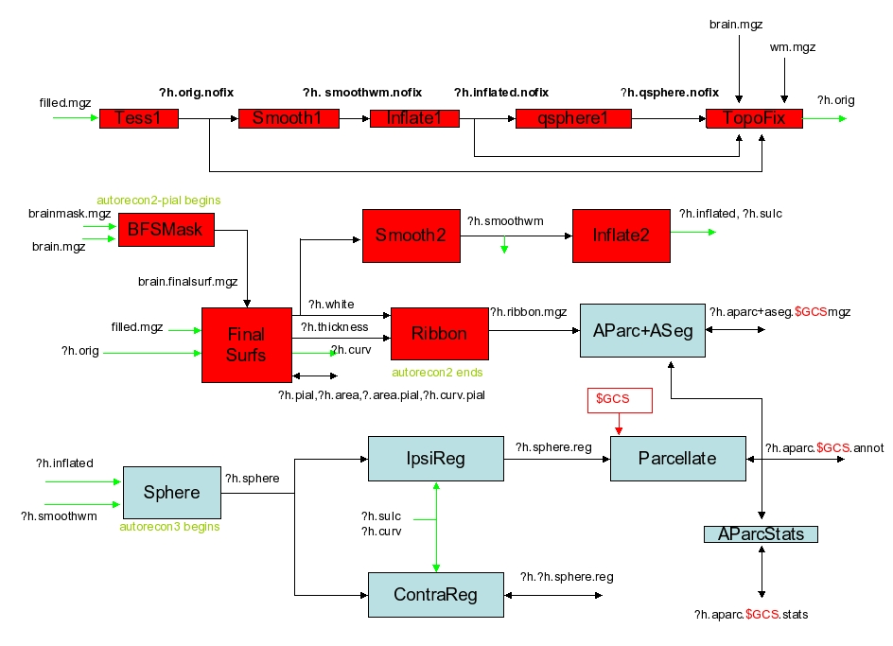
Freesurfer pipeline for data processing

Slide 3
The Euler number is created here:
mris_euler_number ?h.orig.nofix

Slide 4
We don’t need to perform

Slide 5
CAReg: ~4h to process
CALabel: ~1h to process

Slide 6
Added by the user in case of problems.
Added by the user in case of normalization problems.

Slide 7

Example for one subject
** Re-run the scripts for more subjects **
** Re-run more than one time in the same version **
Should we run in different versions of Freesurfer?
Process with “recon-all -all”: 30h
left hemisphere: Euler = -242
Process until the creation of ?h.orig.fix: 6h
left hemisphere: Euler = -242
Process without CAReg and CALabel: 40 minutes
left hemisphere: Euler = -302
Process steps 1-16: 6h30min
left hemisphere: Euler = -242

