Slide 1
In this task you will watch employees participate in an initiative. You will have to determine how important each employee was for the outcome.

Slide 2
This is a group of employees that work in an office.

Slide 3
Management wants employees to be productive. To do this, they give a reward to every employee if the office reaches their goal of productivity.

Slide 4

Every employee has a goal to meet. At the end of the week, they report their success or failure in meeting their goal.

Slide 5
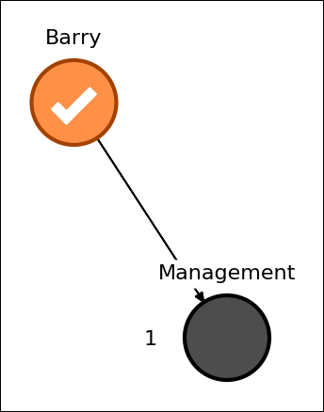
Some employees will contribute to the Office Goal.

Slide 6
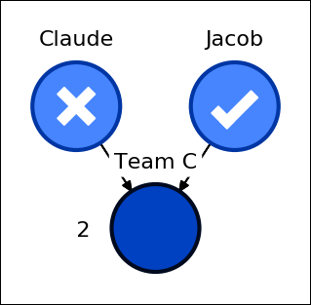
Some employees will contribute to teams.

Slide 7
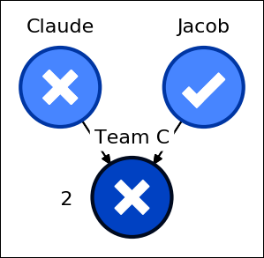
For a team to succeed, it must receive a certain number of successes. This number will be indicated to the left of the team.

Slide 8
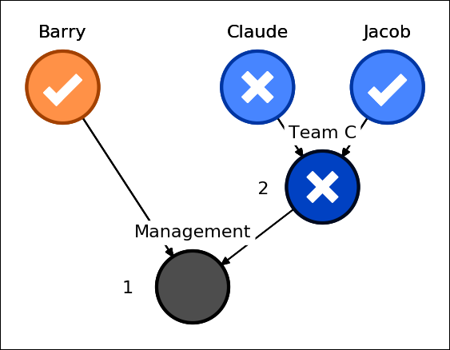
Similar to employees, a team will contribute to the Office Goal.

Slide 9
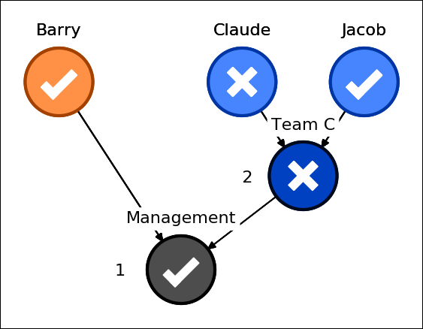
To win the reward, the Office Goal must receive a certain number of successes. This number will be indicated to the left of Office Goal.

