Slide 1
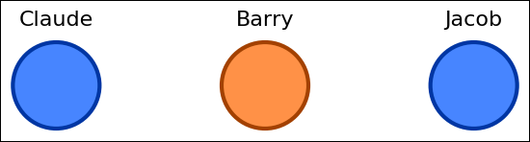
This is a group of employees that work in an office.

Slide 2
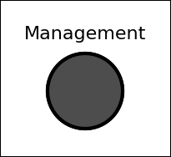
This is Management.
Management wants employees to be productive.
To do this, they give a reward to every employee if the office reaches their goal of productivity.

Slide 3
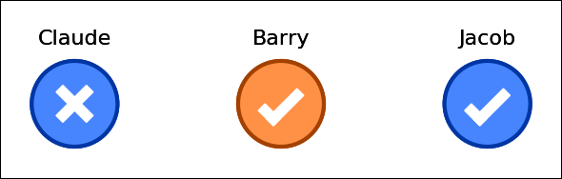
Every employee has a goal to meet.
At the end of the week, they report their success or failure in meeting their goal.

Slide 4
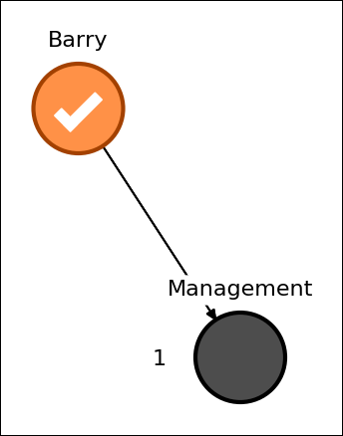
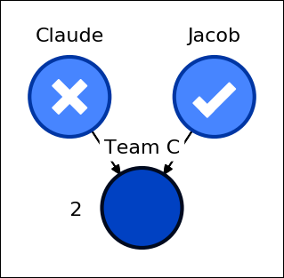
Some employees will report to management.
Others will report to teams.

Slide 5
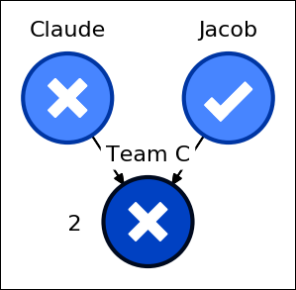
For a team to succeed, a certain number of its employees must succeed.
This number will be indicated to the left of the team.

Slide 6
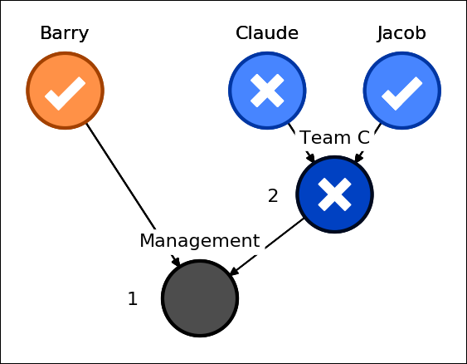
Similar to employees, a team will report a success to management if they succeed.

Slide 7
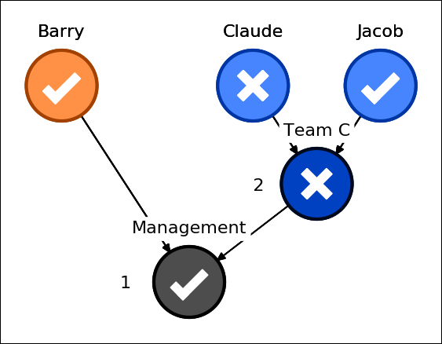
To win the reward, management must receive a certain number of successes.
This number will be indicated to the left of management.

Slide 8
In this task you will watch employees participate in the initiative.
You will have to determine how important each employee was for the outcome.

