Slide 1
In this task you will look at employees’ productivity.
You will have to determine how important each employee was for the the overall productivity.

Slide 2
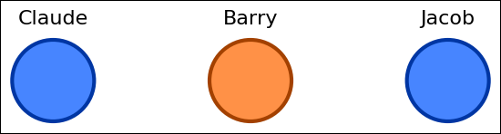
This is a group of employees that work in an office.

Slide 3
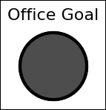
The office has a goal to meet.
To evaluate whether the Office goal has been met, we must evaluate employee productivity.

Slide 4
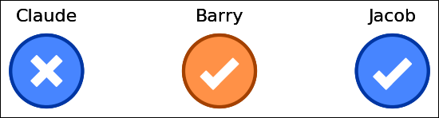
Every employee has a goal to meet.
At the end of the week, they report their success or failure in meeting their goal.
An X means failure. A check mark means success.

Slide 5
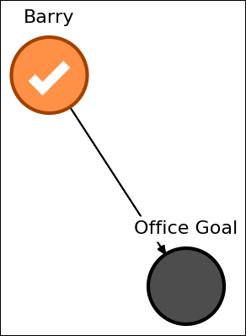
Some employees will contribute to the Office Goal.
Here, the arrow means that Barry contributes to the Office Goal.

Slide 6
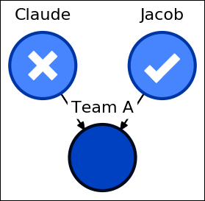
Others will contribute to teams. Teams and their employees share the same color.
Claude and Jacob are in Team A.

Slide 7
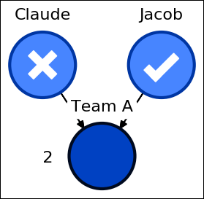
Teams also have goals to meet.
The number 2 next to the Team A node, indicates that at least 2 employees have to succeed in order for the team to meet its goal.

Slide 8
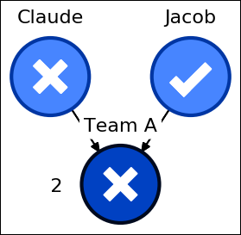
In order for Team A to meet its goal, both Claude and Jacob have to succeed in their task.
The team failed because Claude did not succeed.

Slide 9
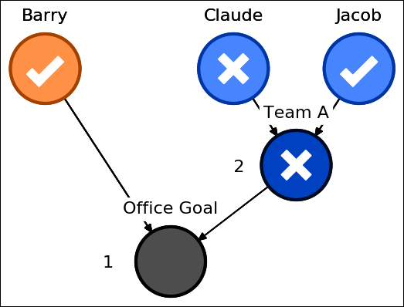
Similar to employees, a team may contribute to the
Office Goal.

Slide 10
The number 1 next to the Office Goal, indicates that at least 1 employee/team has to succeed in order to meet the Office Goal.

Slide 11

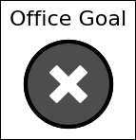
A check mark means the office met their goal.
An X means the office did not meet their goal.

Slide 12
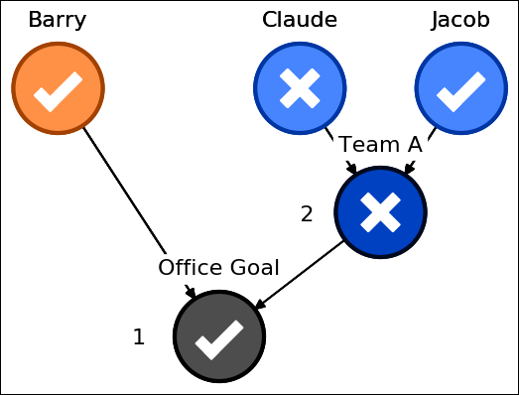
To win the reward, Barry or Team A or both must succeed.
The Office Goal was met because Barry succeeded.

Slide 13
This concludes the introduction.
In the following page we will present you a set of questions to check your understanding of the task.
Then, you may begin the task.

