Slide 1
Basics of programming
Nathalie Jurisch-Yaksi
FOR5547
27.05.2025

Slide 2
What is programming?
- a collaboration between humans and computers
- giving a set of instructions to a computer to execute
Languages are involved
Different languages exists (JavaScript, html, python, C, R, MATLAB)

Slide 3
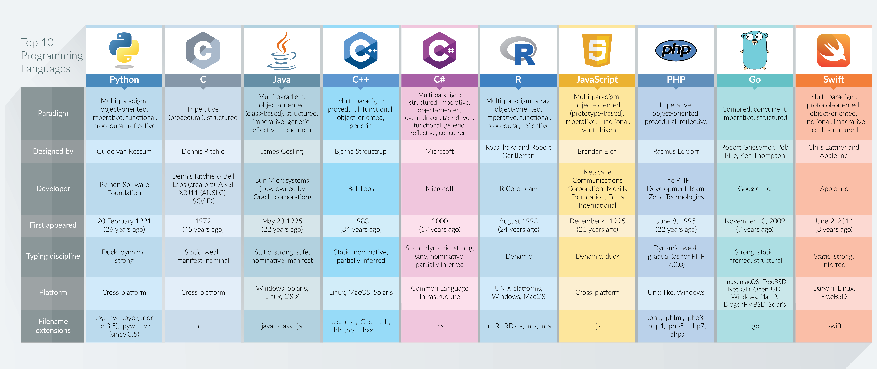
https://dzone.com/articles/top-10-programming-languages-in-2017

Slide 4
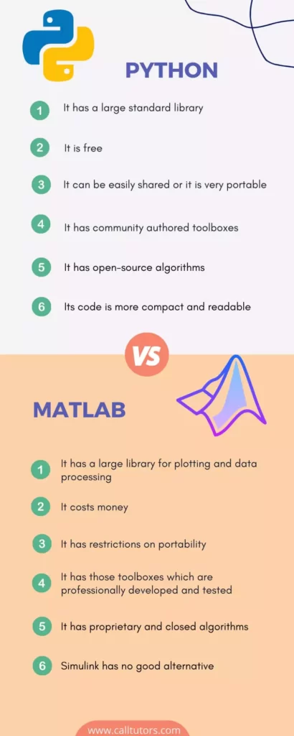
Which programming language to use?
https://www.calltutors.com/blog/python-vs-matlab/

Slide 5
What is a code and how to code?
A code is a sequence of instructions that a programmer (you) writes to tell a device (like a computer) what to do.
The instructions aim to do alterations on
Text
Numbers
Date
Logical (true, false)
….

Slide 6
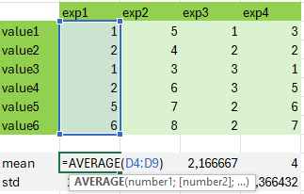
Example excel sheet
Possible to do small calculations but hard to analyze large datasets
Provide a user interface that is easy to navigate and contain all information organized in a visual way

Slide 7
Basics of Matlab

Slide 8
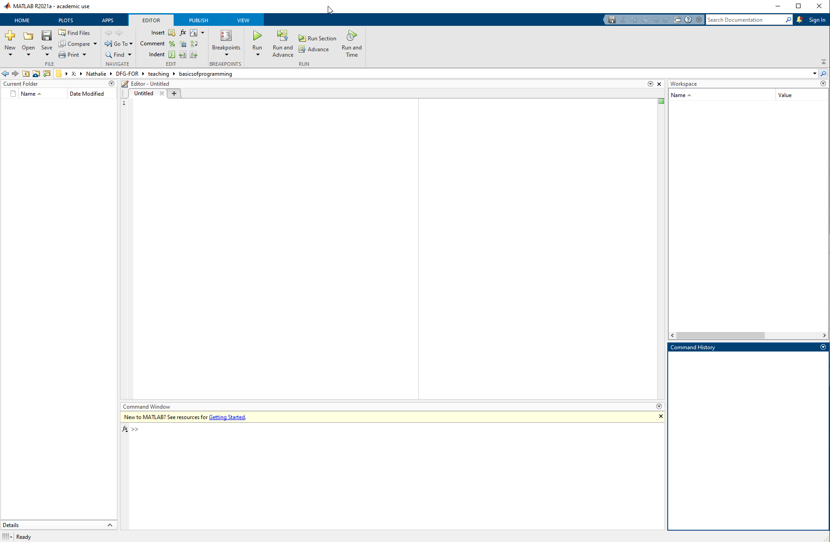
Folder where the files are
Where your data variable are
Editor (where you write your codes)
History of what you wrote
Command window

Slide 9
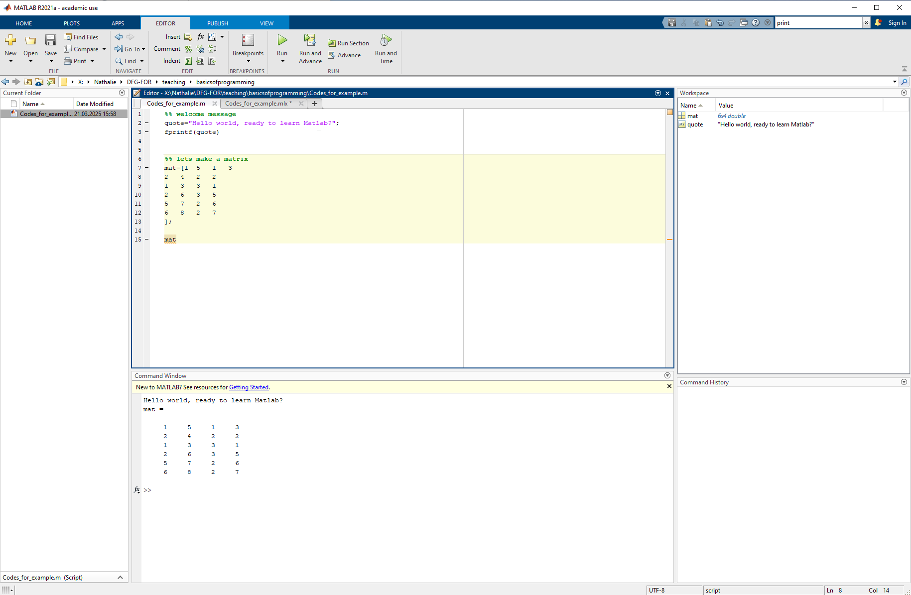

Slide 10
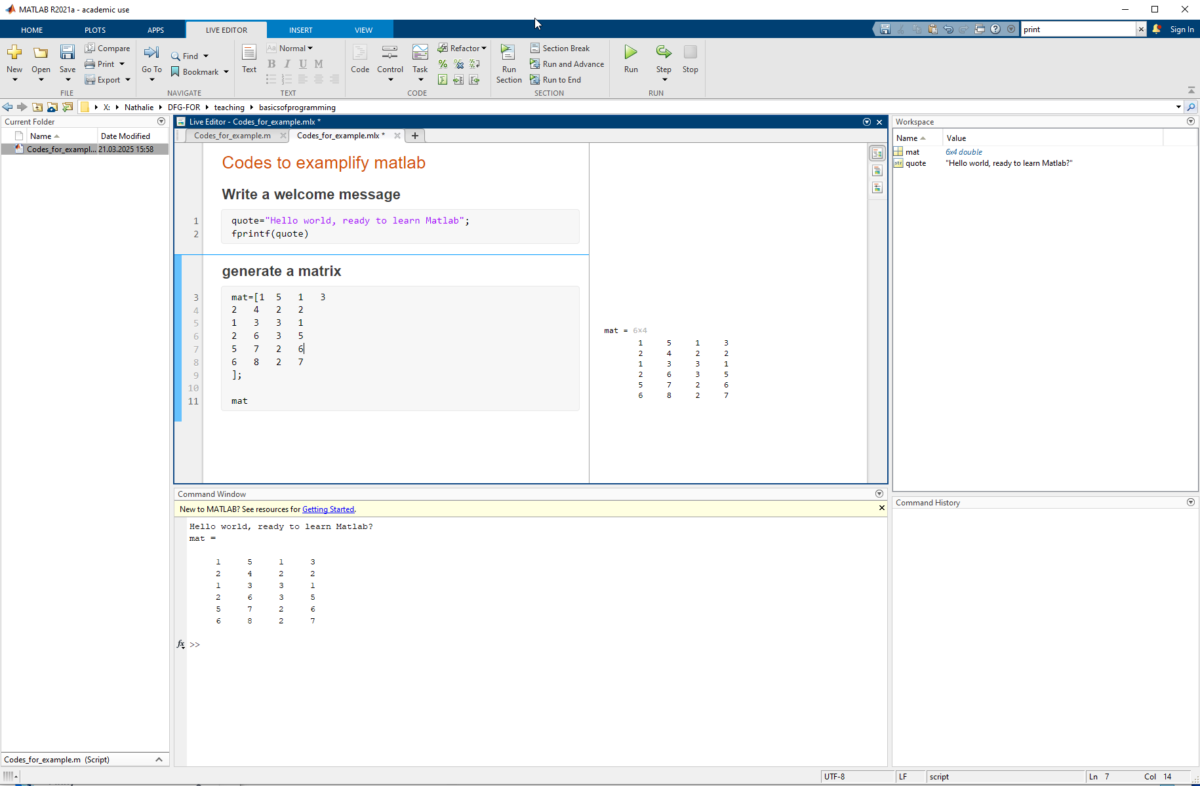

Slide 11
Use the live script to exemplify Matlab

Slide 12

Data/code Management: why is it important?
Benefit | Why It Matters
Clarity | Easier to read and maintain
Performance | Faster and more memory-efficient code
Scalability | Can handle bigger datasets without breaking
Reusability | Write general-purpose functions
Debuggability | Easier to isolate and fix problems
Collaboration | Makes teamwork and sharing code easier
Data Accuracy | Prevents bugs from corrupt or inconsistent data
Source chatGPT

Slide 13
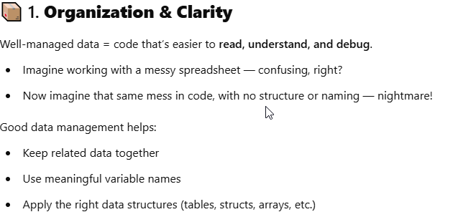
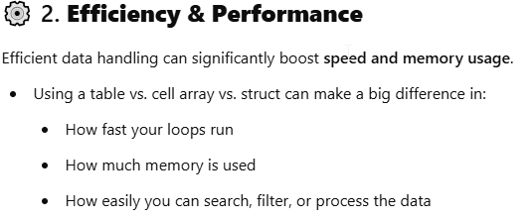
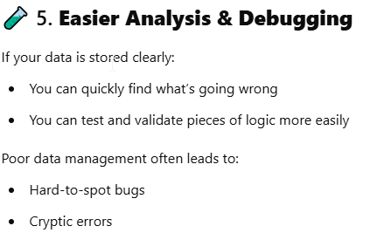
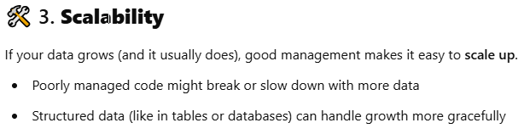
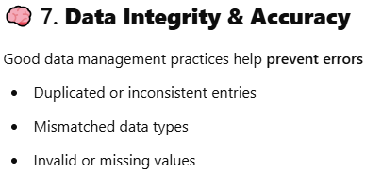
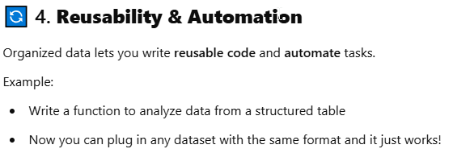
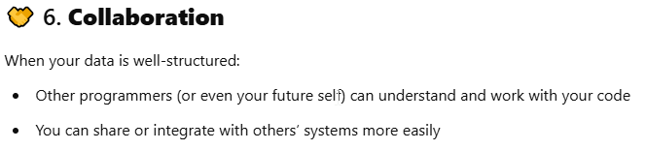

Slide 14
How to keep track of changes?
Lets take one example: your latest report/manuscript…
Now: codes are text that import data, transform data and generate outputs (data, tables, figures).
One slight change a + to a – in a code can change the output and the conclusion
Easy to make mistakes, hard to find mistakes
→ Version control is absolutely necessary

Slide 15
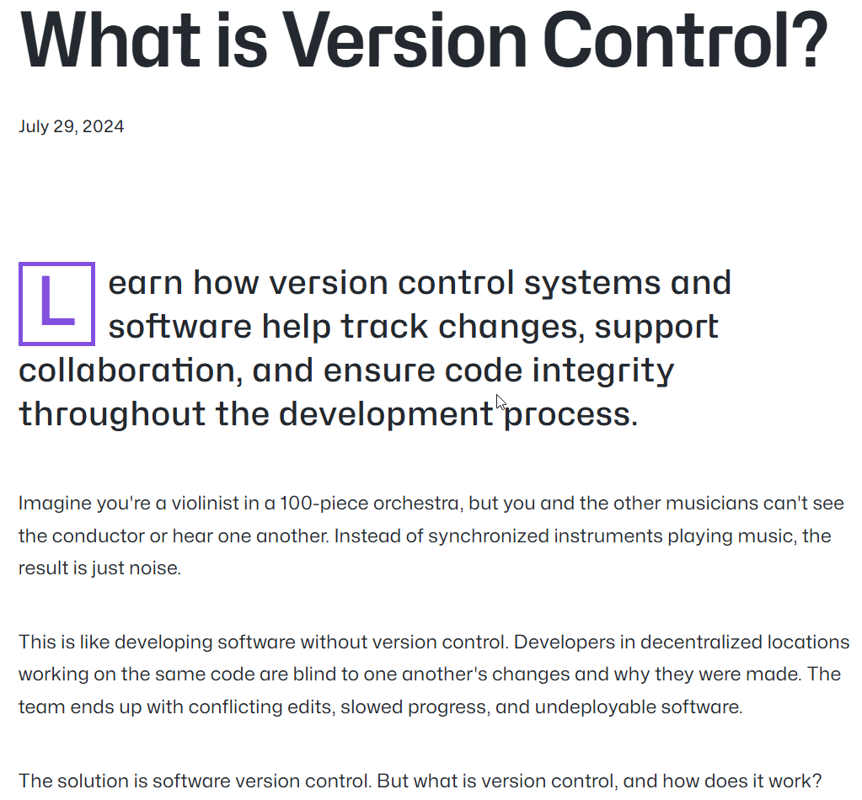
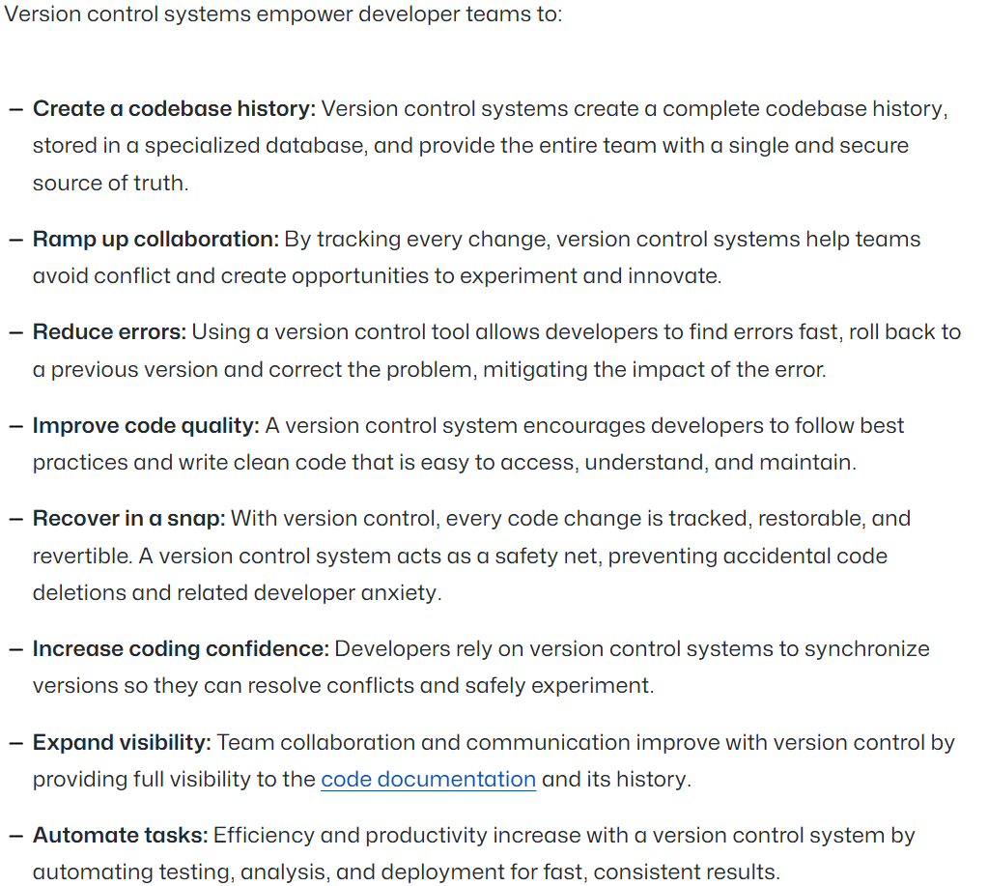
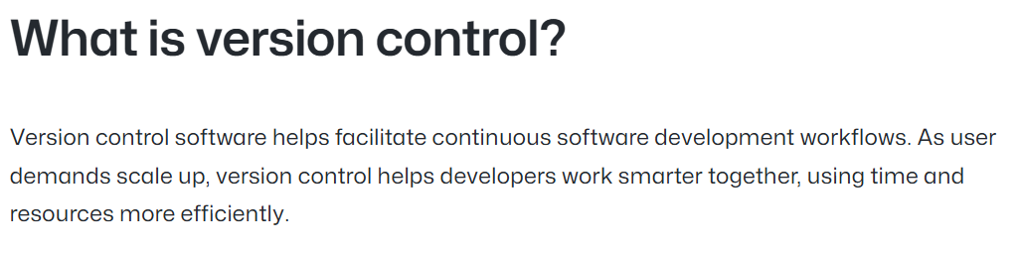
https://github.com/resources/articles/software-development/what-is-version-control

Slide 16

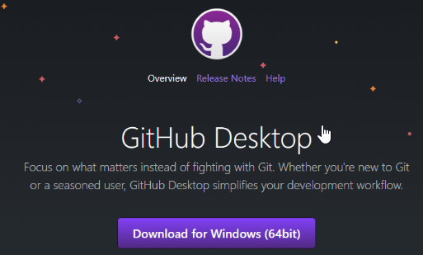
Git and GitHub
Several version control system exists
Git is an open source version control
GitHub is a cloud-based hosting system working with Git
GitHub Desktop allows you to do version control locally on your computer and push the data on the cloud (very user-friendly)
GitHub education allows you to use language learning models within visual studio (GitHub copilot)

Slide 17
GitHub
Demonstration in the computer

Slide 18
Use of AI in coding ChatGPT or copilot
Demonstration in the following lecture on python

Slide 19
What comes next?
I want you to
Think about data management: how can you improve version control in your daily activities?
Think about your data: how can you use matlab or equivalent to make data analysis more straightforward
Set up a github education account
If you have access to matlab, please download it and play with the codes I loaded on github https://github.com/nathalju/DFG-FOR-intro-to-programming
Next session will be about python and everyone can have access to it

