Slide 1
Basics of programming: intro to python
Nathalie Jurisch-Yaksi
FOR5547
Spring 25

Slide 2
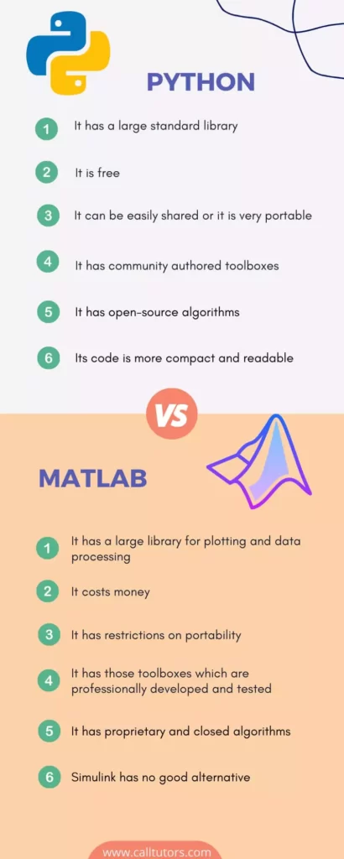
Which programming language to use?
Download and installation more complex
One click download/installation
https://www.calltutors.com/blog/python-vs-matlab/

Slide 3
Python installation
Link to download python https://www.python.org/downloads/
Can be run using different user interface (also known as Integrated Development Environment or IDEs)
IDE range from pure coding to more interactive
Find the one you like the most
My favorite: Visual Studio Code
Additional information: https://www.python.org/about/gettingstarted/

Slide 4
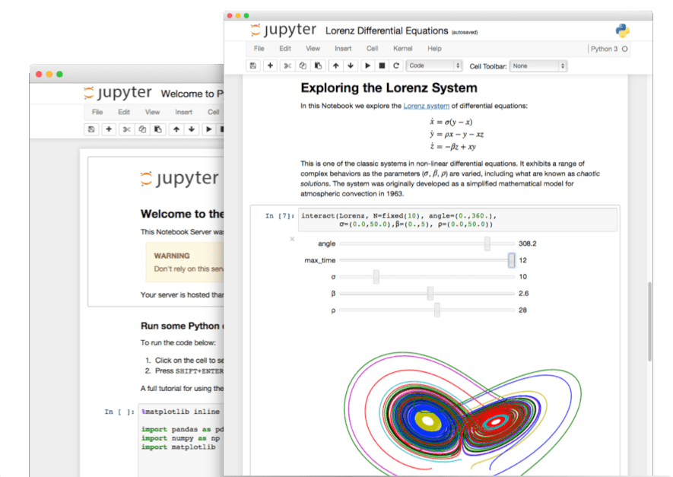
Jupyter notebook
Jupyter Notebook is a popular, open-source web application used for creating and sharing computational documents. It combines code, text, visualizations, and rich media into a single document, making it a powerful tool for data science, machine learning, and other computational tasks.

Slide 5
To do next…
Download Python and VS code on your computer
Get a github education account
Get the extensions for jupyter, github copilot
Download the jupyter notebook from github (https://github.com/nathalju/DFG-FOR-intro-to-programming ) and run the code
Read through and try to get a good sense of what the code does. If you do not understand, ask copilot or ChatGPT
Use your own data that you can import from an excel sheet
Generate figures and graphs

Slide 6
Challenges with python
Working with Python environments comes with several concerns and best practices
1. Package Conflicts
Different projects may require different versions of the same package.
Problem: Installing one version may break another project.
Solution: Use virtual environments (e.g. venv, virtualenv, conda) to isolate dependencies per project.
2. Global Environment Pollution
Installing packages globally (pip install) can clutter your system and cause versioning problems.
Solution: Always install packages inside a virtual environment
3. Reproducibility
You or someone else may not be able to run your code later if dependencies change or aren’t documented.
Solution: Save dependencies in a file:
4. Python Version Incompatibility
Some packages (or even your code) may only work with certain Python versions.
Solution: Use tools to manage multiple Python versions on the same system.
5. Environment Activation Confusion
Forgetting to activate the virtual environment can lead to running the wrong version of Python or missing packages.
Tip: Use a consistent project setup and name your environments clearly (e.g., .venv, env, project_env).
6. Environment Size and Clutter
Environments can become large and filled with unnecessary packages.
Solution: Regularly audit or recreate your environment from a minimal requirements.txt.
7. Security Issues
Outdated or untrusted packages may introduce vulnerabilities.
Solutions: Use trusted sources (e.g., PyPI), Regularly update packages

Slide 7
Virtual environements
Virtual environments in Python are isolated environments that let you install packages just for one project, without affecting other projects or your system-wide Python installation.
Problem | Virtual Environment Fixes It
Project A needs numpy==1.20, Project B needs numpy==1.26 | Each gets its own version inside its own environment
Avoid polluting global Python with packages | Keeps each project clean and self-contained
Reproducibility issues | Helps lock down and share exact dependencies

Slide 8
How to make a virtual environement
On the terminal window (not the notebook)
python -m venv myenv
source myenv/bin/activate (for MacOS)
pip install notebook ipykernel
Go to Kernel → Change Kernel → Python (myenv)
pip freeze > /Users/nathalju/Documents/DFG-FOR/teaching/codes_FOR5547teaching/requirements.txt
At the end deactivate the virtual environement on the terminal by writing deactivate

