Slide 1
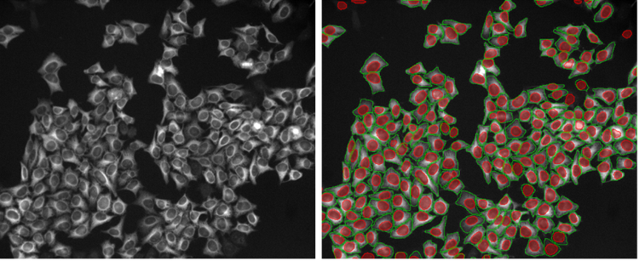
Segmentation 1.0.1
Nathalie Jurisch-Yaksi
https://evidentscientific.com/en/insights/20-examples-of-effortless-nucleus-and-cell-segmentation-using-pretrained-deep-learning-models

Slide 2
What is image segmentation?

Slide 3
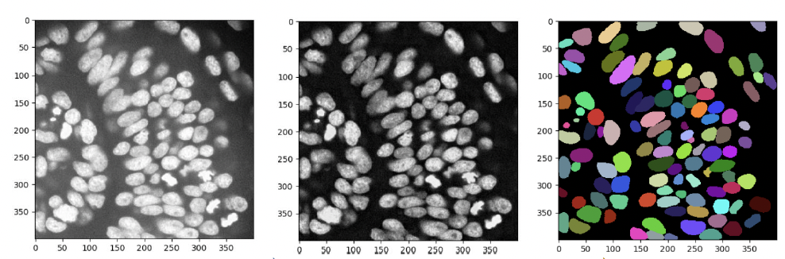
What is image segmentation?
Image segmentation is the process of partitioning an image into meaningful regions or objects.
Why do you want to do segmentation?
https://github.com/BiAPoL/Bio-image_Analysis_with_Python/blob/main/04_image_segmentation/Image_segmentation.pdf

Slide 4
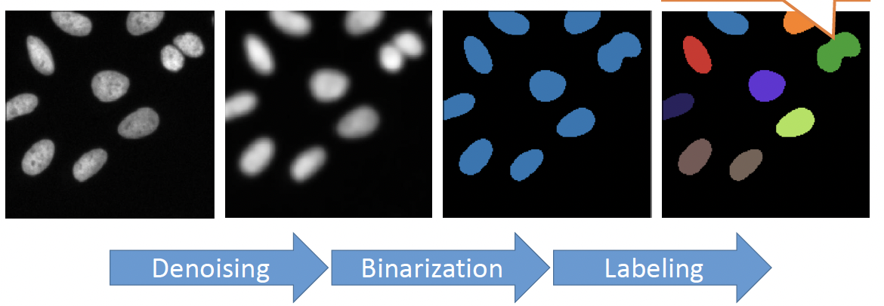
Segmentation: what are the steps?
https://github.com/BiAPoL/Bio-image_Analysis_with_Python/blob/main/04_image_segmentation/Image_segmentation.pdf
https://bioimagebook.github.io/chapters/2-processing/3-thresholding/thresholding.html

Slide 5
Things to consider when segmenting data

Slide 6
Things to consider
Pre-processing? What kind?
2D versus 3D?
Automatization? Or User in the loop?
Batch processing, one image at a time?
Check of quality?
Use of AI?

Slide 7
Segmentation: lots of tools available

Slide 8
CiliaQ

Slide 9

Morning project
several datasets
Link to data:
https://uni-bonn.sciebo.de/s/dYZ5Hkypz8YNTKi
  Perfect cilia (Daniel)
  Overlapping cilia (Valentina)
  Short cilia with high background (Himanshu)
  Bundled cilia (Yasmin)
  Thick 3D dataset with lots of nuclei (Nathalie)

Slide 10
Segmentation: reflections
What is a "correct" segmentation?
What determines the quality of a segmentation?
What are weakness and challenges with segmentations? And why are these problematic?

Slide 11
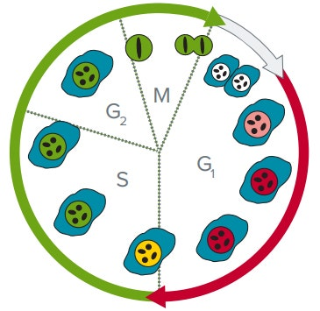
Afternoon project (group of 4)
Your data suggest that in your mutant cells, cilia take longer time to re-assemble after mitosis.
You want to quantify these data. For this, you plan to perform live-cell confocal fluorescence microscopy with a cilia marker and a FUCCI cell-cycle reporter.
Design an imaging and analysis pipeline to quantify cilia reassembly dynamics.
Consider: programing language, data handling, version control and reproducibility, documentation and usability, data output, visualization and statistics, AI-use, available computer infrastructure.
https://www.moleculardevices.com/en/assets/app-note/dd/img/evaluating-cell-cycle-inhibitors-using-live-cell-assay

Slide 12
References
https://bioimagebook.github.io/index.html
https://github.com/BiAPoL/Bio-image_Analysis_with_Python/tree/main

