Slide 1

Formal Verification of Browser Fingerprinting and Mitigation with Inlined Reference Monitors
Nathan Joslin, Phu H. Phung, Luan Viet Nguyen

Slide 2
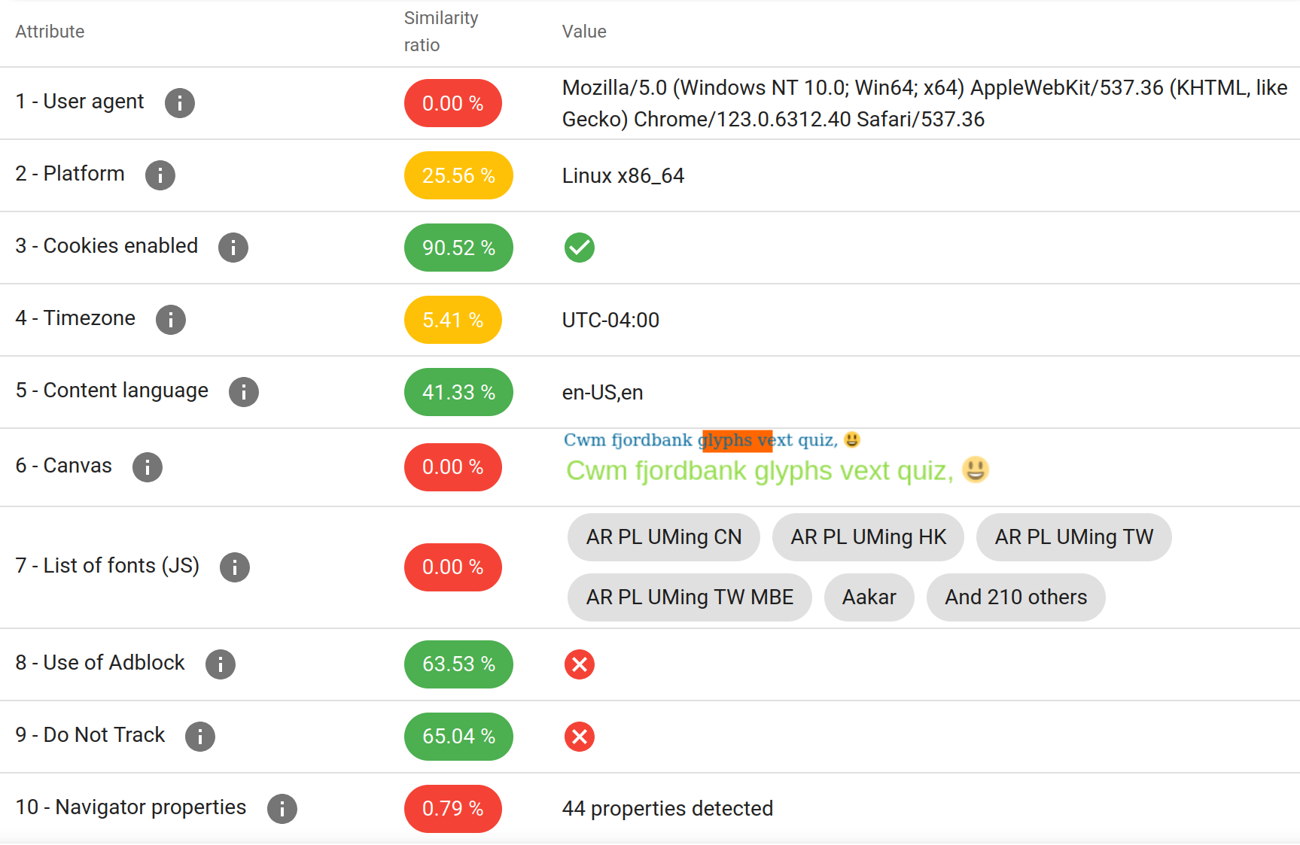
What is Browser Fingerprinting?
Definition: An aggregation of browser attributes
Stateless: Unlike cookies, no information is saved client-side
Silent: User is completely unaware
Source: amiunique.org
Notes:
Digital fingerprinting is a technique used to create unique identifiers by aggregating a variety of attributes associated with a device.

Slide 3
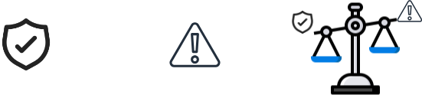
Applications and Motivations
Positive
Malicious
Ad Fraud Prevention
Bot Detection
Multi-Factor Auth
Cross-site Tracking
Malware Targeting
Social Media Linking
Duality
Involuntary Tracking
Voluntary MFA
Fraud Prevention

Slide 4
Rising Popularity
Frequency of Fingerprinting on Popular Web Pages - Today
Fingerprinting the Fingerprinters
Iqbal et al. (2021)
Estimated Usage:
30.60% of Alexa top 1K
10.18% of Alexa top 100K
By Category:
14% of News sites
6% of Shopping
Other:
2,349 domains serving scripts
3.78% considered tracking by Disconnect
The Double Edged Sword
Senol, Ukani et al. (2024)
Estimated Usage:
25.75% of CrUX top 1K
8.9% of CrUX top 100K
By Category:
9.2% of Login Pages
12.5% of Sign-up Pages
Other:
60% of scripts use the Canvas API

Slide 5
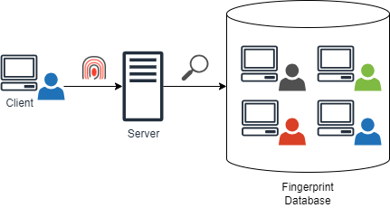
Fingerprinting Mitigation
Policy Decision Making
Machine Learning Based
Developer Defined Heuristics
Enforcement Methods
API Blocking
Randomization
Normalization
Notes:
Two aspects of Fingerprinting Mitigation
Policy Decision Making: “When do we mitigate”
Policy Enforcement: “How do we mitigate”
We’re concerned about the reliability of enforcement

Slide 6
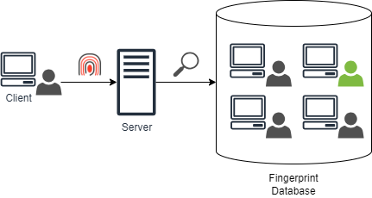
Mitigation Approaches: Normalization
Normalization:
Goal: “Hide in the crowd”
Reduces fingerprint uniqueness by setting attributes to a shared value.
Usage: Tor Browser

Slide 7
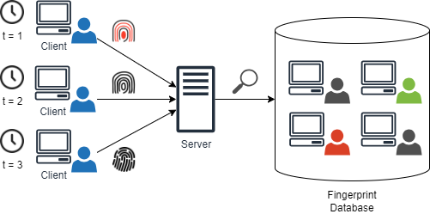
Mitigation Approaches: Randomization
Randomization:
Goal: “Moving Target”
Increases fingerprint uniqueness by adding noise or changing attribute values
Usage: Brave Browser
Canvas Poisoners

Slide 8
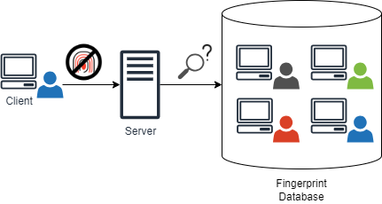
Mitigation Approaches: API Blocking
Goal: Prevent function execution
Prevents some or all attributes of a fingerprint from being collected
Usage: Tor Browser, preventing canvas API

Slide 9
Mitigation Approaches
No Mitigation
Randomization
Normalization
API Blocking
Notes:
Shows the effects of mitigation approaches on fingerprinting schemes
Normalization: Hide in the Crowd
Randomization: Moving Target
API Blocking: Prevent function execution

Slide 10
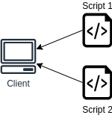
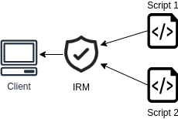
Inlined Reference Monitors
Language-based security approach
Rewrite/Weave security policies into the application
Runtime interception of function calls or property accesses

Slide 11
Building the Components

Slide 12
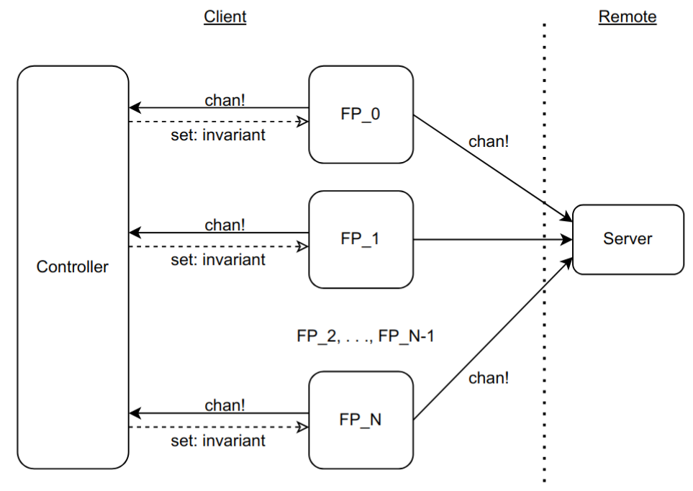
System Overview

Slide 13
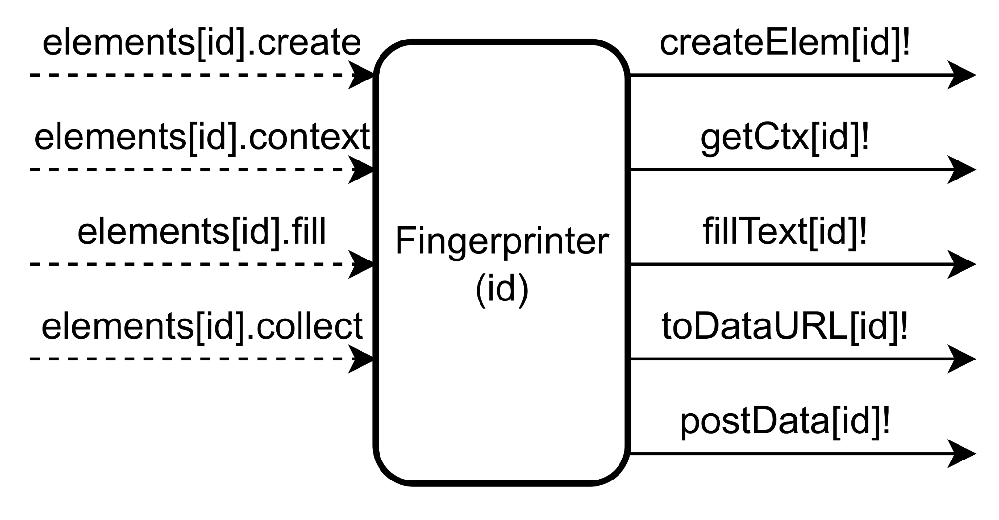
Fingerprinter: Overview
Description:
Models a canvas fingerprinting script
Based off of open-source libraries and related research
Attempts to make function calls that are intercepted by the Controller
𝑥 : Funcs Monitored
𝑦 : Fingerprinter Components
Input: Invariants set by the controller.
𝑓 (𝑥,𝑦) = 𝑥𝑦
Output: Send channel synchronizations.
𝑓(𝑥,𝑦) = 𝑥𝑦 + 𝑦

Slide 14
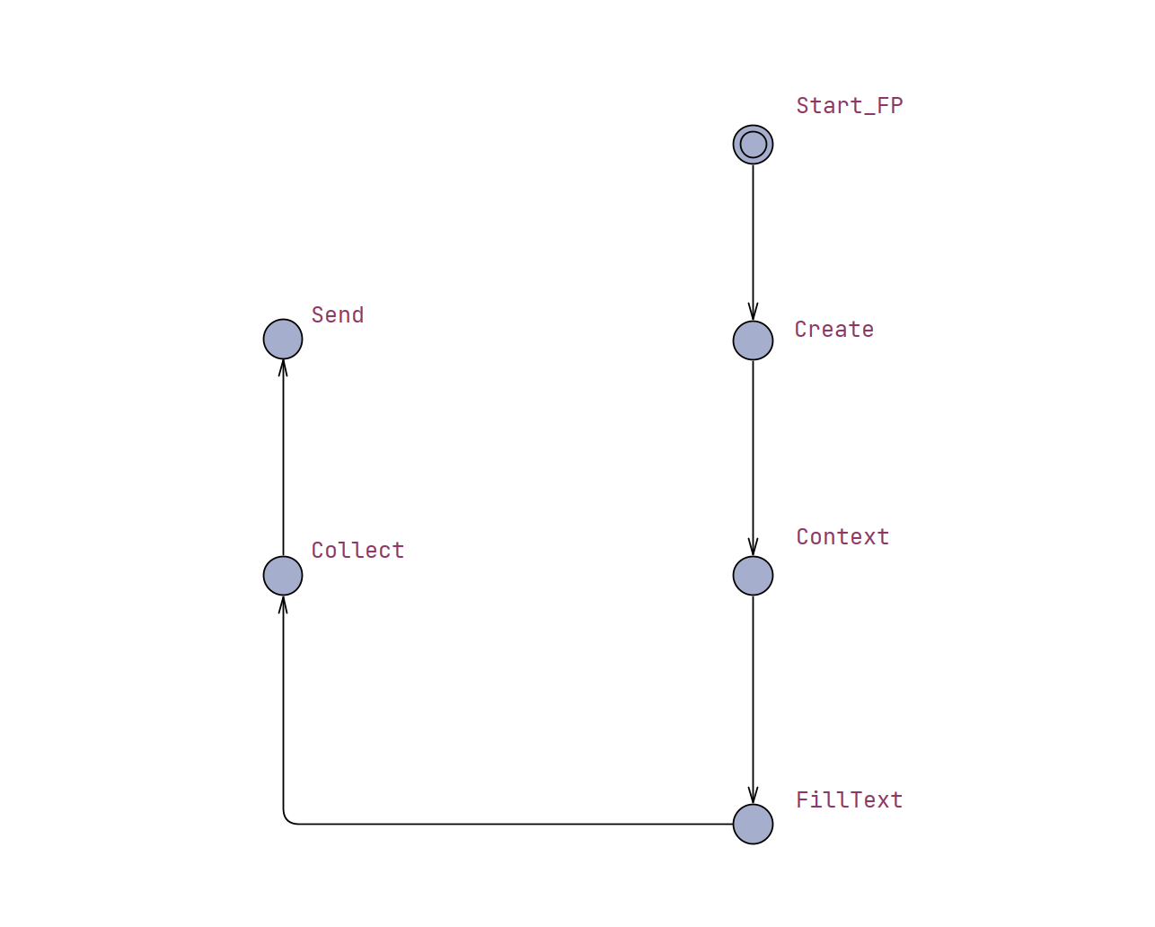
Main States
Create canvas element
Get canvas context
Draw on context
Collect value
Send to server
Notes:
Edges leading into states model function execution
States themselves represent successful completion of the function call

Slide 15
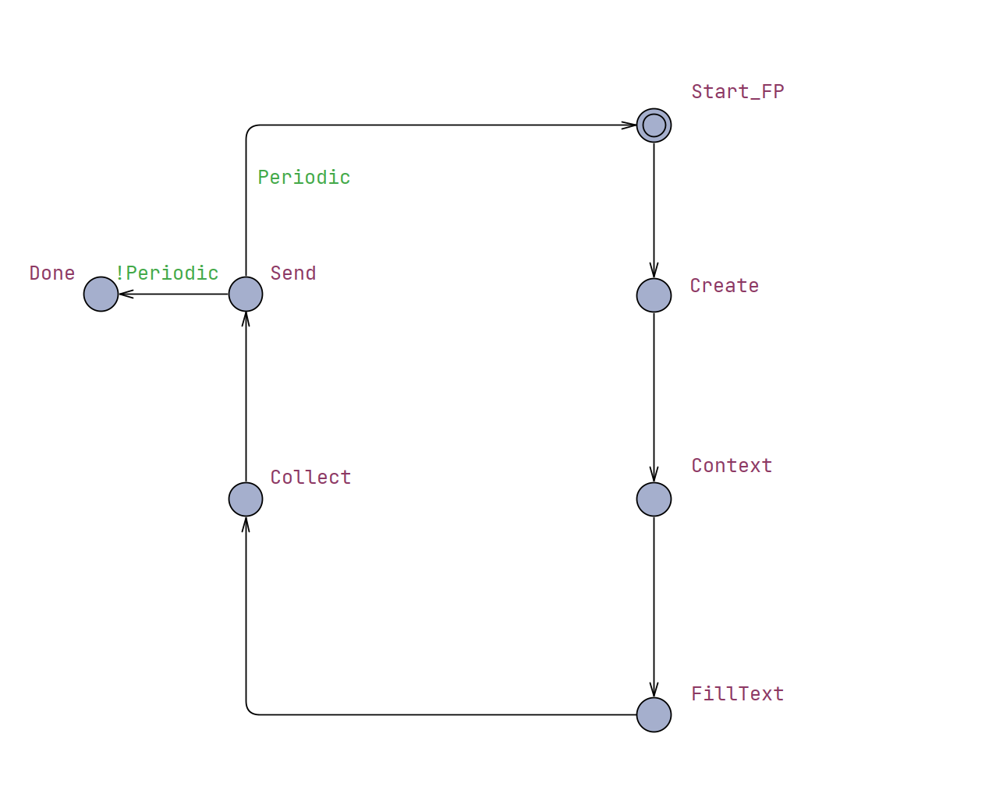
Periodicity
Supports modeling one-and-done and repetitive scripts
Helpful for analyzing behavior across runs
Easily modified to an integer value

Slide 16
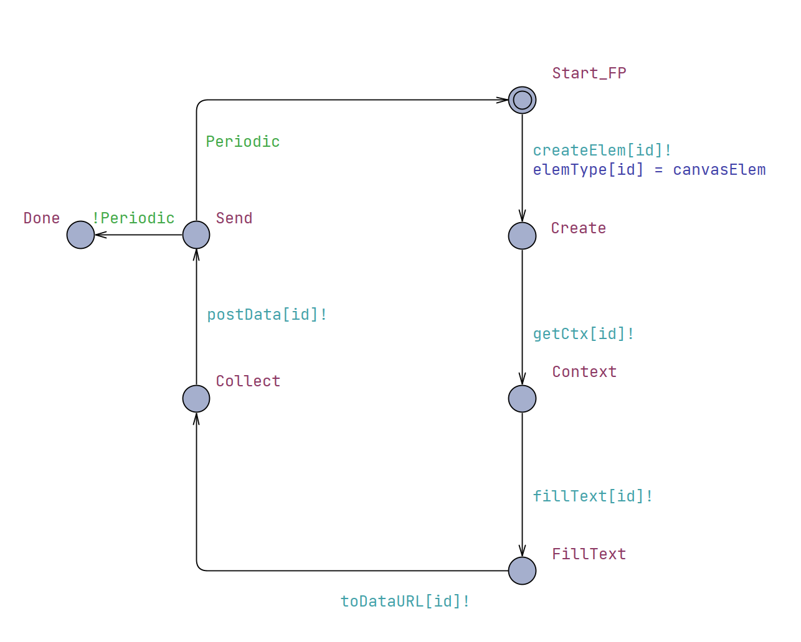
Synchronization Channels
Instrumentation for Controller
Models IRM function interception

Slide 17
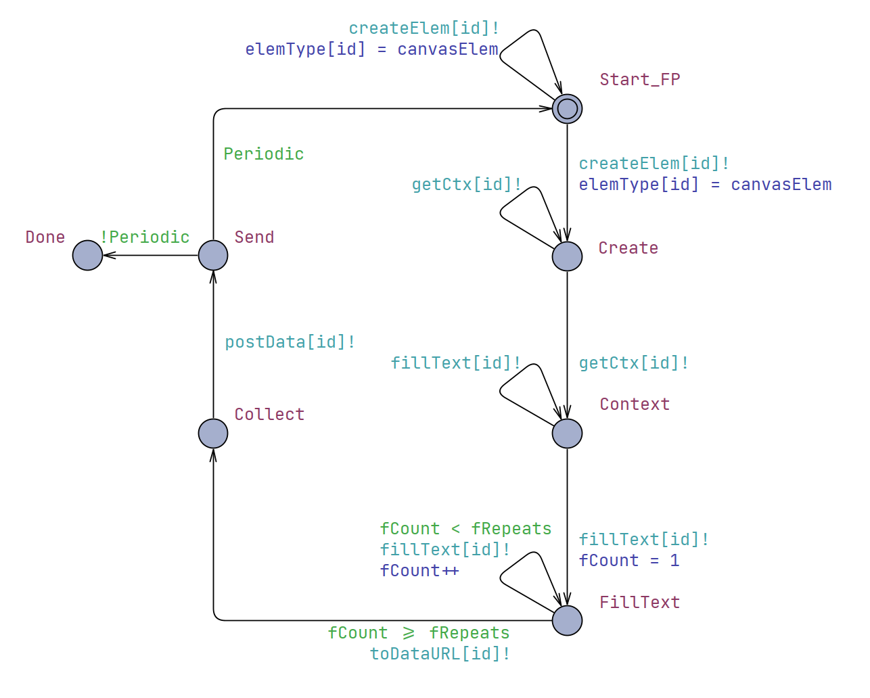
Persistent Loops
Supports a wider variety of scripts that may not be “well formed”
Notes:
Well formed or formed smartly, i.e. a script that intentionally makes function calls that aren’t necessary in an attempt to bypass defense mechanisms

Slide 18
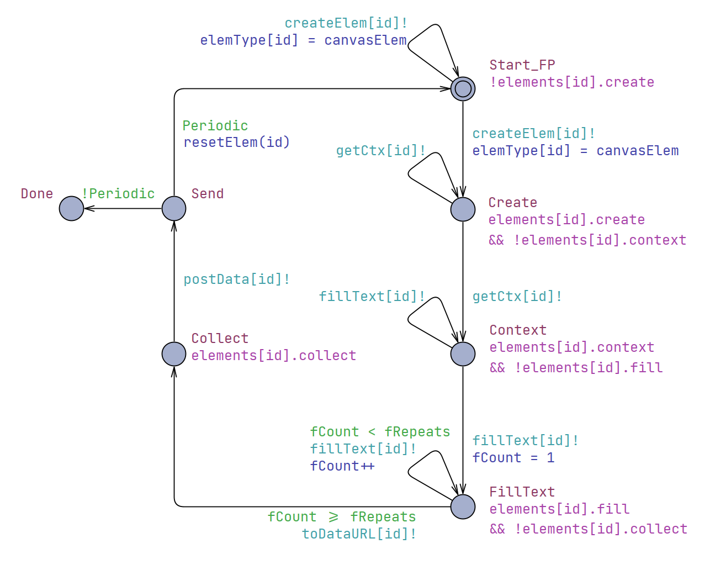
Controller Invariants
Instrumentation for Controller
Models IRM policy enforcement

Slide 19
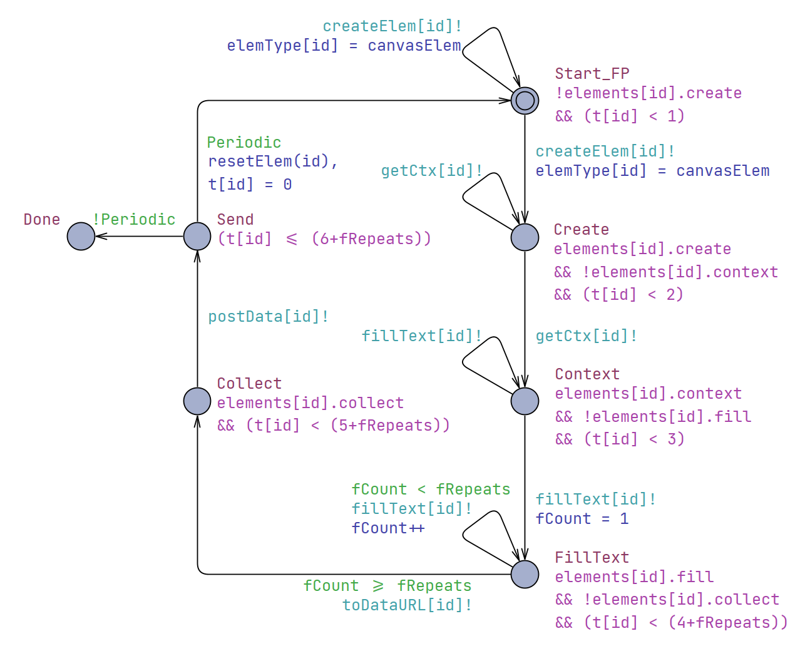
Timing Constraints
Ensures progression, if possible
Aids in evaluating liveness and reachability properties

Slide 20
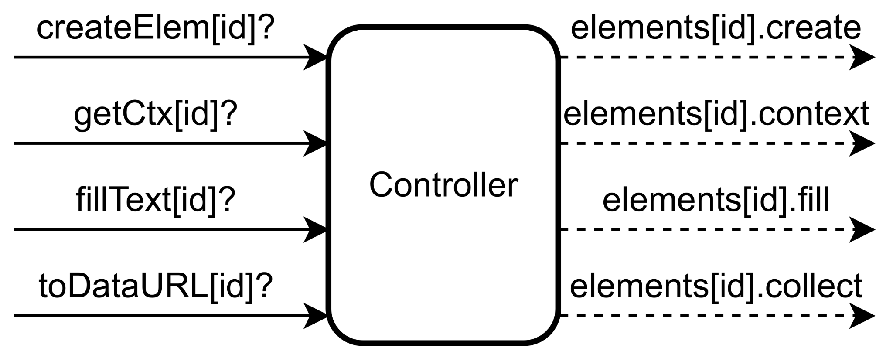
Controller: Overview
Description: An abstraction of an Inline Reference Monitor intercepting function calls.
Synchronizes with Fingerprinter components
𝑥 : Funcs Monitored
𝑦 : Fingerprinter Components
Input: Receive channel synchronizations.
𝑓 (𝑥,𝑦) = 𝑥𝑦
Output: Set state invariants.
𝑓(𝑥,𝑦) = 𝑥𝑦

Slide 21
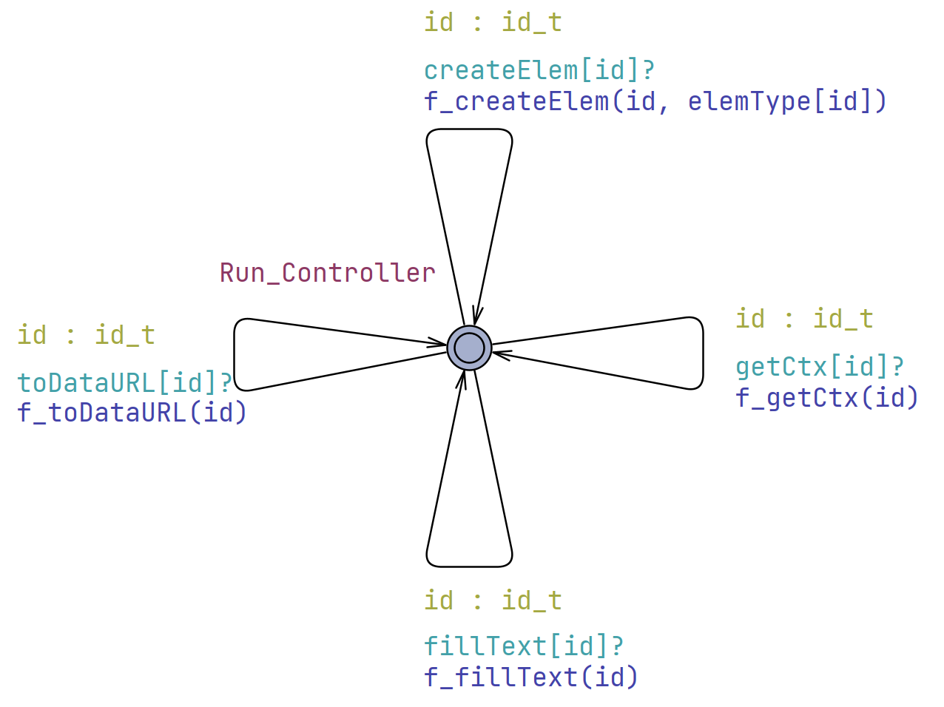
Controller: Timed Automata
Transitions:
One for each func controlled/monitored
Sync: Receive from any channel
Select: Sending component ID
Update: Policy Evaluation, or other actions

Slide 22
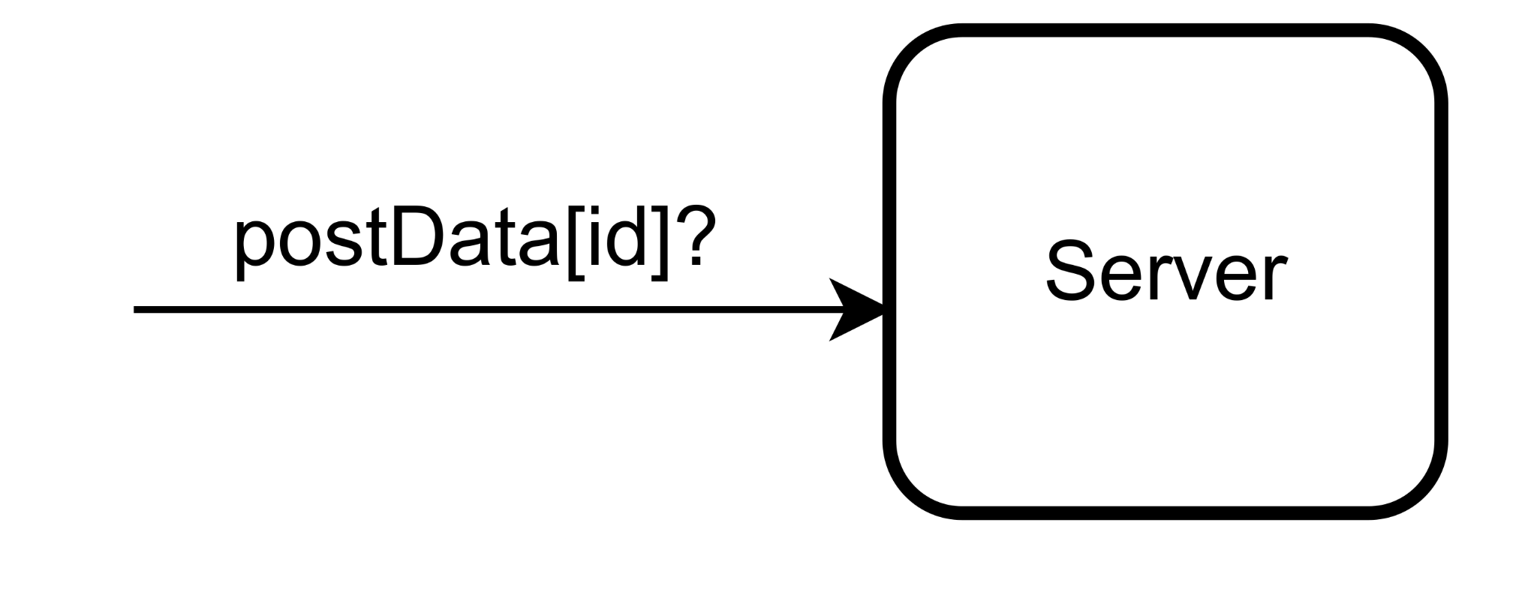
Server: Overview
Description:
Models a remote server and database
A comprehensive model of the remote components is out of scope
Combining remote components reduces state space
Allows fingerprint values to be evaluated over time
Input: Receive from data channel
Output: n/a, internally stores data

Slide 23
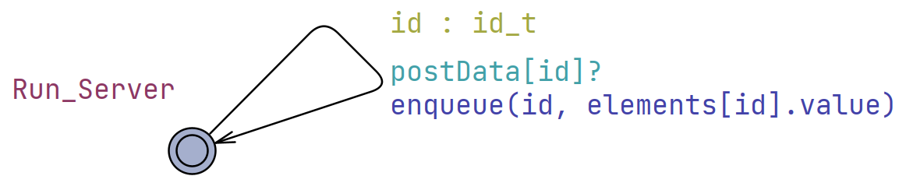
Server: Timed Automata
Transitions:
Sync: Receive from any channel
Select: Sending component ID
Update: Store data
One data channel for each Fingerprinter component
Notes:
Simply receives data from any fingerprinter component
Stores data into a queue
Distinct queues are defined for each fingerprinter component
Limited entries, such that an enqueue on a full queue first dequeues the oldest value (FIFO)

Slide 24
Requirements and Policy Configuration

Slide 25
Informal Requirements
FP_0
FP_1
FP_2
No Mitigation
Randomization
API Blocking
Allow fingerprints to be freely collected, without intervention from the Controller.
Allow fingerprints to be collected, but poison the data first.
Do not allow fingerprints to be collected whatsoever.

Slide 26
Policy Configuration
Policy | Type | FP_0 | FP_1 | FP_2
Create Element | Blocklist | False | False | False
Get Canvas Context | Blocklist | False | False | False
Fill Text | Blocklist | False | False | False
Collect Data | Blocklist | False | False | True
Poison Data | Allowlist | True | False | False
Notes:
The matrix approach is a caveat of UPPAAL
As an application, such as a browser extension, they could either be maps or array depending on implementation

Slide 27
Verifying Formal Safety and Liveness Properties

Slide 28
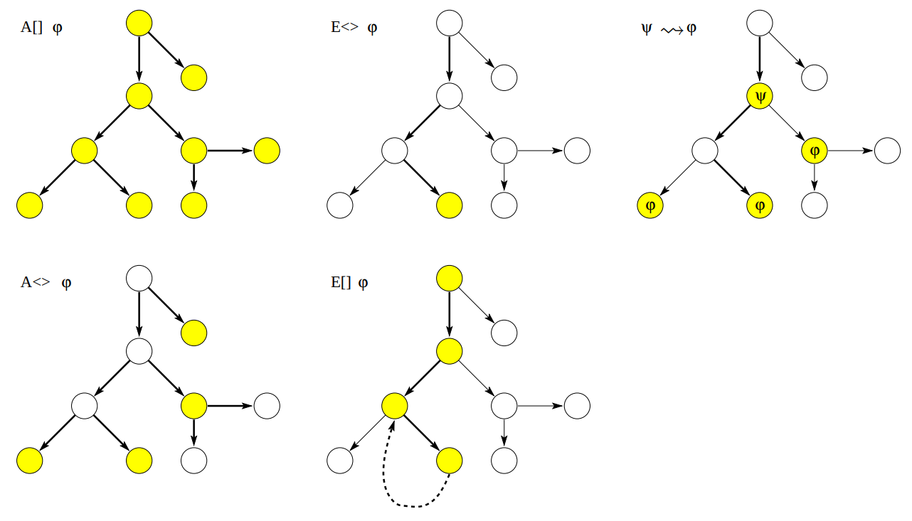
Safety Properties
A [ ] φ
E [ ] φ
Some property is invariantly true
φ is true in all reachable states
Some property is possibly always true
There should exist a maximal path where φ is always true
Source: UPPAAL Tutorial

Slide 29
Safety Properties
Prop. | Sat. | CTL/Meaning
A | True | A[ ] FP_0.Collect imply (elements[0].value > 0)
 |  | For all reachable states, component FP_0 being in the location Collect implies that its attribute value is not the default and is not poisoned.
B | True | A[ ] FP_1.Collect imply (elements[1].value < 0)
 |  | For all reachable states, component FP_1 being in the location Collect implies that its attribute value is poisoned.

Slide 30
Safety Properties
Prop. | Sat. | CTL/Meaning
C | True | A[ ] FP_2.Collect imply evalPolicy(p_toDataURL, 2)
 |  | For all reachable states, component FP_2 being in the location Collect implies the policy configuration allows it.
D | True | A[ ] !FP_2.Collect
 |  | For all reachable states, component FP_2 is never in the Collect location.
E | True | A[ ] Server.db[2].len == 0
 |  | For all reachable states, the server never receives fingerprint values from FP_2.

Slide 31
Liveness Properties
E <> φ
A <> φ
Ψ → φ
It is possible for some property to be satisfied
φ possibly can be satisfied by any reachable state
Something will eventually happen
φ is eventually satisfied
When some condition is met, eventually some property is satisfied
Whenever ψ is satisfied, eventually φ is satisfied
Source: UPPAAL Tutorial
Notes:
E<> is considered a reachability property by UPPAAL
A<> and → are considered liveness properties by UPPAAL

Slide 32
Liveness Properties
Prop. | Sat. | CTL/Meaning
F | True | E< > FP_0.Collect
 |  | The Collect location is reachable in the FP_0 component.
G | True | E< > FP_1.Collect
 |  | The Collect location is reachable in the FP_1 component.
H | False | E< > FP_2.Collect
 |  | The Collect location is not reachable in the FP_2 component.

Slide 33
Liveness Properties
Prop. | Sat. | CTL/Meaning
I | True | A<> ((Sever.db[0].len > 0) && (Server.db[0].entries[0] == Server.db[0].entries[1]) && (Server.db[0].entries[1] == Server.db[0].entries[2]))
 |  | Eventually all database entries for FP_0 are the same.
J | False | A<> ((Server.db[1].len > 0) && (Server.db[1].entries[0] == Server.db[1].entries[1]) && (Server.db[1].entries[1] == Server.db[1].entries[2]))
 |  | Eventually all database entries for FP_1 are the same.
Notes:
We don’t have a similar property for Fingerprinter Component 2 (FP_2) because it’s impossible for it to submit data, proved by property D

Slide 34
Wrapping Up
Contributions
Formal Models
Canvas Fingerprinter
IRM Controller
Evaluation of Models using CTL
Formal properties reflect requirements of mitigation methods
Takeaways:
Effectiveness of IRMs to enforce mitigation methods:
Randomization
Normalization
API Blocking
Proof of IRM reliability
Extensible Framework

Slide 35
Limitations and Future Work
Lack of Comprehensive Model
Extend our framework to support common attributes used by fingerprinters
Attack Model
Evaluate minimum effective mitigation strategies
Model-based Code Generation
Verified system to practical application
Bridge the gap between research and real-world implementations

Slide 36
Thank You!

Slide 37
External Links
UPPAAL Documentation
This work’s Github
amiunique.org

Slide 38
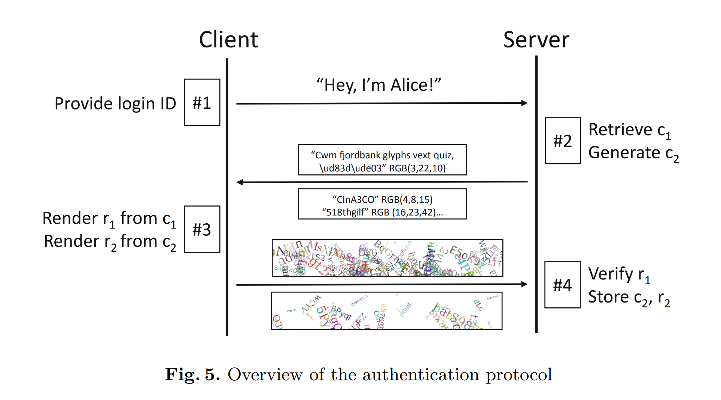
Benign Application Example
A challenge/response-based authentication mechanism proposed by Laperdrix et al. (2019).

Slide 39
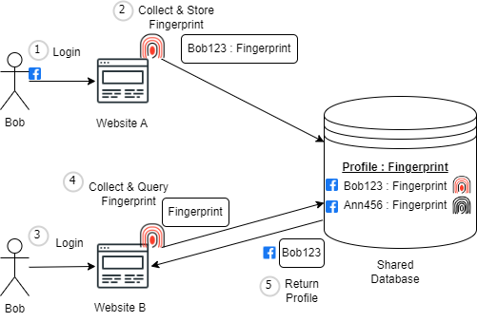
Malicious Application Example
Source: Khademi et al. (2015)

Slide 40
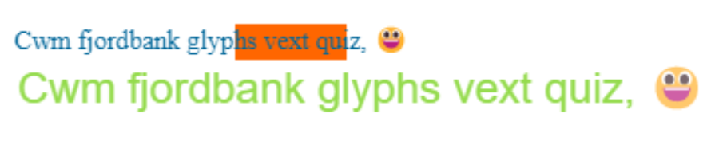
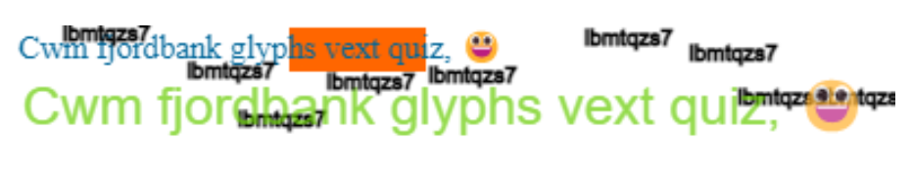
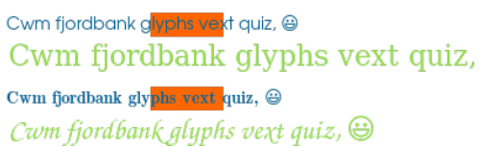
Canvas Poisoning Examples
Base Canvas Image
Poisoned Versions
Testing Tool Used: https://amiunique.org/
Source: Laperdrix et al. (2017)

Slide 41
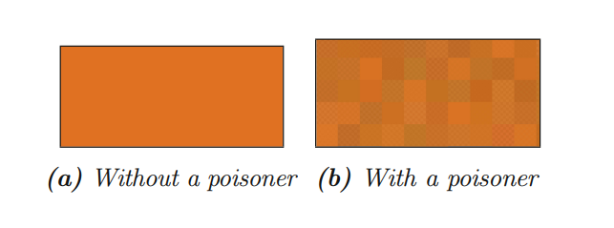
Canvas Poisoning Examples
Source: Laperdrix et al. (2019)

Slide 42
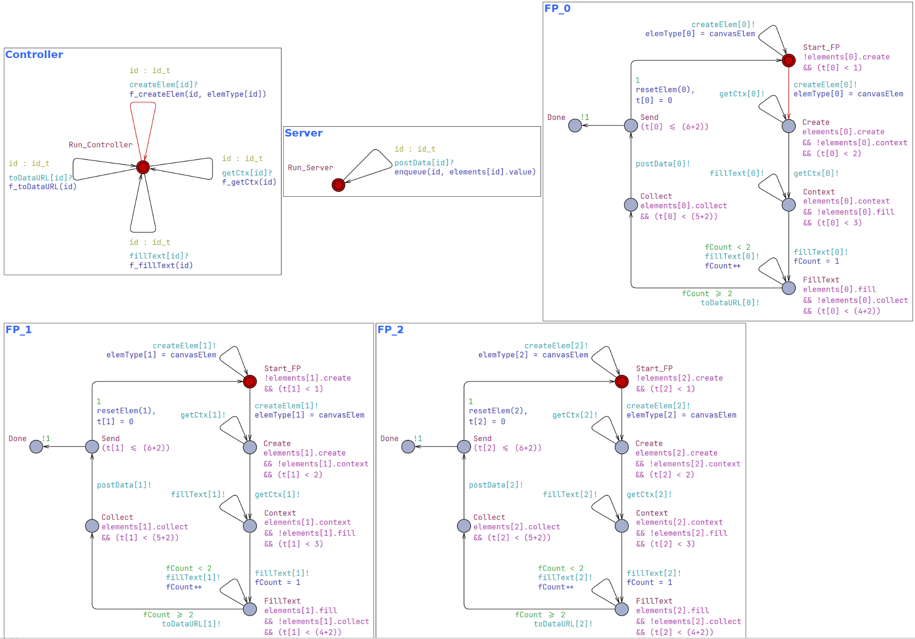

Slide 43
Computation Tree Logic (CTL)
In UPPAAL
Source: UPPAAL Tutorial

Slide 44
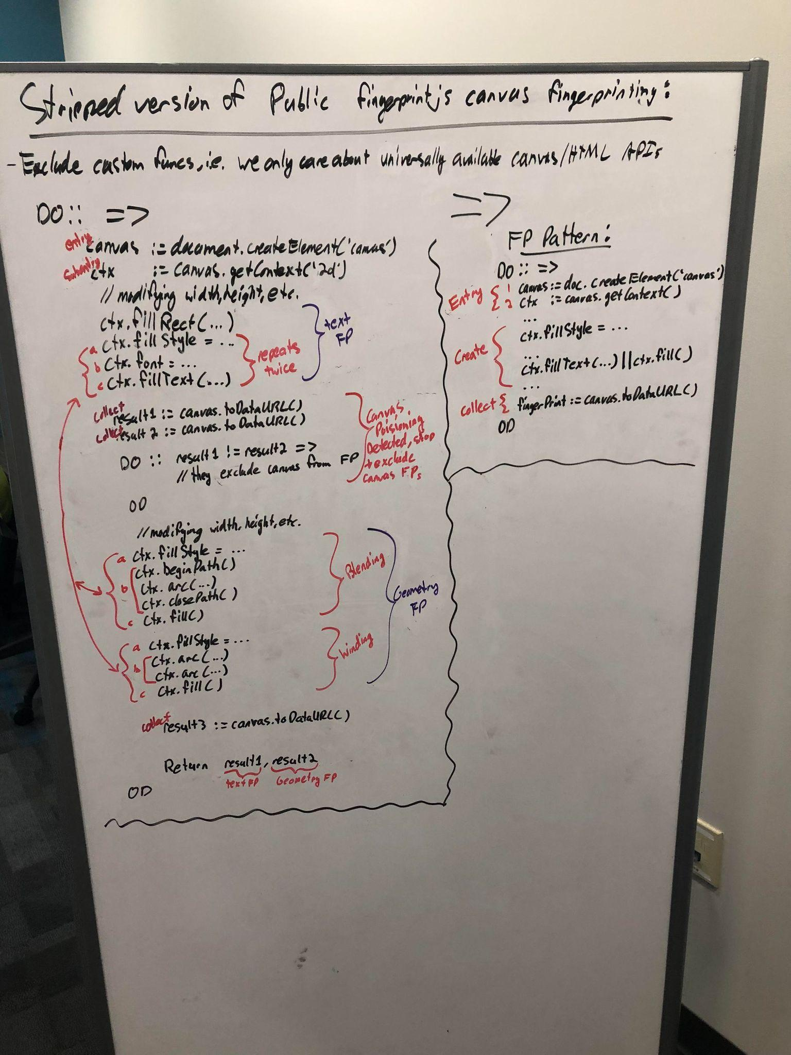
Abstracting Fingerprinting Scripts

