Slide 1
Development of an
Exploratory Visualization Tool for Comparison of Biotic and Abiotic Amino Acids
December 3, 2020
Kristina Bridgwater
Paul Heiss
Nathan Vanbourgondien

Slide 2
Motivation
Our client for this effort is Dr. Stephen Freeland, an Evolutionary Biologist at UMBC.
The focus of this work is to produce a prototype visualization tool which will allow researchers to more easily compare multiple sets of user-defined amino acids in the Euclidean space.
These data sets are defined by quantitative measures of amino acid properties like size, charge and hydrophobicity.
The goal is that this tool can evolve into one used by research communities distributed between North America, Europe, and Japan.
Focus of this project’s work is building the framework for a stand alone data viz tool, not data analysis.

Slide 3
Background and Related Works
The building blocks of life are amino acids:
  Amino acids are organic compounds that form proteins when combined.
Research areas of amino acids include:
  Synthetic biology
  Meteoritics
  Biochemistry
Research areas need to compare amino acids individually and in sets.
The developed tool presents a set of visualizations that interactively expedites the discovery of amino acid properties.

Slide 4
Processed Data
Data was supplied from the sponsor in a CSV format
  Data included an ID, a SMILES formula, and 4 attributes.
  There is not description of the attributes provided, as the sponsor thought that was irrelevant
    Columns could have been labeled A, B, C and D
The static sample data set from sponsor consisted of 2,000 rows:
  Mib Vol
  LogP Jchem
  Pka Uncap
  Biotic / abiotic indicator
SMILES is standard notation representing a chemical structure.
  SMILES formulas utilize the atomic symbol from the periodic table to represent each atom in a complex chemical structure.
The developed tool is attribute agnostic empowering users to load and analyze other formulas and attributes.

Slide 5
Technology Stack
React
  a web-based framework for developing user interfaces
Node.js
  a server based framework for rendering web apps and accessing data
D3, Plotly and material-table
  Visualization libraries
Vercel.com
  Public facing web service that can pull / recompile code from GIT repo
Tools leveraged JavaScript and enabled integration, albeit with some technical challenges and issues.

Slide 6
Visualization Tool Design
Three primary visualizations combined into a single web application
  Visualization selection influenced/guided by sponsor interaction
Primary visualizations in the developed tool are:
      Sortable and searchable table
      Scatterplot Matrix (SPLOM) of attributes
      3D rotatable model of an amino acid
    Additional visualizations include
  Tooltip in SPLOM
  Amino acid attribute details
Focus of this project’s work is building the framework for a stand alone data viz tool, not data analysis.

Slide 7
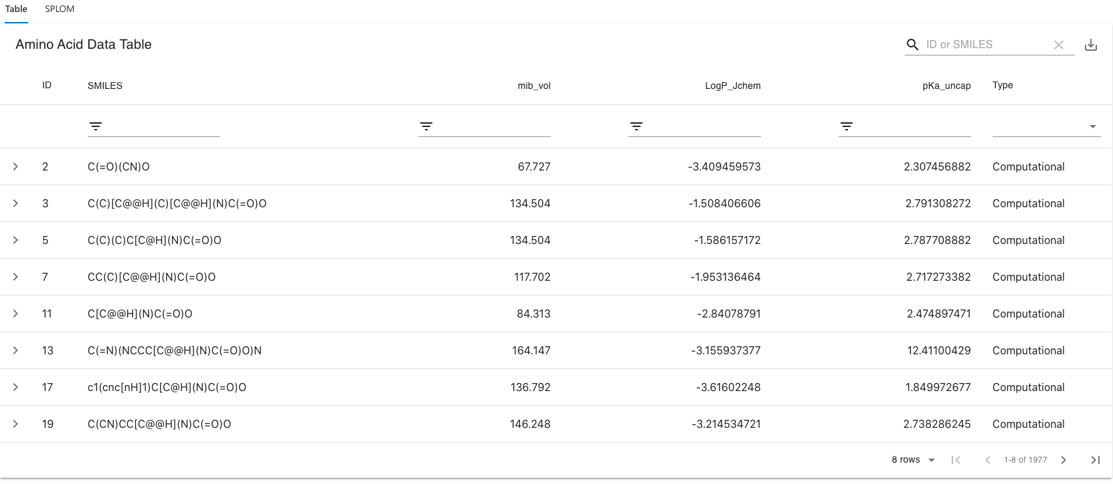
Viz #1: Sortable and searchable table

Slide 8
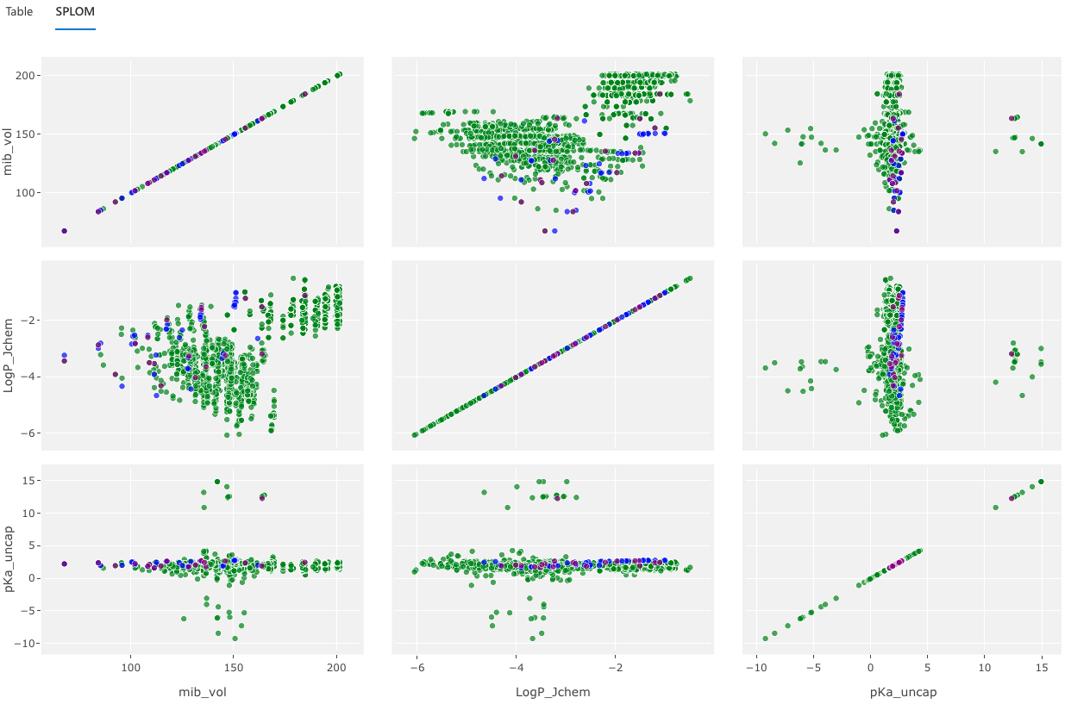
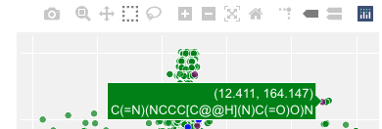
Viz #2: Scatterplot Matrix (w/ Tooltip)
If the user clicks on a point in the SPLOM, that data point is highlighted in all the plotted matrices, and Viz #3 is loaded in the adjacent pane.
When hovering on a data point, a mouse over provides contextual values and displays the tools for manipulating the SPLOM.

Slide 9
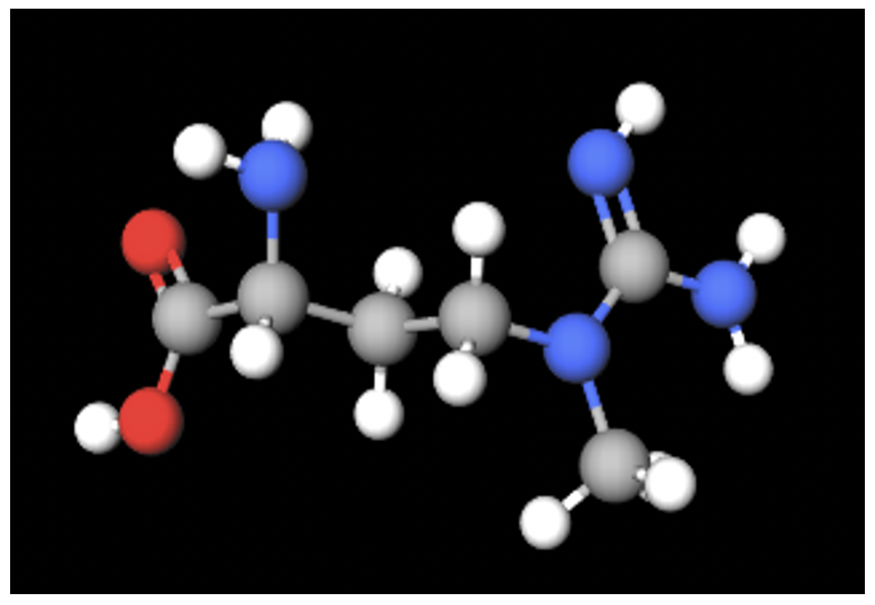
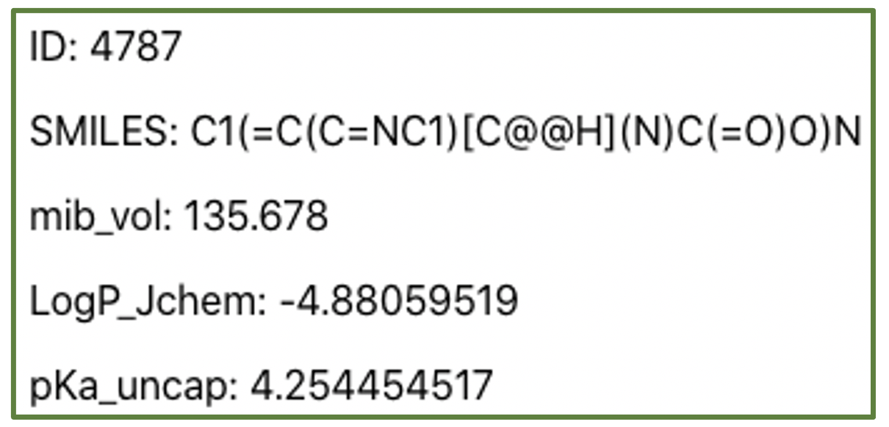
Viz #3: 3D Model of Amino Acid (w/ Details)
Details of selected amino acid.
The 3D rendering supports rotation and zooming with each of the organic compounds uniquely colored.

Slide 10
Demo

Slide 11
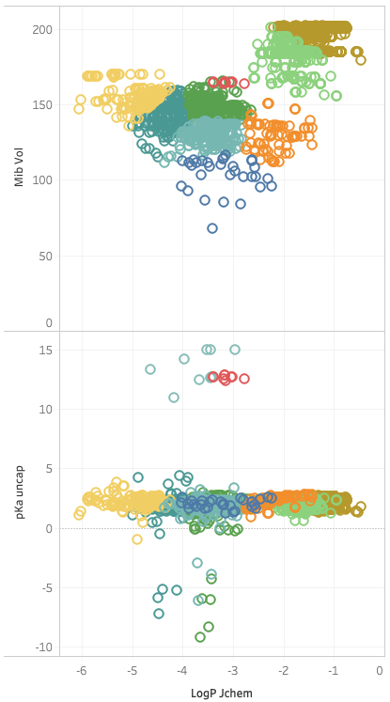
Longer Term Goals
Improve dynamic data handling data loading
Provide data visibility across users (e.g. data sharing)
Other visualizations
  Clustering
  Rank ordering of the data attributes
  Comparisons of selected amino acids
Drive the SPLOM from the filtered data sets
Deliver the developed tool to research communities in North America, Europe, and Japan.

Slide 12
Q & A

