Slide 1
Toronto Zoo Visitor Experience Insights
Nathan Wheeler

Slide 2
Outline
Extracting top themes of visitor dissatisfaction (Topic Modeling)
Identifying pain points and hidden gems (Quadrant Mapping)
Pinpointing top areas of improvement (Key Driver Analysis)
Determining experience specific customer personas (Customer Segmentation)

Slide 3
Key Takeaways
Across all analyses, customers reported being most frustrated with the core zoo experience
In particular, the largest increases in zoo recommendations and visits could be gained from:
improving animal visibility, availability and variety
reducing the impact of construction closures and the overall admission fee
Further, the best subareas to the zoo to target for such improvements would be:
The African Savannah
The Eurasian Wilds
The Tundra Trek
However, these changes will be slow and costly. In the meantime, lower-hanging fruit changes can be made to fix zoo amenities.
In this area, the largest increases in zoo recommendations and visits could be gained from improving:
Food services (The clear standout).
Operational Reliability (e.g. Zoomobile delays)

Slide 4
Extracting Top Themes of Customer Dissatisfaction

Slide 5
Complaint Themes:
Open feedback entries were cleaned and grouped into topics using topic modeling (BERTopic).
High-friction topics were then determined using sentiment analysis.
These high-friction topics were then grouped semantically into 7 themes of customer dissatisfaction.
Complaint Theme | Prominent Sub-Topics | % of Total Respondents
Mobility, Accessibility | Steep terrain, wheelchair and stroller access, narrow paths, lack of automatic doors | 4.96%
Navigation, Information Access | Lack of signage indicating directions or closures, lack of website info on displays/closures | 1.71%
Animal Availability, Visibility | Animals not available or visible in exhibits | 7.88%
Construction, Closures, Disruption | Construction, subarea closure limiting access/experience | 6.41%
Amenities, Comfort, Cleanliness | Washrooms messy or unavailable, food services expensive, slow, limited or unsatisfactory. | 8.77%
Cost, Value, Pricing | Admission price too expensive, value for cost too high, parking too expensive | 2.15%
Operational Reliability | Zoomobile wait times and breakdowns, parking and ticket payment issues. | 6.95%

Slide 6
Identifying Popular Pain Points

Slide 7
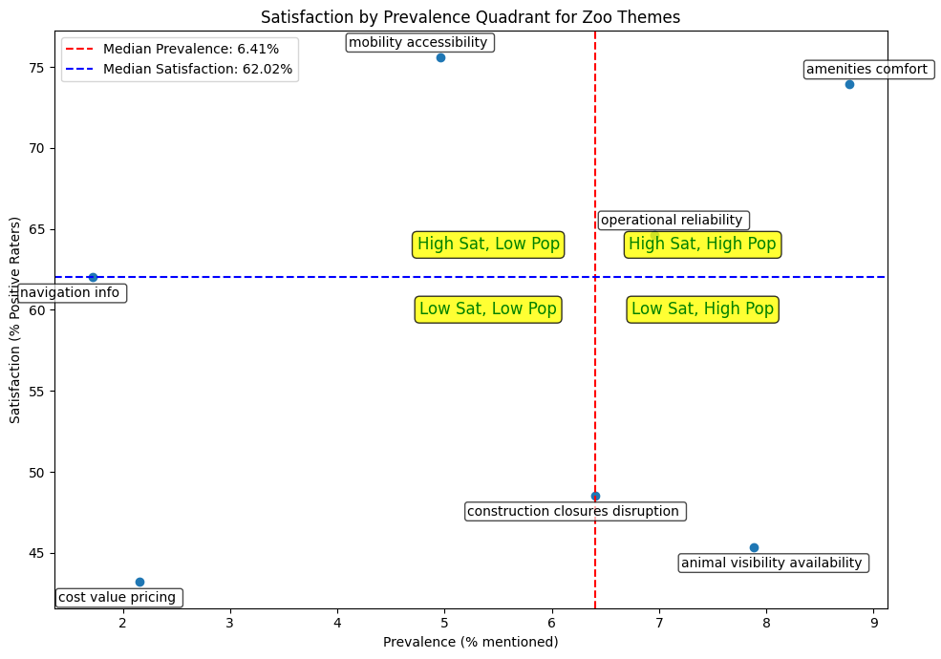
Pain Points: Complaint Themes
An average satisfaction vs prevalence matrix highlights highlights possible pain points to prioritize among complaint themes.
The X-axis is the percentage of respondents who had a particular type of complaint
The Y-axis is the average satisfaction of customers who brought up a given complaint.
The lower right quadrant shows complaints that are highly common and shared by the most dissatisfied customers.

Slide 8
Pain Points: Complaint Themes
Notable Pain Points (lower right quadrant):
Animal Availability and Visibility
Construction Closures

Slide 9
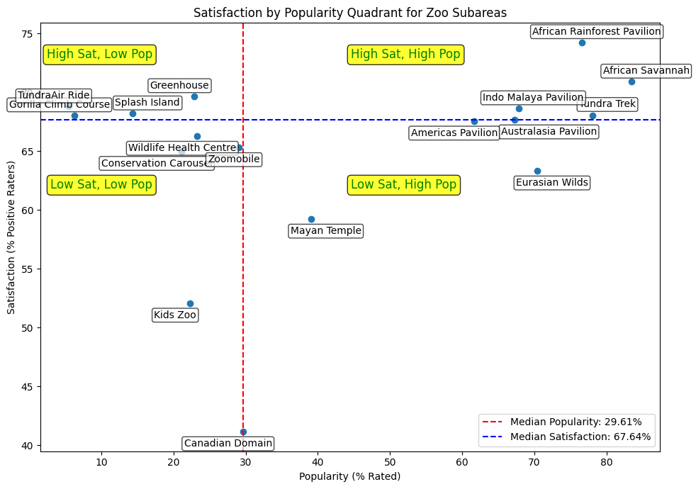
Pain Points: Zoo Sub-Areas
Similarly, a satisfaction by popularity matrix can highlight pain points and hidden gems among zoo subareas.
The X-axis is the percentage of respondents attended a given subarea.
The Y-axis is reported satisfaction respondants had for that specific subarea.
The lower right quadrant shows well attended, but disliked sub areas (pain points
the top left shows unattended but liked subareas (hidden gems)

Slide 10
Pain Points: Zoo Sub-Areas
Pain Points (lower right quadrant):
Eurasian Wilds
Mayan Temple
Canadian Domain
Hidden Gems (upper left quadrant):
TundraAir Ride
Splash Island
Greenhouse

Slide 11
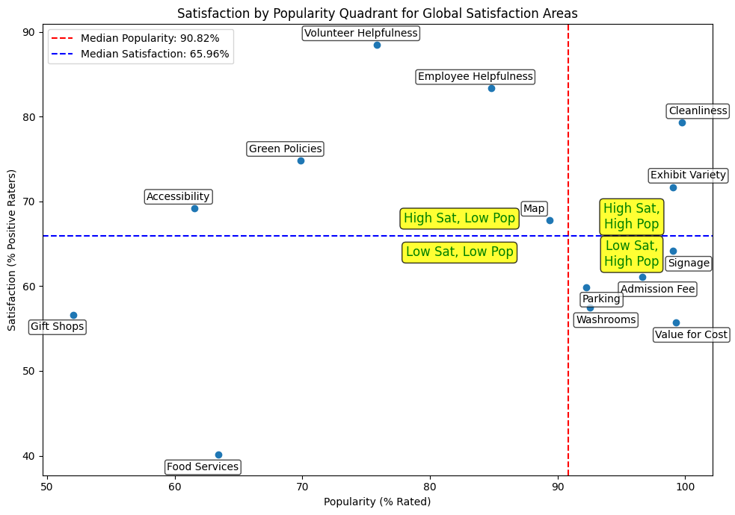
Pain Points: Global Satisfaction Areas
Finally, I highlighted pain points and hidden gems among sub-features of global satisfaction.
The X-axis is the percentage of people who rated a given sub-feature, as a proxy for whether users experienced that areas.
The Y-axis is the same as before.
The bottom right quadrant shows near universal pain points of the zoo experience
While the top left shows experience-specific hidden gems.

Slide 12
Pain Points: Global Satisfaction Areas
Pain Points (lower right quadrant):
Value for Cost
Washrooms
Parking
Signage
Hidden Gems (upper left quadrant):
Volunteer/Employee Helpfulness
Green Policies
Accessibility Policies

Slide 13
Pain Points: Summary
Domain | Pain Points | Hidden Gems
Complaint Themes | Animal Availability and Visibility, Construction Closures | -
Zoo Sub-Area | Eurasian Wilds, Mayan Temple, Canadian Domain | TundraAir Ride, Splash Island, Greenhouse,
Global Satisfaction | Value for Cost, Washrooms, Parking, Signage | Volunteer/Employee Helpfulness, Green Policies, Accessibility Policies
Customers highlight pain points and hidden gems.
However, we do not know the importance of these concerns.
It is unclear how much increasing satisfaction in any domain will improve overall likelihood to recommend (or return to) the zoo.
Key driver analysis will be conducted to translate pain points and hidden gems into areas of improvement.

Slide 14
Pinpointing Areas of Improvement

Slide 15
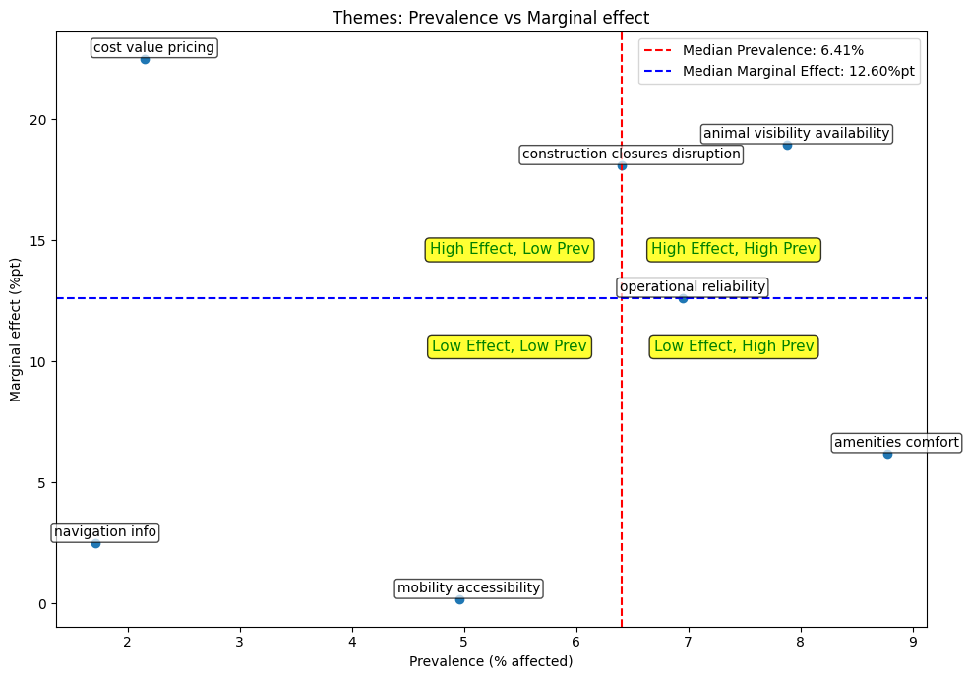
Areas of Improvement: Complaint Themes
I estimated how much more affected visitors would be likely to recommend the zoo if their complaints were addressed.
The X-axis is the percentage of respondents who had a particular type of complaint
The Y-axis is how much more those respondents would be likely to recommend the zoo if their complaints were addressed.
The top right quadrant shows complaints that are highly common and that would lead to the largest % increase in zoo recommendations if addressed.

Slide 16
Areas of Improvement: Complaint Themes
Top 3 Areas of Improvement (top right quadrant):
Animal Availability and Visibility
(est. 1.49% lift in total recommendations if addressed.)
Construction Closures
(est. 1.16% lift in total recommendations if addressed.)
Operational Reliability
(est. .88% lift in total recommendations if addressed.)

Slide 17
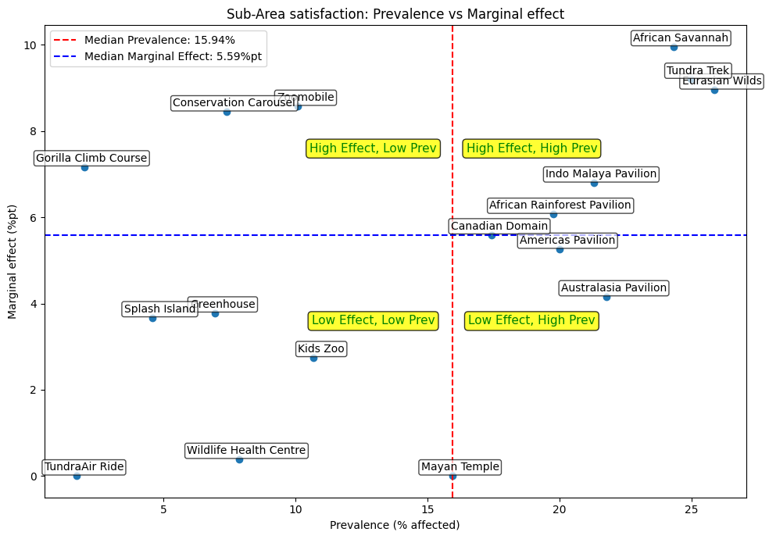
Areas of Improvement: Zoo Subareas
The same analysis was repeated to see how much every point increase in satisfaction with a given zoo subarea would increase recommendation likelihood.
The X-axis represents the percentage of survey respondents who reported by dissatisfied with a given subarea
The Y-axis represents how much more likely those respondents would be to recommend the zoo if their satisfaction with the zoo increase by 1 point (out of 5).

Slide 18
Areas of Improvement: Zoo Subareas
Top 3 Areas of Improvement (top right quadrant):
African Savannah
(est. 2.42% lift in total recommendations per 1 point increase in satisfaction.)
Eurasian Wilds
(est. 2.31% lift in total recommendations per 1 point increase in satisfaction.)
Tundra Trek
(est. 2.30% lift in total recommendations per 1 point increase in satisfaction.)

Slide 19
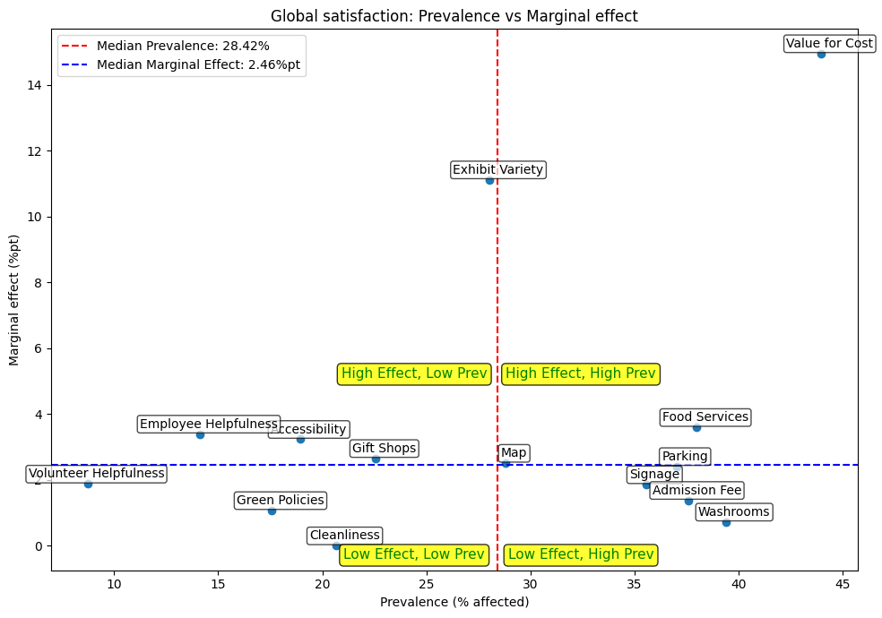
Areas of Improvement: Global Satisfaction
Similarly, I examined which sub-features of global satisfaction with the zoo could be the most impactful if addressed.
I estimated how much every point increase in satisfaction with a given sub-feature would increase recommendation likelihood.
The X and Y axes are marked the same as before.

Slide 20
Areas of Improvement: Global Satisfaction
Top 3 Areas of Improvement (top right quadrant):
Value for Cost
(est. 6.57% lift in total recommendations per 1 point increase in satisfaction.)
Exhibit Variety
(est. 3.12% lift in total recommendations per 1 point increase in satisfaction.)
Food Services
(est. 1.37% lift in total recommendations per 1 point increase in satisfaction.)

Slide 21
Areas of Improvement: Summary
Domain | Areas of Improvement
Complaint Themes | Animal Availability and Visibility, Construction Closures, Operational Reliability
Zoo Sub-Area | African Savannah, Eurasian Wilds, Tundra Trek
Global Satisfaction | Value for Cost, Exhibit Variety, Food Services
Targeting the following areas of improvement would have the greatest increase in overall zoo recommendations (and perhaps visits).
However, customer concerns will depend on individual experiences at the zoo.
For example, food service satisfaction would be more important to customers who plan to each lunch at the zoo.
Thus, I will further segment customers into experience-specific personas.

Slide 22
Segmenting Customers into Distinct Personas

Slide 23
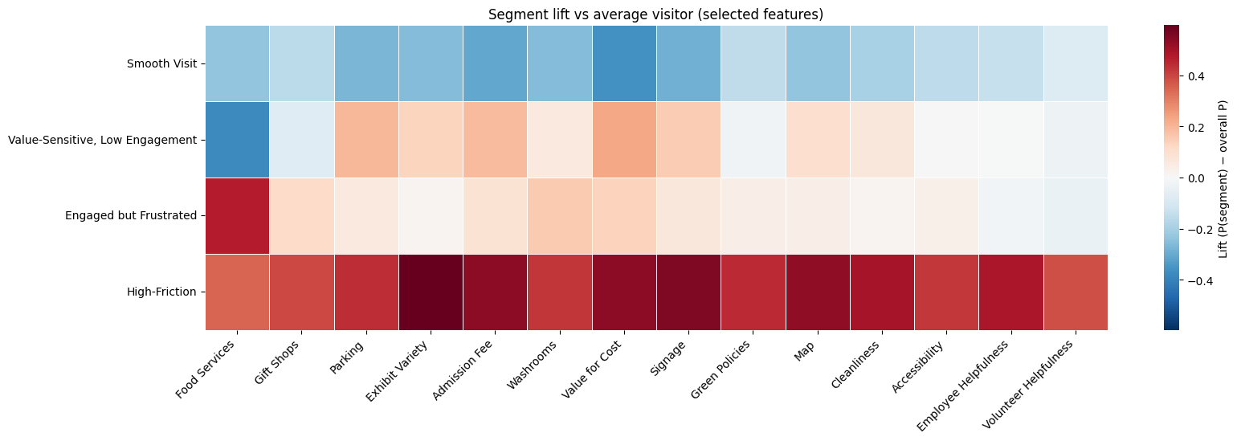
Customer Segmentation
4 distinct customer personas were determined using Latent Class Analysis:
Smooth Visit customers were globally satisfied across all domains
Value-Sensitive, Low Engagement customers wanted better value for cost, exhibit variety and parking experiences.
Engaged but frustrated customers were particularly dissatisfied with food services, gift shops and washrooms.
High Friction customers were dissatisfied with all aspects of their zoo experience

Slide 24
Customer Segmentation
Persona | Total Number | Percentage of Sample | Percent Members | Percent Local | Avg. Subareas Skipped | Percent Recommended
Smooth Visit | 3094 | 41.14% | 51.26% | 70.24% | 5.62 | 94.39%
Value-Sensitive, Low Engagement | 1454 | 19.34% | 43.48% | 69.91% | 6.00 | 50.63%
Engaged but Frustrated | 2010 | 26.72% | 37.06% | 61.97% | 5.35 | 58.75%
High-Friction | 963 | 12.80% | 23.42% | 58.57% | 4.08 | 13.79%
The majority of the sample is made up by smooth-visit customers and only a small minority represent high-friction customers.
However, a significant portion of customers were either value-sensitive, low engagement or engaged but frustrated by zoo amenities.
Addressing the respective concerns of one or both of these personas could increase zoo recommendations.
Value-sensitive, low engagement concerns (Exhibit Variety, Value for Cost) may be harder to implement.
Therefore, engaged, but frustrated customers might be the easiest to address by improving amenity quality (Food Services, Washrooms, Gift Shops).

