Slide 1
Predictors of Popular Board Games
Nathan Wheeler

Slide 2
Outline
Exploratory Analyses
Predictive Features of Game Popularity
Most Popular Kinds of Games
Game Recommendation

Slide 3
Key Takeaways
Some games tend to be both highly rated and widely owned.
Strategy, economic or management games.
Other games, while being widely owned, are not highly regarded or vice-versa
War games, while receiving high ratings, are not widely owned.
Party and family games, while being widely owned, are not highly rated.
These differences likely reflect the fact that ratings can be inflated by a small dedicated fan-base (i.e. a selection effect).
A game that is not generally know might only be rated by dedicated fans, leading to higher ratings.
Meanwhile, a game that is widely owned may be widely rated, leading to more diverse opinions that regress ratings towards the mean.
Therefore, one should be suspicious of relying too much on ratings as a proxy for sales data.
Party and family games might be a better investment than war games, except under certain conditions.

Slide 4
Exploratory Analyses

Slide 5
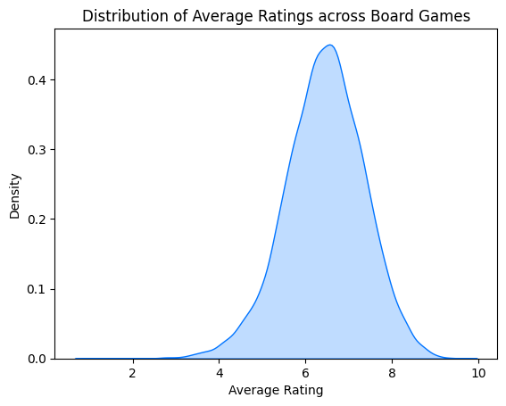
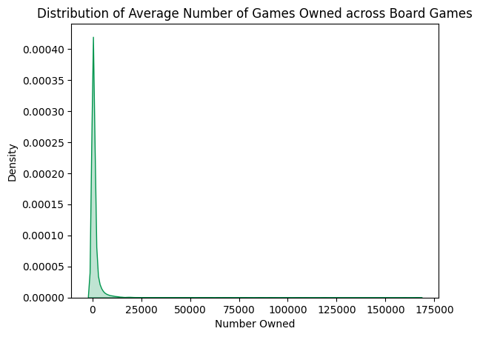
Average Board Game Rating and Ownership
Board games are rated an average of 6.44 out of 10.
Meanwhile, the average board game is owned by 1,493 BGG Raters, with a handful of games being owned by over 100,000.

Slide 6
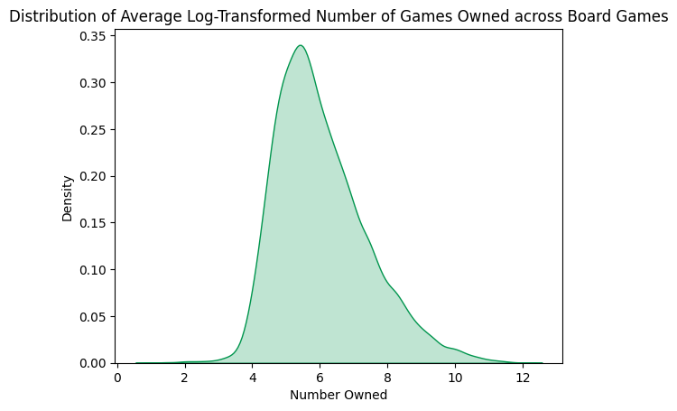
Average Board Game Rating and Ownership
To reduce the effect of outliers and keep our data normally distributed, we will log transform game ownership for further analyses.

Slide 7
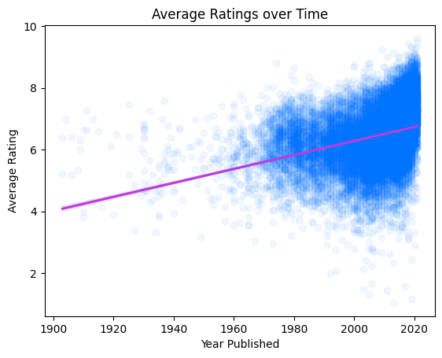
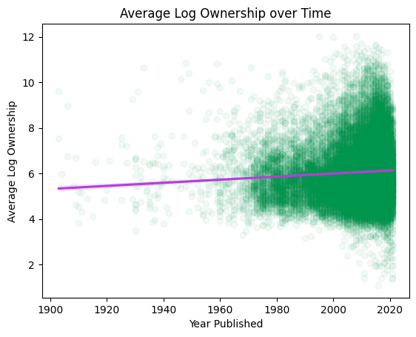
Game Rating and Ownership over Time.
The average game rating as increased with time.
However, this might simply indicate that BGG raters find games closer to the present time more relevant
Similarly, game ownership has also increased with more modern games.
However, this increase is notably much smaller.

Slide 8
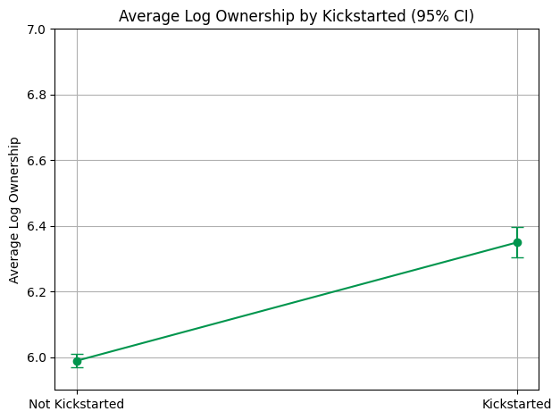
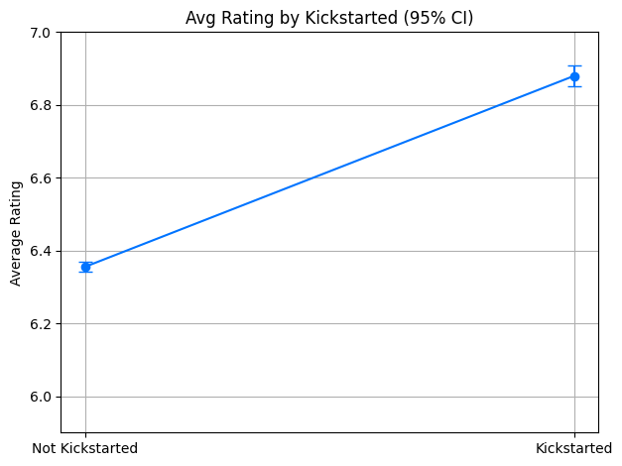
Are Kickstarters Successful?
Kickstarted games are on average rated as more successful than non-kickstarted games.
Similarly, kickstarted games are owned more than non kickstarted games.

Slide 9
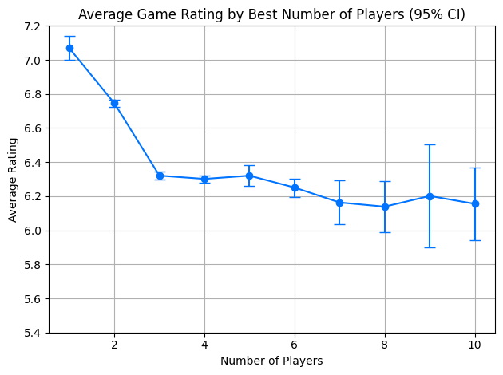
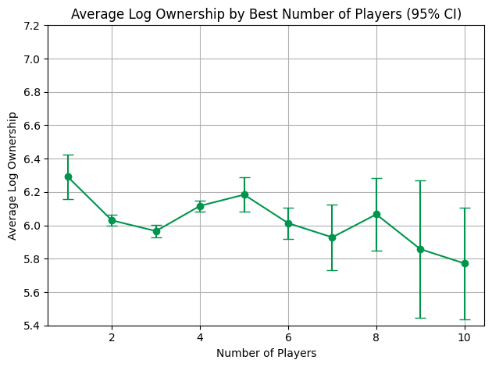
Ideal Number of Players
Game rating decreases with ideal player count, with simulation games with only a few players being rated highest.
Notable, this ratings for such simulation games may be inflated by a small, but dedicated audience.
Similarly, game ownership also decreases with ideal player count.
However, games with 4-5 players notably increased in rating, indicating that game ownership may not be as influenced by niche audience as rating.
Note that player-rated best number of players from a board game was imputed as the mean between min and max players when missing.

Slide 10
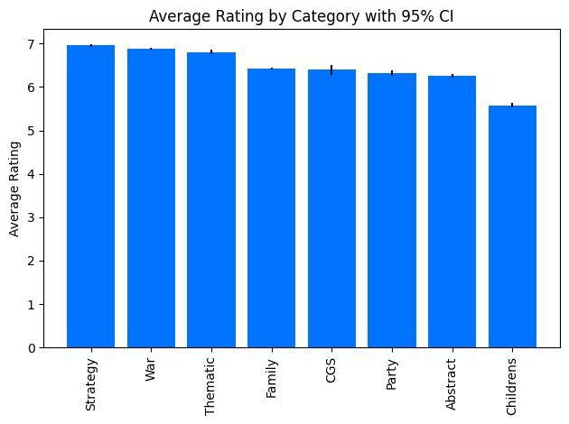
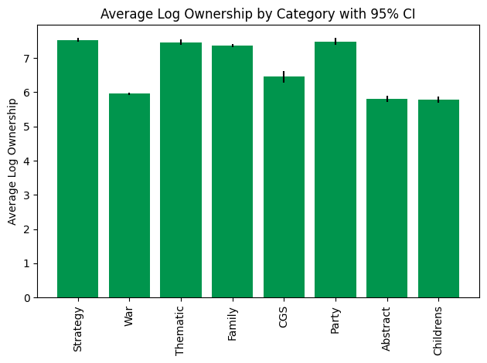
Most Popular Game Categories
Across both rating and ownership metrics, the same categories of game were similarly popular.
Strategy games were most popular and children's games least.
However, there were key differences between these metrics.
Party games were widely owned, but rated lower, perhaps because of their generic appeal.
Meanwhile, war games were rated highly, but seldom owned, perhaps due to a smaller fan base driving up ratings.
These differences emphasize that higher ratings may not always be a good indicator of higher sales.

Slide 11
Predictive Features of Game Popularity

Slide 12
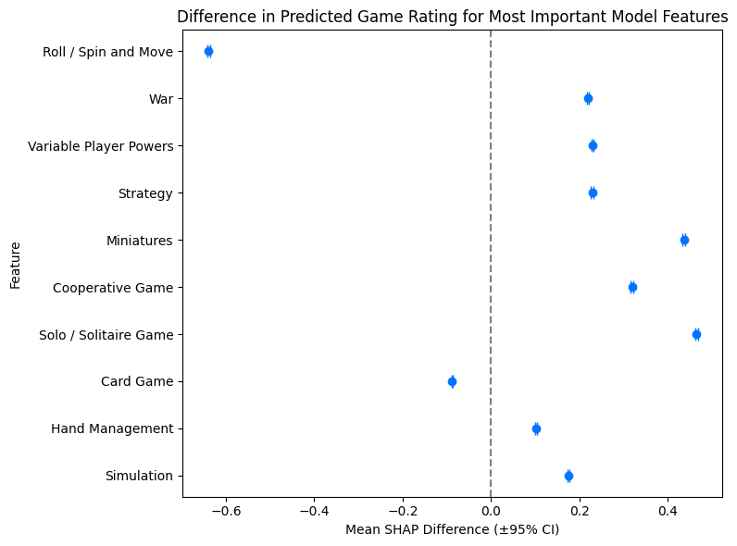
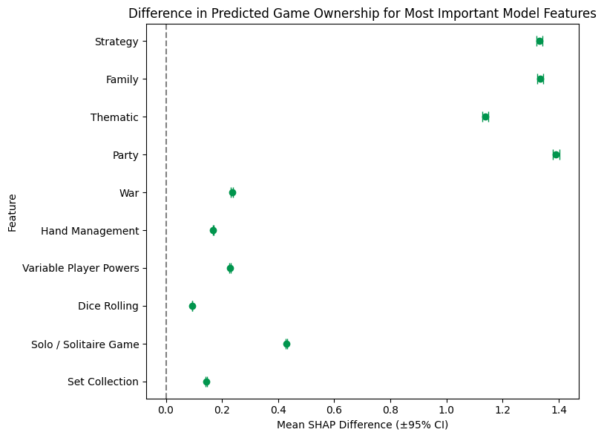
Most Important Features of Popularity: Methods
To identify the most important features for predicting popularity, I predicted both game rating and ownership from all possible game tags using XGBoost, optimizing hyper parameters using Optuna.
These tags includes game category, theme and possible game mechanics.
This model explain 39.8% of the variance of game rating and 48.9% of the variance of game ownership.
To measure feature importance, SHAP values were extracted.
To show the estimated effect of each feature, I calculated the mean SHAP difference in having versus not having a given feature.
Displayed here are the estimated effects of the top 10 most predictive features of game rating and popularity, ordered by estimated overall importance [mean(|SHAP value|)].

Slide 13
Most Important Features of Popularity: Results
Some features were most important to predicting both rating and ownership.
Notably, strategy and war games, as well as games with variable player powers and that can be played/simulated solo were predictive of higher ratings and wider ownership.
Notably, war gaming being predictive of game ownership is interesting, given the early finding that war games were associated with lower ownership.
Because XGBoost takes into account non-linearities and interaction effects, it maybe that while war games do not on their own associate with higher game ownership, they can be associated with increased sales under the right conditions.

Slide 14
Most Important Features of Popularity: Results
There were also key differences.
Games where players moves were determined by a dice roll were rated lower, while games involving miniatures were rated higher, but neither were critically important to game ownership.
Again, this may be because these mechanics are correlates of generic/niche appeal. Games of chance may tend to be more generic (e.g. Parcheesi), where games with miniatures may tend to be more niche (e.g. Warhammer).
Meanwhile, thematic, party, and family games were predictive of higher ownership but were not as important for rating.
Again, this may simply be that these games are seen as more generic and thus are both owned and rated by a wider audience.
These results highlight that we should be suspicious of using ratings as a proxy for sales.

Slide 15
Most Popular Kinds of Games

Slide 16
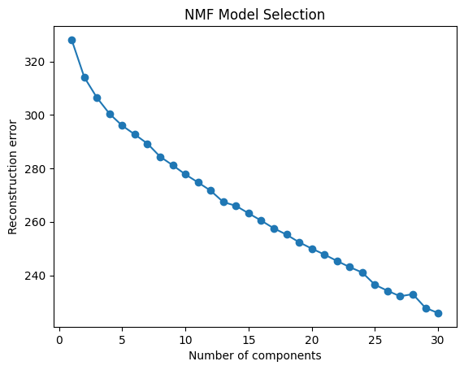
Most Popular Kinds of Games: Methods
Component | Top Tags
Card | Card Game, Hand Management, Drafting, Take That, Humor
War | War, Hexagon Grid, Simulation, World War II, Grid Movement
Thematic/Co-op | Variable Player Powers, Fighting, Science Fiction, Modular Board, Thematic
Strategy/Management | Strategy, Economic, Area Majority / Influence, Auction/Bidding, Worker Placement
Luck-Based | Dice Rolling, Push Your Luck, Roll / Spin and Move, Area Movement, Paper-and-Pencil
Pattern/Puzzle | Tile Placement, Abstract, Modular Board, Pattern Building, Puzzle
Social Deduction | Betting and Bluffing, Deduction, Memory, Team-Based Game, Party
Family/Children | Family, Animals, Dexterity, Childrens, Push Your Luck
Trading/Negotiation | Set Collection, Drafting, Roll / Spin and Move, Auction/Bidding, Trading
Fantasy/Adventure | Fantasy, Adventure, Fighting, Medieval, Exploration
To group games in the interpretable categories based on their features, I will use non-negative matrix factorization as this method can best address a large sparse matrix of game tags without problematic underlying assumptions.
Examining reconstruction error by number of categories extracted reveals no natural number of categories. Therefore, for simplicity I will extract 10 categories.
I generated plausible names for each of these categories based on the top tags associated with each.
The popularity of each category of game was then assessed using bootstrapped soft-weighted averages of rating and ownership.

Slide 17
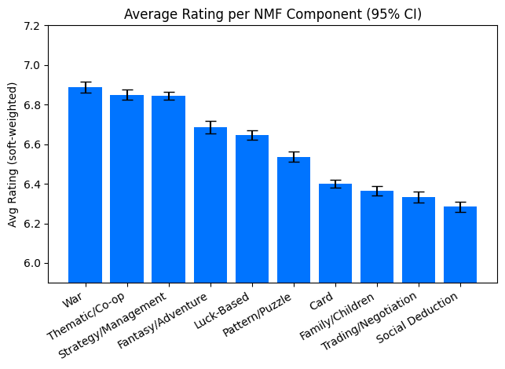
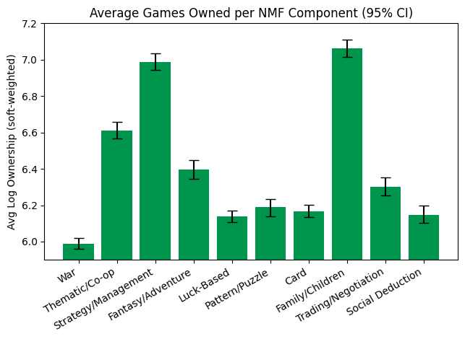
Most Popular Kinds of Games: Results
Assessing the popular of the NMFs reveals similar results as before.
In particular, strategy/management games remained both highly regarded and widely owned.
Notably, thematic/co-op games (e.g. Pandemic), also were rated highly and sold well, and to a lesser degree this was true of fantasy/adventure games as well (e.g. Gloomhaven).
Meanwhile, key differences were even more starkly replicated.
War games, while being the mostly highly rated category, were the least owned.
By contrast, family/children games, while being one of the least regarded categories, was the most widely owned.
Again, this shows that ratings can be driven down by widespread audiences and up by niche audiences. Games that are owned widely are also rated widely, regressing towards the mean. Ratings should not on their own be used as a proxy for sales data.

Slide 18
Game Recommendation

Slide 19
Game Recommendation
Games Similar to ‘Settlers of Catan’
Games Similar to ‘Apples to Apples’
Name | Rating | Log Owned | Similarity
Istanbul | 7.57 | 10.38 | 0.82
Star Trek: Catan | 7.00 | 9.07 | 0.77
Vault of Dragons | 6.61 | 6.80 | 0.77
Can't Stop | 6.85 | 9.47 | 0.76
Bananagrams Party | 6.43 | 6.24 | 0.76
Las Vegas | 7.13 | 9.41 | 0.75
Machi Koro | 6.62 | 10.70 | 0.75
Power Grid | 7.84 | 11.15 | 0.75
Captive | 6.86 | 7.28 | 0.74
Stone Age | 7.56 | 10.82 | 0.74
Name | Rating | Log Owned | Similarity
Cards Against Humanity | 5.87 | 10.65 | 0.95
Joking Hazard | 6.37 | 9.34 | 0.91
Unstable Unicorns | 6.27 | 9.54 | 0.85
Fluxx | 5.67 | 10.24 | 0.84
Munchkin | 5.89 | 11.27 | 0.83
Skip-Bo | 5.50 | 9.63 | 0.82
Cheating Moth | 6.42 | 8.87 | 0.82
Monty Python Fluxx | 6.06 | 9.32 | 0.81
Snake Oil | 6.69 | 8.56 | 0.81
What Do You Meme? | 5.14 | 8.21 | 0.80
To suggest similar games, I created a function that recommends the most similar board games based on their cosine similarity across all tags, as well as game rating and log ownership.
For an example, here we can see the recommend games for “Settlers of Catan” and “Apples to Apples”

