Slide 1

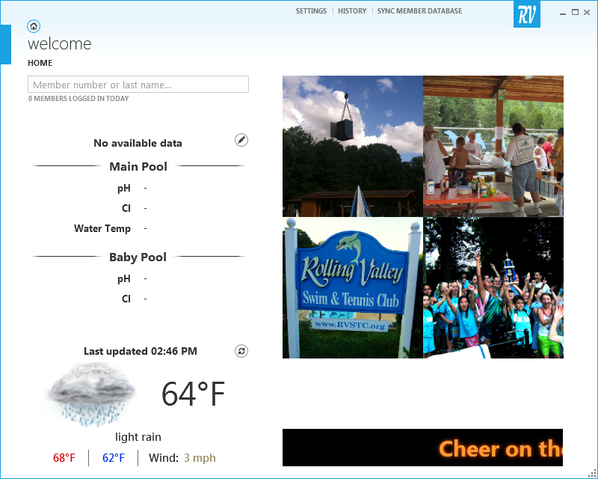
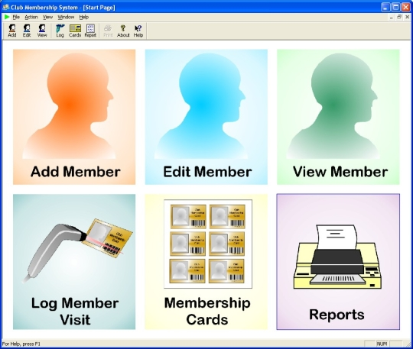
The Next Wave of Front Desk Software
Nathan Williams
Dr. Shane Torbert Period 4
Background
Results & Implications
Unlike many other senior tech lab projects, this one aims to serve a specific customer, the Springfield community of Rolling Valley Swim and Tennis Club (RVSTC).
As a result of the deliberate design of this software, pool members will be able to seamlessly sign in their families by scanning a barcode or with just their name or member number. Beyond meeting the specifications of the RVSTC pool board, certain features also contribute in terms of aesthetics, as with the FlipImageGrid and varying color scheme, convenience, as with the Weather Applet, and customizability, with numerous settings for several components and variables within the application.
Methodology
Taking advantage of IntelliSense and other great design tools, the application was created using Microsoft Visual Studio, and coded in C# with a XAML markup to give the presentation directions.
In the world of development, although creating an application completely from scratch is ideal, this becomes progressively more difficult as the application in question grows in sophistication. This is due to the multitude of subfields within computer science, which are areas of expertize in their own right (e.g. 3d animation). Therefore, in the interest of time and resources, several open source libraries were modified in order to better suit the needs of this application.
When RVSTC first opened, families had to sign in on paper. Hoping to trivialize some of the administrative tasks, though, the board opted for a new electronic system in 2013. Although this made some improvements over the predecessor, the new software also introduced new issues, and solved some preexisting problems only satisfactorily.
Component | Source
Organization | RVSTC
Language | CSharp (C#), XAML
Framework | .NET Framework 4.5
User Interface | Modern UI + Elysium
Weather Provider | OpenWeatherMap
Weather Applet | WPF: OpenWeather
3D Animation | Thriple
Scrolling Text | MarqueeDripRoll
In the future, the software will hopefully be generalized to the point that any facility in which this type of software would be applicable may utilize it without needing a version of the product to be made specifically for them. Perhaps it may even find its way into your local pool or recreational center at some point..
With the new member sign in system, many of the previously noted weaknesses were addressed, including the ability to verify members, member data update delays, and the lack of source code through which to implement future tweaks to the software.

