Slide 1
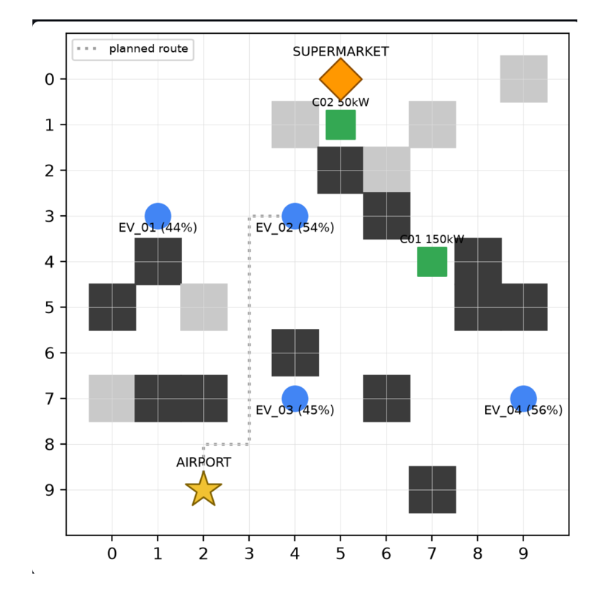
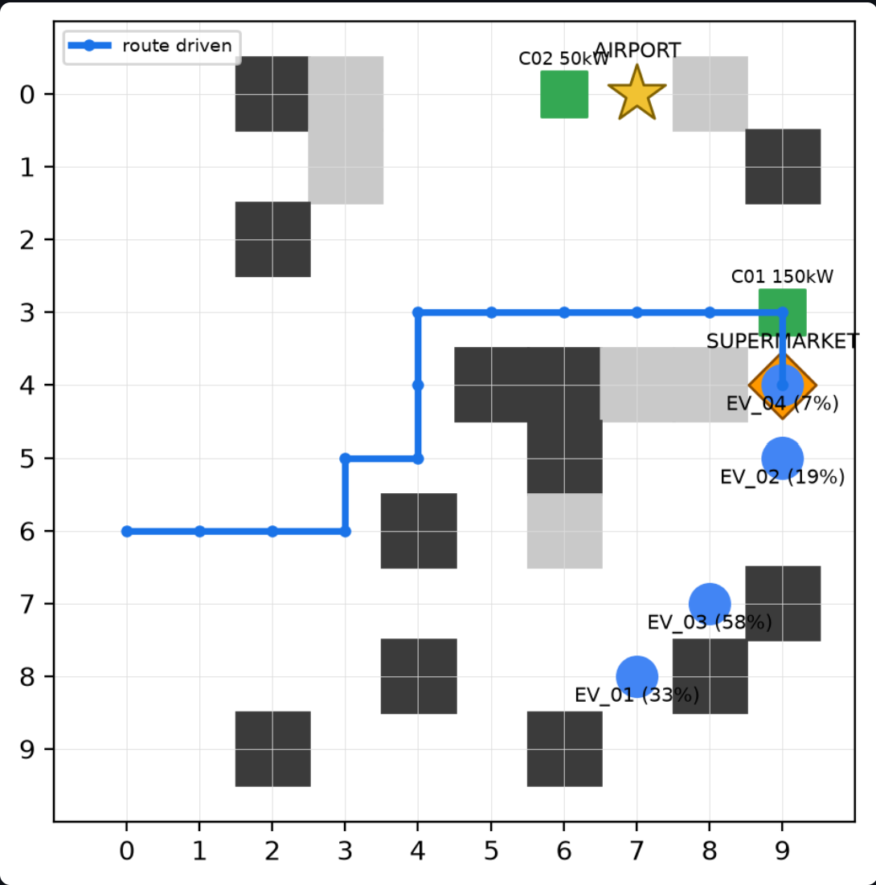
Autonomous EV Routing
Nathan · KREA University · Capstone demo, 19 Sep 2026

Slide 2
System Architecture
→
→
→
1
2
3
4
Parse
Route
Verify
Execute
llm_parser.py
pathfinding.py
verifier.py
orchestrator.py
Sentence → structured task: vehicle, destination, battery use per cell
A* on a 10×10 grid; toll cells cost 3× battery
Z3 proves the battery never drops below 0 on the route
Verified: car drives, DB updated. Rejected: car stays put

Slide 3
LLM parsing, and the manual path
A
Natural language
B
Manual entry
“Take EV-02 to the supermarket. It uses 2% battery per cell.”
Vehicle to drive
EV_02 ▾
↓ gpt-5-mini in JSON mode
Destination
{ "vehicle_id": "EV_02",
"destination": "SUPERMARKET",
"drain_per_cell": 2.0 }
AIRPORT / SUPERMARKET ▾
Battery use per cell
slider, 0.5 to 10 %
LLM-based parser with a strict JSON schema to convert operator instructions into structured parameters such as vehicle ID, destination, and battery drain.
Both paths meet at plan_trip(vehicle_id, drain_per_cell destination) → A* → Z3

Slide 4
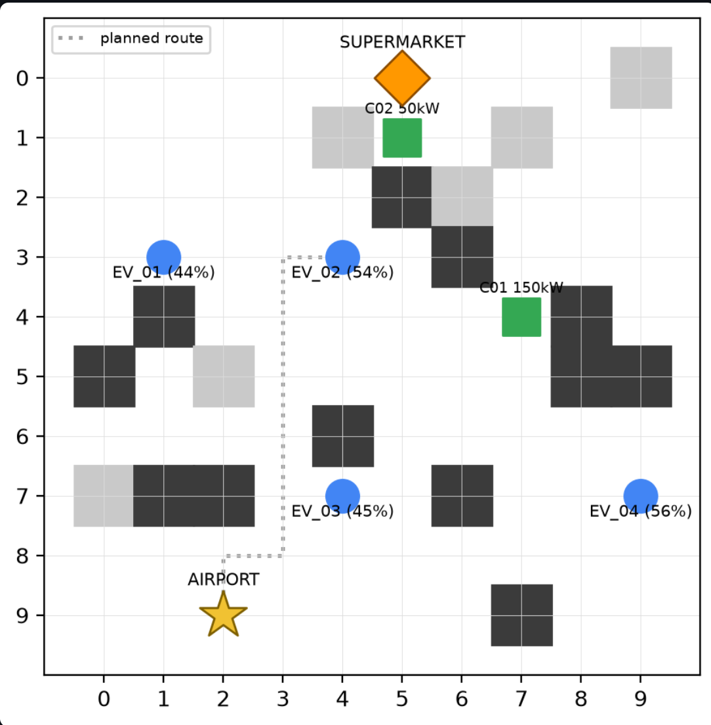
A*
f(n) = g(n) + h(n)
1
Manhattan heuristic
Never overestimates on a 4-connected grid, so the route found is optimal.
2
Terrain-weighted cost
Entering a toll cell costs 3× battery.
3
Live obstacles
Other parked cars block cells while planning. Destinations are never blocked.

Slide 5
Z3 / SMT: proof that the battery never hits zero
b[0] = battery in DB
b[i] = b[i-1] - drain * cost(cell[i])
b[i] >= 0 for every step i
Z3/SMT formally verifies that battery levels remain non-negative at every step of the route.
If negative its just calculates the path while the car stays put.
At 5% per cell the car runs flat at cell (7, 3), step 5 of 8.

Slide 6
Same car, same route, two verdicts
Real output, map seed 2026
VERIFIED
REJECTED
“Take EV-01 to the airport, 2% per cell”
“Take EV-01 to the airport, 5% per cell”
A* route (7,8) -> (7,0)
8 steps, 1 toll cell
A* route (7,8) -> (7,0)
8 steps, 1 toll cell
[PASS] Route exists
[PASS] Battery reaches airport
has 33.4%, needs 20.0%
arrives with 13.4%
[PASS] Route exists
[FAIL] Battery reaches airport
has 33.4%, needs 50.0%
16.6% short, flat at (7,3)
RESULT: PLAN VERIFIED (SAFE)
RESULT: PLAN REJECTED
The car drives to the airport. Task becomes COMPLETED in the database.
The car stays put. Task becomes REJECTED and the event is logged.

Slide 7
Verification layer: what it guards, where it grows
1
Implemented
2
Next extensions
• EV chargers along the route
• Route exists, also rejects plans where A* cannot find a path
• On rejection, propose a new plan and re-verify
• Battery ≥ 0 on every step, proven by Z3
• Conflict rules: when two cars compete for a cell
• Rejected plans never move a car
• Implementation of Stochasticity in the Environment
• Every plan is logged to SQLite and shown on the dashboard
• RL-based multi-objective optimisation with time constraints

