Slide 1

Introduction:
Nathan Lee
Experience: 10 years as an analyst and programmer

Slide 2

Market Expansion
Exploring Revenue Optimization

Slide 3


Does store type have a statistically significant effect on revenue?
If so, why does it matter?

Slide 4
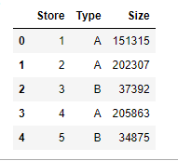
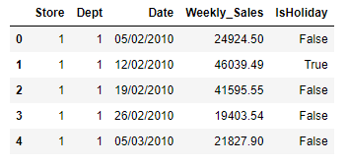
Data Overview
Table 1
Table 2
Store numbers
Corresponding departments
Date of recorded sales
Departmental revenue per week
Holiday weekend designation
Store numbers
Store type
Size

Slide 5
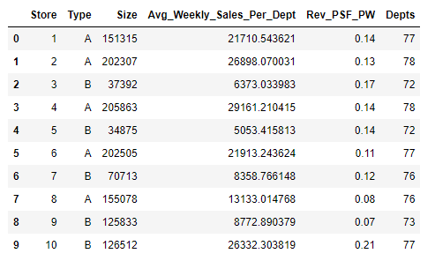
Compiling the data
The data was combined and condensed – dropping unnecessary columns.
Departmental sales numbers were averaged for each store.
Department counts were totaled and added.
Revenue per square foot was calculated and added to the compiled table.
Data was organized by store type.
It was clear there were three store types, but the distribution of these store types was unknown.

Slide 6
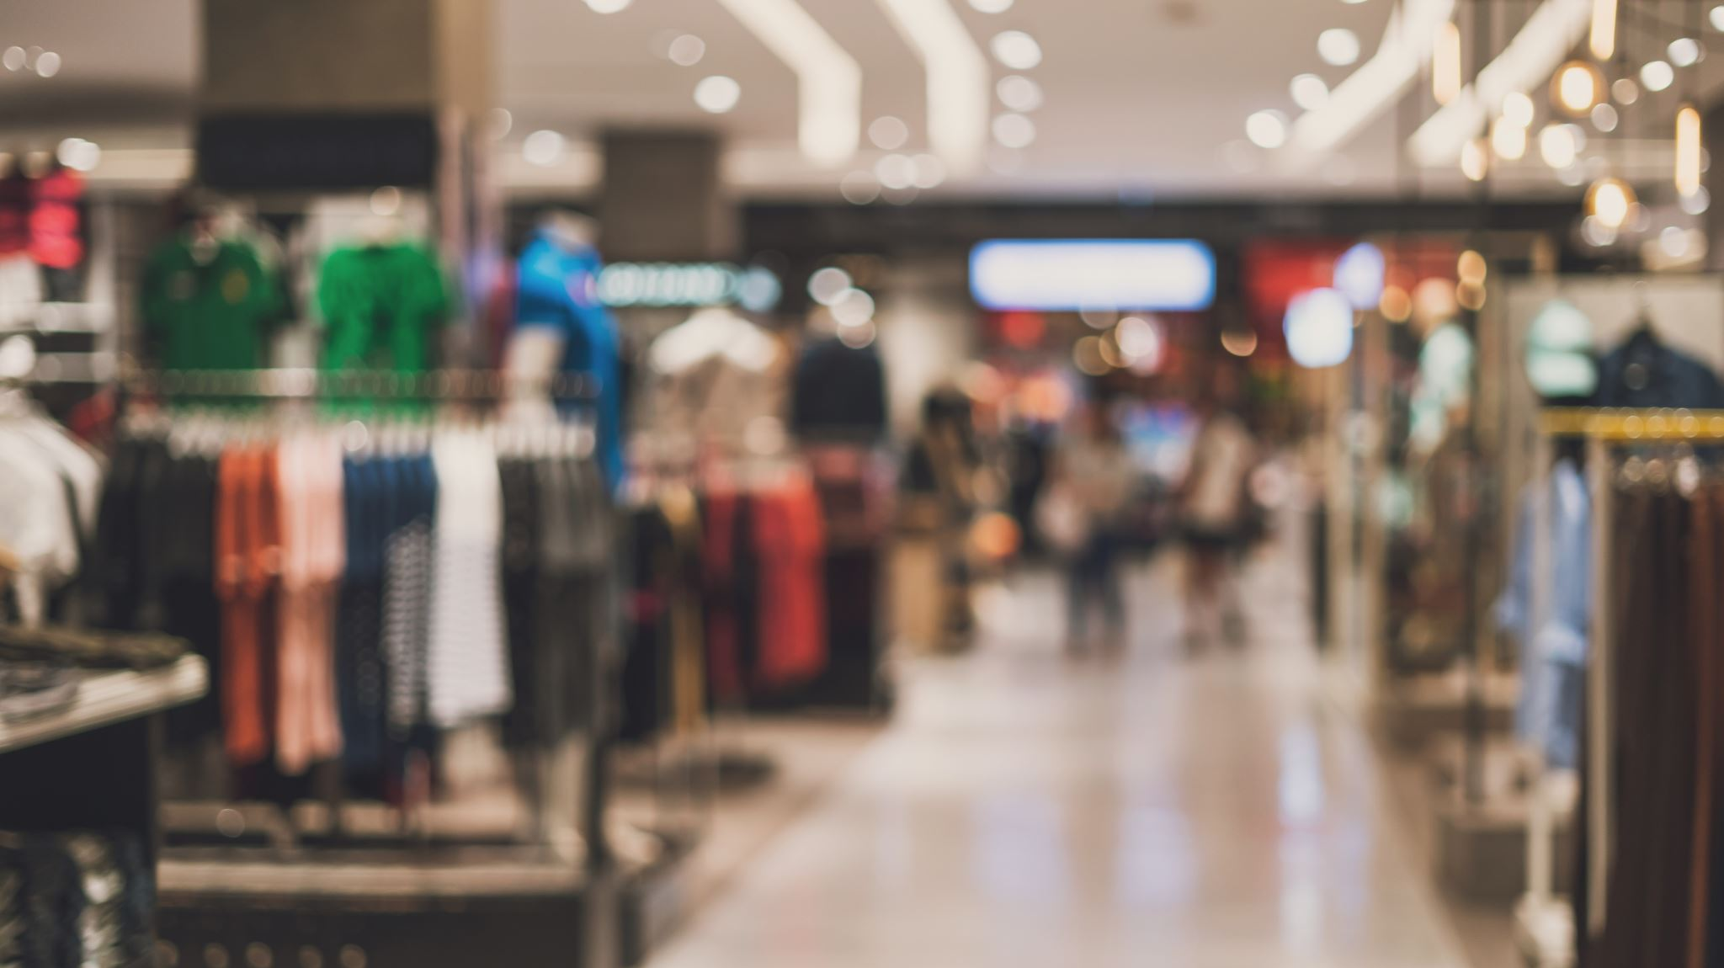
There are currently 45 active store locations
22 – A Store locations
17 – B Store Locations
6 – C Store Locations

Slide 7
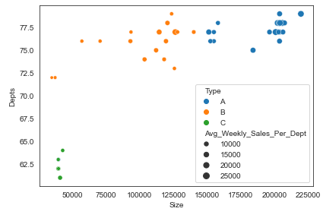
There are currently 45 active store locations
22 – A Store locations
17 – B Store Locations
6 – C Store Locations
A – Locations:
Vary the most in terms of
Size
Number of departments
Weekly revenue per department
Tend to be the largest on average

Slide 8
There are currently 45 active store locations
22 – A Store locations
17 – B Store Locations
6 – C Store Locations
B – Locations:
Almost 60% of the size of A stores
Average just as many departments
Generate 62% of the revenue

Slide 9
There are currently 45 active store locations
22 – A Store locations
17 – B Store Locations
6 – C Store Locations
C – Locations:
The smallest in size
Have the most consistent number of departments
Generate the least weekly revenue per department

Slide 10
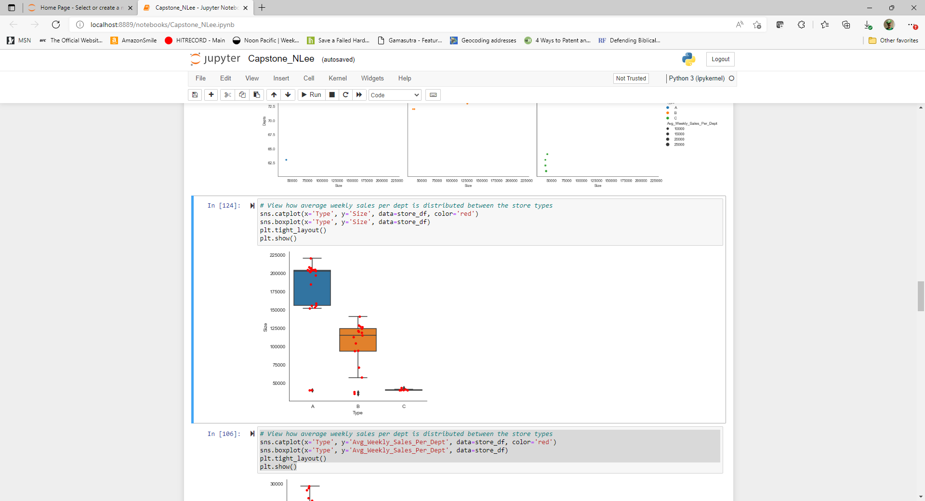
Distribution of Store Size by Type
While most A stores are very large at around 200,000 sq ft, a few are closer to B-sized stores and one is as small as a C store

Slide 11
Distribution of Store Size by Type
While most A stores are very large at around 200,000 sq ft, a few are closer to B-sized stores and one is as small as a C store
B stores are more tightly clustered than A stores in terms of size and two of them are C store sized

Slide 12
Distribution of Store Size by Type
While most A stores are very large at around 200,000 sq ft, a few are closer to B-sized stores and one is as small as a C store
B stores are more tightly clustered than A stores in terms of size and two of them are C store sized
C stores are all within about 1,000 sq ft of one another

Slide 13
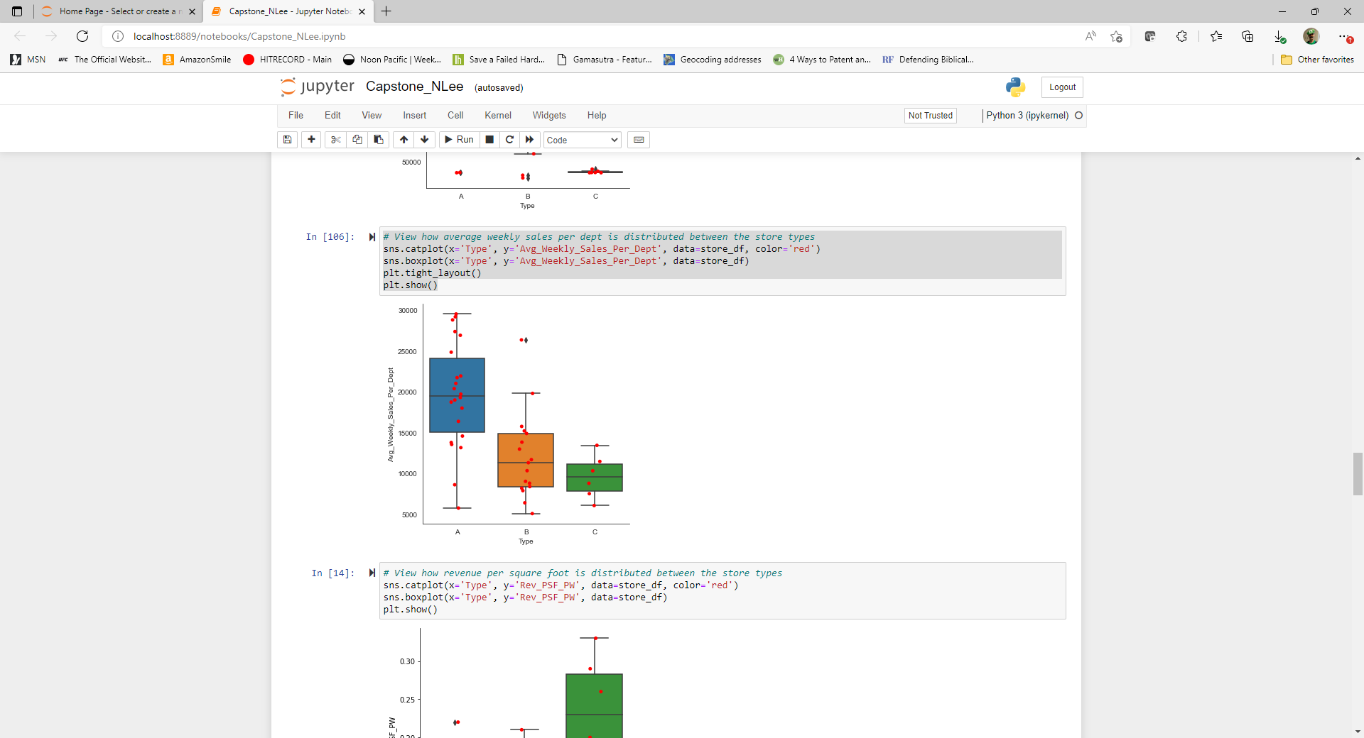
Distribution of Avg Weekly Rev Per Dept by Type
A Stores have the highest variance of revenue, from 5,000 to 30,000

Slide 14
Distribution of Avg Weekly Rev Per Dept by Type
A Stores have the highest variance of revenue, from 5,000 to 30,000
B stores are more consistent but there is one outlier that performs better than most A stores

Slide 15
Distribution of Avg Weekly Rev Per Dept by Type
A Stores have the highest variance of revenue, from 5,000 to 30,000
B stores are more consistent but there is one outlier that performs better than most A stores
C stores again are the most consistent and have the most predictable performance

Slide 16

The clear winner is, A!
A
B
C

Slide 17

Is that the whole story?

Slide 18
Where haven’t we looked?

Slide 19
Revenue Efficiency
Larger stores definitively bring in more revenue, but larger stores cost more to build, manage and maintain.
How does the revenue relate to the size of the building itself, which correlates strongly to its type.
How does revenue per sq ft of building space compare among the store types?

Slide 20
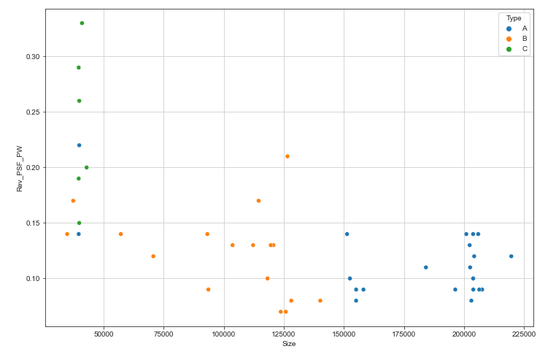
Revenue Per Sq Ft by Size and Store Type
Average weekly revenue per sq ft, per department tells a different story.
A – stores on average generate the least revenue per sq ft
C – stores generate the most revenue per sq ft
The smaller B and A stores, generate more revenue per sq ft than their larger counterparts

Slide 21
How to test if this is true?
Is this difference statistically significant?

Slide 22
ANOVA Test
What is an ANOVA test?
ANOVA means analysis of variance.
Used to check whether the means of different populations are equal or not
The goal is to check for variability within the groups as well as the variability among the groups.

Slide 23
ANOVA Test
What is an ANOVA test?
How can it be used with this data?
ANOVA means analysis of variance.
Used to check whether the means of different populations are equal or not
The goal is to check for variability within the groups as well as the variability among the groups.
An ANOVA test can evaluate the variance of the different store types with respect to each other, while also evaluating the variance within each individual store type.

Slide 24
ANOVA Test
What is an ANOVA test?
How can it be used with this data?
What do the results of an ANOVA test mean?
ANOVA means analysis of variance.
Used to check whether the means of different populations are equal or not
The goal is to check for variability within the groups as well as the variability among the groups.
An ANOVA test can evaluate the variance of the different store types with respect to each other, while also evaluating the variance within each individual store type.
The key metric to note when running an ANOVA test is called a p-value. The lower the p-value, the less likely it is that the connection being evaluated, is due to chance. In this instance, a low p-value would mean that there is a statistically significant link between store type and revenue per sq ft.

Slide 25
ANOVA Test
Setup
The input for an ANOVA test requires at least 2 inputs: an independent variable and a dependent variable.
In this instance, the independent variable will be store type and the dependent variable will be revenue per sq ft.
As mentioned previously, ANOVA compares different populations, so in this instance, the different populations would be the groupings of different store types.

Slide 26
ANOVA Test
Setup
Results
The input for an ANOVA test requires at least 2 inputs: an independent variable and a dependent variable.
In this instance, the independent variable will be store type and the dependent variable will be revenue per sq ft.
As mentioned previously, ANOVA compares different populations, so in this instance, the different populations would be the groupings of different store types.
This ANOVA test calculated a p-value of 2.12 x 10⁻⁷ which is an extremely small number.

Slide 27
ANOVA Test
Setup
Results
Implications
The input for an ANOVA test requires at least 2 inputs: an independent variable and a dependent variable.
In this instance, the independent variable will be store type and the dependent variable will be revenue per sq ft.
As mentioned previously, ANOVA compares different populations, so in this instance, the different populations would be the groupings of different store types.
This ANOVA test calculated a p-value of 2.12 x 10⁻⁷ which is an extremely small number.
With a p-value this small, it means there is a very small chance that this connection between store type and revenue per sq ft, is due to chance.

Slide 28
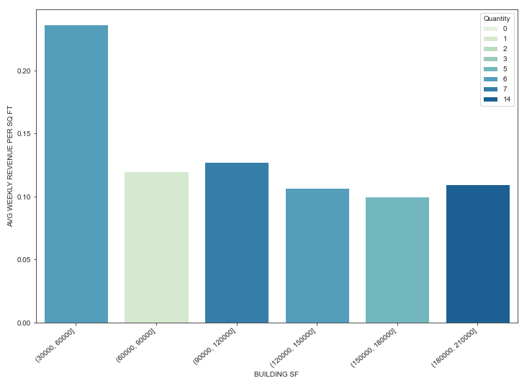
Visualizing the Results
The majority of the stores are larger than 60,000 sq ft. However, the stores ranging from 30,000 to 60,000 sq ft, generate an average of twice the revenue per sq ft of the larger stores.

Slide 29
Does store type have a statistically significant effect on revenue?
If so, why does it matter?

Slide 30
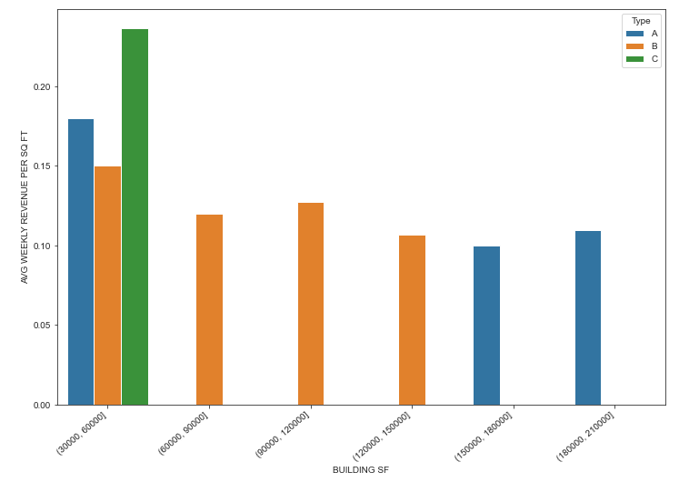
Does store type have a statistically significant effect on revenue?
If so, why does it matter?
It matters because the A and B stores that were built with a smaller square-footage, while generating a higher average revenue per sq ft than their larger versions, still did not exceed the revenue per sq ft of the C-stores. Further strengthening that store type can determine potential revenue per sq ft.

Slide 31
Limitations
Departmental configurations were not evaluated for their contribution or hindrance to revenue
This analysis assumes that the surrounding demographics of each location is relatively consistent among all locations
What is not accounted for in this analysis?

Slide 32
Recommendations
Future sites should be designed with the C-store type layout
Specific departments should be evaluated for performance and drop those that are below a threshold
Convert smaller A and B stores into C stores
How to proceed from here?

Slide 33
Expected Results
77% smaller on avg than A stores, thus saving on construction and overhead once up and running
Produces 2x more revenue per sq ft on average
What will the focus on building C stores provide?

Slide 34
Thank you!

