Slide 1
InternHub

Slide 2
Question
How many of you are in the co-op program?
How many of you like to use the outdated Career Learning Network (CLN) or Career Services Manager (CSM)?

Slide 3
The Idea behind InternHub
InternHub is a universal job board for co-ops, interns and employers.
One stop shop for all your job searching
Post all your jobs once as an employer.
Bye bye to University Job boards.

Slide 4
Competition
University Job Boards:
University of Waterloo’s WaterlooWorks
University of Toronto Scarborough’s CSM
University of Toronto’s CLN (Career Learning Network)
Public Job Boards:
Talent Egg
Indeed etc

Slide 5
Competitive Advantage
More Opportunities
Specifically for you
Less Posting
Easy Application Process

Slide 6
Demo

Slide 7

Team Introduction
Team Member Name:
Venkada Prasad
Contribution:
Frontend(HTML, CSS, Material Design Lite)
Documentation

Slide 8

Team Introduction
Team Member Name:
Salman Sharif
Contribution:
Scrum master
Front end Developer

Slide 9


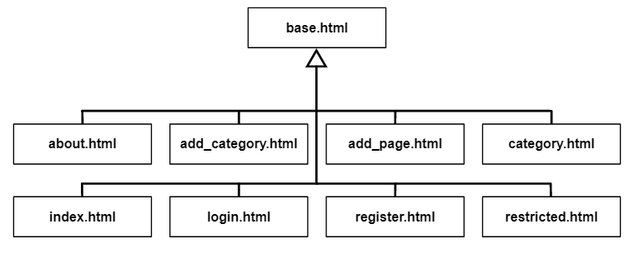
Team Introduction
Team Member Name:
Aiyaz Noor
Contribution:
Frontend, initial designs and implementations
Setting up Django template inheritance for code reuse; eg: navbar

Slide 10


Team Introduction
Team Member Name:
Nathan Seebarran
Contribution:
Backend(Django)
File upload and download
Database models/schema
Searching/sorting jobs

Slide 11

Team Introduction
Team Member Name:
Omid Najmeddini
Contribution:
Frontend: webpage concept design(photoshop), HTML, CSS, Javascript
Documentation

Slide 12


Team Introduction
Team Member Name:
Osaru Ize-Iyamu
Contribution:
Product Owner
Login and Registration
Database design and modeling
Setup Project structure

Slide 13





Process
Highlights
Switched from Facebook Messenger to Slack - allowed multiple channels use like “frontend”, “backend”, “gihub”, “general”.
Originally, the frontend and backend teams were split, but eventually had to be merged; Django allows writing “block psuedo-python code”.
Django made it all a lot easier - a very “full-stack” kind of framework.

Slide 14
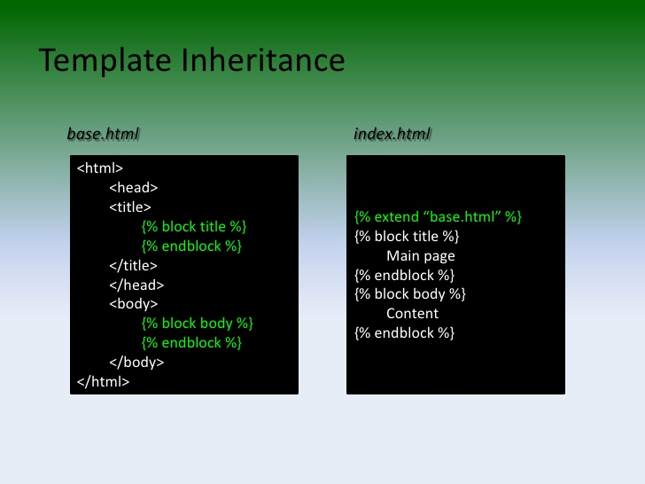
Standards/conventions/techniques
Group meetings almost every week - talked about stories to implement for upcoming sprint, who is doing which task, etc.
Have code reviewed by someone familiar with what you’re doing before merging any Pull Request.
GitHub branching - by feature or sub-feature.
Retrospective meeting immediately after sprint demos.
Using Django template inheritance for maximal code reuse.

Slide 15


Difficulties as a Team
How to store data
Splitting tasks
Time management
Choice of files to commit
Choice of stories
How to efficiently communicate

Slide 16
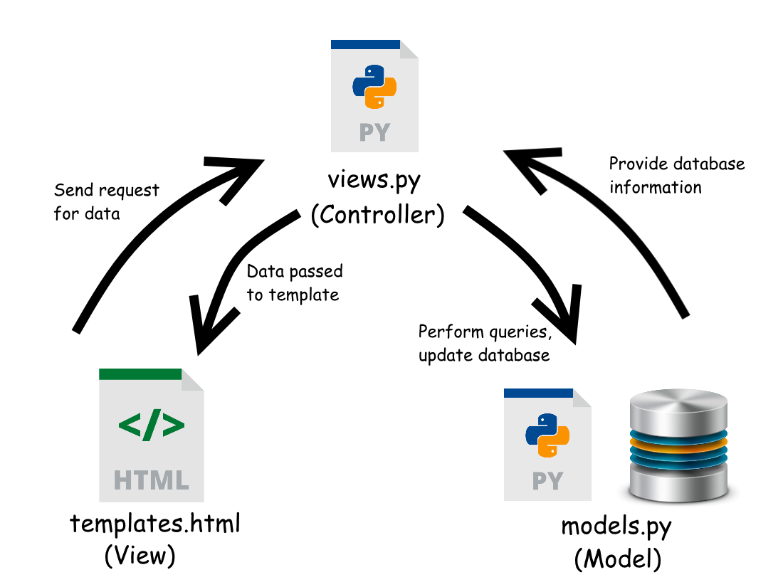
Software Architecture

Slide 17




Technologies & Tools
Front-end: Material Design Lite, HTML, CSS, jQuery
Back-end: Django
Sorting/Searching: List.JS
Database: SQLite

Slide 18



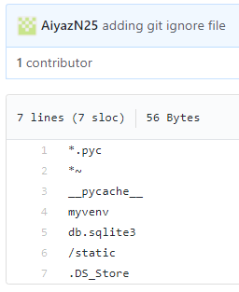


Technical Challenges
Git merge issues

Slide 19

QUESTIONS?

