Slide 1
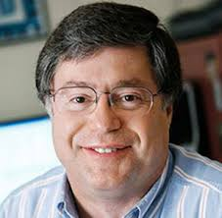
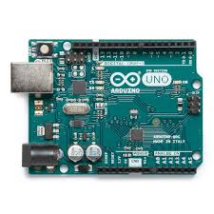
RichArduino
“
”
-
By Jack Hyde, Nathan Jarvis, Dean Choi, Jabari Booker

Slide 2

Life Cycle of Program
“SMOP”
Compile
Assemble
Execute
.source
.asm
.bin

Slide 3
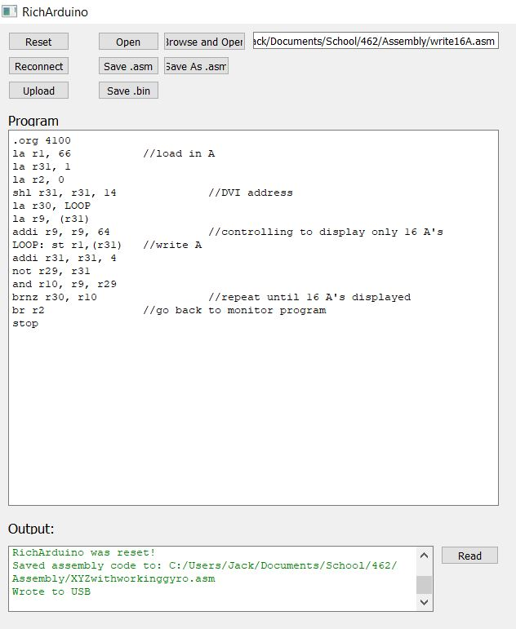
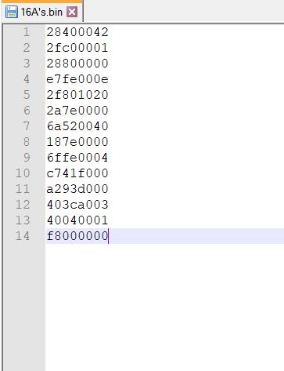
Program Flow
lots of work
Notes:
When we actually run upload, prepends length and appends branch to address 0 which is the monitor program (more on this later)

Slide 4
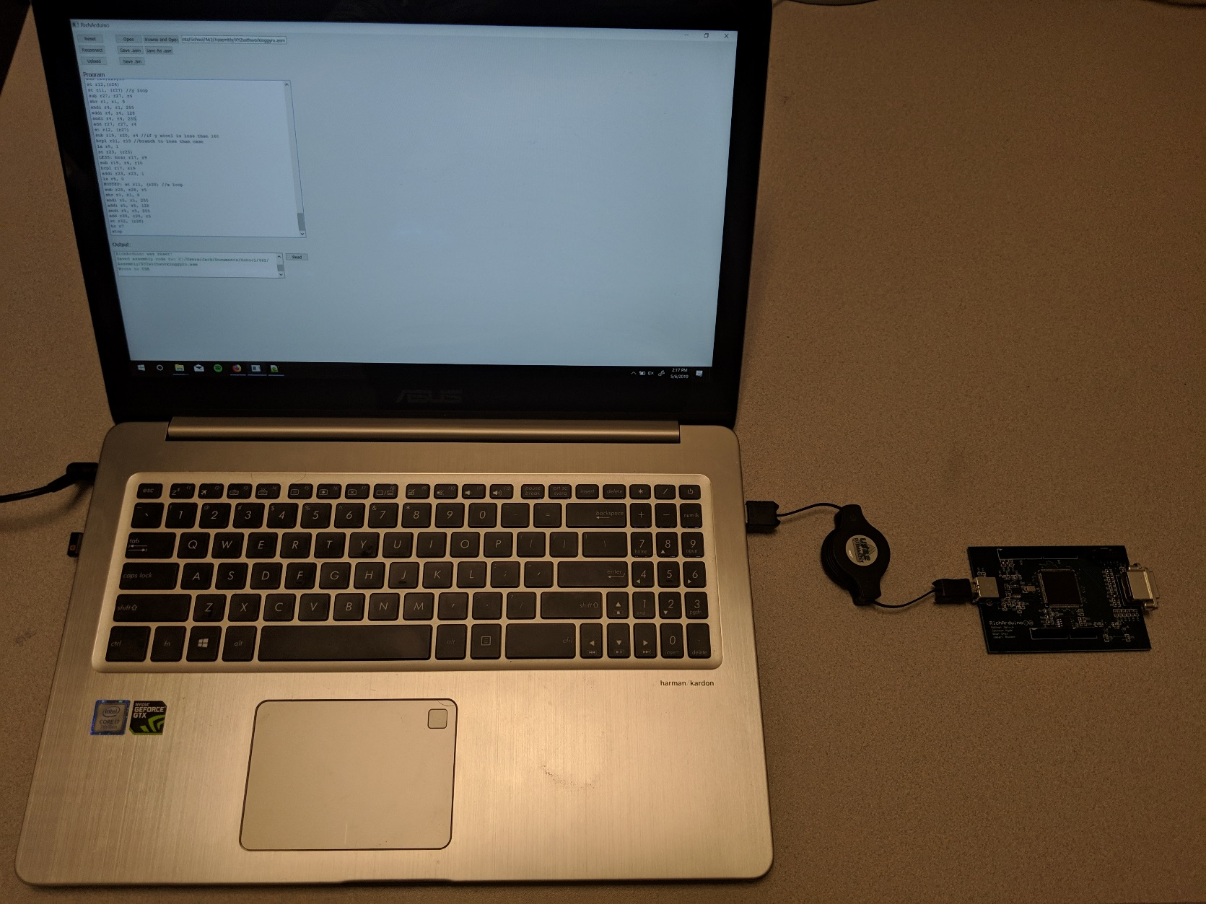
Host
RichArduino
GUI
FT201x
FPGA
FTDI Drivers
USB
I²C

Slide 5
RichArduino
FPGA
BUS
RSRC
SRAM
FT201x
FIFO
I²C Slave
I²C Master
EEPROM
I²C
Notes:
What are you downloading to?
Only subset of bus elts necessary for program downloading
I2C limited to byte reads so we need 4 reads
Procedure: RSRC running EEPROM code (monitor)
RSRC queries I2C Master which initiates an I2C transaction
First word sent is a length header.. Registered and decremented
I2C checks for four bytes, reads, RSRC decrements counter and stores full word to next address in SRAM

Slide 6
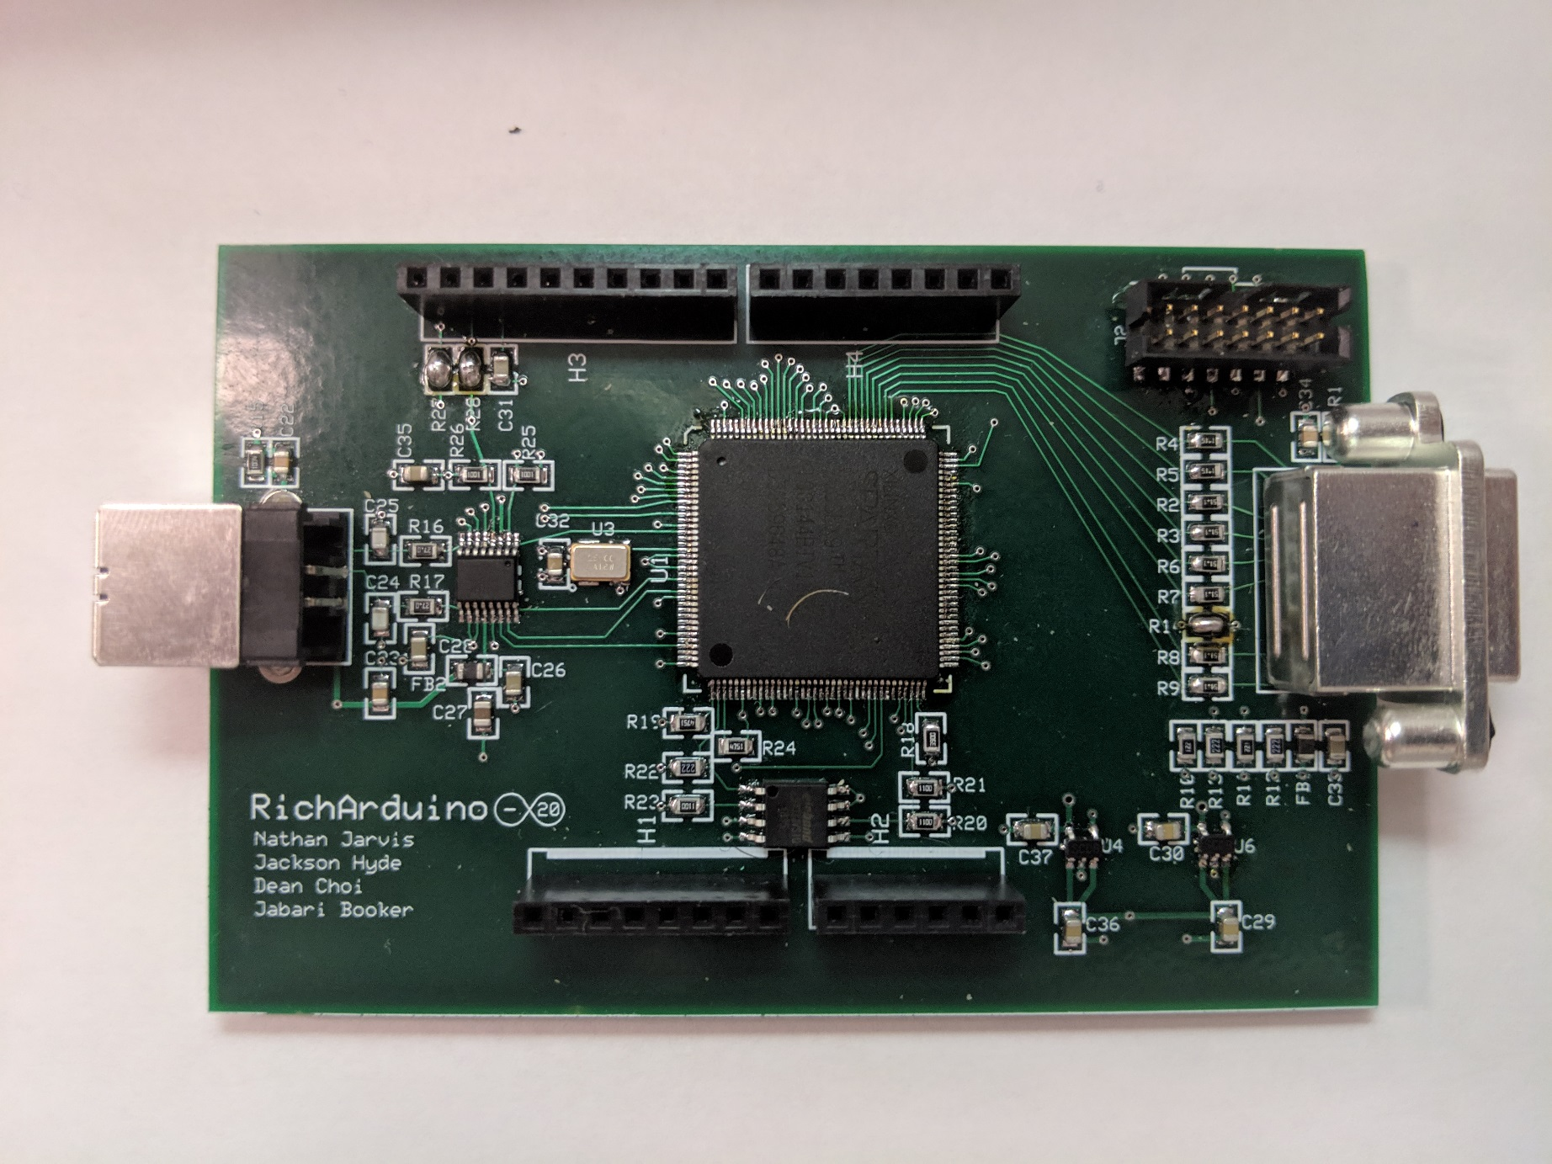
RichArduino Peripherals
20 DIO
Headers for Arduino Shield
I²C
“HDMI”
Power
Notes:
Once running, what do you have at your disposal?
Explain Shields
Explain 20 DIO’s (inout, DIO Manager)
Explain I2C shared with FT201x

Slide 7
DEMO!

