Slide 1



Analyse of Zephyr’s Performances
Bachelor’s Thesis
Nathan Loretan
August 2017
Trondheim, Norway
Version 2.0
Notes:
Collaboration with HES-SO & Nordic, help from NTNU
At start, no idea of Nordic product or Zephyr RTOS

Slide 2
Conclusion
Results
Measurements
Table of contents
Software
Hardware
Specifications
Table of Contents
Introduction
Specifications
Hardware
Software
Measurements
Results
Conclusion

Slide 3

Conclusion
Results
Measurements
Nordic Semiconductor
Software
Hardware
Specifications
Introduction
Specialized in:
System On Chip (SoC)
Bluetooth & Bluetooth Low Energy (BLE)
No final products but typically used with:
Wireless mobile phone accessories
Mouse
Keyboard
Wireless medical remote control
Notes:
nRF52 series -> recent Nordic SoC

Slide 4
Conclusion
Results
Measurements
What Nordic provides
Software
Hardware
Specifications
Introduction
Customers use with Nordic SoC
SoftDevice → protocol stack and API for Bluetooth Low Energy
Nordic SDK → API for GPIO, Serial Communication, …
If necessary
RTOS, e.g. FreeRTOS
But
Versions of SoftDevice and Nordic SDK not adaptable with every SoC
RTOS in addition of SD and SDK
Nordic SoC have memory requirements to use complex RTOS
Why could Zephyr RTOS be another solution ?

Slide 5

Conclusion
Results
Measurements
Why Zephyr RTOS ?
Software
Hardware
Specifications
Introduction
Open source RTOS designed for IoT application
Easily Portable
Supports multiple hardware architectures
Licensed Apache 2.0
Maintained on public GitHub Repository
Zephyr Project = SD + SDK + RTOS
Notes:
Apache 2.0:
- all copies, modified or unmodified, are accompanied by a copy of the licence
- all modifications are clearly marked as being the work of the modifier

Slide 6
Conclusion
Results
Measurements
However
Software
Hardware
Specifications
Introduction
Important to know
the performance of Zephyr RTOS
the behaviour of Zephyr with high BLE traffic
Contribution
Fix a bug nRF5x SPI driver configuration
Misunderstanding in API Documentation about sleep function
Added for my project
nRF52840 GPIO Port 1 Driver
nRF52840 SPI2 Driver

Slide 7
Conclusion
Results
Measurements
Goals
Software
Hardware
Specifications
Measure the performance of Zephyr RTOS
Power Consumption
Interrupt Latency
Bluetooth Low Energy Behaviour
Compare with Bare Metal system using Nordic SD+SDK
Important: not determine which one is the best
To do this
Create Application Peripheral and central
Use cases
Test cases
Notes:
- Measure, important elements for embedded system
- Not which one is the Best, SD+SDK as Reference
Applications,
BLE Peripherals, acquires data
BLE Central, receives data
maintain connection
Use cases for application,
parameters of BLE connection
Data rate
Test cases, scenario

Slide 8
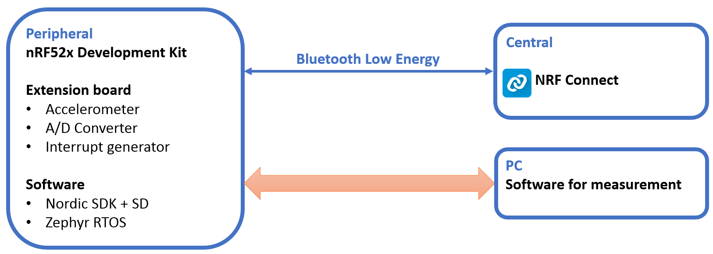
Conclusion
Results
Measurements
Peripheral
Software
Hardware
Specifications
Notes:
Extension Board
Sensors to simulate real condition
ACC & ADC
Simple to implement
Interrupt generator
Stress system
Measure interrupt latency
nRF Connect
Emulate central
Provide by nordic

Slide 9
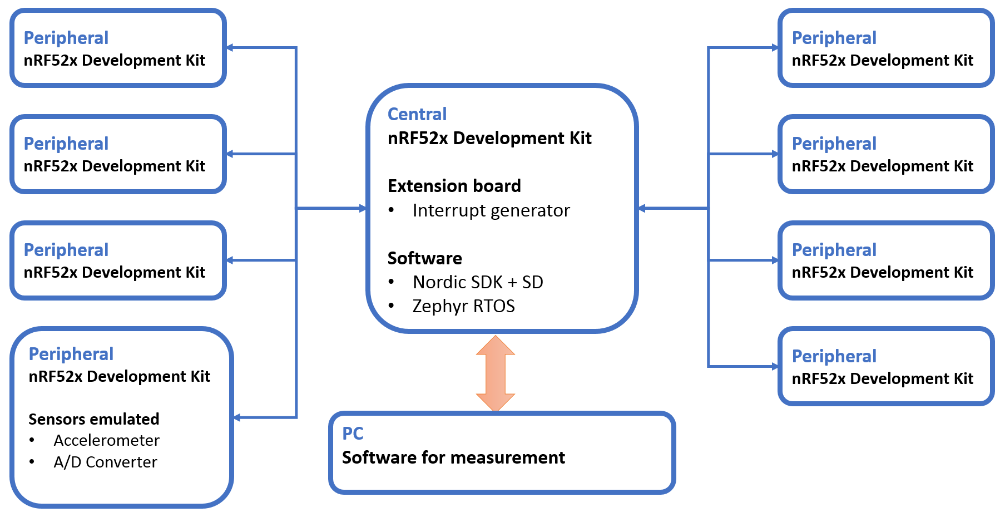
Conclusion
Results
Measurements
Central
Software
Hardware
Specifications
Notes:
Extension Board
Interrupt generator
Stress system
Measure interrupt latency
Peripheral
Emulate sensors
8 max SoftDevice connections

Slide 10
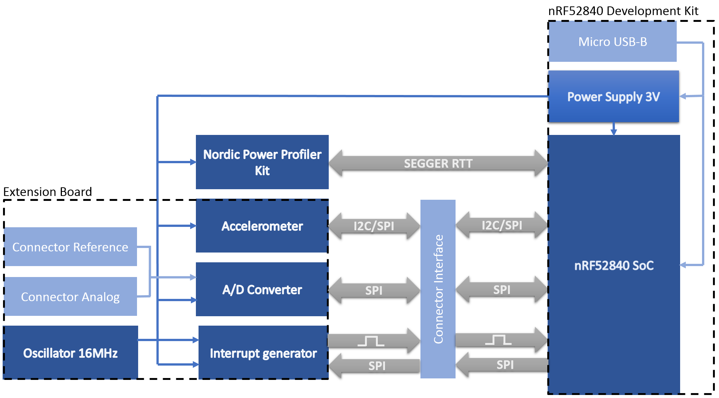
Conclusion
Results
Measurements
Schema Block
Software
Hardware
Notes:
nRF52840
more features
Power Profiler Kit
Developed by nordic
performant and easily use
Extension Board
Accelerometer A/D Converter
use serial communication
Interrupt generator
Programmable, precise frequency

Slide 11
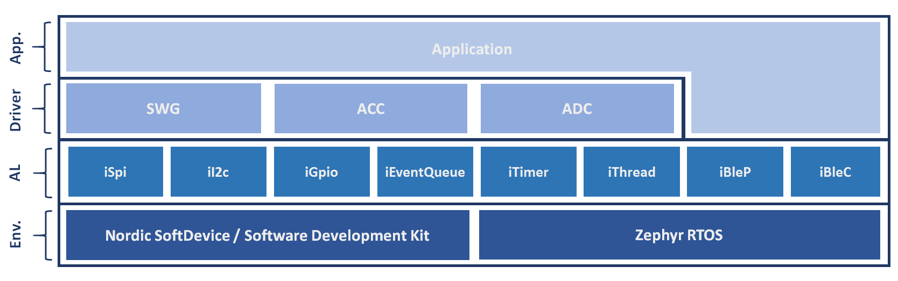
Conclusion
Results
Measurements
Architecture
Software
SoftDevice S140, nRF5 SDK v13.0.0
Zephyr SDK v0.9.1, source code updated until the start of measurements

Slide 12
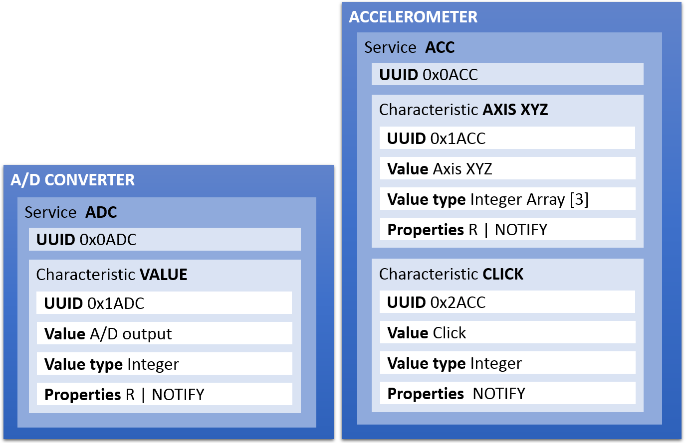

Conclusion
Results
Measurements
Applications
Software
3 applications
Peripheral connected to 1 central nRF-Connect
Central connected to 1-8 E-Peripherals
E-Peripheral Emulated peripherals, nRF52832 S132
2 services
Soft Timer
External interrupt
Buttons & Leds
Notes:
- Application
- E-Peripheral
nRF52832, SoftDevice S132
Because possibility to have more DK
Soft Timer
Influence interrupt latency
External interrupt
Interrupt latency measurement
Stress the system

Slide 13
Conclusion
Results
Measurements
Type
Power Consumption
Interrupt Latency
Bluetooth Low Energy Behaviour
Advertising interval Peripheral → defined by Bluetooth Core 4.0
Stack Propagation Delay Peripheral
Scanning Interval/Window Central → defined by Bluetooth Core 4.0
Connection Interval Central → defined by Bluetooth Core 4.0
Connection Event Interval Central
Difficult because no access to the source code of SoftDevice
PPK
GPIOs & Logic Analyser
Notes:
Diffcult because no access to SD, need to compare
Ble Interval
- Define by Bluetooth core
- Work or Not
- Analyze if high interrupt frequency or anything else influence

Slide 14
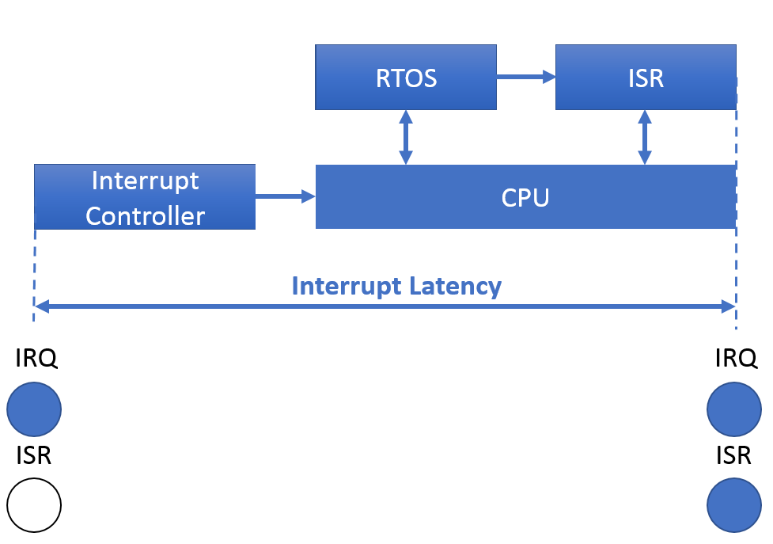
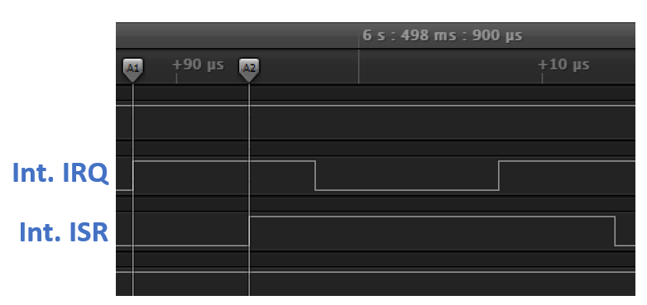
Conclusion
Results
Measurements
Interrupt Latency
Notes:
Basic interrupt latency
No other because no access to SD
IRQ on GPIO
Interval to ISR

Slide 15
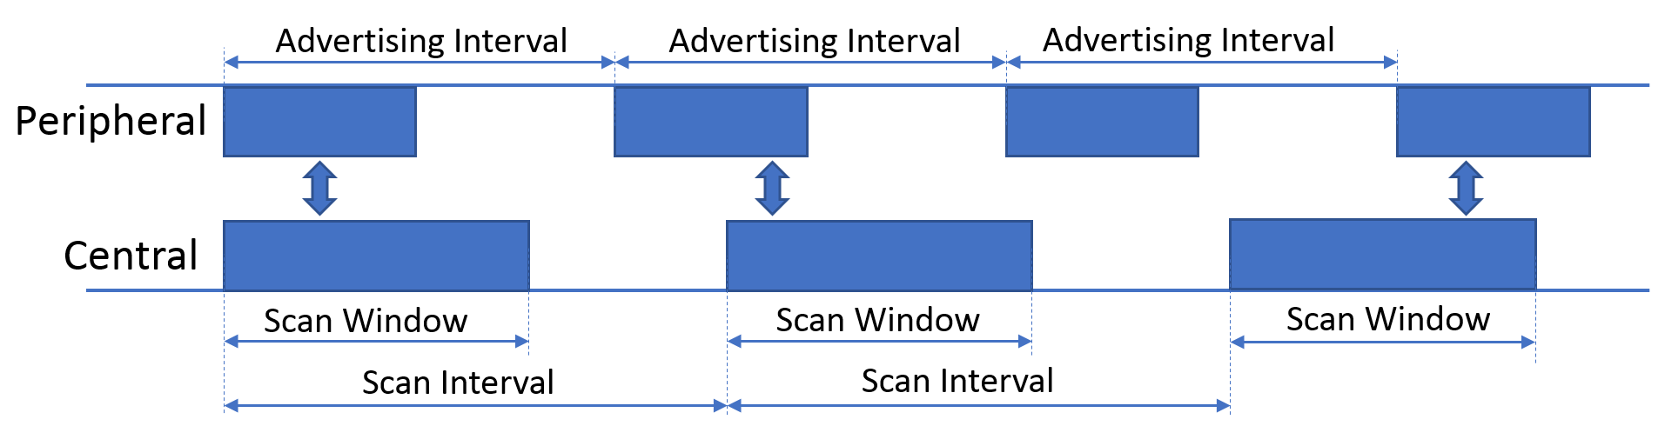
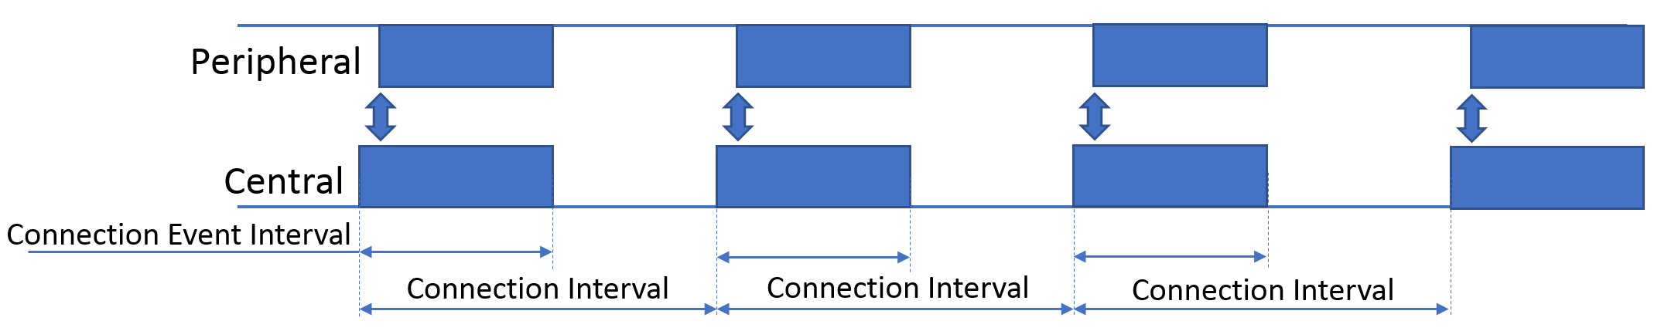
Conclusion
Results
Measurements
BLE Interval
Not Connected
Connected

Slide 16
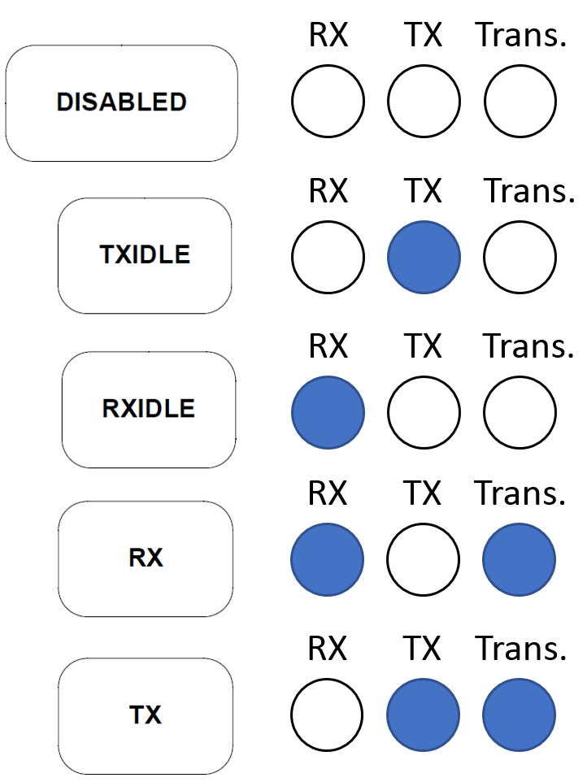
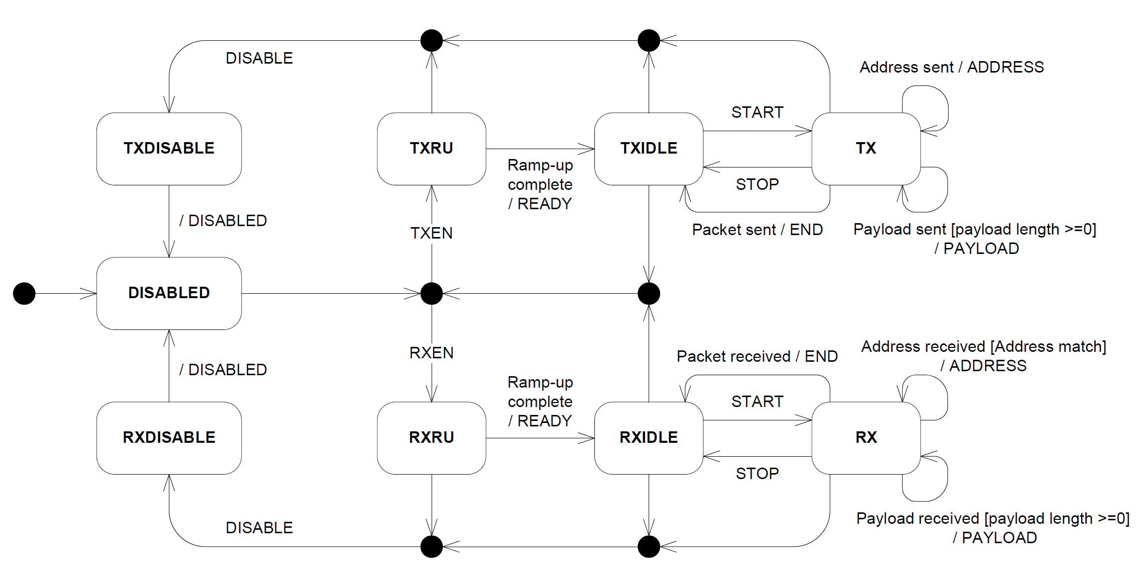
Conclusion
Results
Measurements
BLE Interval

Slide 17
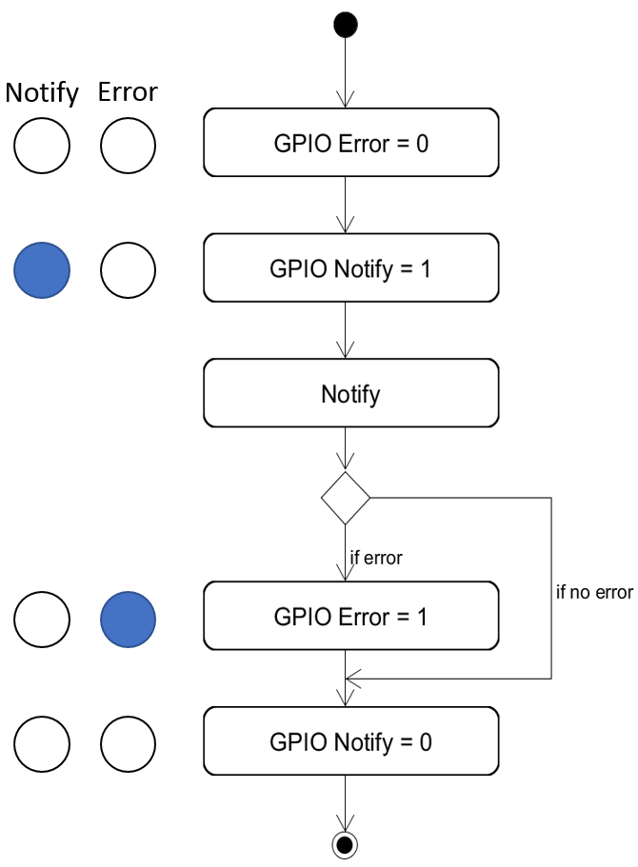
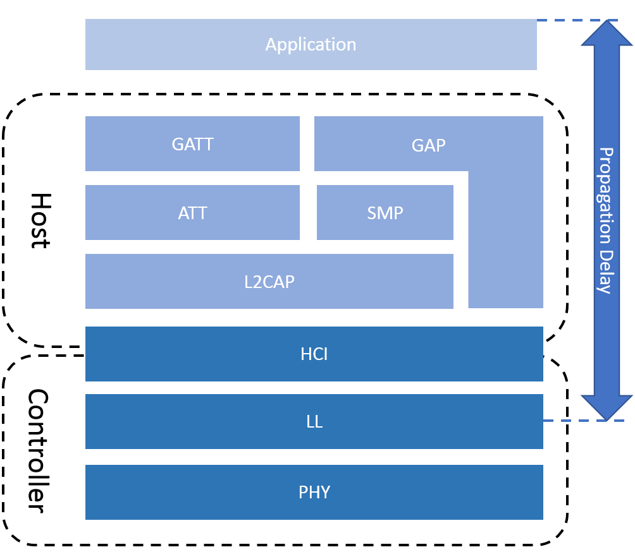
Conclusion
Results
Measurements
BLE Stack Propagation Delay
Notes:
- Time within the function to notify

Slide 18
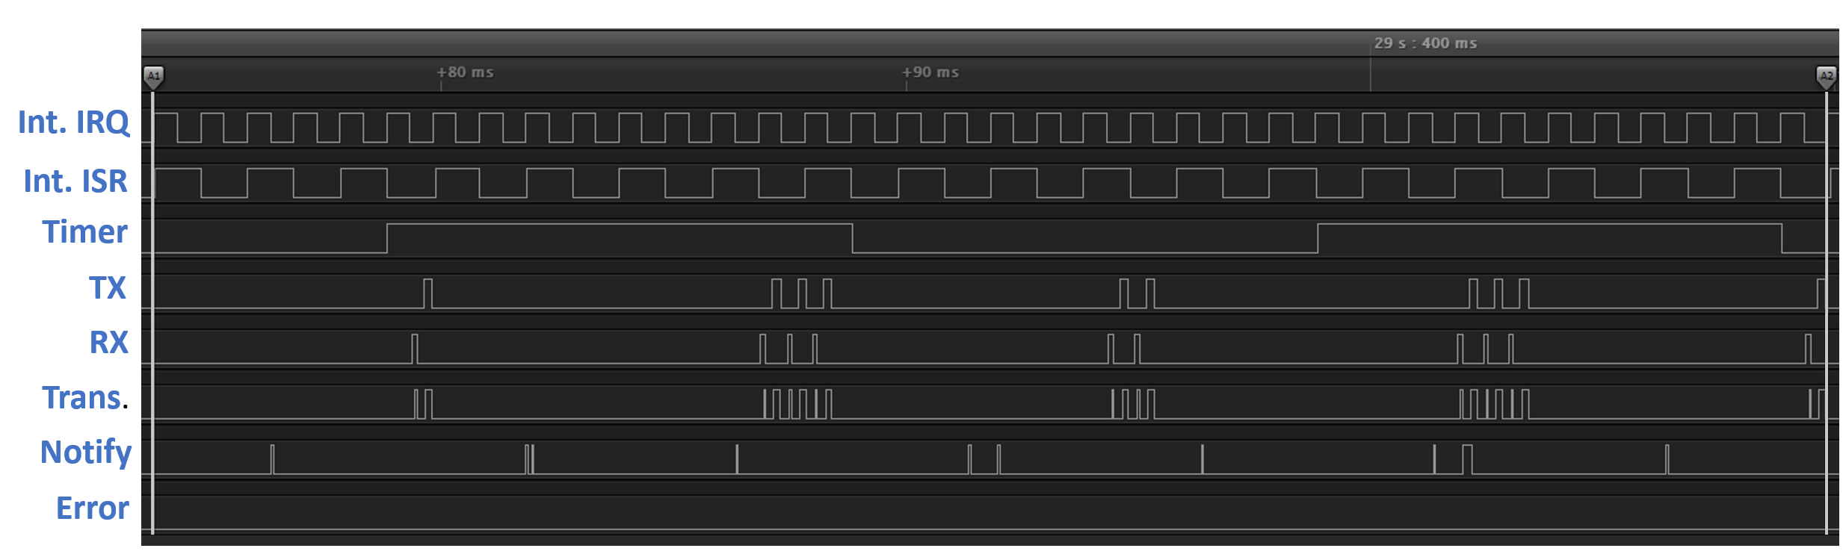
Conclusion
Results
Measurements
Example of measurement

Slide 19
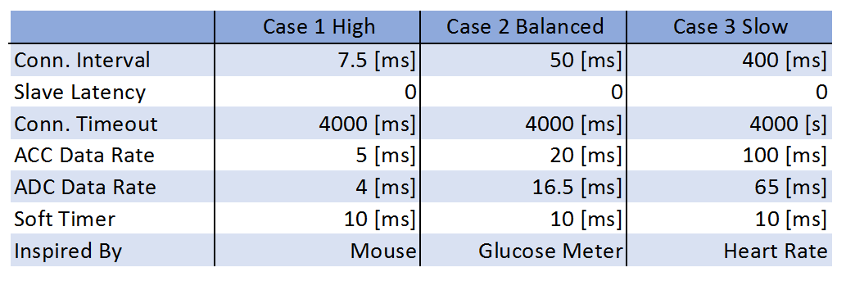
Conclusion
Results
Measurements
Use cases
Based on examples of nRF5 SDK v13.0.0
Central tested with 1, 4, 8 peripherals connected
Notes:
- Examples from nRF5 SDK
Case 1, worst cases,
central only one connection with my app.
Connection event interval bigger than connection interval
Case 2, save power, good throughput,
Case 3, power more important

Slide 20
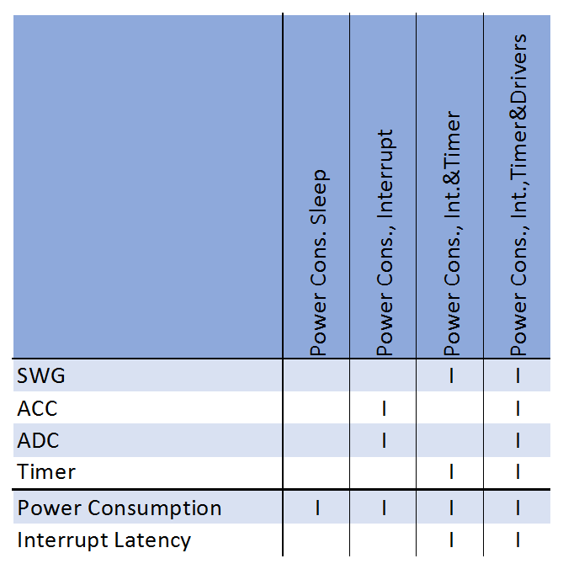
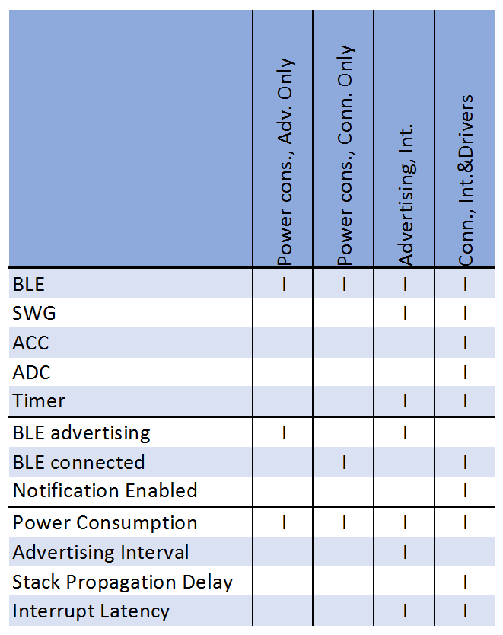
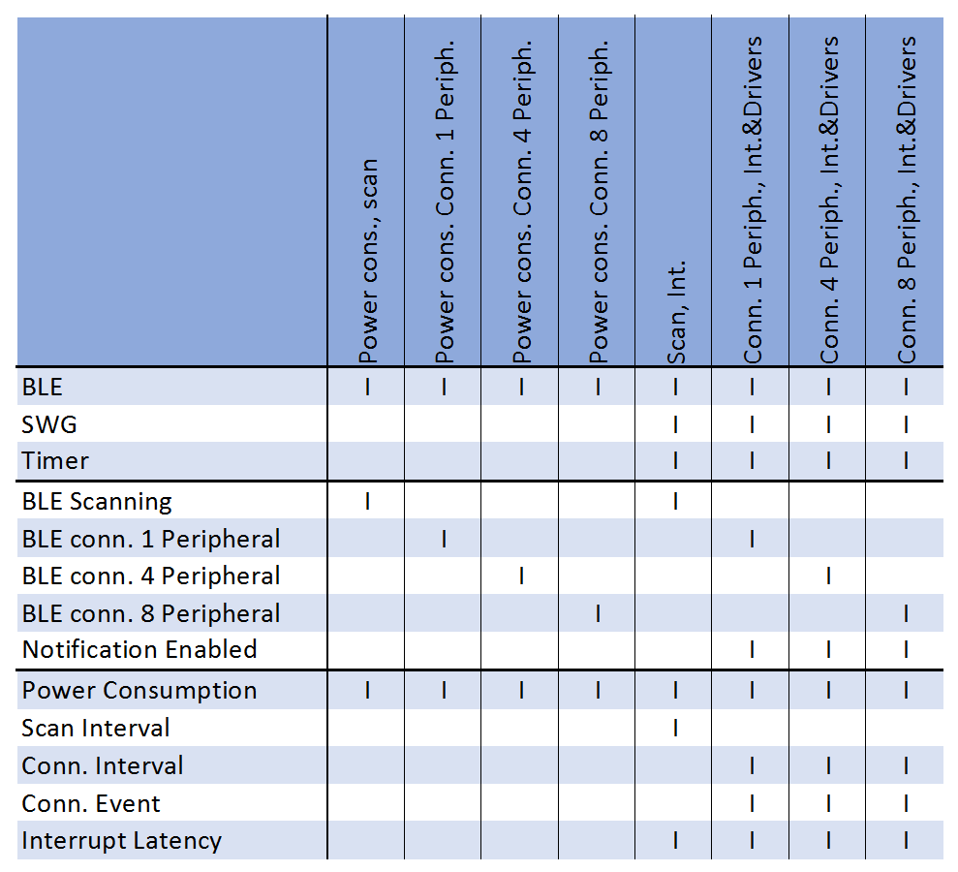
Conclusion
Results
Measurements
Test cases
Extension Board Peripheral Central
Notes:
With/Without drivers ACC ADC SWG for power consumption
Each BLE measurement with each use cases
Interrupt frequency is increased until break
BLE must work when crash

Slide 21
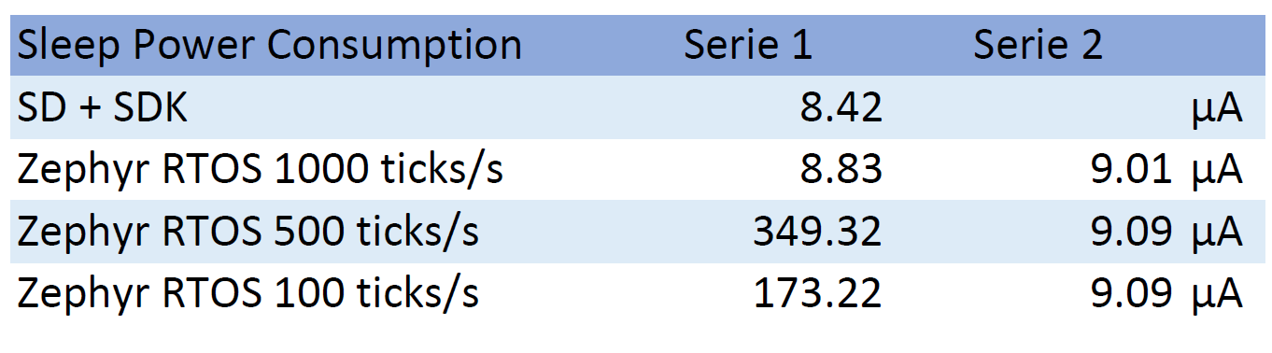
Conclusion
Results
Power Consumption without BLE
Notes:
Two power consumption series
Serie1 Wrong Zephyr sleep
Serie2 Right Zepyhr sleep
Darker Zephyr
Lighter SDK+SD

Slide 22
Conclusion
Results
Power Consumption with BLE
Notes:
Darker Zephyr
Lighter SDK+SD
Blue Conn. int. 7.5ms
Red Conn. int. 50ms
Green Conn. int. 400ms

Slide 23
Conclusion
Results
Interrupt Latency
Notes:
Darker Zephyr
Lighter SDK+SD
Blue Average
Red Min.
Green Max.

Slide 24
Conclusion
Results
Stack Propagation Delay
Notes:
Darker Zephyr
Lighter SDK+SD
Blue Average
Red Min.
Green Max.
- Unfortunatly, influence of interrupt latency not measured

Slide 25
Conclusion
Results
Connection Event Interval
Notes:
- Huge difference
- Default communication way different

Slide 26
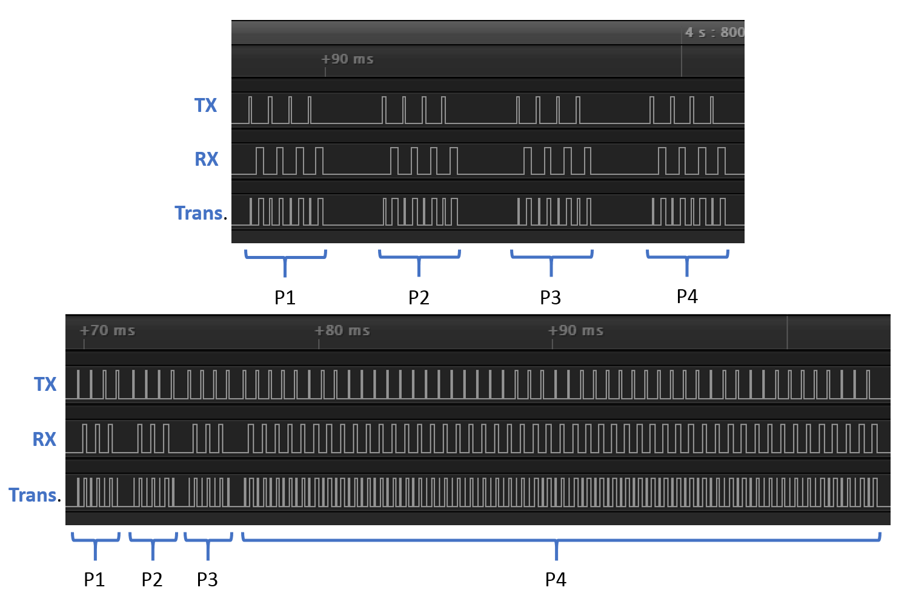
Conclusion
Results
Connection Event Interval
SoftDevice
Zephyr
Notes:
No time to define same communication way

Slide 27
Conclusion
Results
Summary
Power Consumption
Zephyr slightly lower than SD+SDK
Interrupt Latency
Zephyr: 15µs SD+SDK: 7µs
Break Frequency
Zephyr: 130kHz SD+SDK: 130kHz
Bluetooth Low Energy Behaviour
Advertising interval OK
Scanning Interval/Window OK
Connection Interval OK
Stack propagation delay Zephyr: 93µs SD+SDK: 50µs
Notes:
Break frequency, higher, not important in this case because interrupt latency

Slide 28
Conclusion
Conclusion
Zephyr RTOS performance
Satisfy the conditions
Near SD+SDK
+ Zephyr
Portable
System easily configurable
+ SoftDevice
Safe
Certification Bluetooth Low Energy

Slide 29
Conclusion
Questions ?

