Slide 1



Analyse of Zephyr’s Performances
Bachelor’s Thesis
Nathan Loretan
August 2017, Trondheim Norway
Professor HES-SO: Medard Rieder
Professor NTNU: Dag Roar Hjelme
Contact at Nordic: Torstein Heggebo
Notes:
Exchange students, Switzerland
Collaboration with HES-SO & Nordic, help from NTNU
Not technical presentation
Not vs, more compare
Me, no idea about Nordics components, Zephyr, SoftDevice, ...

Slide 2
Conclusion
Results
Measurements
Table of contents
Software
Hardware
Specifications
Table of Contents
Introduction
Specifications
Hardware
Software
Measurements
Results
Conclusion

Slide 3
Conclusion
Results
Measurements
What Nordic provides
Software
Hardware
Specifications
Introduction
Customers use
SoftDevice → API for Bluetooth Low Energy
Nordic SDK → API for GPIO, Serial Communication, …
If necessary
RTOS, e.g. FreeRTOS
But
Versions of SoftDevice and Nordic SDK not adaptable with every SoC
If required, RTOS in addition of SD and SDK
SoC with memory requirement to use complex RTOS
Why could Zephyr RTOS be another solution ?

Slide 4

Conclusion
Results
Measurements
Why Zephyr RTOS ?
Software
Hardware
Specifications
Introduction
Open source RTOS designed for IoT application
Easily Portable
Supports multiple hardware architectures
Licensed Apache 2.0
Maintained on public GitHub Repository
Zephyr Project = SD + SDK + RTOS
Notes:
Apache 2.0:
- all copies, modified or unmodified, are accompanied by a copy of the licence
- all modifications are clearly marked as being the work of the modifier

Slide 5
Conclusion
Results
Measurements
However
Software
Hardware
Specifications
Introduction
Important to know
the performance of Zephyr
the behaviour of Zephyr with high BLE traffic
Contribution
Fix a bug nRF5x SPI driver configuration
Added for my project
nRF52840 GPIO Port 1 Driver
nRF52840 SPI2 Driver

Slide 6
Conclusion
Results
Measurements
Goals
Software
Hardware
Specifications
Measure the performance of Zephyr RTOS
Power Consumption
Interrupt Latency
Bluetooth Low Energy Behaviour
Compare with Bare Metal system using Nordic SD+SDK
Important: not determine which one is the best
To do this
Create Application Peripheral and central
Use cases
Test cases
Notes:
- Measure important elements for embedded system
Not the Best, SD+SDK as Reference
Application,
Peripherals, acquire data and central, receive data
P&C because maintain connection
real condition
acquire data from sensors
Stress the systems
Use cases for application, commnication with BLE
Test cases element enabled with

Slide 7
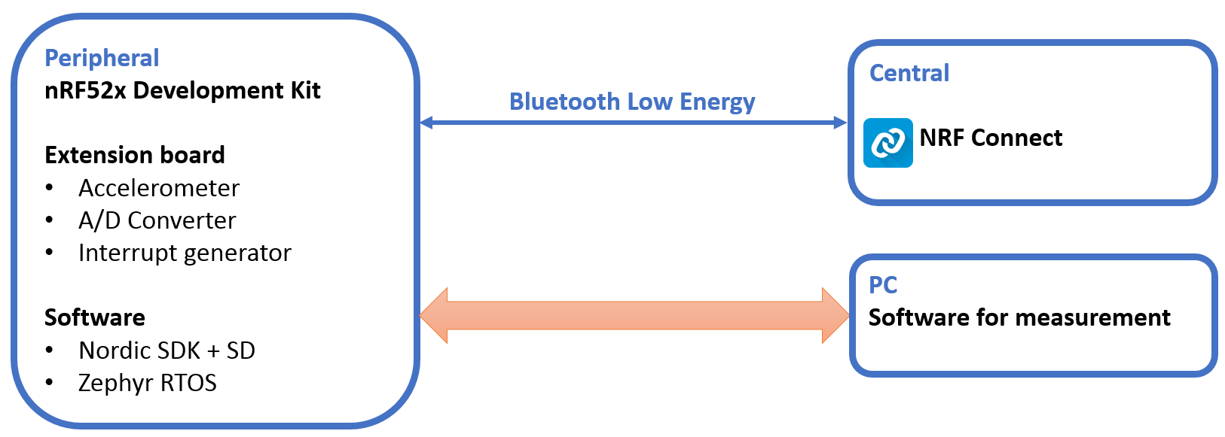
Conclusion
Results
Measurements
Peripheral
Software
Hardware
Specifications

Slide 8
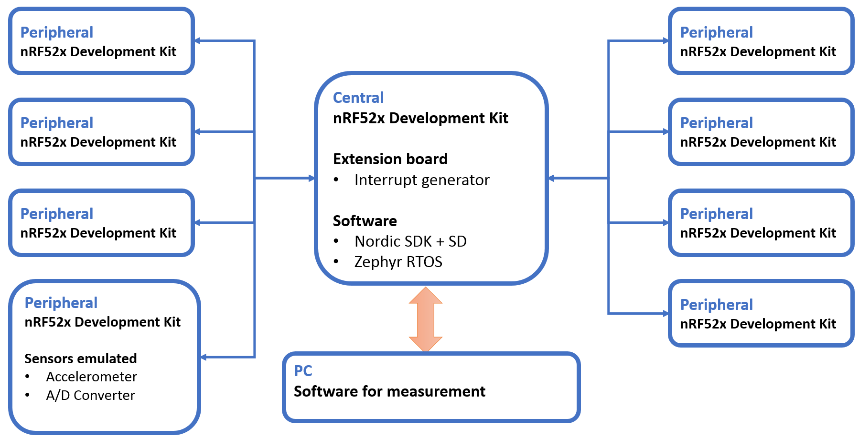
Conclusion
Results
Measurements
Central
Software
Hardware
Specifications

Slide 9
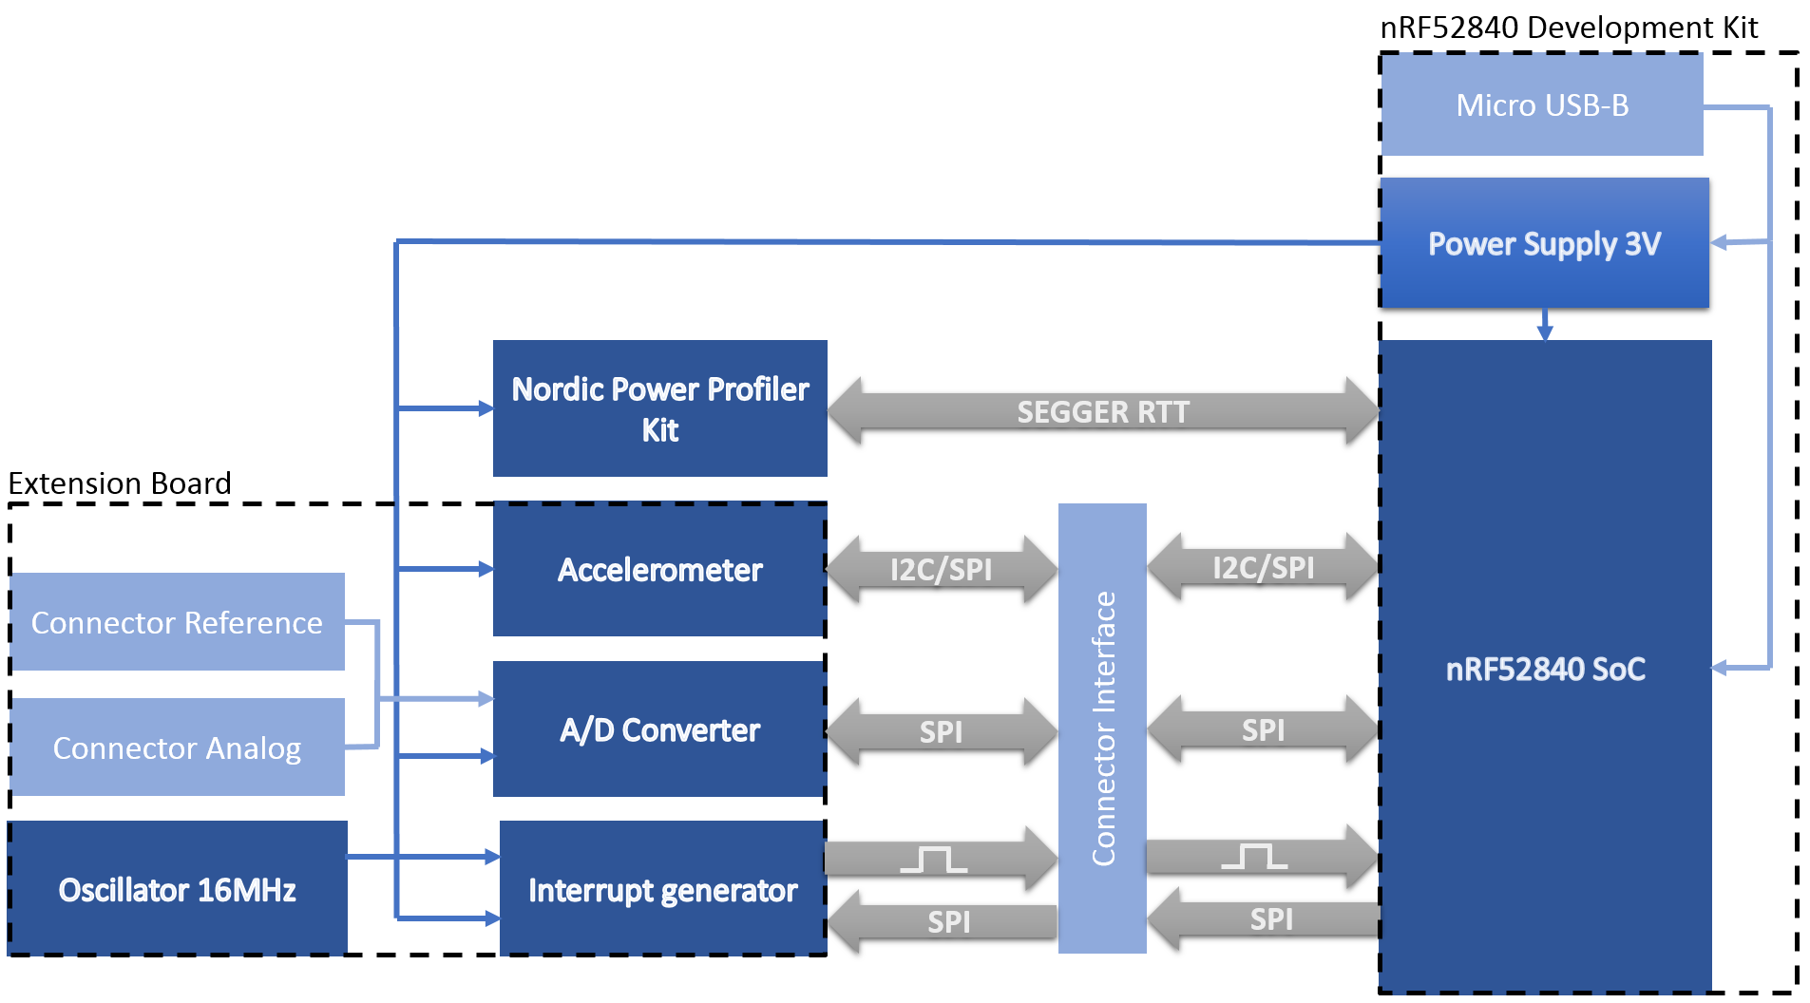
Conclusion
Results
Measurements
Schema Block
Software
Hardware
Notes:
nRF52840, more features to not be restricted
Power Profiler Kit, performant and easily use
Accelerometer A/D Converter, quickly implemented, use serial communication
Interrupt generator, stress and measure the interrupt latency

Slide 10
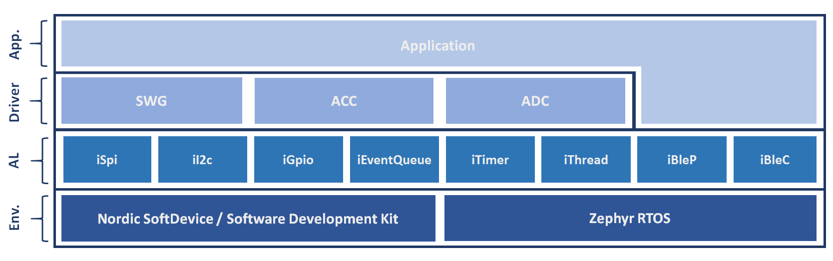
Conclusion
Results
Measurements
Architecture
Software
SoftDevice S140, nRF5 SDK v13.0.0
Zephyr SDK v0.9.1, source code frequently updated from GitHub repository

Slide 11
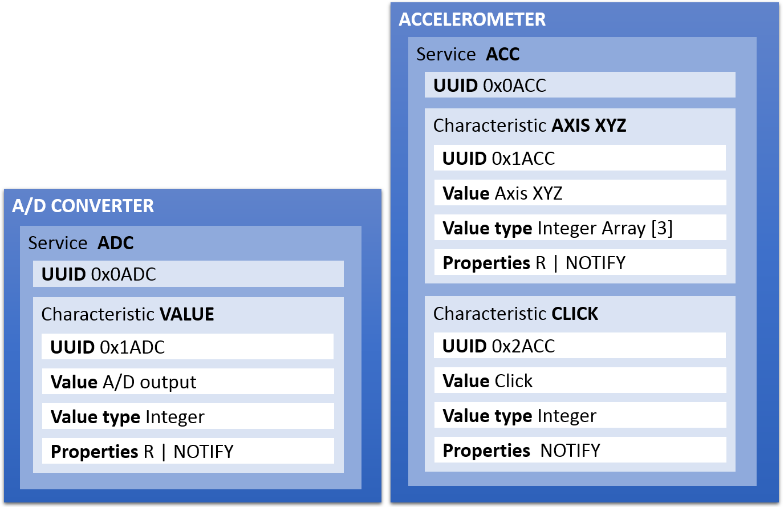

Conclusion
Results
Measurements
Applications
Software
3 applications
Peripheral connected to 1 central nRF-Connect
Central connected to 1-8 E-Peripherals
E-Peripheral Emulated peripherals, nRF52832 S132
2 services
Soft Timer
External interrupt
Buttons & Leds
Notes:
E-Peripheral nRF52832, because possibility to have more

Slide 12
Conclusion
Results
Measurements
Type
Power Consumption
Interrupt Latency
Bluetooth Low Energy Behaviour
Advertising interval Peripheral → defined by Bluetooth Core 4.0
Stack Propagation Delay Peripheral
Scanning Interval/Window Central → defined by Bluetooth Core 4.0
Connection Interval Central → defined by Bluetooth Core 4.0
Connection Event Interval Central
Difficult because no access to the source code of SoftDevice
PPK
GPIOs & Logic Analyser
Notes:
Interval, define by Bluetooth core, work or not

Slide 13
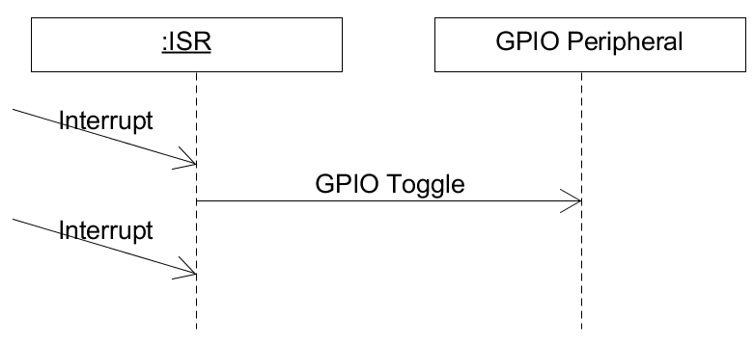
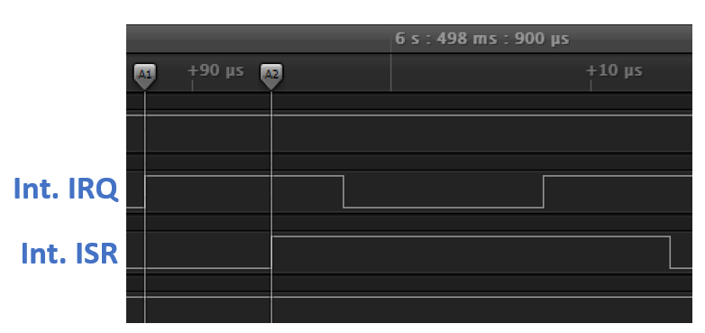
Conclusion
Results
Measurements
Interrupt Latency

Slide 14
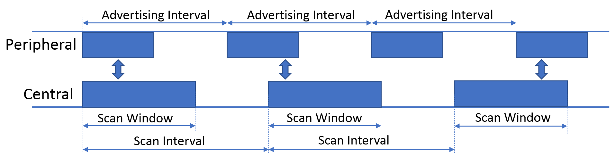
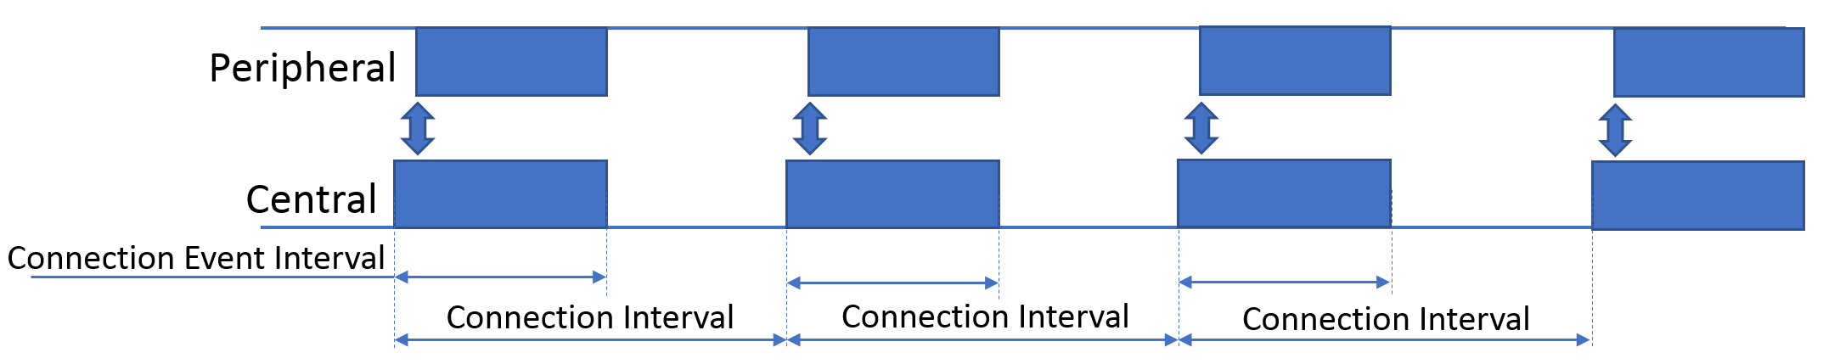
Conclusion
Results
Measurements
BLE Interval

Slide 15
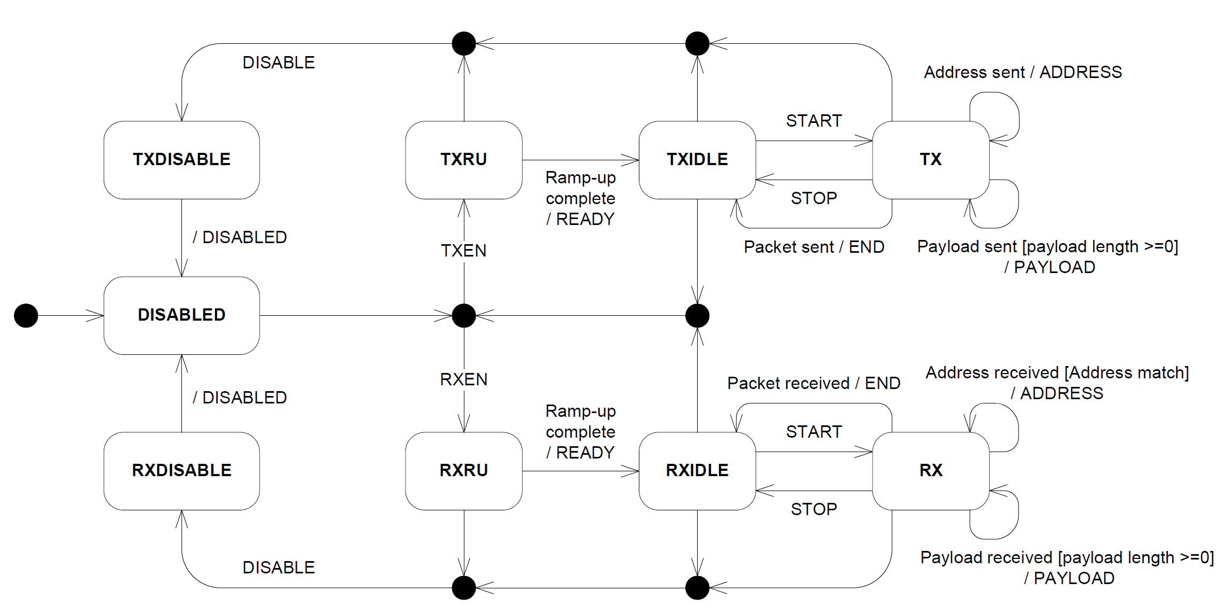
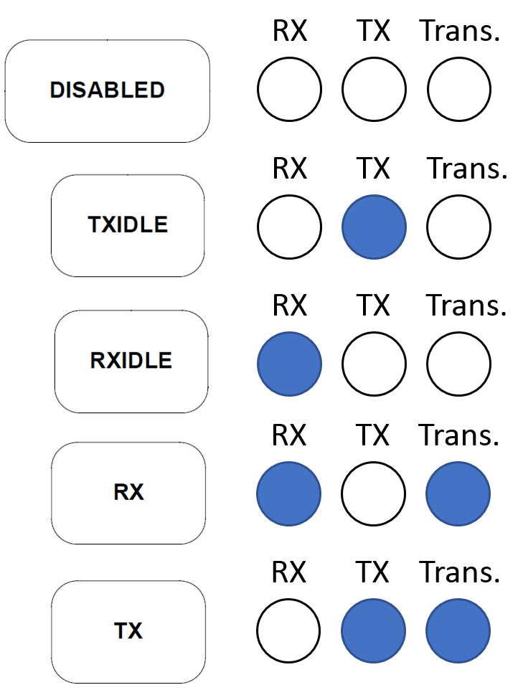
Conclusion
Results
Measurements
BLE Interval

Slide 16
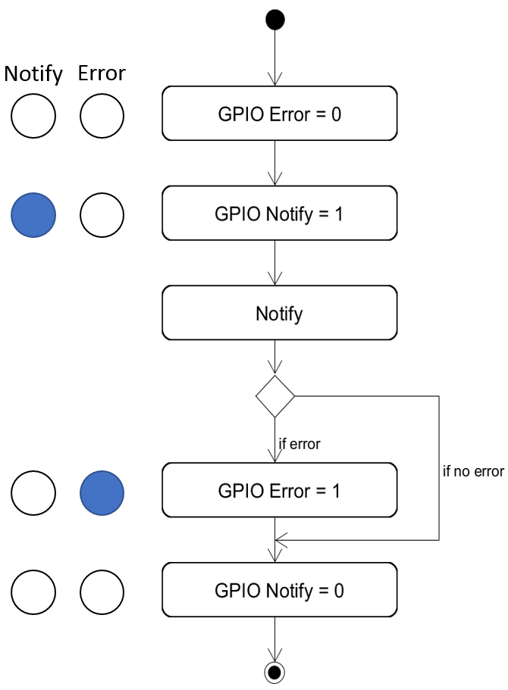
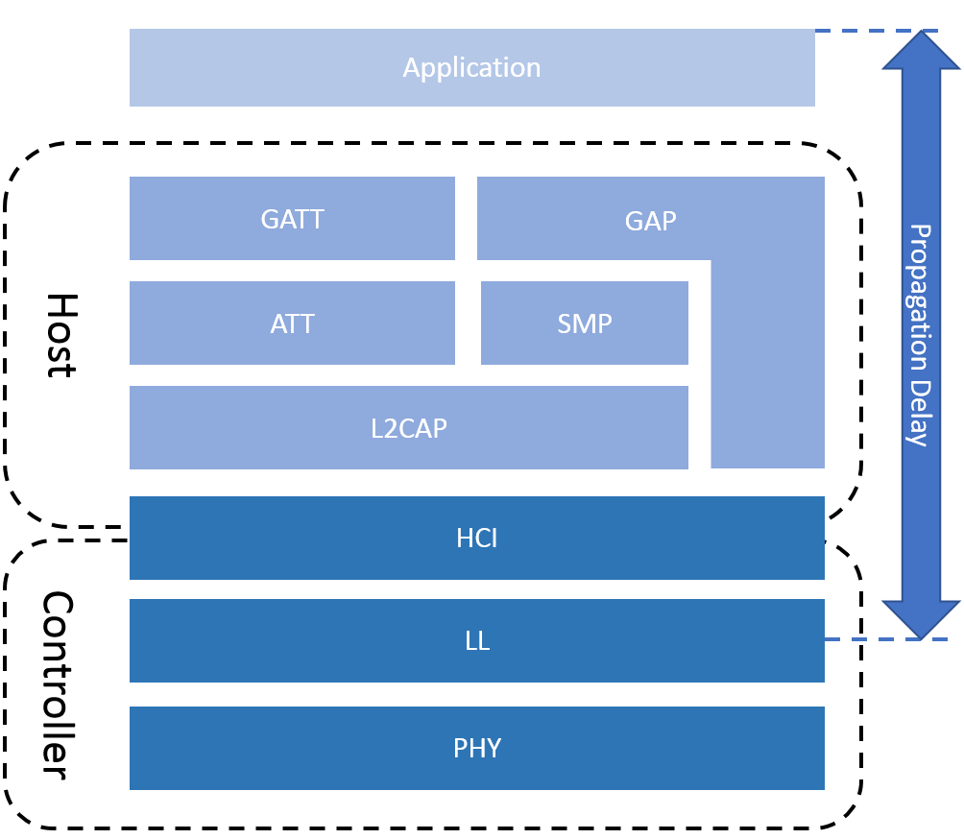
Conclusion
Results
Measurements
BLE Stack Propagation Delay

Slide 17
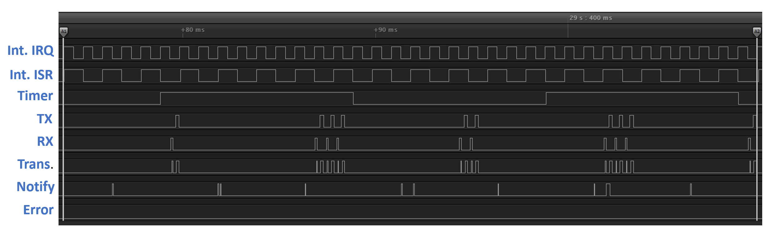
Conclusion
Results
Measurements
Example of measurement

Slide 18
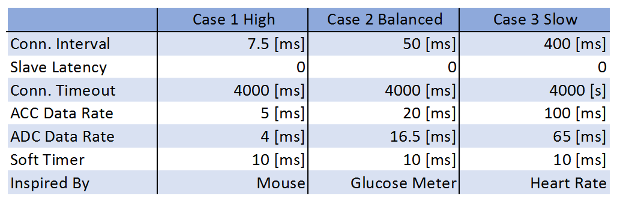
Conclusion
Results
Measurements
Use cases
Based on examples of nRF5 SDK v13.0.0
Central tested with 1, 4, 8 peripherals connected
Notes:
- Examples from nRF5 SDK
Case 1, worst cases, central only one connection.
Case 2, save power, good throughput,
Case 3, power more important

Slide 19
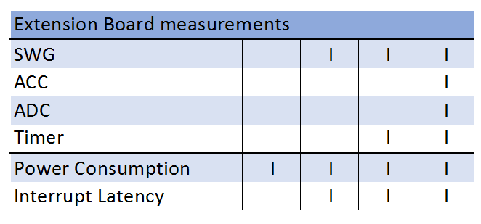
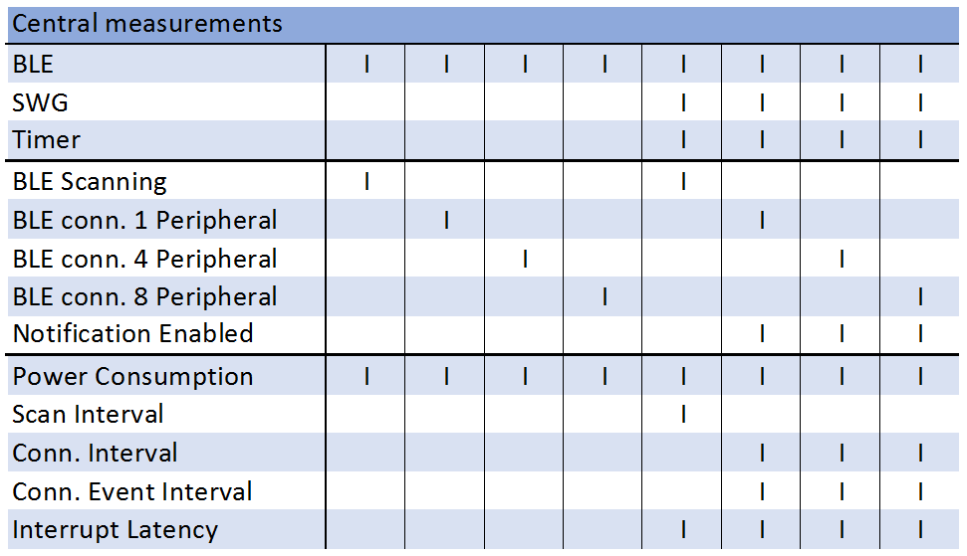
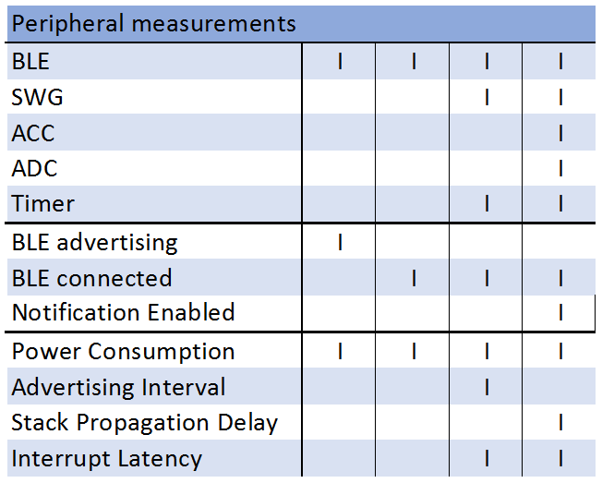
Conclusion
Results
Measurements
Test cases
Notes:
Interrupt increase until break

Slide 20
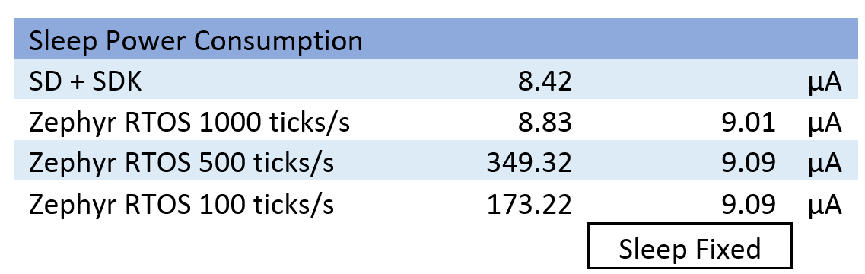
Conclusion
Results
Power Consumption without BLE
Notes:
- Darker Zephyr
- Lighter SDK+SD
- Wrong sleep first measurements

Slide 21
Conclusion
Results
Power Consumption with BLE

Slide 22
Conclusion
Results
Interrupt Latency

Slide 23
Conclusion
Results
Stack Propagation Delay

Slide 24
Conclusion
Results
Connection Event Interval

Slide 25
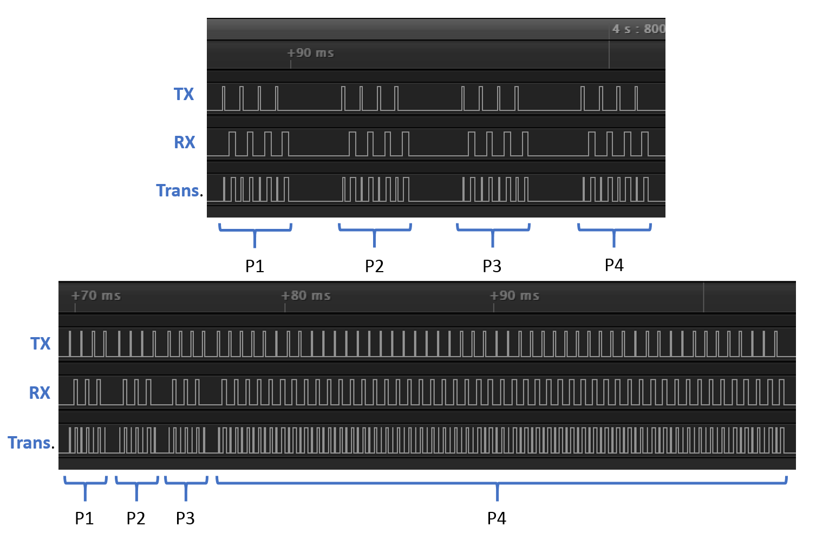
Conclusion
Results
Connection Event Interval
SoftDevice
Zephyr

Slide 26
Conclusion
Results
Summary
Power Consumption
Zephyr slightly lower than SD+SDK
Interrupt Latency
Zephyr: 15µs SD+SDK: 7µs
Break Frequency
Zephyr: 130kHz SD+SDK: 130kHz
Bluetooth Low Energy Behaviour
Advertising interval OK
Scanning Interval/Window OK
Connection Interval OK
Notes:
Break frequency, higher, not important in this case because interrupt latency

Slide 27
Conclusion
Conclusion
Zephyr RTOS performance
Satisfy the conditions
Near SD+SDK
My impression
Better API Documentation
Easier to configure
Questions ?

