Slide 1

Peripheral
nRF52x Development Kit
Extension board
Accelerometer
A/D Converter
Interrupt generator
Software
Nordic SDK + SD
Zephyr RTOS
Central
NRF Connect
Bluetooth Low Energy
PC
Software for measurement

Slide 2
Peripheral
nRF52x Development Kit
Peripheral
nRF52x Development Kit
Central
nRF52x Development Kit
Extension board
Interrupt generator
Software
Nordic SDK + SD
Zephyr RTOS
Peripheral
nRF52x Development Kit
Peripheral
nRF52x Development Kit
Peripheral
nRF52x Development Kit
Peripheral
nRF52x Development Kit
Peripheral
nRF52x Development Kit
Sensors emulated
Accelerometer
A/D Converter
Peripheral
nRF52x Development Kit
PC
Software for measurement

Slide 3
Profile
Service 1
Service 2
…
Service
Declaration
UUID
Characteristic
Characteristic 1
Declaration
UUID
Properties
Value Handle
Characteristic 2
…
Value
Descriptor 1
Descriptor 2
…

Slide 4
Profile
Service
Service
Declaration
Declaration
Characteristic
Characteristic
Declaration
Declaration
Value
Value
Descriptor
Characteristic
Characteristic
Declaration
Declaration
Value
Value

Slide 5
Attribute Opcode
(1 Bytes)
Attribute Parameters
(MTU -1)
Handle
(2 Bytes)
Data
(MTU - 3)

Slide 6
nRF52840 Development Kit
Micro USB-B
Power Supply 3V
Nordic Power Profiler Kit
nRF52840 SoC
SEGGER RTT
Extension Board
Accelerometer
I2C/SPI
I2C/SPI
Connector Reference
A/D Converter
Connector Interface
Connector Analog
SPI
SPI
Oscillator 16MHz
Interrupt generator
SPI
SPI

Slide 7
App. = application
AL = Abstract Layer
Env. = environment
Application
App.
SWG
ACC
ADC
Driver
iSpi
iI2c
iGpio
iEventQueue
iTimer
iThread
iBleP
iBleC
AL
Nordic SoftDevice / Software Development Kit
Zephyr RTOS
Env.

Slide 8






BLE Event Queue
Event CONNECTED
Event DISCONNECTED
BLE Thread
ACC Event Queue
Event INT1 (data)
Event INT2 (click)
Event WAKEUP
Event SLEEP
ON/OFF
Data Ready
Click
ACC Thread
ADC Event Queue
Event DATA
Event WAKEUP
Event SLEEP
ON/OFF
Data Ready
ADC Thread
SWG Event Queue
Event FREQ
Event WAKEUP
Event SLEEP
ON/OFF
New Frequency
SWG Thread
GPIO Interrupt Latency
Soft Timer
Push Button
GPIO interrupt
Timer

Slide 9
ACCELEROMETER
Service ACC
UUID 0x0ACC
Characteristic AXIS XYZ
UUID 0x1ACC
A/D CONVERTER
Value Axis XYZ
Service ADC
Value type Integer Array [3]
UUID 0x0ADC
Properties R | NOTIFY
Characteristic VALUE
Characteristic CLICK
UUID 0x1ADC
UUID 0x2ACC
Value A/D output
Value Click
Value type Integer
Value type Integer
Properties R | NOTIFY
Properties NOTIFY

Slide 10

BLE Event Queue
Event CONNECTED
Event DISCONNECTED
BLE Thread
ACC Event Queue
Event INT1 (data)
Event INT2 (click)
ACC Thread
Data
Click
ADC Event Queue
Data
Event DATA
ADC Thread
ON/OFF ACC Data
ON/OFF ACC Click
ON/OFF ADC Data
LED
Push Button
GPIO interrupt
Timer
Connected
Started

Slide 11

BLE Event Queue
Event CONNECTION
Event DISCONNECTION
Event READY
BLE Thread
SWG Event Queue
Event FREQ
Event WAKEUP
Event SLEEP
ON/OFF
New Frequency
SWG Thread
ACC Data
GPIO Interrupt Latency
Notify
ACC Click
Soft Timer
Push Button
GPIO interrupt
Timer
ADC Data

Slide 12
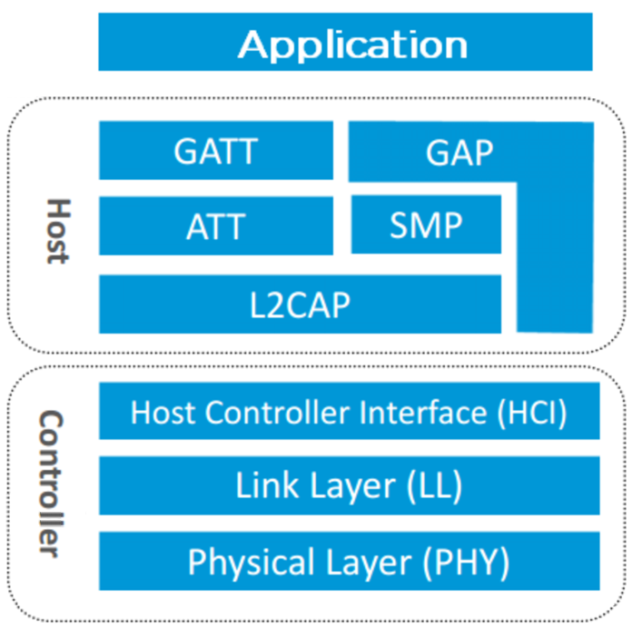
Propagation Delay

Slide 14
Application
Host
GATT
GAP
ATT
SMP
L2CAP
HCI
Controller
LL
PHY

Slide 15
Application
Propagation Delay
Host
GATT
GAP
ATT
SMP
L2CAP
HCI
Controller
LL
PHY

Slide 16
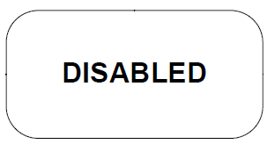
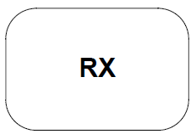
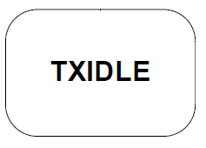
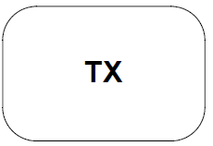
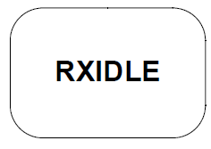
RX
TX
Trans.
RX
TX
Trans.
RX
TX
Trans.
RX
TX
Trans.
RX
TX
Trans.

Slide 17
RX
TX
Trans.
RTX
→ EVENT DISABLED
→ EVENT ADDRESS
RX
Trans.
RTX
→ EVENT TXREADY
→ EVENT END
RX
Trans.
→ EVENT RXREADY

Slide 18
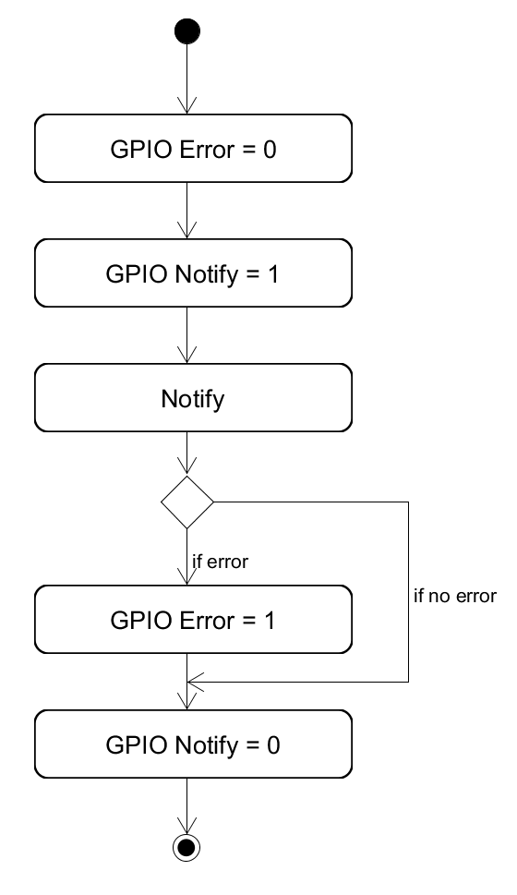
Notify
Error
Start
End, no error
End, with error

Slide 19
Interrupt Latency
BLE Interval BLE Stack Propagation Delay
IRQ
ISR
RX
TX
RTX
CRCOK
Notify
Error
→ EVENT DISABLED
Start
RX
TX
→ EVENT TXREADY
End, no error
RX
TX
→ EVENT RXREADY
End, with error
Power Consumption
SDK+SD
NRF_LOG_BACKEND_SERIAL_USES_RTT
NRF_LOG_BACKEND_SERIAL_USES_UART
Zephyr RTOS
CONFIG_CONSOLE
CONFIG_SERIAL
RTX
CRCOK
→ EVENT ADDRESS
CRCOK
→ EVENT CRCOK
RTX
→ EVENT END

Slide 20
RTOS
RTOS
ISR
ISR
Interrupt Controller
Interrupt Controller
CPU
Interrupt Latency
IRQ
IRQ
ISR
ISR

Slide 21
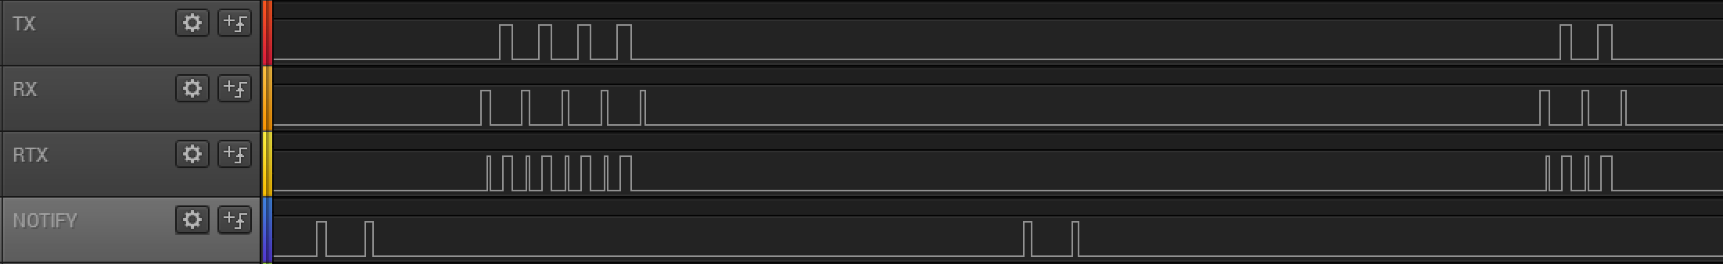
Data sent by
the peripheral
Notify
Data sent by
the peripheral
Connection Interval
Connection Event
Connection Event

Slide 22
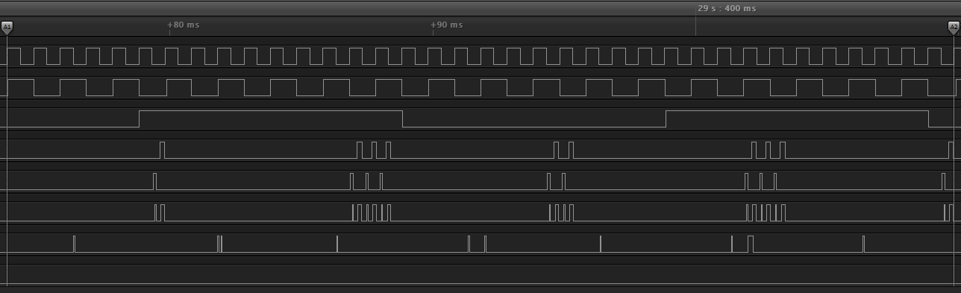
Int. IRQ
Int. ISR
Timer
TX
RX
Trans.
Notify
Error

Slide 23
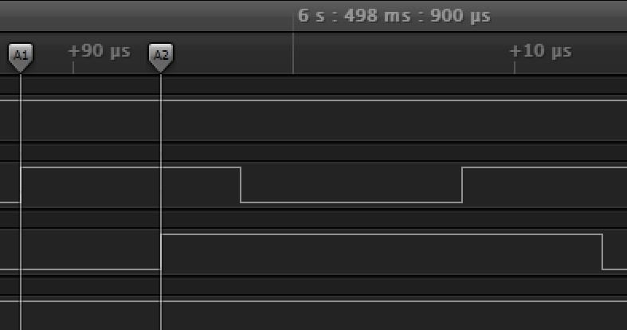
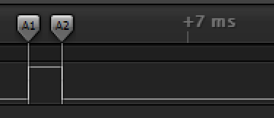
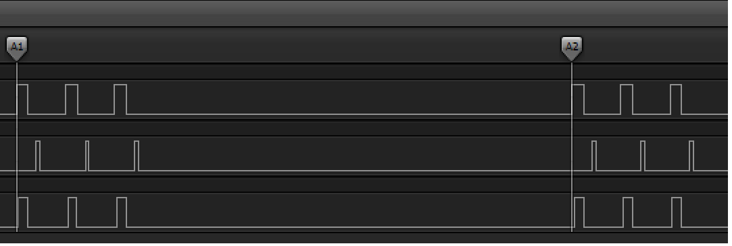
Notify
Int. IRQ
Int. ISR
TX
RX
Trans.

Slide 24
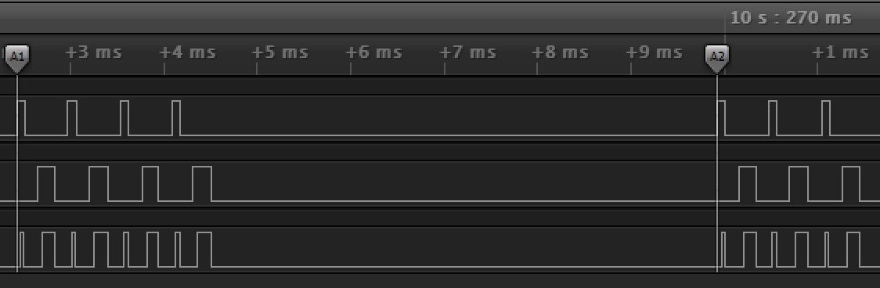
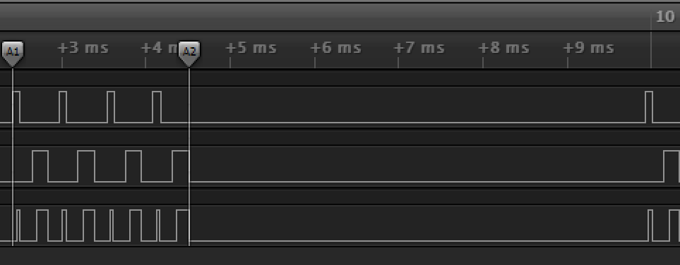
TX
RX
Trans.
TX
RX
Trans.

Slide 25
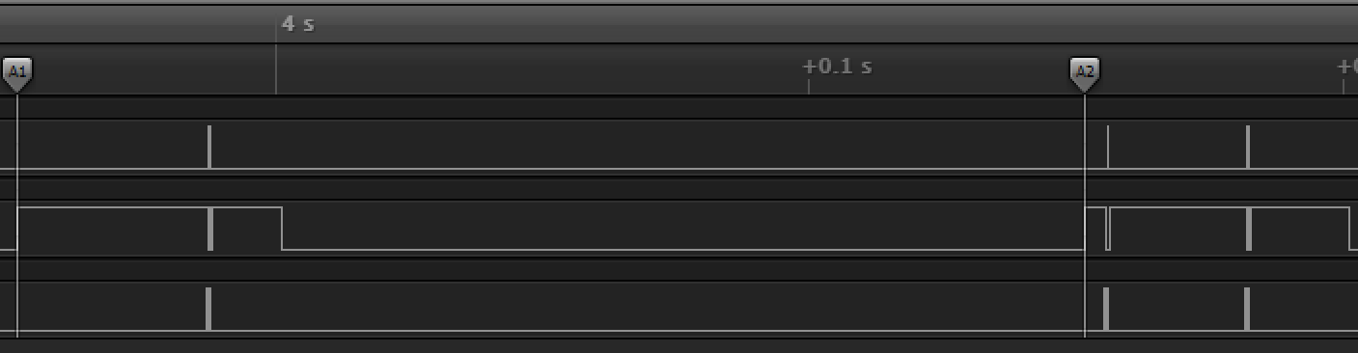
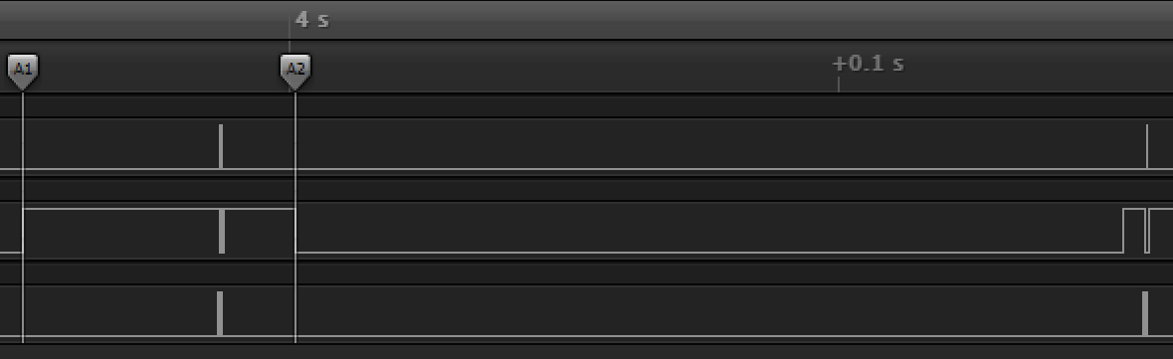
TX
RX
Trans.
TX
RX
Trans.

Slide 26
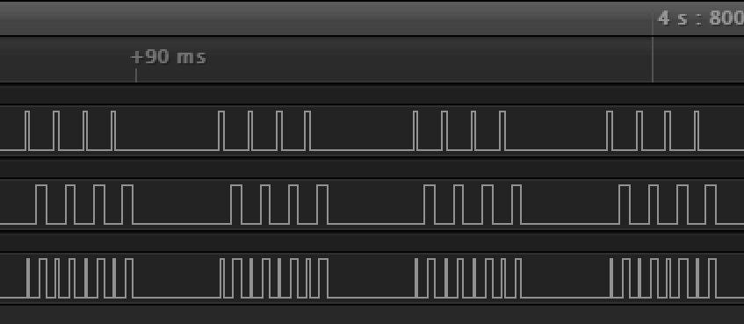
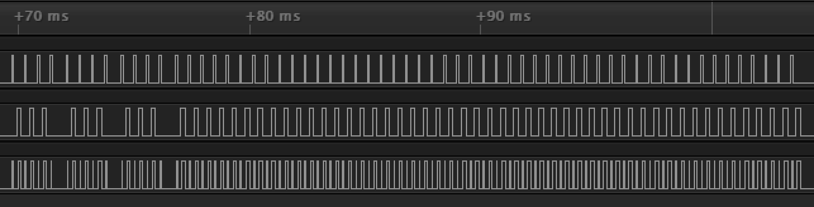
TX
RX
Trans.
P1
P2
P3
P4
TX
RX
Trans.
P1
P2
P3
P4

Slide 27
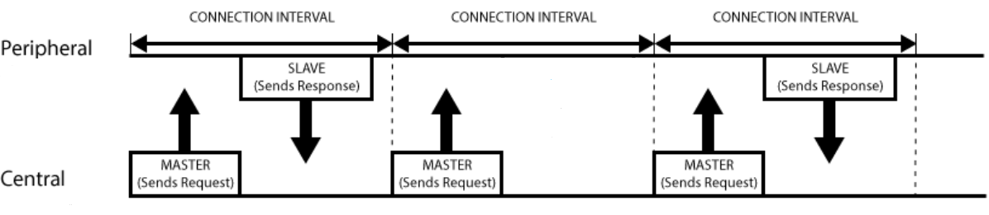
Advertising Interval
Advertising Interval
Advertising Interval
Peripheral
Central
Scan Window
Scan Window
Scan Window
Scan Interval
Scan Interval
Peripheral
Central
Connection Event Interval
Connection Interval
Connection Interval
Connection Interval

