Slide 1
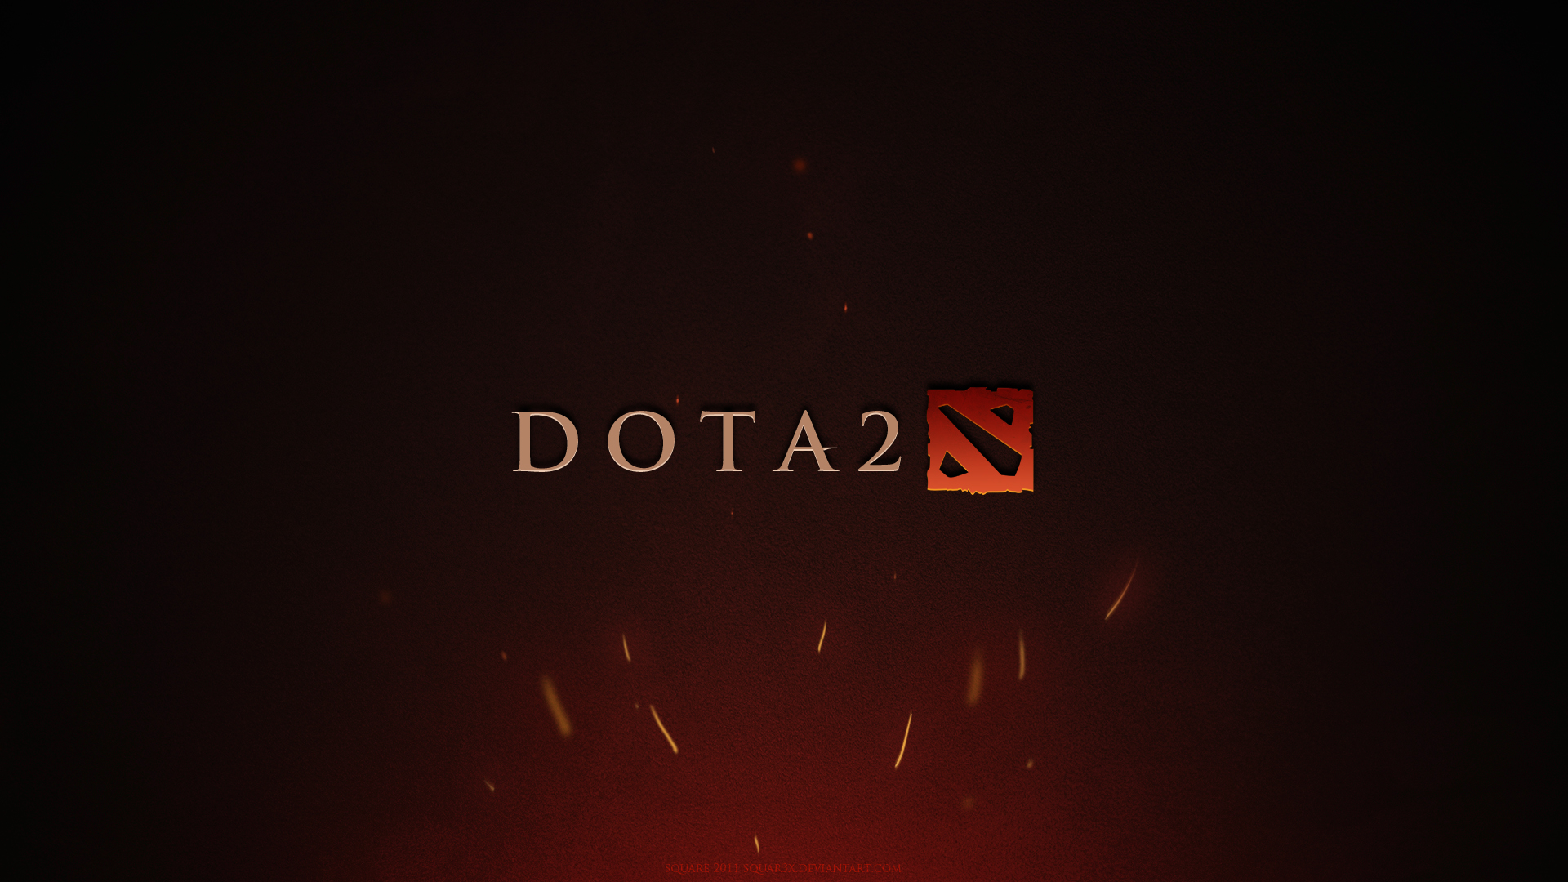
Dota 2 Dataset
Nathanael Bosch

Slide 2
Quick review
Dataset: 50.000 games of Dota2, a competitive multiplayer online game
  18 different .csv files
  Many different data types
Results from the last presentation:
  Leading in gold is highly relevant to win the game, but gets less relevant for very long games
  Simple win-prediction only using the gold lead of a team
  Word-clouds of the chat to investigate differences between winning and losing teams

Slide 3
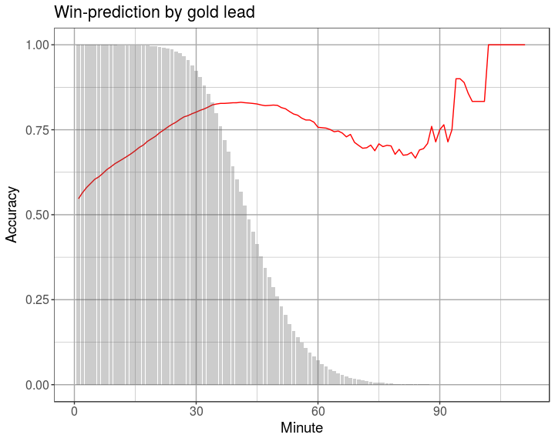

Slide 4
Progress since
Investigation of the teamfight data
  Dota2 is a team game, and teamwork is very important for success
  Teamfights should therefore be highly relevant for the outcome of a game
  Teamfights get more important for the game outcome as the game progresses
  => Combine gold and teamfights to get better predictions
  This leads to some questions:
    Do winning teams win the last teamfight?
    Answer: 88% of teams do.
    How relevant is this number, and how does it evolve over time?
    Answer: Plot on the next slide
Combine both gold and teamfights to predict games
  Simple linear models on the gold and teamfight data
  Combination of those predictions (currently the mean, but work in progress)
  Result: Predictions for each minute of a game
  Accuracy: 97.92%

Slide 5
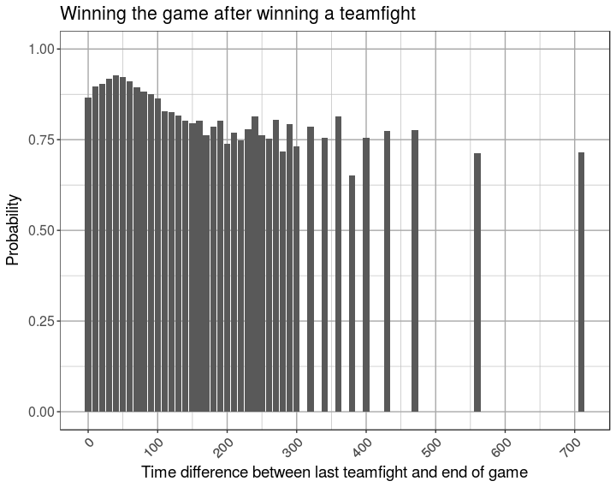

Slide 6
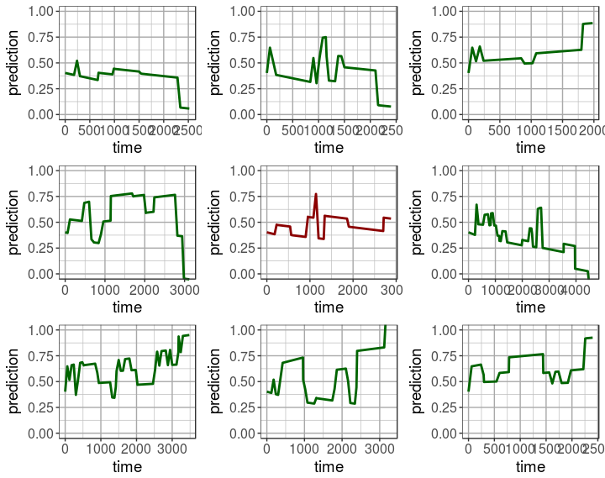

Slide 7
Further Progress
Use better models than just linear regression
  LSTM to keep game-history relevant ?
Work on the general programm architecture
  Is it feasible to combine all data in a large dataset? Only if discretizing times
  Should I stay in this modularized form?
  If yes, how do they communicate? So far by processing each independently
Think about my data
  Do I need to format the full dataset or am I fine with what I have?

