Slide 1

Dota 2 Dataset
Nathanael Bosch

Slide 2
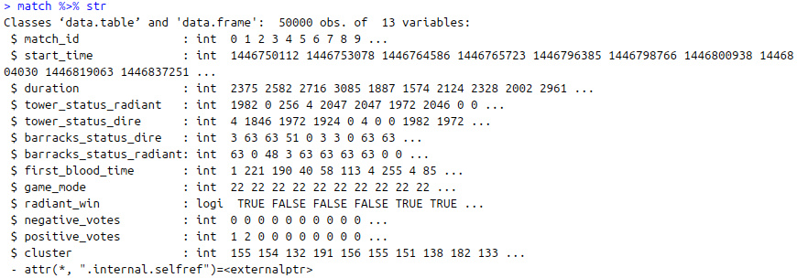
Top-level Data
match.csv:

Slide 3

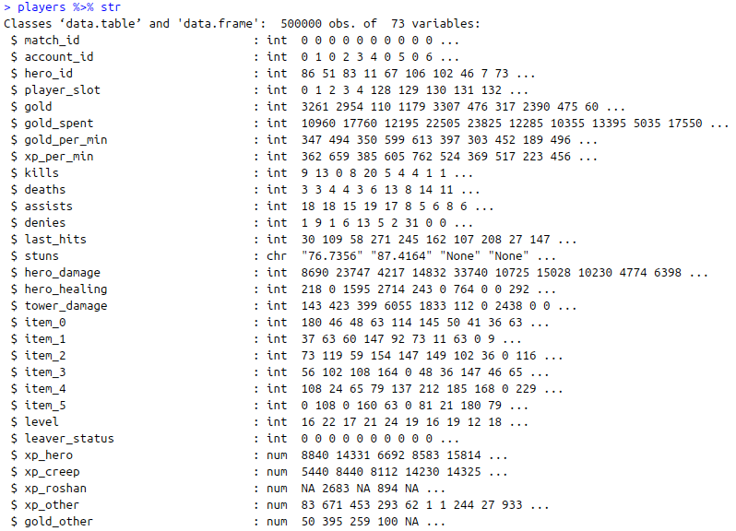
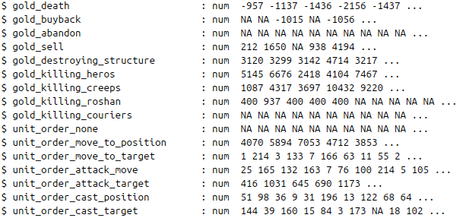
Top-level Data
players.csv:
Lots of detailed data,
but only a summary
…

Slide 4
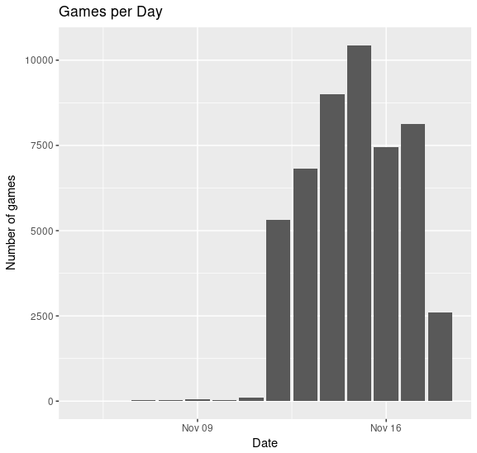
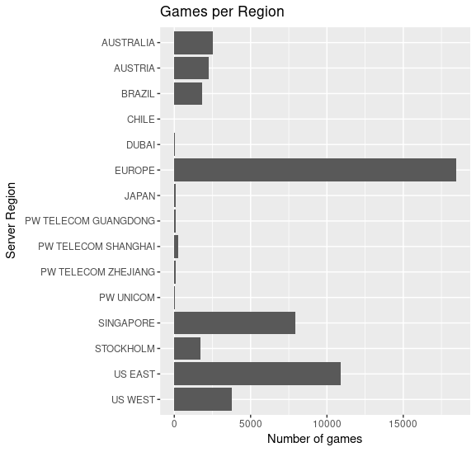
Summaries

Slide 5
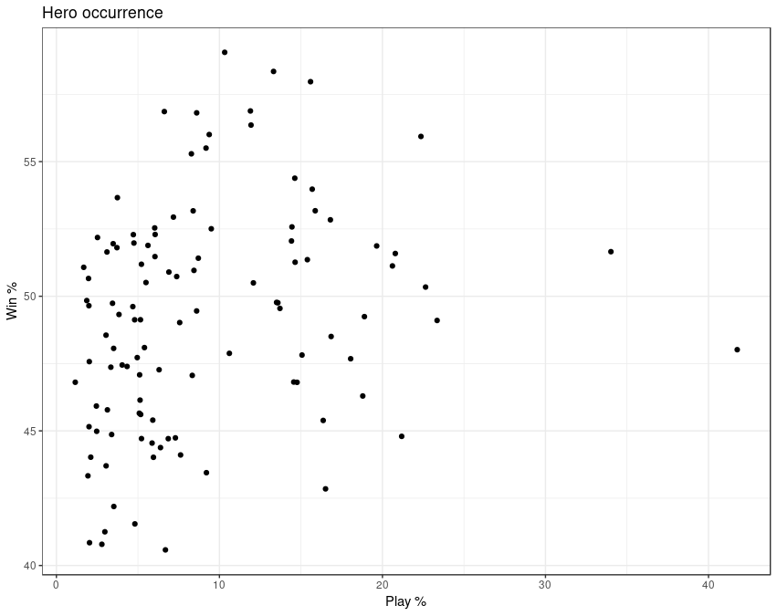
Summaries
> cor( heroes$win_percentage, heroes$play_percentage)
0.25

Slide 6
In-game Data
During the match
player_time.csv:
Gold & Experience for each player at each minute
objectives.csv:
Objective type, exact game time, involved players, ...
teamfights.csv & teamfights_players.csv:
Starttime and endtime of teamfights, summary, involved players, result, ...
purchase_log.csv:
Item buys for each player with exact time
ability_upgrades.csv
chat.csv
=> Very different data types with different formatting
=> Not equispaced in time

Slide 7
Looking at a single game
> id <- sample(match$match_id, 1)
> match[match_id==id] %>% dim
[1] 1 13
> players[match_id==id] %>% dim
[1] 10 73
> player_time[match_id==id] %>% dim
[1] 56 32
> objectives[match_id==id] %>% dim
[1] 28 9
> ability_upgrades[match_id==id] %>% dim
[1] 207 5
> purchase_log[match_id==id] %>% dim
[1] 434 4
> teamfights[match_id==id] %>% dim
[1] 13 5
> teamfights_players[match_id==id] %>% dim
[1] 130 8
> chat[match_id==id] %>% dim
[1] 35 5
Total of 914 rows
~150 different variables

Slide 8
Ideas & Challenges
General win-prediction:
Use player history and team composition to predict wins
On-line win-prediction:
Use all available in-game data to predict
Update prediction each time new information is available
Challenge:
Very different types of information
Many variables
Information is not equispaced
On-line prediction for events in general:
Similar approach as above, while we do not limit us to the binary outcome „win“

