Slide 1

Dota 2 Dataset
Nathanael Bosch

Slide 2
Dataset and Context
50.000 games of Dota2
18 different .csv files
Two types of data:
Match summaries
In-game data
Looking at a single game (sampled):
#rows/#columns
„match.csv“: 1/13
„players.csv“: 10/73
„player_time.csv“: 56/32
„objectives.csv“: 28/9
„ability_upgrades.csv“: 207/5
„teamfights.csv“: 13/5
„teamfights_players.csv“: 130/8
„purchase_log.csv“: 434/4
„chat.csv“: 35/5
Total: 914/~150

Slide 3
Ideas & Challenges
General win-prediction:
Use player history and team composition to predict wins
On-line win-prediction:
Use all available in-game data to predict
Update prediction each time new information is available
Challenge:
Very different types of information
Many variables
Information is not equispaced
On-line prediction for events in general:
Similar approach as above, while we do not limit us to the binary outcome „win“

Slide 4
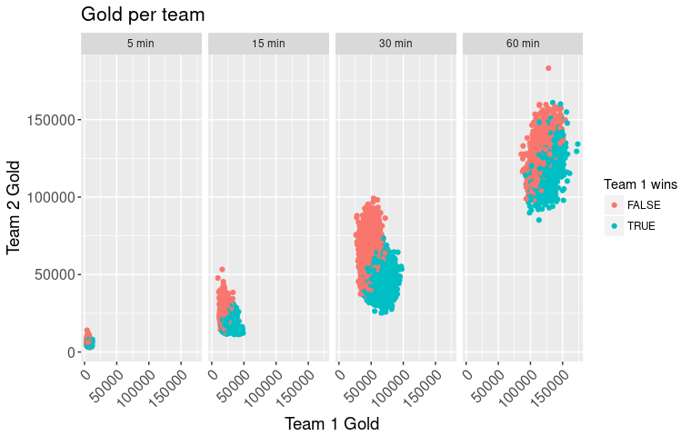

Slide 5
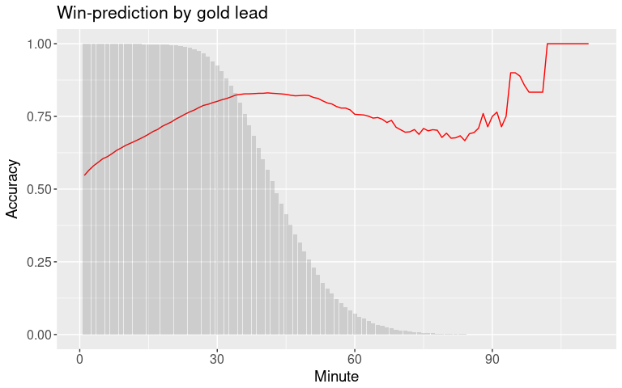

Slide 6
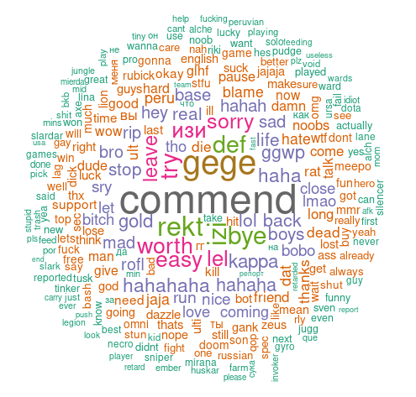
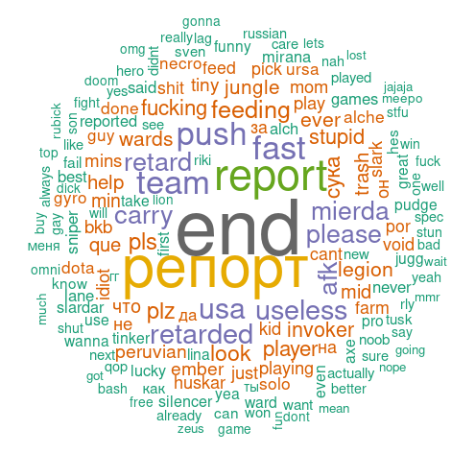
How relevant is the chat?
Winning teams
Losing teams

