Slide 1


REVISED RESULTS
VC Scout
Revised Results, Insights Summary, and Implementation Plan
Startup Growth and Investment | Expanded Dataset Audit + Audited Benchmark Model
75,230
950
1,829
0.30
0.49
77%
expanded rows audited
unit-suspect funding rows flagged/corrected
rows with valuation
audited test R²
funding elasticity
noisy Form D mega dollars
Executive answer
VC Scout should be implemented as a benchmark-and-scouting framework, not a startup-success prediction engine. The revised work audits the expanded data, preserves traceability, and shifts the insight from raw valuation to funding-adjusted outperformance.
Team 17
Mia Murphy • Finn Kliewer • Kayvon Jafarzadeh • Nathanael Gill • Om Patel
Submission package includes PPTX/PDF plus auditable CSVs, source-of-truth JSON, and a reproducible Python script.

Slide 2
DELIVERABLE FOCUS
What changed since the prior submission
The prior work established EDA and a first valuation model; this submission turns that into a defensible implementation plan.
Refined tools and models
Shortcomings addressed
Insights and hypotheses
We landed on a two-layer architecture: an audited unicorn valuation benchmark plus an expanded-tier diagnostic layer. Gradient Boosting remains the benchmark champion, while OLS/Ridge remain interpretability checks.
The expanded data adds useful controls, but it also introduces funding-unit risk, source/timing mismatch, missing valuation coverage, and noisy Form D entities. We address these through flags, corrections, and decision boundaries.
The analysis now tests 2021 as a market-regime shock, validates diminishing returns to funding, stress-tests no-funding scouting, and uses residuals to identify outperformance patterns.
Business implications
Implementation plan
Traceability standard
VC Scout should rank segments by benchmark outperformance, not raw valuation or raw unicorn count. This reduces hype bias and makes rankings more explainable.
The final deliverable should include a transparent scoring layer, sample-size confidence flags, investor network features, and a dashboard/dashboard-style slide for business users.
Every number in the deck maps to a cleaned CSV, model output file, source-of-truth JSON, or reproducible script. The goal is to avoid black-box reporting.
Framing shift
From predict unicorn valuation to identifying funding-adjusted valuation outperformance signals among unicorn and comparable startup tiers.
Team 17 | Startup Growth & Investment | VC Scout
02

Slide 3
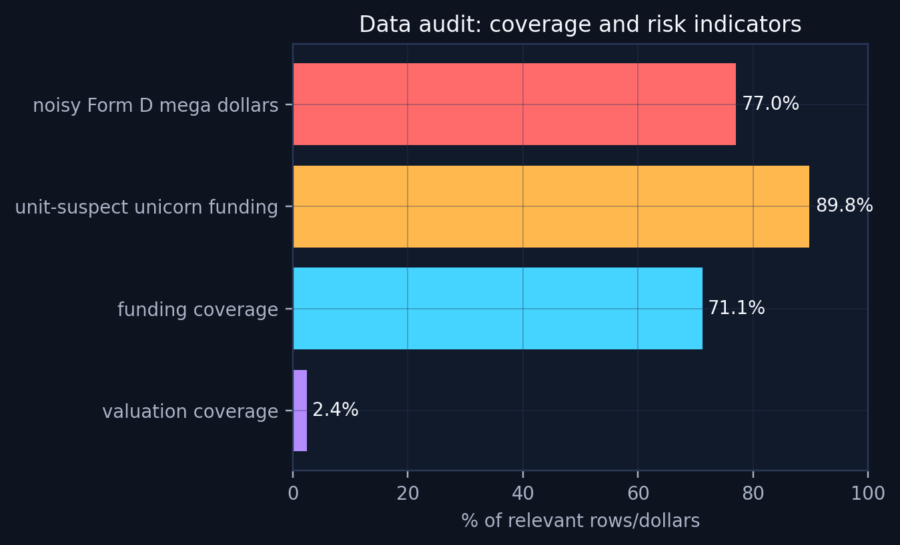
DATA SHORTCOMINGS
Expanded data improves the project only after an audit
This is where the revised analysis directly addresses data quality and survivorship-bias risk.
Coverage limitation
Funding unit risk
Only 1,829 of 75,230 rows have valuation. This prevents valuation modeling across the full startup universe.
950 unicorn rows were flagged because funding exceeded valuation, indicating a likely M/B scaling issue in the expanded build.
Form D noise
Survivorship remains
Raw Form D includes many funds, real estate entities, and finance vehicles. It is retained as market context, not a clean startup-training set.
The expanded master adds comparison tiers but is not a time-aligned panel of all startups from formation to outcome.
How we addressed it
The cleaned master preserves raw values, adds audited funding, assigns audit flags, isolates Form D, and separates unicorn valuation benchmarking from broader tier diagnostics.
Team 17 | Startup Growth & Investment | VC Scout
03

Slide 4
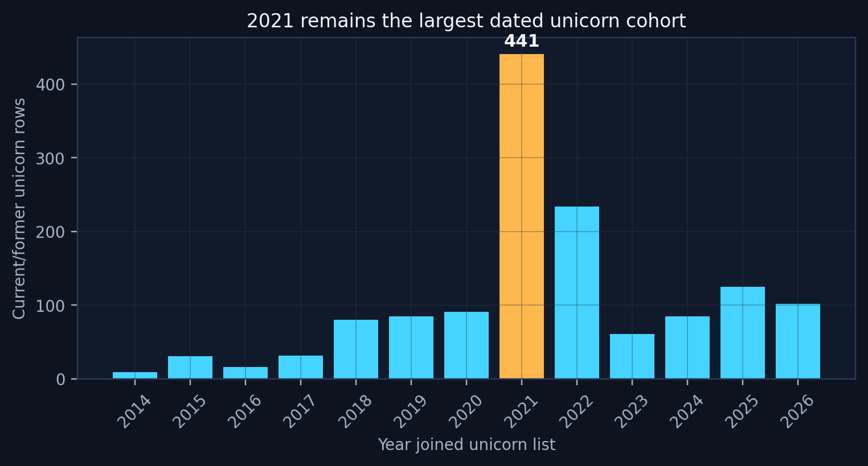
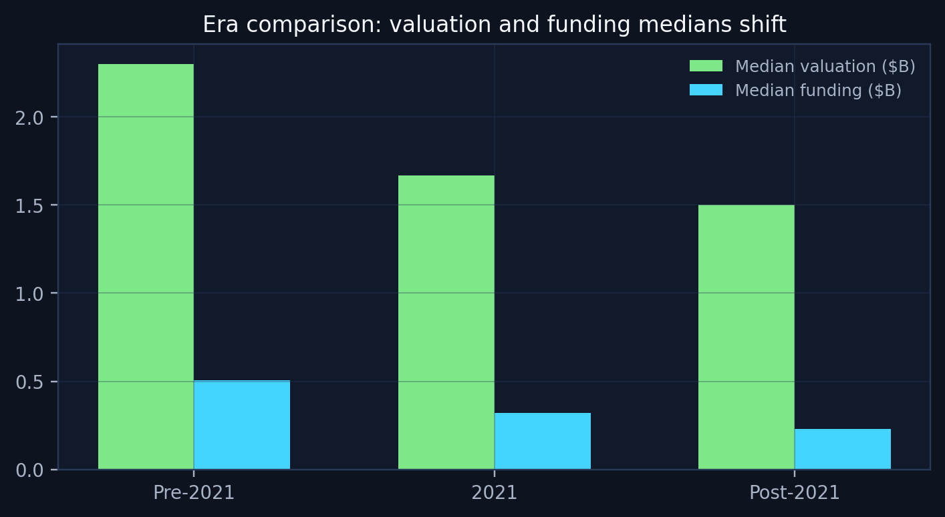
HYPOTHESIS H1
2021 is a market-regime shock, not a normal trend line
The data flags the discontinuity; it does not prove COVID causality by itself.
Evidence line: Kruskal-Wallis p<0.001 for valuation and funding by era; χ² p<0.001 for sector mix; time-to-unicorn is not significant (p=0.267).
What is proven
What is not proven
Action for VC Scout
2021 is the largest single dated current-unicorn cohort in the expanded data, and era differences in valuation, funding, and sector mix are statistically significant.
The dataset alone cannot separate COVID-driven demand, cheap capital, investor behavior, or valuation inflation as causal explanations.
Keep a 2021/era indicator and show users when a benchmark is influenced by an unusual funding regime.
Team 17 | Startup Growth & Investment | VC Scout
04

Slide 5
TOOLS LANDED ON
Two-layer analytics architecture
The tools are chosen to match what the data can support, not what sounds most sophisticated.
Layer A: audited unicorn valuation benchmark
Layer B: expanded-tier diagnostic model
Supervised regression on ln(valuation) for unicorn-history rows with audited funding. Gradient Boosting captures nonlinearity; OLS/Ridge provide explainability and elasticity checks.
Classifier compares unicorn-history companies with funded controls, accelerator controls, and high-funding proxies. It is useful for screening patterns, not causal winner prediction.
Benchmark
Residuals
Scoring
Decision
Model output
Insight output
VC Scout score
User action
Expected valuation given funding, sector, geography, era, tier, speed, and investors.
Actual minus expected valuation identifies funding-adjusted outperformance.
Blend residuals, tier signal, sample size, data confidence, and investor network features.
Prioritize sector/region/investor clusters for deeper diligence, not automatic investing.
Guardrail
No claim of “probability of becoming a unicorn” until there is a true time-aligned non-unicorn panel with observed outcomes.
Team 17 | Startup Growth & Investment | VC Scout
05

Slide 6
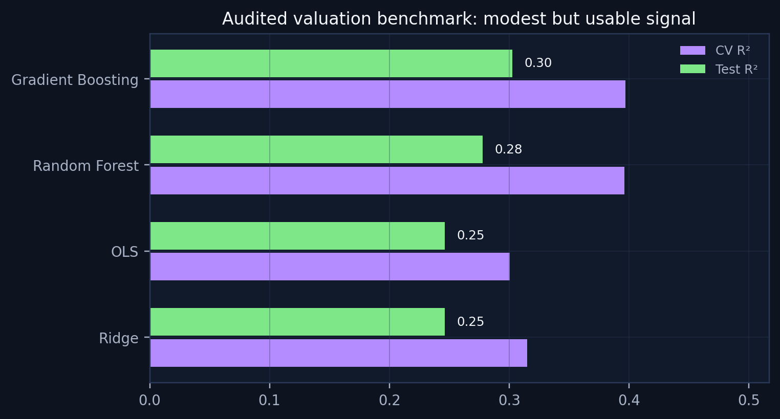
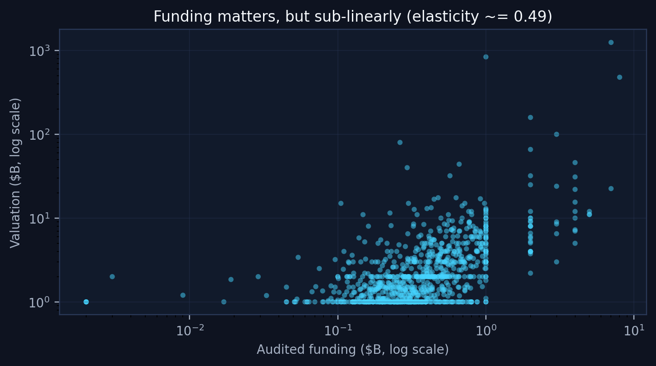
REVISED RESULTS
The audited benchmark has modest but credible signal
The important result is not a perfect model; it is a defendable benchmark engine.
Champion
Funding effect
No-funding stress test
Implication
Gradient Boosting remains preferred after the audit: test R² ~= 0.30. This is lower than the earlier Kaggle-only result, but more defensible.
Funding remains important, but elasticity ~= 0.49 means valuation rises less than one-for-one with capital raised.
Removing funding drops R² to about 0.05, showing early-stage scouting is much harder than late-stage benchmarking.
Use model residuals and segment signals, not exact point estimates.
Team 17 | Startup Growth & Investment | VC Scout
06

Slide 7
INSIGHTS DEVELOPED
Hypotheses proven, disproven, and carried forward
This turns the analysis into decision-ready learning, not just charts.
Hypothesis
Status
Evidence / implication
H1: 2021 is a distinct regime
Supported
Largest dated cohort; valuation/funding distributions and sector mix differ by era. Interpret as market-regime signal, not proof of COVID causality.
H2: Funding has diminishing returns
Supported
Audited log-log elasticity ~= 0.49. More capital helps, but raw funding does not scale valuation one-for-one.
H3: Sector/geography add signal
Partially supported
Residual tables show directional variation, but thin samples need confidence flags before ranking.
H4: Expanded controls solve survivorship bias
Disproven / partial
The 75k-row master helps context, but source timing, missing valuation, and proxy labels remain.
H5: Investor count captures network quality
Not proven
Investor count is too crude; final model should use top-fund flags and co-investor clusters.
Next analytic emphasis
Move from company-level valuation prediction to segment-level outperformance, where data quality and sample-size caveats can be surfaced honestly.
Team 17 | Startup Growth & Investment | VC Scout
07

Slide 8
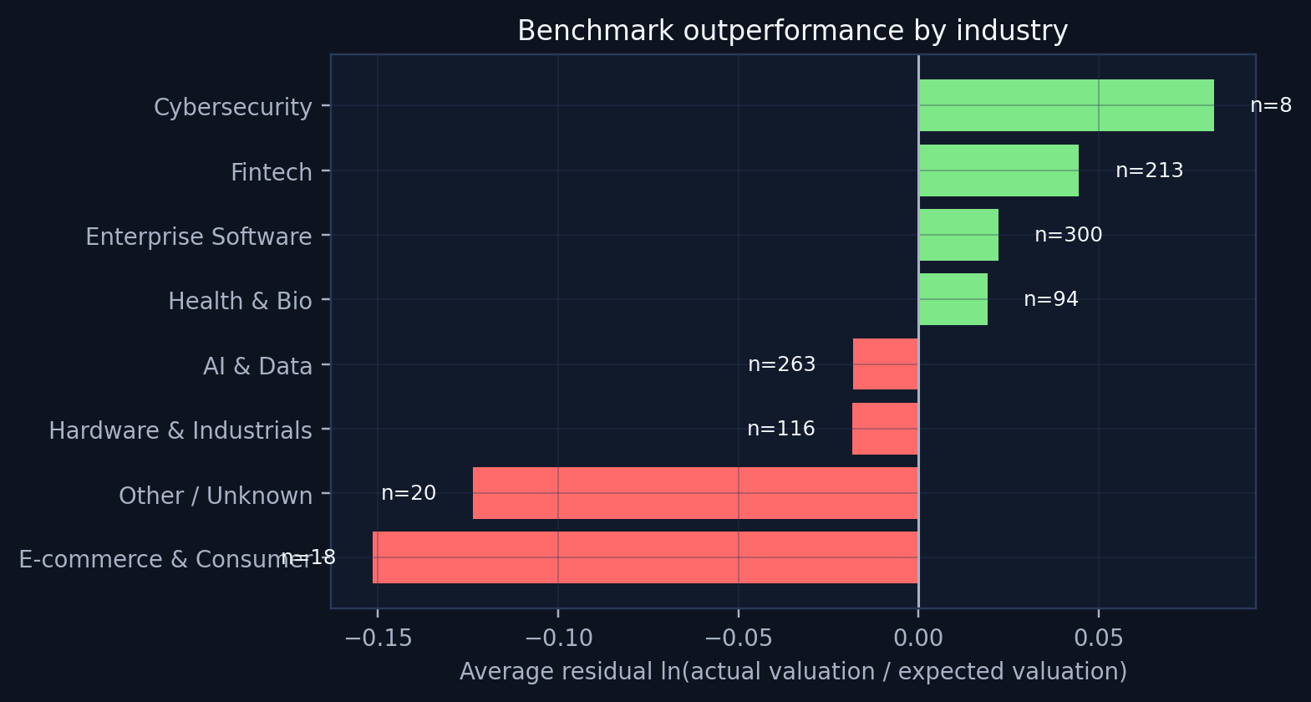
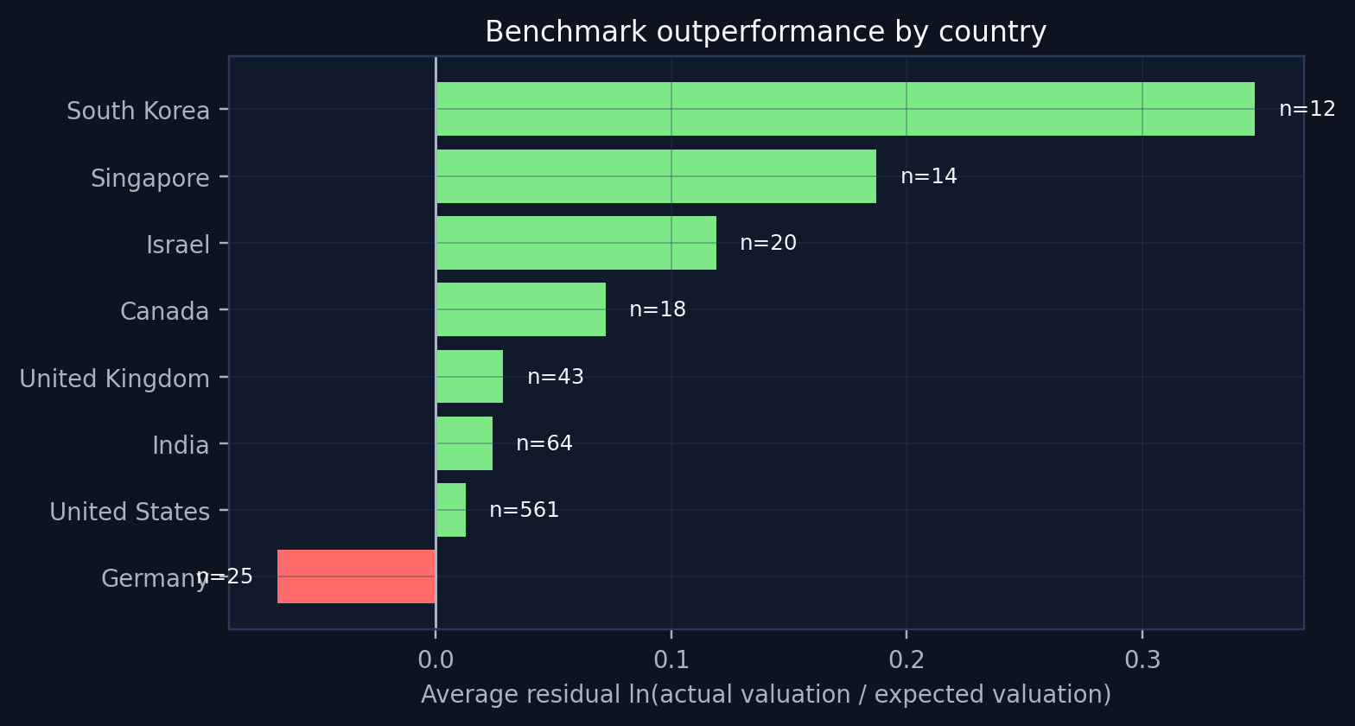
INSIGHT ENGINE
Residuals turn a model into VC Scout
Actual minus expected valuation is the cleanest bridge from statistics to business action.
How to read it
What is useful
What to avoid
Positive residuals mean a segment exceeds expected valuation after adjusting for funding and context.
Residuals create watchlists: segments worth deeper diligence because they outperform a fair benchmark.
Do not treat small-n residual leaders as final rankings. Add confidence and sample-size penalties.
Team 17 | Startup Growth & Investment | VC Scout
08

Slide 9
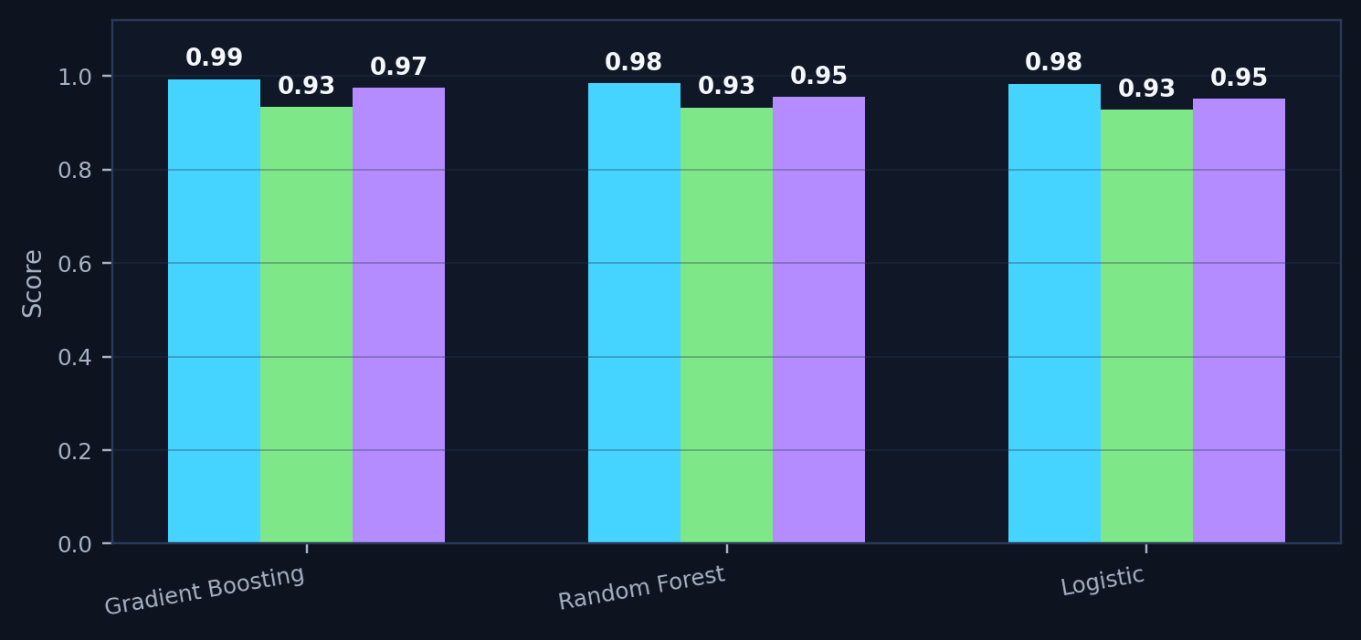
EXPANDED-TIER DIAGNOSTIC
High accuracy can be a warning sign
The classifier can screen patterns, but it can also learn source artifacts.
Expanded-tier classifier: high diagnostic accuracy, high bias risk
ROC AUC
Balanced accuracy
Avg precision
Tempting read
Statistician read
The model separates unicorn-history rows from controls with very high diagnostic accuracy.
Some of that signal is likely source/timing bias, not true startup destiny.
Safe use
Unsafe use
Use expanded-tier scores to prioritize sectors and questions for diligence.
Do not claim this predicts arbitrary startups becoming unicorns.
Implementation decision
The expanded dataset belongs in VC Scout as a diagnostic comparison layer and confidence input, not as the sole basis for a success-probability model.
Team 17 | Startup Growth & Investment | VC Scout
09

Slide 10
BUSINESS ACTIONS
Initial recommendations for a VC Scout user
The recommendations are deliberately decision-support oriented.
1. Rank outperformance, not size
2. Keep 2021 visible
3. Use residuals as watchlists
Raw valuation and raw unicorn count are too sensitive to capital intensity and market cycles. Rank segments against expected valuation benchmarks.
Treat 2021 as a market-regime flag. Do not let one unusual funding period define “normal” scouting baselines.
Sectors, countries, or investor clusters with repeated positive residuals become candidates for deeper diligence.
4. Add confidence labels
5. Upgrade investor features
6. Separate model from diligence
Every score should show sample size, data coverage, and whether the signal depends heavily on audited/corrected fields.
Replace investor count with top-fund flags, sector specialization, co-investor networks, and timing of involvement.
The tool narrows the search space. Final investment judgments still require revenue, retention, burn, TAM, and ownership data.
Recommended positioning
VC Scout is a market-intelligence and prioritization tool, not an automated investment recommender.
Team 17 | Startup Growth & Investment | VC Scout
10

Slide 11
IMPLEMENTATION PLAN
What gets built before in-person week
The final submission should be traceable enough that every number can be defended.
Sprint
Workstream
Concrete output
Deliverable structure
PowerPoint/PDF for stakeholders; audit-trail ZIP for the professor or anyone asking for raw analysis.
1
Data QA hardening
Finalize audited master, funding audit rule, source notes, and Form D exclusion/context logic.
2
Benchmark model
Lock audited valuation benchmark, residual outputs, and no-funding stress test.
Final model language
3
VC Scout score
Combine residual outperformance, tier signal, sector/geography medians, sample-size penalty, and data confidence.
“Funding-adjusted valuation outperformance signal” stays defensible and avoids unsupported causal success claims.
4
Dashboard / slideware
Build final user-facing view: sector, region, investor cluster, confidence, and limitations.
5
Final review
Package PPTX/PDF, cleaned CSVs, source-of-truth JSON, and reproducible script for auditability.
Remaining data need
A true success model requires a time-aligned startup panel with non-unicorns, failures, acquisitions, and follow-on outcomes.
Audit-trail files
Audited master CSV, Form D audited CSV, model results CSV, residual tables, hypothesis summary, source-of-truth JSON, and analysis script.
Team 17 | Startup Growth & Investment | VC Scout
11

