Slide 1
MODEL DELIVERABLE
VC Scout
Model Definition and Initial Results
Startup Growth and Investment | Unicorn Companies Dataset
1,060
7
80 / 20
5-fold
0.51
Companies modeled
Models compared
Train / test split
Cross validation
Held-out test R²
Team 17 Mia Murphy • Finn Kliewer • Kayvon Jafarzadeh • Nathanael Gill • Om Patel
Goal: define the modeling toolkit for the deeper dive, show a working implementation on the cleaned unicorn dataset, and compare candidate models before locking the champion for the VC Scout framework.
Team 17 | Startup Growth & Investment | Model Definition & Initial Results
01

Slide 2
MODELING OBJECTIVE
What we model, and which tools we use
The deeper dive moves from description to supervised prediction, framed strictly as conditional-on-unicorn pattern learning.
The prediction task
Optimization, simulation, and other tools
Target: ln(Valuation in $B) for each unicorn company.
Supervised ML (scikit-learn)
Regression, not classification: every row is already a unicorn, so "success vs failure" cannot be learned from this data. We instead predict the valuation scale a unicorn reaches.
The log transform tames the long right tail found in EDA (median $2B, max $180B) so errors are measured in relative terms.
Model outputs feed VC Scout: predicted valuation given funding, sector, and geography becomes the benchmark, and companies or segments above the benchmark flag efficient growth signals.
Framing stays non-causal: coefficients and importances are read as associations among historical unicorns, never as guarantees.
Core tool. Regularized linear models and tree ensembles inside leakage-safe Pipeline objects.
Grid-search optimization
Hyperparameters chosen by exhaustive GridSearchCV over 5-fold cross validation. This is the optimization component of the project.
Bootstrap simulation
2,000 resamples of the held-out test set simulate the sampling distribution of model accuracy and give a confidence interval.
Weighted scoring framework
Model residuals and importances convert into transparent VC Scout sector and region scores in the next phase.
Team 17 | Startup Growth & Investment | Model Definition & Initial Results
02

Slide 3
DATA & FEATURES
Variable definitions, feature engineering, and sampling
Every engineered field is auditable, and every excluded row is counted, consistent with the EDA cleaning rules.
Variable | Role | Definition and engineering
ln(Valuation) | Target | Natural log of valuation parsed from strings like "$180B" into numeric $B.
ln(Funding) | Feature | Natural log of disclosed funding; $M values converted to $B before the log.
Industry | Feature | 15 standardized sectors; the AI capitalization duplicate is merged.
Continent | Feature | Headquarters region, 6 categories, one-hot encoded.
Era | Feature | Market regime cohort: Pre-2021, 2021, Post-2021, from EDA finding H1.
Years to unicorn | Feature | Unicorn year minus founding year; speed of the growth path.
Investor count | Feature | Count of names listed in the Select Investors field.
Preprocessing and sampling
One-hot encoding for categoricals; standardization for linear and KNN models only.
Sampling: 80/20 train/test split (848/212, seed 17); 5-fold CV inside the training set.
All transforms fit on training folds only, inside sklearn Pipelines, to prevent leakage.
Exclusions: 1,074 to 1,060 rows
12 rows with unknown funding and 1 with $0 funding (log undefined).
1 negative years-to-unicorn date anomaly flagged in EDA.
Funding efficiency is NOT a feature: it contains the target (valuation / funding), so using it would leak the answer.
Team 17 | Startup Growth & Investment | Model Definition & Initial Results
03

Slide 4
MODEL DEFINITIONS
Why this set of models: interpretability plus flexibility
Each candidate answers a different question about the data; together they bracket the bias-variance tradeoff.
Baseline (mean) Sanity floor
Linear OLS Interpretability
Ridge & Lasso Stability
Predicts the training mean. Any real model must beat R² = 0.
The log-log regression planned in EDA. Its funding coefficient is an elasticity: the % change in valuation per 1% more funding.
Regularization handles 20+ correlated one-hot columns; Lasso also zeroes weak features, acting as automatic feature selection.
KNN Local structure
Random Forest Nonlinearity
Gradient Boosting Champion candidate
Nonparametric check: predicts from the most similar unicorns, with no functional form assumed.
Bagged trees capture sector-by-funding interactions and thresholds that linear models miss.
Sequential shallow trees, strongest expected fit on tabular data of this size; still explainable via permutation importance.
Selection logic
EDA showed a skewed target, strong sector and geography segmentation, and a suspected nonlinear funding relationship. That points to tree ensembles for accuracy, while the linear family is kept as the interpretability companion whose coefficients VC Scout can explain to users. KNN and the baseline guard against overclaiming: if a simple method matched the ensembles, the extra complexity would not be justified.
Team 17 | Startup Growth & Investment | Model Definition & Initial Results
04

Slide 5
IMPLEMENTATION
How the models are built: split, tune, validate
One leakage-safe pipeline per model; every hyperparameter is chosen by cross validation, never by peeking at the test set.
Clean + engineer
Split 80/20
Pipeline prep
GridSearchCV
Final test
1,074 raw rows to 1,060 modeled
→
848 train / 212 held-out test
→
encode + scale inside CV folds
→
5-fold CV over 99 combinations
→
one look at the 212 test rows
Model | Hyperparameter grid searched | Best setting (5-fold CV)
Ridge | alpha in {0.1, 1, 3, 10, 30, 100} | alpha = 30
Lasso | alpha in {0.0005, 0.001, 0.005, 0.01, 0.05} | alpha = 0.005
KNN | k in {5, 10, 15, 25, 40}; uniform or distance weights | k = 25, uniform
Random Forest | 300/600 trees; depth {4, 6, 10, none}; leaf {2, 5, 10} | 600 trees, depth 4, leaf 2
Gradient Boosting | 200/400/800 trees; rate {0.01, 0.03, 0.1}; depth {2, 3, 4}; subsample {0.8, 1.0} | 200 trees, rate 0.03, depth 2, subsample 0.8
Validation discipline
Same folds (seed 17) for every model, so comparisons are apples to apples.
Scoring metric: R² on ln(Valuation); MAE and RMSE reported alongside.
The 212 test companies are touched exactly once, after all tuning is frozen.
The tuned winner prefers shallow, slow-learning trees: evidence that regularization matters more than raw capacity here.
Team 17 | Startup Growth & Investment | Model Definition & Initial Results
05

Slide 6
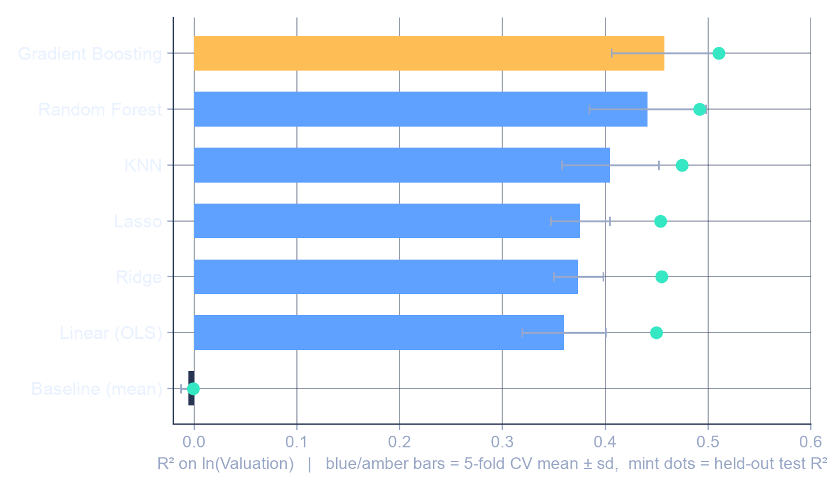
ALTERNATE MODELS
Gradient boosting wins, and the margin is honest
Every alternate model was fit, tuned, and scored on identical folds and the identical held-out test set.
Model accuracy comparison, target ln(Valuation)
Model | CV R² | Test R² | MAE (ln)
Baseline (mean) | -0.01 | 0.00 | 0.62
Linear (OLS) | 0.36 | 0.45 | 0.45
Ridge | 0.37 | 0.45 | 0.45
Lasso | 0.38 | 0.45 | 0.45
KNN | 0.41 | 0.47 | 0.46
Random Forest | 0.44 | 0.49 | 0.44
Gradient Boosting | 0.46 | 0.51 | 0.44
Why the champion is better
Best CV R² (0.46) and best test R² (0.51) with the lowest error; the gain over the best linear model (+0.08 CV R²) comes from sector-funding interactions.
Beats Random Forest with a 3x smaller, shallower ensemble (200 trees, depth 2 vs 600, depth 4), and its CV-to-test gap shows no overfitting.
OLS is retained as the explanation layer for VC Scout narratives.
Team 17 | Startup Growth & Investment | Model Definition & Initial Results
06

Slide 7
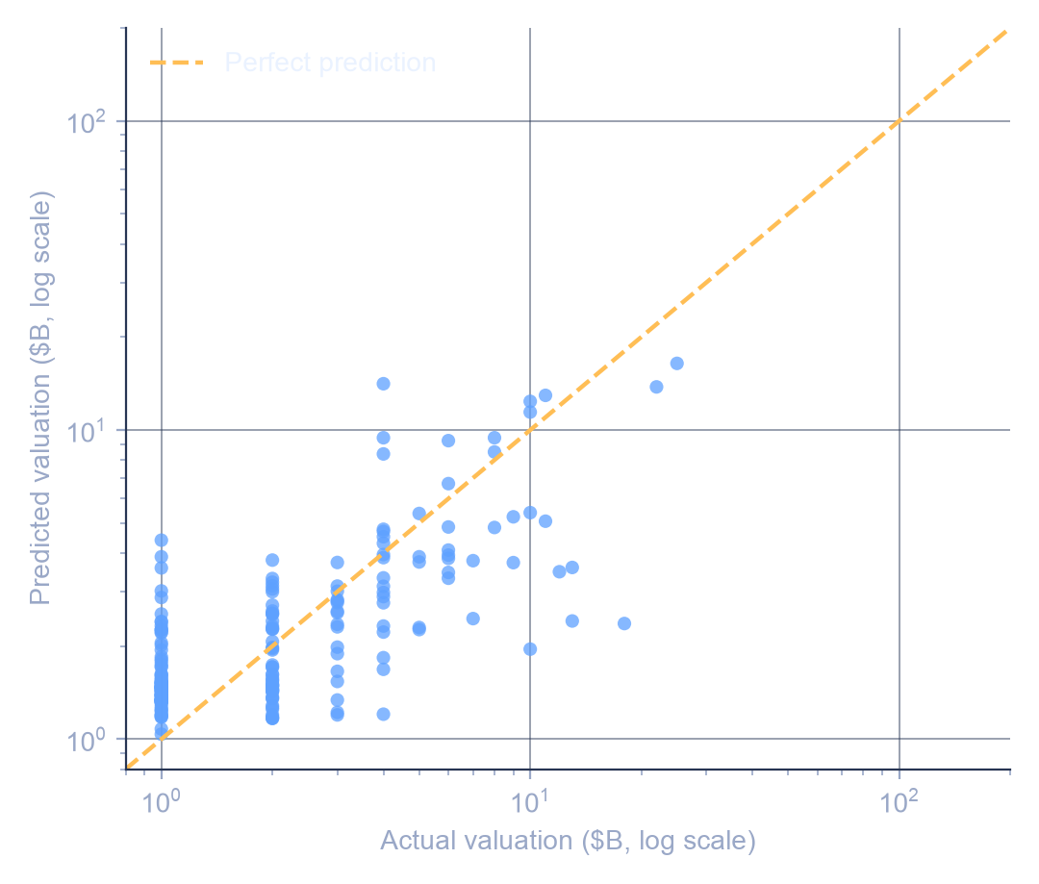
INITIAL RESULTS
The champion predicts valuation scale, not exact price tags
Held-out predictions track actual valuations across two orders of magnitude on the 212 unseen companies.
Predicted vs actual valuation, held-out test set
How to read this
Points hug the diagonal through the $1B to $10B core where most unicorns live.
The model compresses mega-outliers: it under-predicts the $100B+ names, which is expected when features stop at funding, sector, geography, and timing.
Median absolute error is 37% of valuation, versus 77% for the naive baseline: roughly half the error, from public fields alone.
0.51
0.44
Test R² on ln(Valuation)
Test MAE in log units
37%
77%
Median abs. % error
Baseline median error
Team 17 | Startup Growth & Investment | Model Definition & Initial Results
07

Slide 8
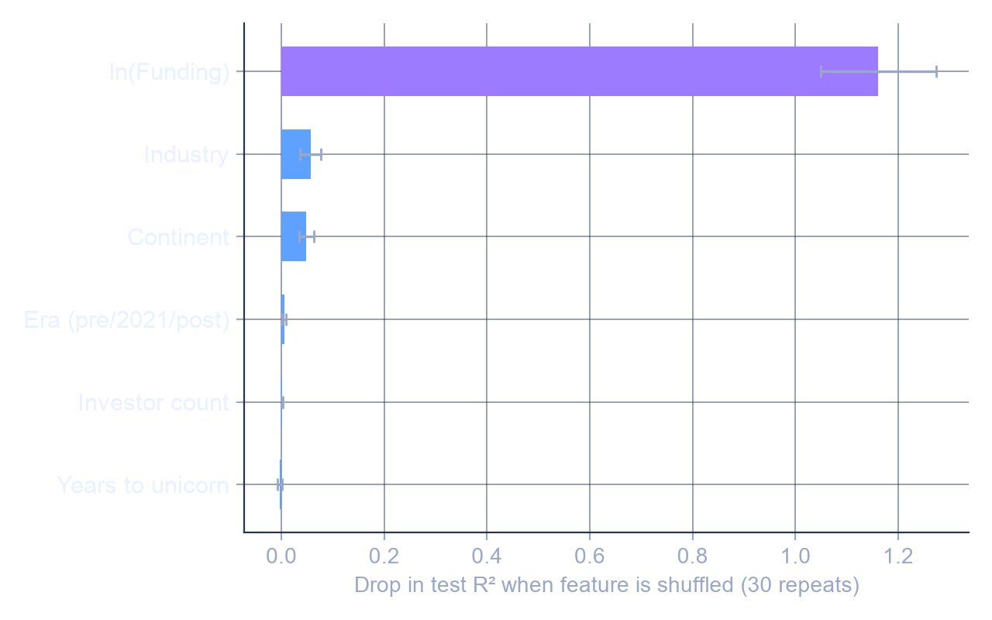
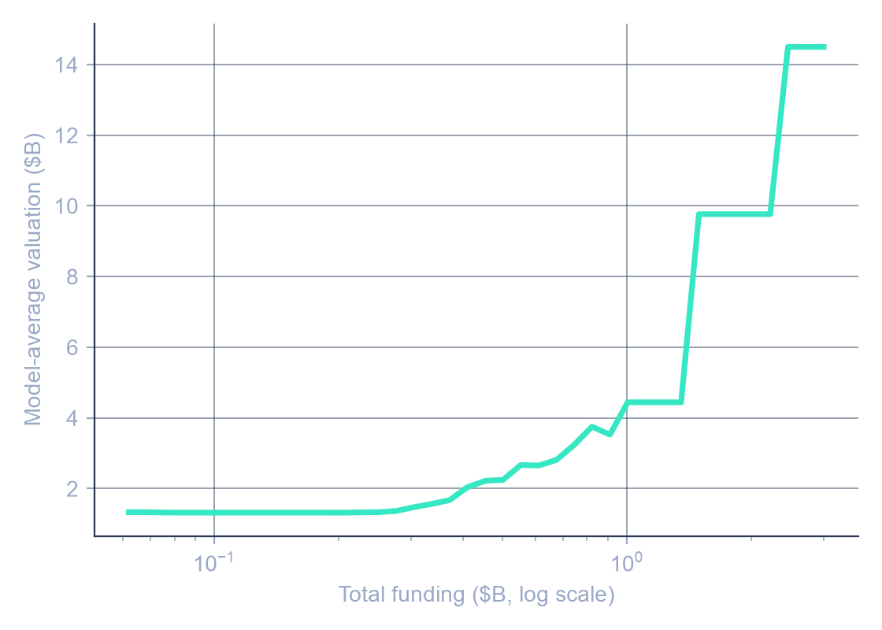
INITIAL RESULTS
Funding dominates; sector and geography refine the estimate
Permutation importance on the test set shows what the champion actually uses, and the funding curve confirms diminishing returns.
Permutation importance, champion model
Partial dependence: valuation vs funding
Elasticity ≈ 0.57. From the OLS companion model: a 1% increase in funding is associated with about a 0.57% higher valuation. Below 1.0 means diminishing returns, confirming EDA hypothesis H3: capital scales valuation, but sub-linearly.
Shuffling ln(Funding) destroys 1.16 points of R² (the drop exceeds 1.0 because shuffled predictions score below zero). Industry (0.06) and Continent (0.05) add real but secondary signal; era, investor count, and speed add little once funding is known.
Team 17 | Startup Growth & Investment | Model Definition & Initial Results
08

Slide 9
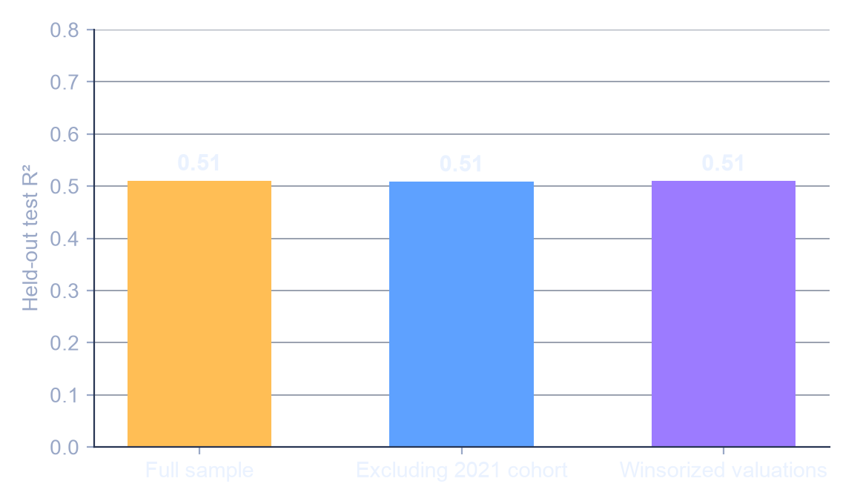
ROBUSTNESS
The result survives the 2021 regime and the mega-outliers
The two biggest threats flagged in EDA, the 2021 cohort and the long tail, barely move the champion's accuracy.
Sensitivity analysis, held-out test R²
Bootstrap simulation of accuracy
2,000 bootstrap resamples of the 212 test companies simulate how accuracy varies across samples.
95% confidence interval for test R²: 0.39 to 0.61.
Even the pessimistic bound beats every linear model's cross-validated R², so the champion choice is not a lucky split.
What this settles from the EDA plan
H1 (2021 is a distinct regime): true for volume, but it does not distort the valuation model.
H3 (log-scale funding effect with diminishing returns): confirmed, elasticity about 0.57.
Robustness checks promised in the EDA deck are now implemented, not just planned.
Retraining without the 520-company 2021 cohort, or with winsorized valuations, changes test R² by less than 0.01.
Team 17 | Startup Growth & Investment | Model Definition & Initial Results
09

Slide 10
NEXT STEPS
From a tuned model to the VC Scout framework
The champion model becomes the engine that scores sectors and regions; the limitations stay on the label.
1
Benchmark engine
2
Scoring layer
3
Hardening
Champion predictions define the expected valuation for any funding-sector-geography profile.
Segments that consistently beat their benchmark (positive residuals) become high-signal VC Scout categories.
Blend model-based signals with EDA descriptives: counts, median efficiency, and time-to-unicorn.
Weights stay transparent and user-adjustable, per the charter's explainability requirement.
Add investor network features (top-fund co-mention flags) and test whether they lift R².
Quantile gradient boosting for prediction intervals, so VC Scout can show ranges instead of false precision.
Limitations we will keep saying out loud
This model explains valuation variation among companies that already became unicorns. It cannot rate an arbitrary startup's probability of success, because failed and non-unicorn startups are absent (survivorship bias). All findings are associations conditional on unicorn status, and VC Scout will present them as scouting signals with confidence ranges, not as predictions or investment advice.
Team 17 | Startup Growth & Investment | Model Definition & Initial Results
10

