Slide 1
Johnson_Assignment
File created on: 3/13/24 3:14:26 PM CDT

Slide 2
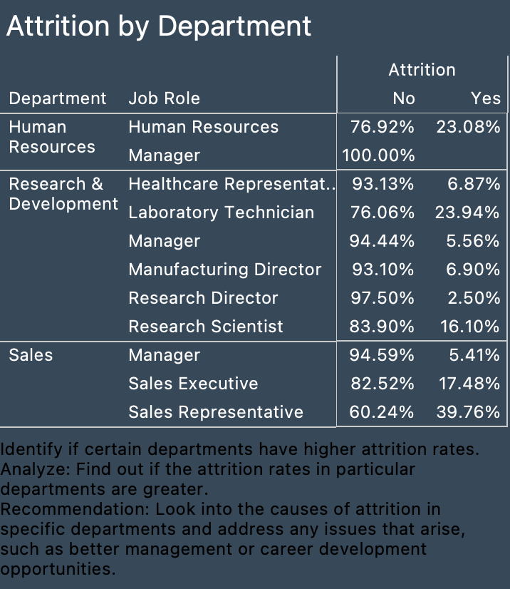

Slide 3


Slide 4


Slide 5


Slide 6


Slide 7
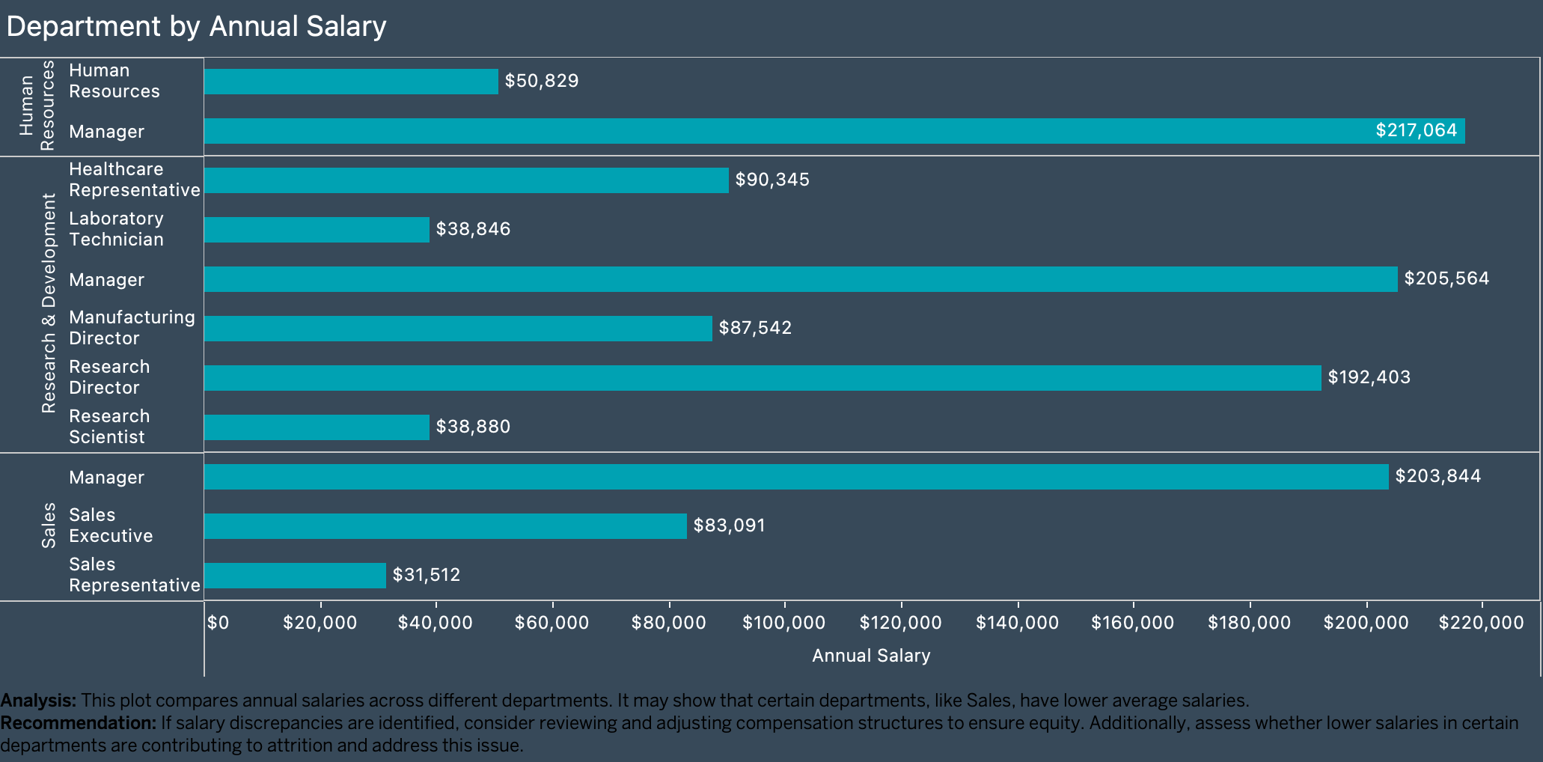

Slide 8
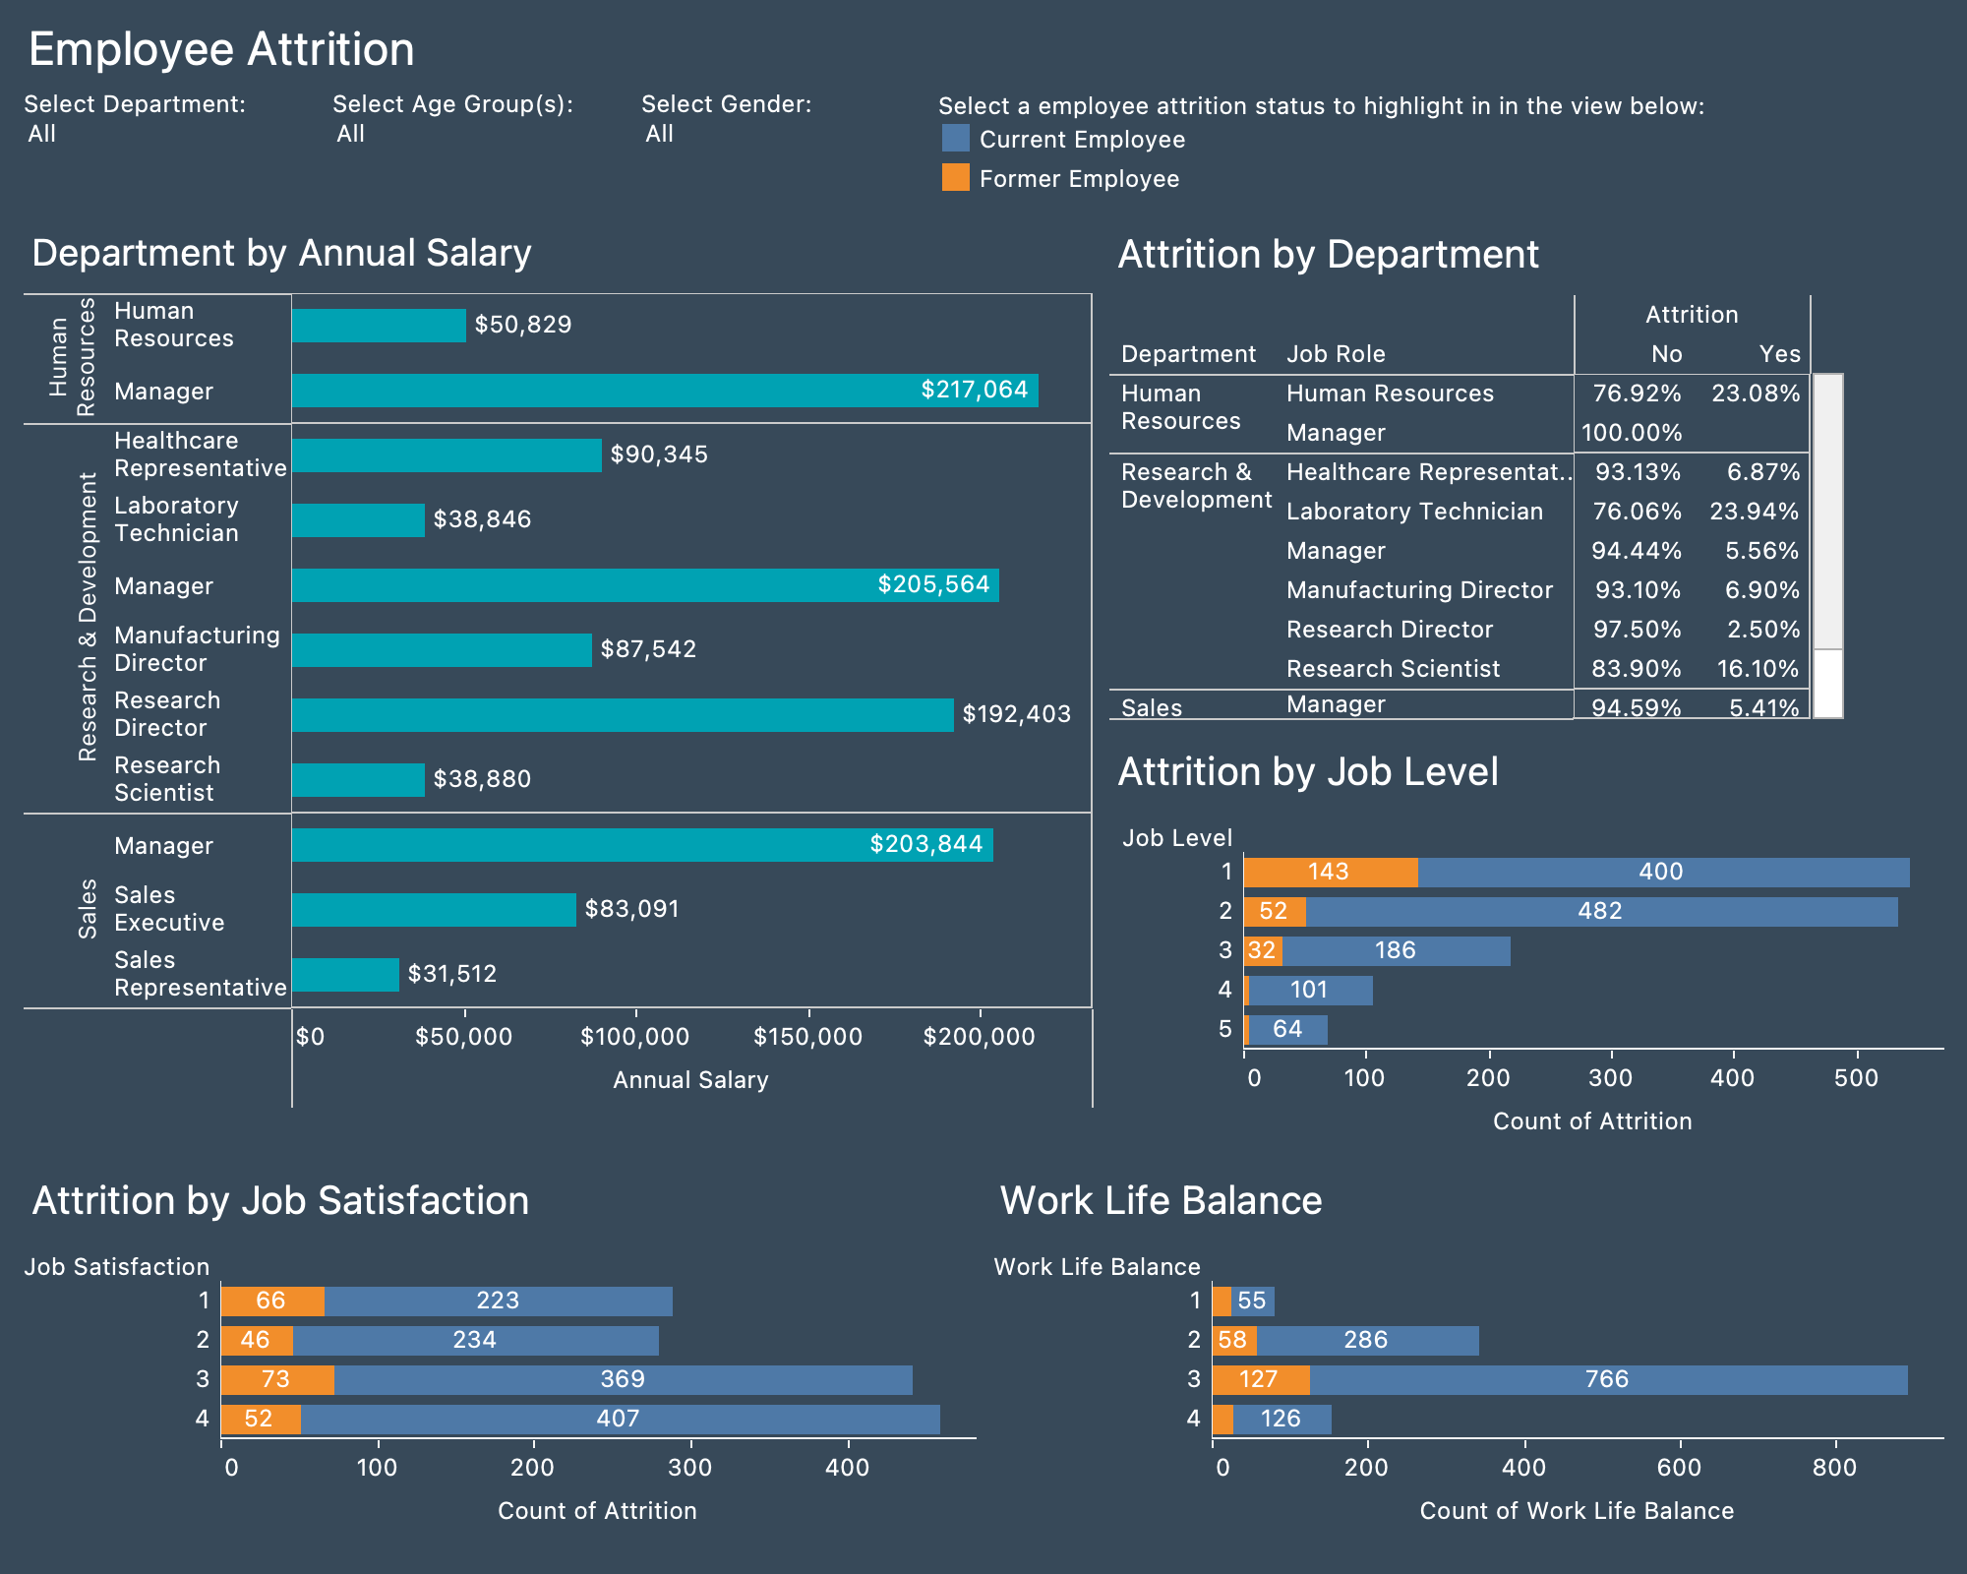

Slide 9
