Slide 1
Graceful Decomposition
Tips for breaking up your monolith

Slide 2
What are we talking about today?
Defining the target
Developing a plan
Cutting over (and rinse and repeat)

Slide 3
But first: why should you care?
Deployment isolation is YUGGE!
while (monolith.scewUp(deployment)) { wholeSystem.status == IS_DOWN; }
Increased agility with greater confidence
Smaller moving parts

Slide 4
Agility correlates with confidence
Confidence
Agility

Slide 5
YMMV
Your mileage may vary
Cookbook rules don’t work.
–Domain Driven Design, Eric Evans (2004)
Know trade-offs
++Deployment complexity
++Build maintenance

Slide 6
Microservice?
The term "Microservice Architecture" has sprung up over the last few years to describe a particular way of designing software applications as suites of independently deployable services. While there is no precise definition of this architectural style, there are certain common characteristics around organization around business capability, automated deployment, intelligence in the endpoints, and decentralized control of languages and data. --https://martinfowler.com/articles/microservices.html

Slide 7
Defining your target
Use
Use techniques when navigating in the wilderness
Know orientation (domain design)
Focus on landmarks (the Big Stuff)
Be action-oriented
Identify
Identify common code
Prioritize
Prioritize services
Notes:
We’re going to talk about each of these in greater detail over the next few slides, but these are the basic steps for defining the target:
Avoid getting obsessed with where you are today. Don’t get sucked into the notion that you have to have a current UML diagram (helpful, but not necessary) and don’t spend the time on it. Instead, spend the time organizing your domain objects with fresh eyes.
Identify the common code you have in your application, if any.
Prioritize the services to build your backlog

Slide 8
Use Domain-Driven Design (DDD)
Worry less about what you’re doing today (position)
Focus on the domain (orientation, landmark)
Use the domain to guide design, organization

Slide 9
Common Code
Use dependency graphing tools
JDeps, NDepend, etc.
Use package names (not as scientific)
Or, it’s the code that breaks everything else… ;)
Common, Core, Utils
You prolly (painfully) know what this is already...

Slide 10
Prioritize Services
Start with most-changing
01
Use rate of change as input to backlog sorting
02
Move the needle
03
Doing small services first has dubious value
Doing services that never change has almost zero value

Slide 11
For example…
/users
/bicycles
/orders

Slide 12
Good design characteristics
Agile != No Design
Simple and fluid
“Tyranny of small decisions”
Both are hard!
It is a situation where a series of small, individually rational decisions can negatively change the context of subsequent choices, even to the point where desired alternatives are irreversibly destroyed.
A myth: people often thing "agile" means "no design".
Remember second law of thermodynamics

Slide 13
Design pitfalls
YAGNI
Avoid getting sucked into ivory tower models
Move
Don’t “microservice” spaghettti–move the needle!
Model
Align packages to the model, not layers or infrastructure

Slide 14
Developing a plan
Iterative > Big Bang!
Prioritizing is critical
Most changing to least changing

Slide 15
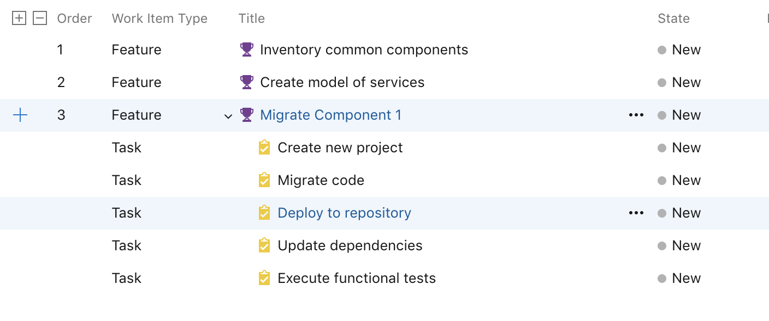
Develop a backlog

Slide 16
Testing
Functional tests, API/web testing techniques
Use code coverage to verify
Test all flows
Do not start with unit tests!
Remember negative testing
Instrument code for functional test executions

Slide 17
Common Code
Use a package repo
NuGet, Maven, NPM, etc.
Use versioning and pin versions
This will be the first cut-over!
Users API -> v 1.0.5
Bicycles API -> v 1.0.7
and that's okay
Test, test, test
Notes:
A package repository (repo) like Sonatype Nexus or JFrog Artifactory should house your packages, and the packages are uploaded to the package repository after a successful build and test cycle in your automated build (you’re using an automated build, right??).
Aside from reusability, this also affords you a new freedom: you can have APIs ”pinned” to particular versions of your common components, and as you change the common components, if a particular API does not need the new changes, you can leave it! Over time this can become somewhat problematic and many companies decide to support a certain version or put the onus of support on the team that owns the API. It is a good idea to develop a deprecation policy, etc.
In all of this, make sure to constantly be running your functional tests.

Slide 18
Services
Create
Create new service
Test
Test with same integration tests against new endpoint
Release
Release, repeat

Slide 19
Summary
Define the target
Develop a plan
Write tests
Migrate common code
Migrate new services

Slide 20
Additional Resources
“Domain Driven Design” by Eric Evans (978-0321125217)
“Refactoring” by Martin Fowler (978-0134757599)

Slide 21
Questions?
Thank you!
Download slides at https://github.com/nathanagood/tccc2019

