Slide 1
Travel Experts

Slide 2
Agenda
About Us
Goals
Objectives
Scope
Schedule
Cost
Demo
Questions

Slide 3
About Us
Hello!
Abel James Manish Nathan
Established in 1980
20 years of experience in .NET Development
100% Customer Satisfaction rate
Calgary based
Notes:
Hand off to nathan

Slide 4
Goal
Create and manage tools for both Customers and Agents to ease the travel booking process
Notes:
Give customers an easy and intuitive tool to connect to “travel experts’
Give a simple tool for managing travel and customer information

Slide 5
Objectives
Intuitive Design
Booking Convenience
User friendly Interface
Security and Support
Notes:
Design – that make it easier for both agents and customers to navigate our application
Booking – convenience for the customer to be able to view their travel information and for agents to add and modify package details
Interface – quickly and easy to navigate the applications
Security – keeping important information not in simple text utilizing hashing.
Pass off to abel

Slide 6

Scope
Windows Forms for Agents to manage bookings
Web App for Customers to register, view bookings and edit their profile
Notes:
Windows – adding packages products and suppliers and linking them together
Web – listing all there purchased packages and editing there contact information

Slide 7
Schedule
Start Date: 11th Feb 2019
End Date: 14th April 2019
Breakdown : Windows Form - 4 weeks
Web App – 4 weeks
Ongoing Support available

Slide 8

Cost
Phase 1 – Discussed
Phase 2- Total Cost $40,000
Ongoing support free for 3 months and more available for purchase
Phase 3 - TBD

Slide 9
DEMO.

Slide 10
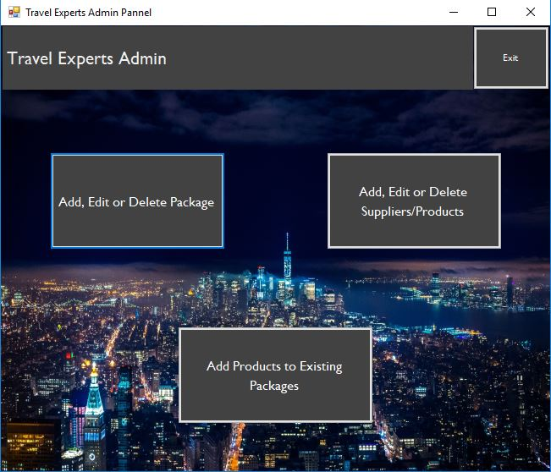
Place your screenshot here
Desktop project

Slide 11
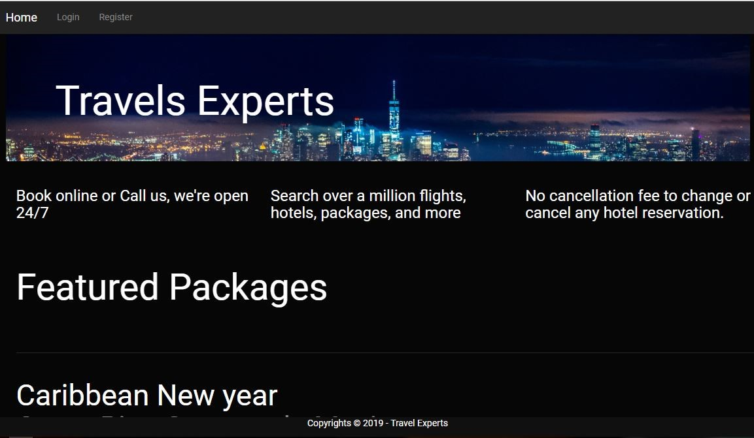
Place your screenshot here
WEB APP

Slide 12
Thanks!
Any questions?
You can find us at:
sait.ca

